Slide 1
COMPARISON BETWEEN SUNDANESE AND KOREAN WEDDING CULTURE
No. Abstract: ABS-ICOLLITE-23143
Ghina Hasanah¹, Didin Samsudin²
Universitas Pendidikan Indonesia

Slide 2
INTRODUCTION
Comparing cultures allows us to find similarities and differences that will make it easier to understand one another’s culture. In this study, the part of culture being compared is Korean and Sundanese wedding culture.

Slide 3
LITERATURE REVIEW
Perbandingan Prosesi Perkawinan Adat Keraton Yogyakarta Masa Sri Sultan Hamengkubuwono VIII Dan IX (Febriantiko, 2014)
Tradisi Upacara Perkawinan Adat Sunda (Tinjauan Sejarah dan Budaya di Kabupaten Kuningan) (Gunawan, 2019)
Perbandingan Prosedur Perkawinan Adat Baduy Dengan Kompilasi Hukum Islam (Muslih, 2019)

Slide 4
METHOD
The method used in the research was comparative study of two documentary videos as the primary research data. The wedding videos compared are taken from YouTube channels “PG TV” and “happysea”. Both videos were analyzed to find similarities and differences. The coding results were then put into some categories.

Slide 5
FINDING AND DISCUSSION
Sundanese wedding procedure:
Mapag Panganten
Prayer session for the groom and the bride
Dowry Handover
Wedding Vow
Sungkem/Greeting from the groom and the bride to both of their parents
Sawer
Nincak Endog/egg cracking
Eating food (Chicken, rice, and water)

Slide 6
FINDING AND DISCUSSION
Korean Wedding procedure
Traditional performance (samulnori, buchaechum)
Kirogi handover to the bride’s family
Matjeol/The groom and bride greeting to each other
Eating session (jujube, chestnut)
Hapgeunjirye, drinking alcohol

Slide 7
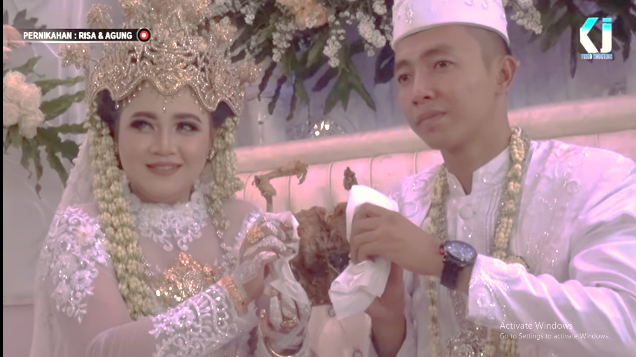
FINDING AND DISCUSSION
Wedding Attire
Korean Wedding
Sundanese Wedding

Slide 8
CONCLUSION
Aside from the differences between Korean and Sundanese wedding culture, they still have several things in common. Just like how they both start their wedding ceremony with cultural performance, including handover session. Both ceremonies also end with eating session. However, in the similarities, they still have their own respective procedure and hold their own special meanings.

Slide 9
REFERENCES
Febriantiko, H. T. (2014). Perbandingan Prosesi Perkawinan Adat Keraton Yogyakarta Masa Sri Sultan Hamengkubuwono VIII dan IX. AVATARA, 2(2), 99-104.
Gunawan, A. (2019). Tradisi Upacara Perkawinan Adat Sunda (Tinjauan Sejarah dan Budaya di Kabupaten Kuningan). Jurnal Artefak, 6(2), 71-84.
Kusumadewi, P. D., & Jerusalem, M. A. (2023). A Review: The Transformation Of The Meaning Of Kebaya From National Clothing To A Media Of Self-Representation and Lifestyle. MUDRA, Jurnal Seni dan Budaya, 38(2), 174-178.
Maulana, M. (2013). Upacara Daur Hidup dalam Pernikahan Adat Sunda. Refleksi, 15(5).
Muslih, M. (2019). Perbandingan Prosedur Perkawinan Adat Baduy Dengan Kompilasi Hukum Islam. Kanun Jurnal Ilmu Hukum, 21(3), 437-458.
Nafisah, A., Rusli, R., Mardiah, A., Ahyar, & Qiso, A. A. (2021). Akulturasi Islam dalam Peradaban dan Budaya. Taujih, Jurnal Pendidikan Islam, 14(2), 97-112.
Rosilawati, R. (2018). Akulturasi Karesmen Mapag Panganten Adat Sunda di Kota Bandung. Makalangan, 5(2), 77-86.

Slide 10
THANK YOU!

