Slide 1
WOMEN STEREOTYPES IN KILL BOKSOON MOVIE
No. Abstract: ABS-ICOLLITE-23073
Valerie Jans Salsabilla¹, Risa Triarisanti², Jayanti Megasari³
Indonesian University of Education

Slide 2
INTRODUCTION
Samovar (in Sobur, 2013) defines stereotypes as perceptions or beliefs that we hold about groups or individuals based on opinions and demeanors that were previously formed. Moreover, with the development of the times, stereotypes are no longer only about a particular race or religion, but can also be about an individual’s gender.
Baron (in Latifa & Pribadi, 2022) defines gender stereotypes as characters that are considered to be truly owned by men and women and also separate these two genders. Gender stereotypes are usually formed from generation to generation through interactions or teachings from family and the environment. For example, stereotypes against women.
The emergence of gender stereotypes in this modern era can also be seen through various sources, such as movie because movie always record the reality that grows and develops in society which is then projected onto a screen (Sobur, 2016).
Kill Boksoon movie, which has a woman as its main character with a different behavior compared to women in general can become a new issue. Thus, this research was conducted to find out and understand the women stereotypes depicted in Kill Boksoon movie.

Slide 3
LITERATURE REVIEW
1. Saputra & Sulawyani (2018)
Korean drama series called Strong Woman Do Bong Soon represents a woman who can act masculine and feminine by showing scenes of protecting men using her strength even though her appearance looks like women in general.
2. Rofidah (2021)
Korean drama Weightlifting Fairy Kim Bok Joo which created stereotypes against women. This Korean drama represents a woman who works as a weightlifter, thus providing a new stereotype for women that women don’t always have to look feminine and can’t become weightlifters.
3. Hasanah & Ratnaningtyas (2022)
Korean drama My Name represents perseverance in strengthening themselves; women who look like men; women who can fight and are strong and independent. In addition, it shows that women are assertive, optimistic, not easy to give up, intelligent, and rational.

Slide 4
METHOD
This research is a qualitative descriptive study with the object of a Korean movie called Kill Boksoon. It also refers to the theory of semiotics by Roland Barthes.
Roland Barthes (in Hasanah & Ratnaningtyas, 2022) states that semiotics includes denotation, connotation, and myth.
This research was conducted by watching the Kill Boksoon movie on Netflix on May 31, 2023. After that, several scenes and dialogues from the movie were screen-captured as attachments, then analyzed by dividing them into two categories; visuals and dialogues to produce women stereotypes research. It also uses several data sources as references, such as journals, books, and news related to the problems studied.

Slide 5
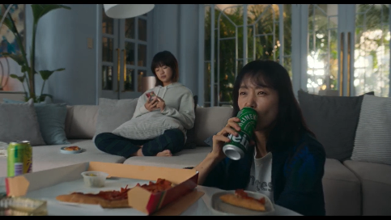
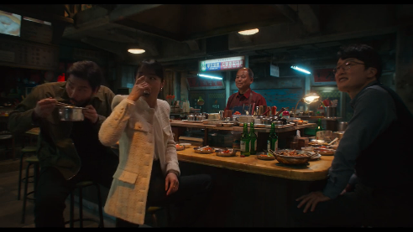
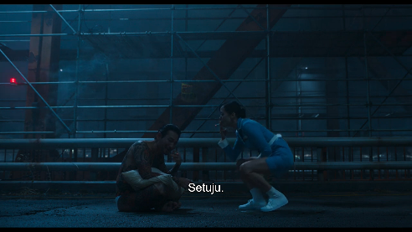
FINDING AND DISCUSSION
a. The results of research that focus on the visuals
1. Women who drink alcohol
- Denotation: Boksoon is drinking beer and accompanied by
her daughter. Then, Boksoon is drinking soju with several of
her male colleagues.
- Connotation: Alcohol is usually consumed more by men.
Myth: Women who drink alcohol are often viewed negatively by society.
2. Women who smoke
Denotation: Boksoon talked while smoking with Shinichiro Oda.
Connotation: Woman is smoking.
Myth: Women who smoke are viewed negatively by society.

Slide 6
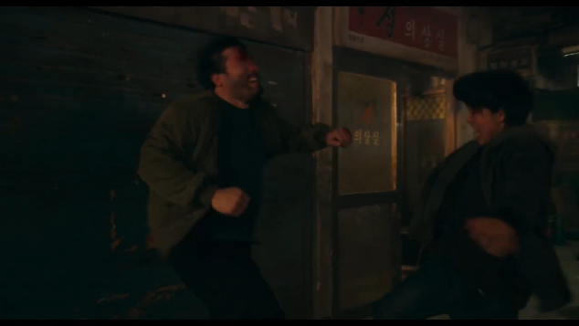
FINDING AND DISCUSSION
3. Women who can fight
- Denotation: Young-Ji is trying her best to counter the attack
from Thug.
- Connotation: Woman is brave, strong, and tough.
- Myth: Woman are known as elegant, gentle, and in need of protection.

Slide 7
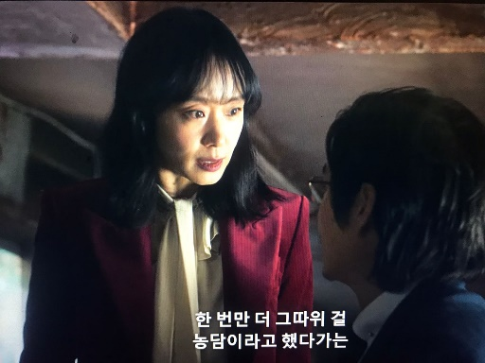
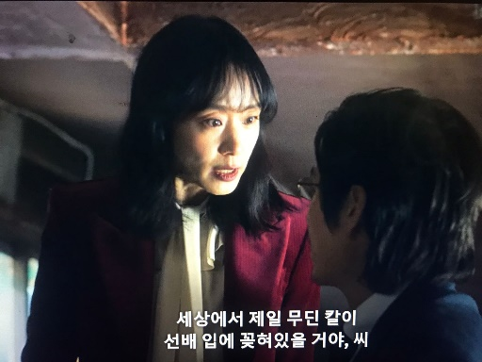
FINDING AND DISCUSSION
b. The results of research that focus on the dialogues
1. Women are assertive
Denotation: Boksoon said to Min-Kyu “한 번만 더 그따위
걸 농담이라고 했다가는 세상에서 제일 무딘 칼이
선배 입에 꽃혀있을 거야, 씨”.
- Connotation: Women are the opposite of the general views of society. Women have often been considered weak and indecisive.
- Myth: Woman is assertive when she speaks looks fiercer and tense.

Slide 8
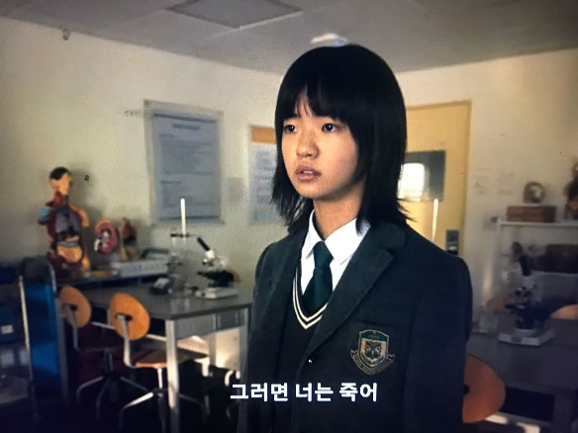
FINDING AND DISCUSSION
2. Women are not easily giving up
Denotation: Jae-Young said to Jin-Sung “그로면 너는 죽어.”
Connotation: Woman break a negative stereotypes by
threatening to kill her friend.
Myth: Society has considered women as weak, infirm living beings,
always afraid of everything and giving up easily.

Slide 9
CONCLUSION
Negative stereotypes towards women have become a culture owned by society since a long ago. Women stereotypes are usually synonymous with women who are weak, give up easily, are afraid of everything, and have to behave elegantly.
Through Roland Barthes’s semiotic analysis regarding the meaning of denotation, connotation, and myth, it can be concluded that the women stereotypes in the Kill Boksoon movie are:
Women can drink alcohol
Women smoke
Women can fight
Women are assertive
Women are not easily giving up

Slide 10
REFERENCES
Fadli, R. (2022, August 18). Benarkah Wanita Rentan Kecanduan Alkohol? Retrieved from halodoc: https://www.halodoc.com/artikel/benarkah-wanita-rentan-kecanduan-alkohol
Fuadah, N. N. (2022, October 27). Dampak negatif dari mengkonsumsi minuman keras pada wanita. Retrieved from ALODOKTER: https://www.alodokter.com/komunitas/topic/dampak-negatif-dari-mengkonsumsi-minuman-keras-pada-wanita
Grehenson, G. (2023, March 09). Remaja Perempuan Merokok Disebabkan Oleh Rasa Keingintahuan dan Tekanan Lingkungan. Retrieved from UNIVERSITAS GADJAH MADA: https://ugm.ac.id/id/berita/23536-remaja-perempuan-merokok-disebabkan-oleh-rasa-keingintahuan-dan-tekanan-lingkungan
Hafidha, S. I. (2021, April 07). Pengertian Drama Menurut Para Ahli, Ketahui Ciri-ciri dan Unsurnya. Retrieved from LIPUTAN 6: https://www.liputan6.com/hot/read/4372319/pengertian-drama-menurut-para-ahli-ketahui-ciri-ciri-dan-unsurnya
Hasanah, R., & Ratnaningtyas, R. P. (2022). Representasi Maskulinitas Perempuan dalam Drama Korea My Name. KOMUKASIANA, Vol. 4, No. 1, 1-12.
Hermanto, A. (2017). Teori Gender dalam Mewujudkan Kesetaraan: Menggagas Fikih Baru. Ahkam: Jurnal Hukum Islam, Vol. 5 No. 2, 209-232.
KBBI DARING. (2016). Retrieved from BADAN PENGEMBANGAN DAN PEMBINAAN BAHASA: https://kbbi.kemdikbud.go.id/entri/stereotip
Kill Boksoon Ratings. (2023). Retrieved from IMDb: https://m.imdb.com/title/tt16900880/ratings/?ref_=tt_ov_rt
Lantowa, J., Marahayu, N. M., & Khairussibyan, M. (2017). Semiotika: Teori, Metode, dan Penerapannya dalam Penelitian Sastra. Yogyakarta: Deepublish.
Latifa, I., & Pribadi, F. (2022). STEREOTIP GENDER DALAM FILM CHAOS WALKING. Journal of History Education and Historiography, 45-56.
Perdana, D. D. (2019). ANALISIS SEMIOTIKA SEXUAL DIFFERENCE, MOTHERHOOD DAN STEREOTIP GENDER DALAM FILM ANNA KARENINA. JURNAL KAGANGA, VOL. 3 NO. 1, 90-99.
Rofidah, L. (2021). Stereotip Gender di Media: Representasi Atlet Angkat Besi Perempuan pada Drama Weightlifting Fairy Kim Bok Joo. JURNAL TRANSLITERA, Vol 10 No 2, 14-26.
Rosyidah, F. N., & Nurwati, N. (2019). Gender dan Stereotipe: Konstruksi Realitas dalam Media Sosial Instagram. Social Work Journal, VOL. 9, 10-19. doi:10.24198/share.v9i1.19691
Saputra, E. R., & Dwiningtyas, H. (2018). REPRESENTASI MASKULINITAS DAN FEMINITAS PADA KARAKTER PEREMPUAN KUAT DALAM SERIAL DRAMA KOREA. Interaksi Online, vol. 6, no. 3, 135-145. Retrieved May 31, 2023, from https://ejournal3.undip.ac.id/index.php/interaksi-online/article/view/20987
Sobur, A. (2013). Psikologi Umum dalam Lintasan Sejarah. Bandung: Pustaka Setia.
Sobur, A. (2016). Semiotika Komunikasi. Bandung: Remaja Rosdakarya.
unknown. (2023, February 10). Dampak Buruk Rokok Bagi Perokok Aktif dan Pasif. Retrieved from KEMENTERIAN KESEHATAN DIREKTORAT PROMOSI KESEHATAN DAN PEMBERDAYAAN MASYARAKAT: https://promkes.kemkes.go.id/dampak-buruk-rokok-bagi-perokok-aktif-dan-pasif#:~:text=Dampak%20Buruk%20Bagi%20Perokok%20Aktif%20dan%20Pasif&text=Penyakit%20paru%2Dparu%20kronis,Tulang%20mudah%20patah

Slide 11
THANK YOU!

