Slide 1
UNVEILING THE USER ACCEPTANCE OF MOODLE IN GERMAN LANGUAGE CLASSROOM
No. Abstract: ABS-23078
Pepen Permana, Irma Permatawati, Ending Khoerudin
German Language Education Study Program FPBS UPI

Slide 2
INTRODUCTION
Moodle, an open-source Learning Management System (LMS), is widely used in education today, including language learning programs.
FPBS UPI's German Language Education Program has integrated Moodle for the past 10 years to facilitate online lecturers for first and second-semester students.
Moodle-based learning platform of GLE Program is called Virtuelles Klassenzimmer (VKZ) available at https://vkz-jerman.upi.edu
Previous studies have shown that Moodle has positive impact on language learning among students.
However, the effectiveness of Moodle depends on how well it is accepted and used by students.
The research aims to explore how students perceive the implementation of Moodle in their language classes using the Technology Acceptance Model (TAM) framework

Slide 3
LITERATURE REVIEW
Technology Acceptance Model (TAM) is a widely used theoretical framework to understand technology acceptance and usage.
Initially introduced by Davis (1989) to evaluate the acceptance of new information technology applications, TAM has since been applied in various fields, including education.
It emphasizes two critical factors: perceived usefulness and ease of use, influencing students' attitudes and intentions towards using Moodle.
Understanding the factors influencing user acceptance and adoption of technology is crucial for designing and implementing successful technological innovations.

Slide 4
METHOD
The study was conducted from June to August 2023 and located at the GLE Study Program FPBS UPI
It involves quantitative with surveys technique.
Participants: 197 Students
Instrument: online questionnaire with Likert-scale
Survey items focuses on four constructs of TAM:
Perceived Usefulness
Perceived Ease of Use
Attitude toward Using
Behavioural Intention to Use
Each constructs consist of ten (10) questionnaire items

Slide 5
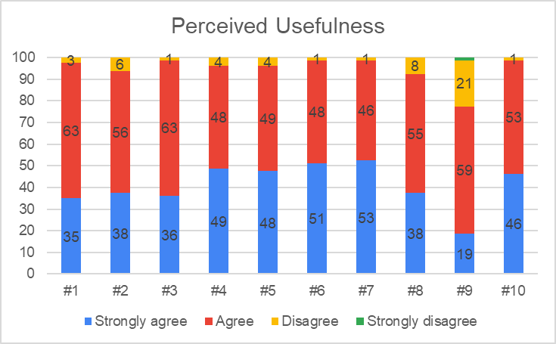
FINDING AND DISCUSSION
Questionnaire items:
Moodle enhanced my overall performance in German language classes.
Moodle contributed to increasing my motivation in learning German.
Moodle had a positive impact on my progress in learning German.
Moodle helped me improve my understanding of German grammar.
Moodle helped me improve my mastery of German vocabulary.
Moodle helped me improve my ability to listen to German audio.
Moodle helped me improve my ability to read German texts.
Moodle helped me improve my ability to write in German.
Moodle helped me improve my ability to speak in German.
Moodle aided me in preparing for exams.
Survey result:

Slide 6
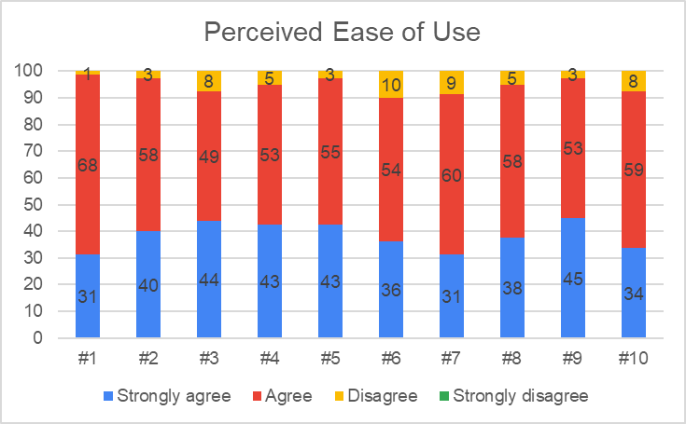
FINDING AND DISCUSSION
Questionnaire items:
Moodle had a user-friendly navigation system.
Moodle presented learning activities that were easy to follow.
Moodle provided clear and well-structured assignments.
Moodle had a user-friendly layout and interface.
Moodle offered learning tasks and instructions that were easy to understand.
Moodle provided easily accessible course content.
Moodle was an adaptable learning tool.
Moodle provided course content that was easy to find and navigate.
Moodle had features that made it easy for me to participate in course activities.
Moodle had a logically structured and organized layout and interface.
Survey result:

Slide 7
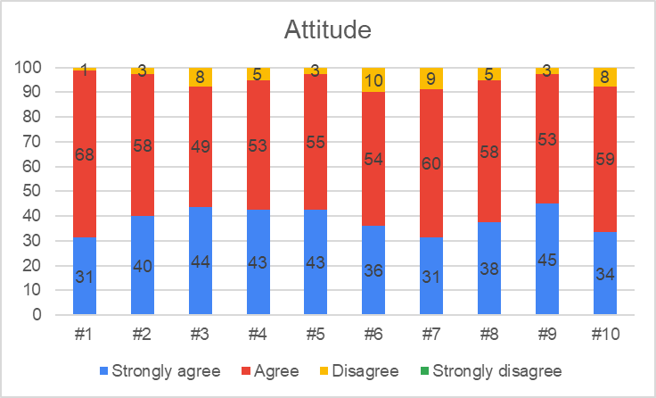
FINDING AND DISCUSSION
Questionnaire items:
I believe that Moodle is an effective platform for learning German.
I consider Moodle to be a meaningful tool in improving my language skills in German.
I felt satisfied with the learning experience provided through Moodle.
I appreciated the convenience and flexibility offered by Moodle in learning German.
I had a positive attitude towards the use of Moodle in my German language classes.
I enjoyed using Moodle for my German language learning.
I was enthusiastic about attending classes that utilized Moodle.
I was motivated and excited when using Moodle for learning German.
I found using Moodle to be an enjoyable way to enhance my language skills in German.
I believe that using Moodle in my classes was beneficial.
Survey result:

Slide 8
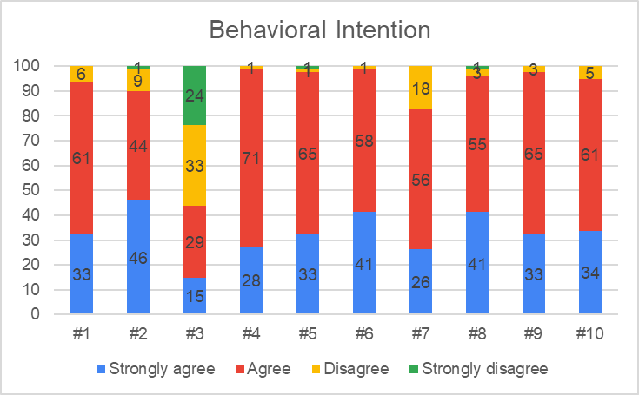
FINDING AND DISCUSSION
Questionnaire items:
I was willing to continue using Moodle in the next semester.
I hoped for blended German language classes, combining Moodle activities with face-to-face sessions.
I hope my future German lectures can be conducted fully online through Moodle.
I was committed to actively participating in Moodle-based German learning activities.
I intended to fully utilize Moodle as a supporting tool for learning German.
I had planned to complete all Moodle assignments in the next semester.
I aimed to use Moodle as the primary platform for learning German.
I would have been more serious about completing all German learning tasks in Moodle.
I was dedicated to utilizing Moodle's learning opportunities for German language learning.
I was interested in exploring Moodle's features for German language learning.
Survey result:

Slide 9
CONCLUSION
The students’ acceptance of using Moodle in German classrooms is overall positive.
Improving the integration of Moodle can lead to enhanced language learning outcomes for students in the German Language Education Program.
The insights from this research can be utilized to enhance Moodle's implementation in similar language learning settings, fostering better acceptance and usage among students.

Slide 10
REFERENCES
Brandl, K. (2005). Are You Ready to "Moodle"? Language Learning & Technology, 9(2), 16-23.
Davis, F. D. (1989). Perceived Usefulness, Perceived Ease of Use, and User Acceptance of Information Technology. MIS Quarterly, 13(3), 319-340. doi:10.2307/249008
Rincón, G. (10. October 2022). Moodle: The most popular Learning Management System. From Solutto Group - Leader in digital transformation: https://soluttoconsulting.com/moodle-the-most-popular-learning-management-system-in-the-world/
Young, B. (12. May 2021). Top 3 Advantages Of Moodle. From eLearning Industry: https://elearningindustry.com/advantages-of-moodle-top-3

Slide 11
DANKE SCHÖN
https://jerman.upi.edu

