Slide 1
If I was a Man: Meaning and Gender-Based Double Standard Represented in Taylor Swift’s "The Man" Lyrics and Music Video
No. Abstract: ABS-ICOLLITE-23068
Zahra Elok Asmanida
Universitas Padjadjaran

Slide 2
INTRODUCTION
Nowadays, people can speak through songs where someone can convey his/her voice to many people by listening to their song. Through the lyrics, a songwriter usually express their experiences, thoughts, and feelings, such as happiness, sadness, and anger. The lyrics can also be the writer's argument or reaction toward the condition surrounding him/her. This is something that is frequently done by the American pop singer Taylor Swift.
This study aims to analyze the song lyric’s meaning using a semantic approach from Leech’s seven types of meaning theory and analyze the music video while also connecting it to real life experiences through data from previous research. Furthermore, the mostly used types of meaning will be analysed further to determine what emotion Swift is trying to convey and connecting it to the music video and real life situation.

Slide 3
LITERATURE REVIEW
Why analyzing song lyrics?
A piece of literary text that brings a message (Lisara, 2014).
Experience and feelings poured into a song.
Why Taylor Swift and The Man?
Famous for her skills in song writing.
The Man has an uncommon yet important message.
Why Gender-based Double Standard?
Even when women gained the opportunity to school and work, differences in social roles still exist (Yazid et al, 2019).
Previous studies mostly focus on the women representation with no real life evidences and only focus on one object, either the song or music video. (Kurniawati, 2021; Lisara, 2014; Alexandra et al, 2021)

Slide 4
METHOD
The initial step was to listen to the song while writing down the lyrics with the help of the music platform Spotify. After gathering the song lyrics, it will be classified according to the Leech’s seven types of meaning theory. The next step is to analyze the music video by watching it several times to not miss any details. The music video was then captured into still pictures and described by utilizing the supporting data from previous studies and the song lyrics.
Descriptive qualitative method is the best fit to analyze this study. Cited by Prabasmoro et al., (2019), descriptive method focuses in describing the study’s subject and object based on facts and discovery that was found in the previous studies. Detailed and in-depth descriptions of situations, events, and people are consisted in a qualitative data (Patton, 1982).

Slide 5
FINDING AND DISCUSSION
Swift’s The Man originally contains nine stanzas, including repeated lines. This analysis only analyzes the non-repeated lines; therefore, this research only analyzes six stanzas and 24 lines. The music video is captured into still images with 14 images from 9 scenes. The table below shows the meaning distribution.
Type of Meaning | Count
Conceptual Meaning | 13
Connotative Meaning | 6
Affective Meaning | 4
Collocative Meaning | -
Associative Meaning | 1
Social Meaning | -
Thematic Meaning | -

Slide 6
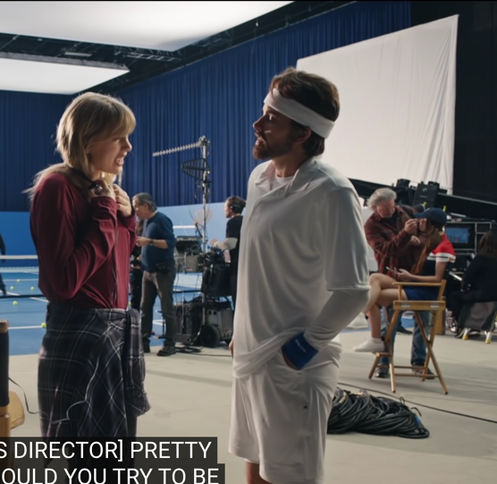
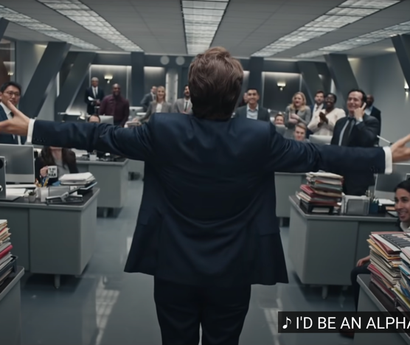
FINDING AND DISCUSSION
This study narrows down the discussion by analyzing those types of meaning in the song lyrics and classifying it into subtopics categorized according to the gender-based double standard that could be found in the song lyrics and or the music videos and. The subtopics include gender-based double standards in the workplace, casual sex, judgment, and parenting.
Gender-Based Double Standard in the Workplace
Correlating the word “boss”, “fearless leader”, and “alpha” which has a conceptual meaning to the role of a man in the workplace.
The way Swift is conveying her anger in the lyrics makes it has an affective meaning.
Unfair treatment in the workplace.

Slide 7
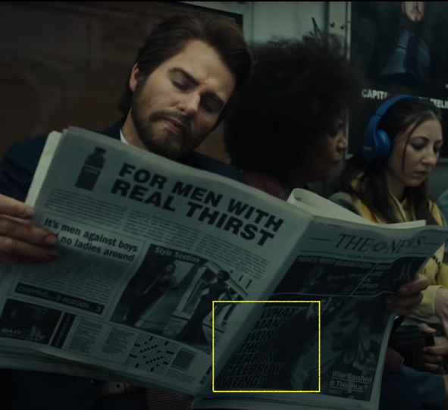
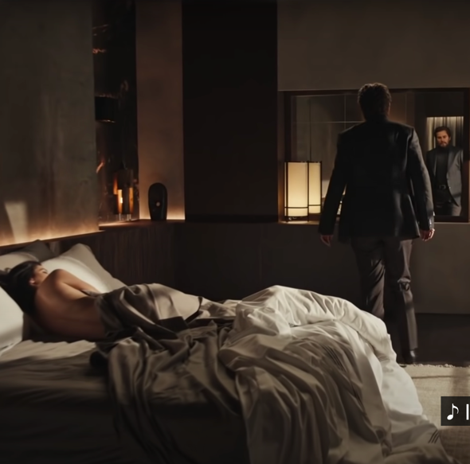
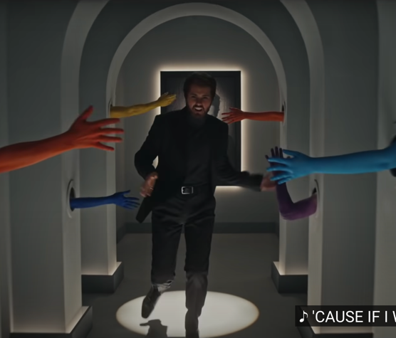
FINDING AND DISCUSSION
Gender-Based Double Standard in Casual Sex
The term “playing the field” and “player”.
Men are praised for intercourse with casual sex. However, if a woman does casual sex, they are more likely to face negative judgment than men. This is proven by the research done by England and Bearak (2014).

Slide 8
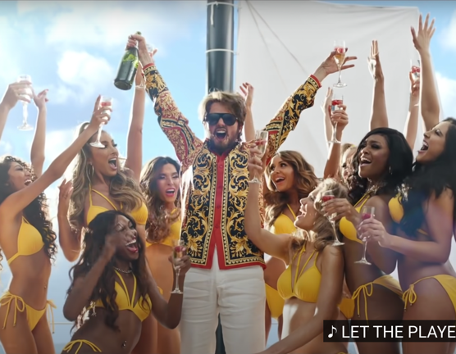
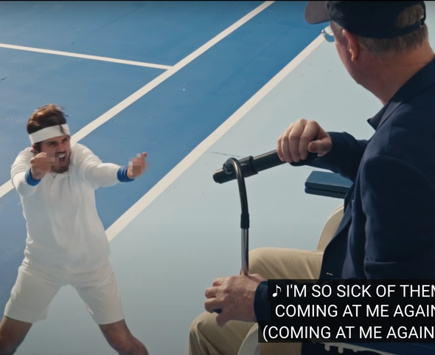
FINDING AND DISCUSSION
Gender-Based Double Standard in Judgments
Swift continues to show her anger by comparing the judgments toward men and women which makes the lyric has an affective meaning.
Having an associative meaning where Swift associates Leonardo DiCaprio for his dating habits.
The Serena Williams tragedy.

Slide 9
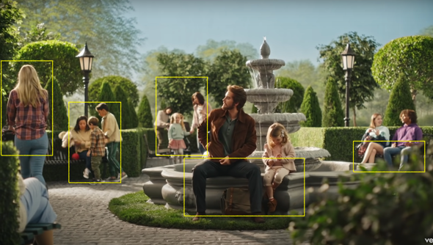
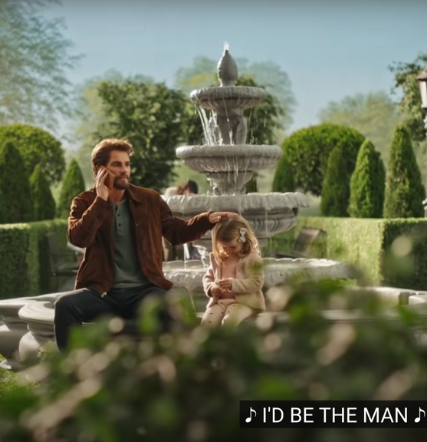
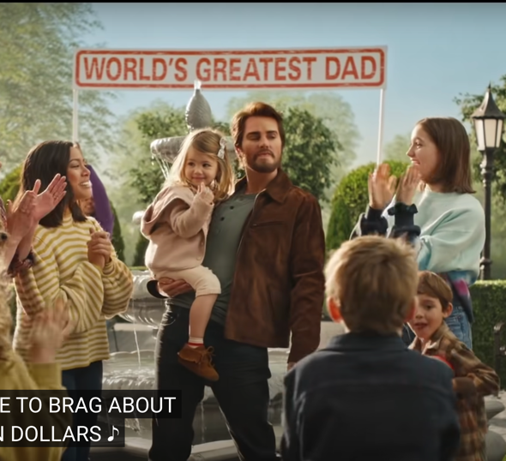
FINDING AND DISCUSSION
Gender-Based Double Standard in Parenting
Tyler is seen sitting with his daughter while still looking at women at the park. He is also seen with his phone while men spreading and patting his daughter's head.
Showered with praise for doing the bare minimum.

Slide 10
CONCLUSION
Swift’s "The Man" song lyrics and music video has successfully portrayed and represented the gender-based double standard that is still happening in reality which are the gender-based double standard in the workplace, casual sex, judgements, and parenting.
By analyzing the lyrics and music video together, the message of the song are conveyed very well in the video and represents the reality. The message was also well-delivered and could be proved using Leech's theory that found the conceptual, connotative, affective, and associative meaning in it.

Slide 11
REFERENCES
Alexandra, Y., Angela Wijayanti, C., & Wahjudianata, M. (2021). Representasi Peran Gender Dalam Video Musik Taylor Swift The Man. Jurnal E-Komunikasi Program Studi Ilmu Komunikasi Universitas Kristen Petra, Surabaya.
Deutsch, F. M., & Saxon, S. E. (1998). The Double Standard of Praise and Criticism for Mothers and Fathers. Psychology of Woirun, 22, 6–11.
England, P., & Bearak, J. (2014). The Sexual Double Standard and Gender Differences in Attitudes Toward Casual Sex Among U.S. University Students. Demographic Research, 30, 1327–1338. https://doi.org/10.4054/DemRes.2014.30.46
Harrison, G. (2019). “We Want to See You Sex It Up and Be Slutty:” Post-Feminism and Sports Media’s Appearance Double Standard. Critical Studies in Media Communication, 36(2), 140–155. https://doi.org/10.1080/15295036.2019.1566628
Leech, G. (1981). Semantics : The Study of Meaning (Second). Penguin Books.
Lisara, A. (2014). The Portrayal of Women in Katy Perry’s Selected Song Lyrics The Portrayal of Women in Katy Perry’s Selected Song Lyrics. 2(2).
Patton, M. Q. (1982). Qualitative Methods and Approaches: What Are They? New Directions for Institutional Research, 1982(34), 3–15. https://doi.org/10.1002/ir.37019823403
Prabasmoro, T., Budhyono, R., & Muhtadin, T. (2019). Black Panther: Identity, Afrofuturism, and Representation of Superheroes. Pertanika J. Soc. Sci. & Hum, 27(4), 2671–2685.
Yazid, T. P., Suryana, A., Sugiana, D., & Yulianita, N. (2019). Women Representation in Lyric of Minang Song “Laki Den Hobi Baburu.” https://digitalcommons.unl.edu/libphilprac

Slide 12
THANK YOU!

