Slide 1

The Effectiveness of the CERMAT Model in Enhancing Islamic Poetry Writing Skills Based on Sufism
No. Abstract: ABS-ICOLLITE-25058
Abdul Latif¹
Yulianeta²
Sumiyadi³
Universitas Pendidikan Indonesia

Slide 2
INTRODUCTION
Research was conducted with university students in Jakarta through three stages: planning, implementation, and evaluation.
Writing poetry is a productive and creative language skill.
However, many students struggle to express ideas meaningfully and aesthetically.
This study investigates the effectiveness of the CERMAT model in enhancing students’ skills in writing Islamic poetry inspired by Sufi values.

Slide 3
LITERATURE REVIEW
CERMAT Model =
Couple Reading, Effective,
Responsive, Writing (Mengarang),
Active, Publishing (Terbit)
Warsono dan Hariyanto (2012) Wirawan Fadly (2022:13-14) Combines principles from Project-Based Learning (PjBL) and CIRC (Cooperative Integrated Reading and Composition)
Poetry Writing Skills
Based on Sufism
(Piscayanti (2015:7), Ma’mur Saadie (2019:4), & Mikihiro Moriyama (2015: 273) Sufistic Poetry is a harmony lafadz with beautiful meaning to be penetrated by the hearts of those who enjoy it, So, it would give a good impact psychologically for the heart who enjoy it, because sufistic poetry has many high good elements as the a means of developing noble morals.
Tasawuf Hamka
Hamka (1994:101-102), asawuf journey consists ikhlas, muraqabah, muhasabah, tajarrud, isya dan hub.

Slide 4
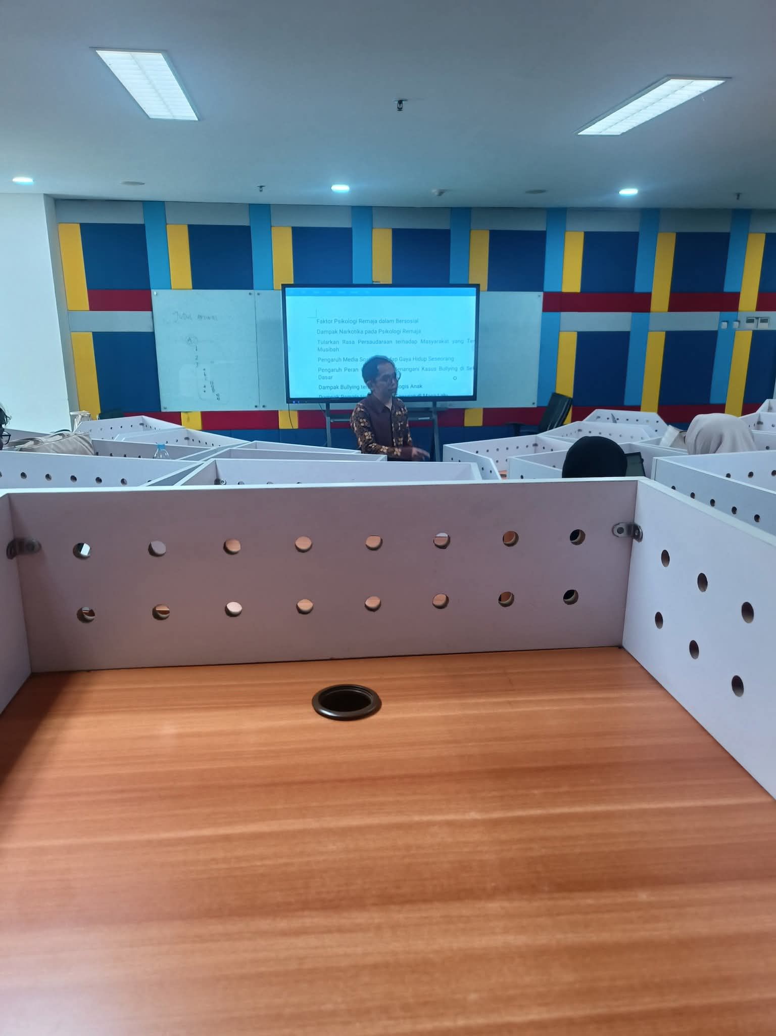
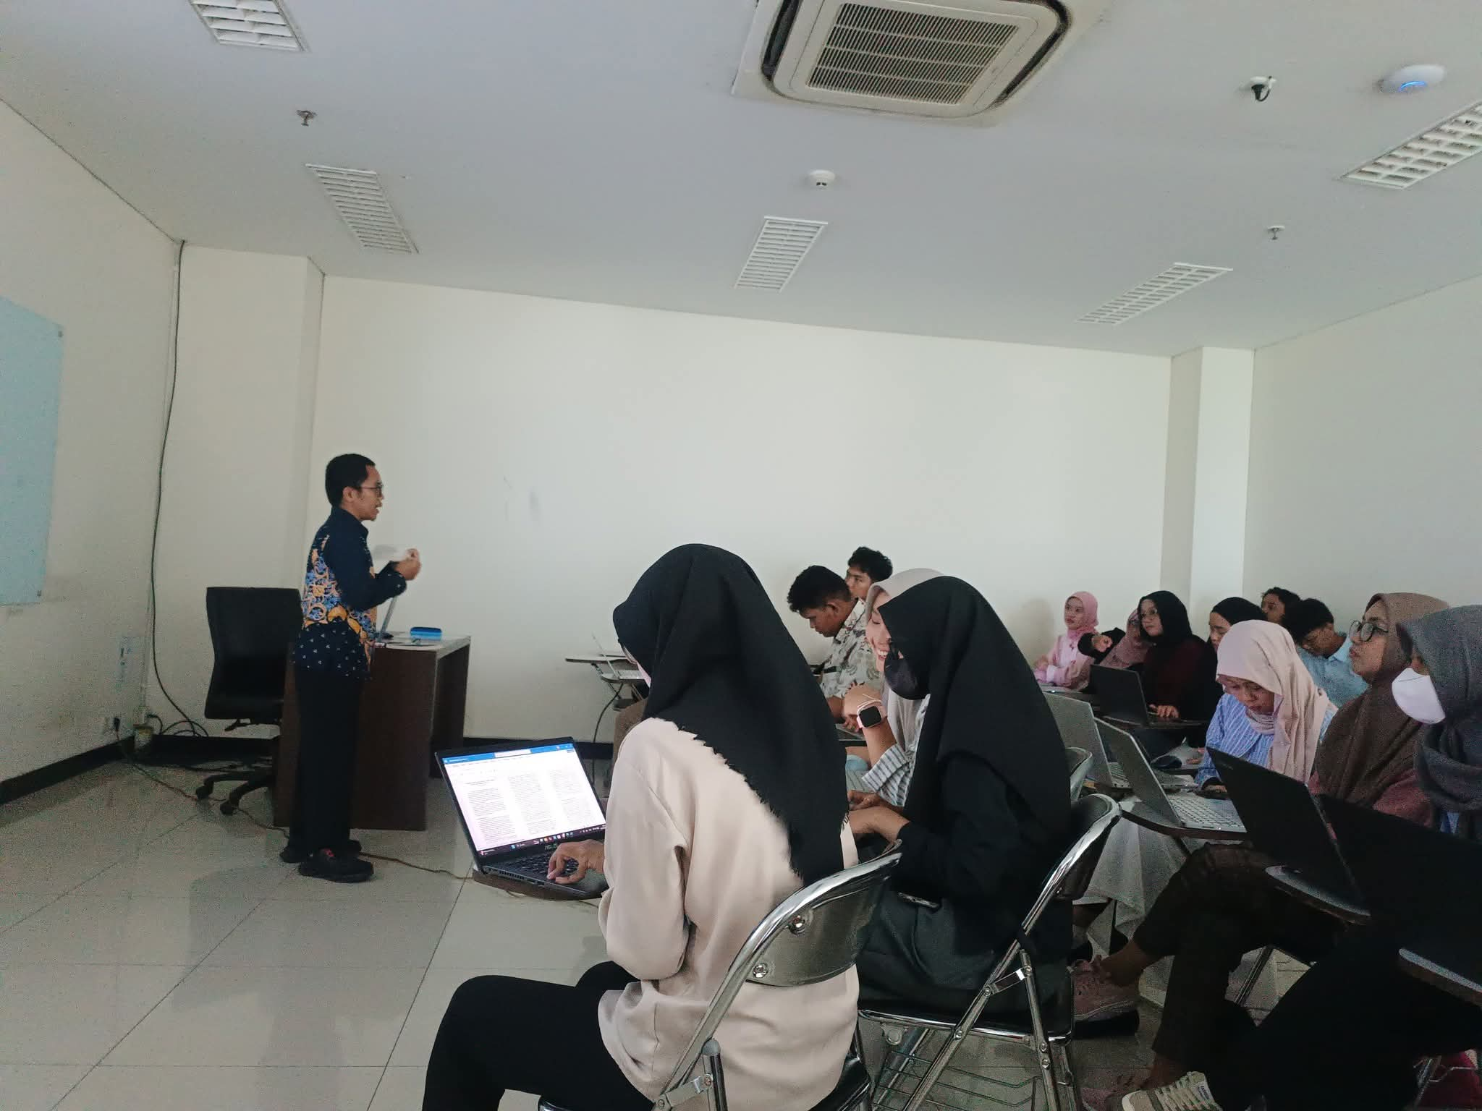
METHOD
Experimental Research :
Design: A saturation sampling technique of two student groups (control & experimental).
Research Population: 24 students
Research Sample: 24 students
Instruments:
Writing test (pre- and post-test), Observation sheet,
Interviews, Questionnaire

Slide 5
FINDING AND DISCUSSION
Table 1 Graphic 1 Pre-Test and Post-Test Scores
Category | Pre-Test |  | Post-Test
 | Highest Score | Average | Highest Score | Average
Controlled Class | 80 | 76 | 88 | 77
Experiment Class | 87 | 79 | 91 | 81

Slide 6
FINDING AND DISCUSSION
Table 2 Homogeneity of Variance Test (Levene’s Test)
Variable | (Levene's Test)
Pre-test | 0.327
Post-test | 0.770
Sign Score > 0.05 then the variance of the two groups is homogeneous.

Slide 7
FINDING AND DISCUSSION
Table 3 Normality Test Result (Shapiro-Wilk)
Category | Pre-test | Post-test
Controlled Class | 0.261 | 0.984
Experiment Class | 0.477 | 0.816
Interpretation
Significance value overall > 0.05 then all data is normally distributed.

Slide 8
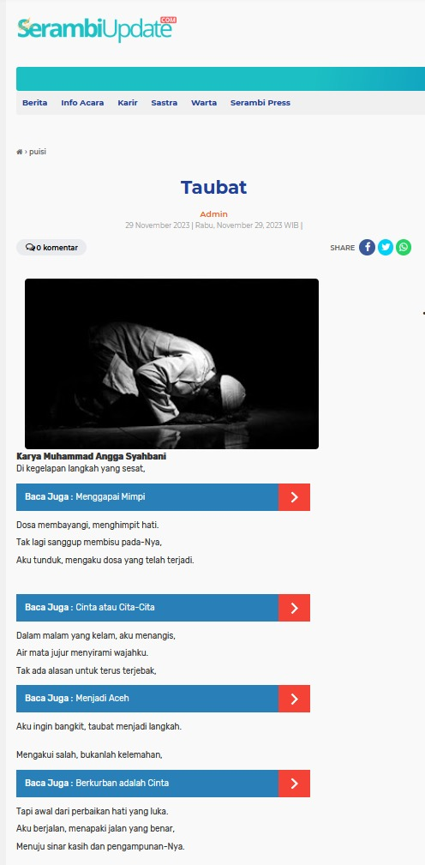
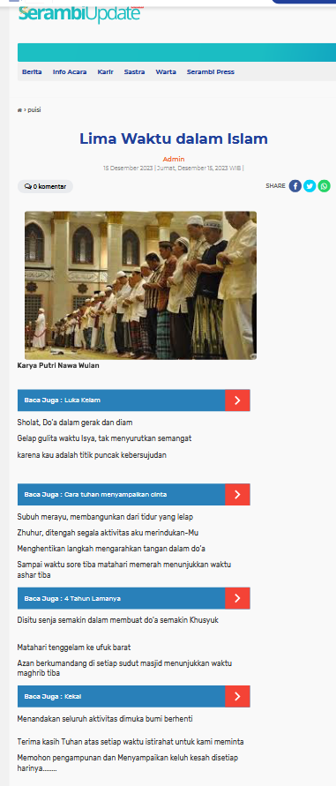
FINDING AND DISCUSSION
Table 4 T Test Result
t count | t table | description
0.278 | 0.279 | T count < T table
Interpretation
It is known that Sig. (2-tailed) is t count 0.278, t table 0.279 < 0.05, so it can be concluded that there is a real difference between the control class and the experimental class.

Slide 9
CONCLUSION
CERMAT is effective in enhancing students’ Islamic poetry writing skills, Especially beneficial in integrating Sufi teachings into literary expression.
Further research needed:
With broader sample and longer duration to explore integration with digital publishing tools

Slide 10
REFERENCES
Etik dkk. (2023). Meningkatkan Keterampilan Menulis Puisi dengan Menggunakan Model Pembelajaran Project Based Learning (PBL) pada Mahasiswa PGSD Semester V Universitas Cokroaminoto Palopo. DEIKTIS: Jurnal Pendidikan Bahasa dan Sastra 3 (4).
Fadly, Wirawan. (2022). Model-Model Pembelajaran untuk Implementasi Kurikulum Merdeka. Bening Pustaka.
Hamka. (2015). Falsafah Hidup. Jakarta: Republika.
______. (2015). Tasawuf Modern, Jakarta: Republika.
Ma’mur Saadie. (2018). Pengembangan Model Pelatihan Menulis Puisi Sufistik dengan Ancangan Tasawuf Kitab Klasik: UPI
Moriyama, Mikihiro. (2015). Poet in an Islamic Community: Cultural and Social Activities of Acep Zamzam Noor in Tasikmalaya. West Jawa: Studia Islamika, Vol. 22.
Piscayanti, Sonia. (2015). The Art of Literature; Poetry and Prose Fcition. Yogyakarta: Graha Ilmu.
Pradopo, Rachmat Djoko. 2010. Pengkajian Puisi. Yogyakarta: Gadjah Mada University Press.
Praptanti, Isnaeni dkk. (2021). Pembelajaran Membaca Sastra (Puisi) dengan Menggunakan Metode Tugas/ Project Best Learning Berbantuan Auvisual. Prosiding Seminar Nasional PIBSI Ke-43.
Rindengan. (2017). Peningkatan Kemampuan Menulis Puisi dengan Pendekatan Kontekstual melalui Teknik Cooperative Integrated Reading and Composition (CIRC). BAHTERA: Jurnal Pendidikan Bahasa dan Sastra.16 (1).
Rozak, Abd & Wiwin S. H. ( 2019). Pengolahan Data dengan SPSS. Yogyakarta: Erhaka
Saadie, Ma’mur. (2018). Pengembangan Model Pelatihan Menulis Puisi Sufistik dengan Ancangan Tasawuf Kitab Klasik. Disertasi: UPI.
Suhita, Sri. (2018). Apresiasi Sastra Indonesia dan Pembelajarannya. Bandung: Remaja Rosdakarya.
Sumiyadi dan Memen Durachman. (2014). Sanggar Sastra Pengalaman Artistik dan Estetik Sastra. Bandung: Alfabeta.
Waluyo, Herman J. (1991). Teori dan Apresiasi Puisi. Yogyakarta: Gelora Aksara Pratama.
Warsono & Hariyanto. (2012). Pembelajaran Aktif: Teori dan Asesmen. Bandung: Rosdakarya.
Yulianeta. (2014). Hakikat Pembelajaran Sastra. Jakarta: Universitas Terbuka
Yuwanto, Listyo. (2019). Metode Penelitian Eksperimen. Yogyakarta: Graha Ilmu.

Slide 11
THANK YOU!
Follow us @...

