Slide 1
Unveiling Speech Act Strategy of Politician in Political Forum
No. Abstract: ABS-ICOLLITE-25152
Neidya Fahma Sunendar
Dadang Sudana
Wawan Gunawan
Cepri Maulana
UNIVERSITAS PENDIDIKAN INDONESIA

Slide 2
INTRODUCTION
The way politician communicate has changed especially in social media.
During the election, politician will be more frequent in communicating both in real life and social media context.
⁠It is interesting to know how the deliver their statements specifically in political setting.

Slide 3
LITERATURE REVIEW
Illocutionary Speech Act
(SEARLE, 1979 & YULE, 1996)

Slide 4
METHOD
RESEARCH METHODOLOGY
Qualitative Case Study
DATA SOURCES
180 Utterances of Anies Rasyid Baswedan retrieved from a political dialogue video
DATA ANALYSIS TECHNIQUE
Mayring's Content Analysis Theory (2000)

Slide 5
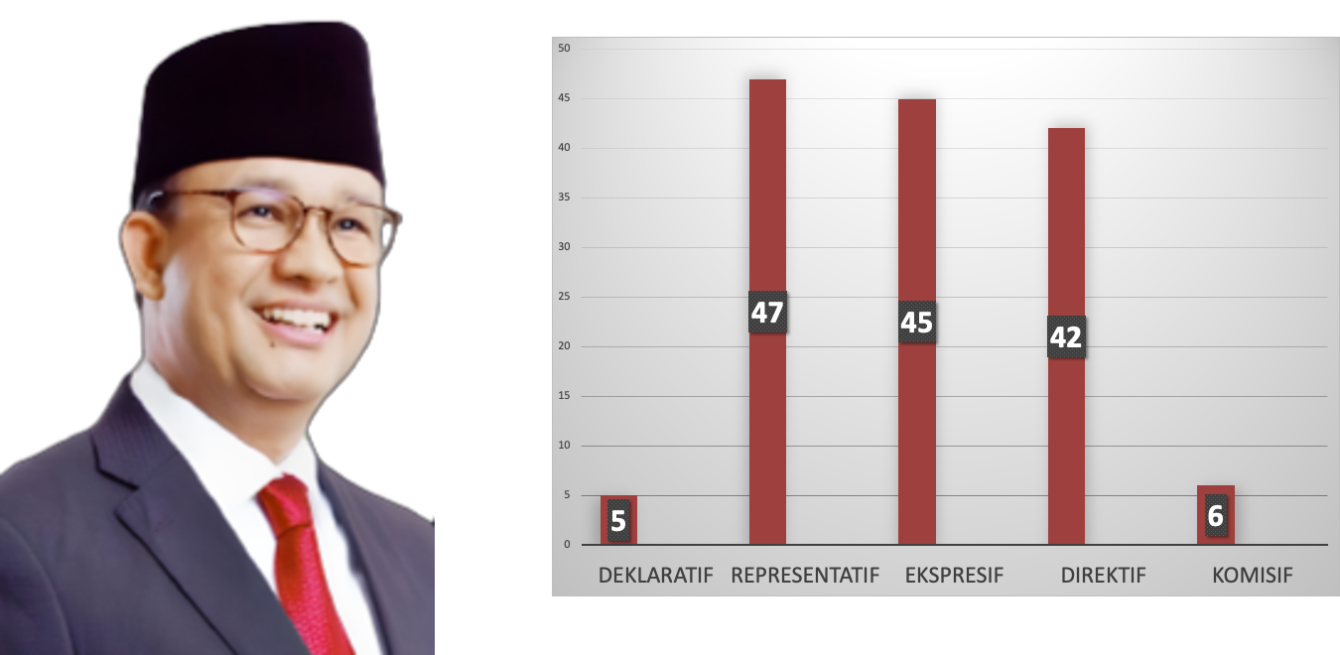
FINDING AND DISCUSSION
FINDINGS ON ILLOCUTIONARY SPEECH ACTS

Slide 6
FINDING AND DISCUSSION
DECLARATIVE SPEECH ACT
IMPRESSION
4
APPROVAL
1
EXAMPLE
Anies: “Pulang kampus dan saya senang sekali Na, tadi baca tulisannya NAJWA SHIHAB UGM.”
The most frequently used phrase was about how impressed Anies R. Baswedan was to be at UGM, his almamater where he studied for his bachelor's degree. These phrases also showed that Anies R. Baswedan wanted to express his feelings, both towards the campus and the event he was attending.

Slide 7
FINDING AND DISCUSSION
REPRESENTATIVE SPEECH ACT
CONVINCING
CONCLUDING
25
3
DESCRIBRING
GUARANTEEING
9
1
GIVING FACT
9
EXAMPLE OF CONVINCING
Anies: “Republik ini didirikan untuk menghadirkan keadilan sosial bagi seluruh rakyat Indonesia, itu kalimat terpenting.”
The statements frequently used by Anies R. Baswedan are intended to convince his audience of the issues he raises and discusses.

Slide 8
EXPRESSIVE SPEECH ACT
REGRETING
22
THANKING
12
COMPLEMENTING
11
EXAMPLE OF REGRETING UTTERANCE
Anies: “sayangnya hanya satu yang hadir untuk menjawab gagasan soal itu.”
.
Anies R. Baswedan often expresses regret regarding issues such as education, law, and the economy in Indonesia, which he feels are still far from ideal and fair for the entire population.

Slide 9
DIRECTIVE SPEECH ACT
QUESTIONING
35
ADVICING
4
REQUESTING
3
EXAMPLE OF QUESTIONING UTTERANCE
Anies: “Kenapa kata keadilan itu penting Bapak Ibu sekalian?”
Anies R. Baswedan asked rhetorical questions.

Slide 10
COMMISSIVE SPEECH ACT
PROMISING
6
EXAMPLE OF PROMISING UTTERANCE
Anies: “Kita menginginkan dan merencanakan kota-kota di seluruh Indonesia minimal 14 kota menjadi mesin penggerak perekonomian yang memungkinkan bagi semua untuk bisa mendapatkan lapangan pekerjaan yang setara.”
It was found that Anies R. Baswedan had promised to make improvements to the state administration, which was considered to be less than optimal..

Slide 11
CONCLUSION
Anies Baswedan's primary rhetorical strategy was characterised by utilizing of convincing utterances. This was reasonable given the prevailing context of the Indonesian presidential election. The act of attending political meetings, which are open to the public or to voters, can serve as a medium through which ideas are conveyed and voters are persuaded to select a particular candidate.

Slide 12
REFERENCES
Chaer, A dan Agustina, L. (2010). Sosiolinguistik: Perkenalan Awal. Jakarta: Rineka Cipta.
Cutting, J. (2003). Pragmatics and discourse. London: Routledge.
Ilie, C., & Norrick, N. R. (2018). Pragmatics and its interfaces. John Benjamins Publishing Company.
Mayring, P. (2000). Analisis Isi Kualitatif [28 paragraf]. Forum Kualitatif Sozialforschung / Forum: Penelitian Sosial Kualitatif,1(2), Pasal. 20, http://nbnresolving.de/urn:nbn:de:0114-fqs0002204.
Nadar, F. X. (2009). Pragmatik & penelitian pragmatik. Graha Ilmu.
Putrayasa, I. B. (2014). Pragmatik. Yogyakarta: Graha Ilmu.
Searle, J. R. (1979). Expression and Meaning. Cambridge: Cambridge University Press.
Yule, G. (1996). Pragmatics. Oxford: Oxford University Press.

Slide 13
THANK YOU!

