Slide 1
Exploring the Use of AI in Language Assessment: ChatGPT for B1 German Writing Tasks
No. Abstract: ABS-25185
Irma Permatawati, Pepen Permana, Nur Muthmainah
Universitas Pendidikan Indonesia

Slide 2
INTRODUCTION
Research Background:
Importance of Writing Skills:
  Writing skills are crucial for expressing complex ideas and supporting effective communication in foreign languages (Saksono, 2022; Schnoor & Usanova, 2023).
Challenges in Traditional Assessments:
  Human evaluators often face issues of subjectivity, bias, and inconsistency in writing assessments (Ahmadi Shirazi, 2019; Basile et al., 2022).
  Diverse interpretations among human evaluators can lead to variability in grading (Shabani & Panahi, 2020).
Potential of ChatGPT:
  ChatGPT, with its AI capabilities, can analyze texts and provide specific feedback, improving assessment objectivity and efficiency (Baskara, 2023; Mahapatra, 2024).
  It has the potential to revolutionize language assessments by providing consistent and unbiased evaluations (Hopfenbeck et al., 2023).
Research Objectives:
Analyze the accuracy and consistency of ChatGPT in assessing German writing skills.
Evaluate the alignment of ChatGPT's assessment results with certified human evaluators.
Describe the potential and limitations of ChatGPT as an assessment tool.

Slide 3
LITERATURE REVIEW
Current State of Technology:
ChatGPT's evolution and capabilities (Brown et al., 2020; Hines, 2023).
Applications of AI in educational assessments (Barrot, 2023; Stojanov, 2023).
Challenges in Human Assessment:
Subjectivity and bias in human evaluations (Suastra & Menggo, 2020).
Potential of AI in Assessment:
AI's role in improving objectivity and consistency (Baskara, 2023; Mahapatra, 2024).
ChatGPT's ability to provide specific feedback and identify errors (Shaikh et al., 2023).

Slide 4
METHOD
Research Design:
Mixed-methods approach combining quantitative and qualitative analysis.
Procedures:
Sample Selection: 35 students of B1 level German from FPBS UPI.
Data Collection: Writing tasks assessed by ChatGPT and certified human evaluators.
Criteria Establishment: Based on CEFR framework.
Assessment Process: Independent evaluations by ChatGPT and human evaluators.
Data Analysis:
  Quantitative: Statistical tests (t-test and correlation analysis) for accuracy and consistency.
  Qualitative: Content analysis of ChatGPT feedback.

Slide 5
FINDING AND DISCUSSION
Consistency of ChatGPT's Evaluations
Pearson Correlation Coefficient:
  Value: 0.616
  Interpretation: Indicates a moderate to strong positive linear relationship between the first and second evaluations by ChatGPT.
Cohen's Kappa:
  Value: 0.564
  Interpretation: Indicates moderate agreement between the two evaluations, accounting for chance.
Cronbach's Alpha:
  Value: 0.602
  Interpretation: Indicates a moderate level of internal consistency across the two evaluations.

Slide 6
FINDING AND DISCUSSION
Accuracy of ChatGPT vs Human Raters
Pearson Correlation Coefficient:
  Value: 0.446
  Interpretation: Indicates a moderate positive relationship between ChatGPT's scores and human raters' scores.
Cohen's Kappa:
  Value: 0.188
  Interpretation: Suggests a low level of agreement between ChatGPT's scores and human raters' scores beyond chance.
Paired t-test:
  t-statistic: -2.026
  p-value: 0.051
  Interpretation: Borderline significant difference between the mean scores of ChatGPT and human raters.

Slide 7
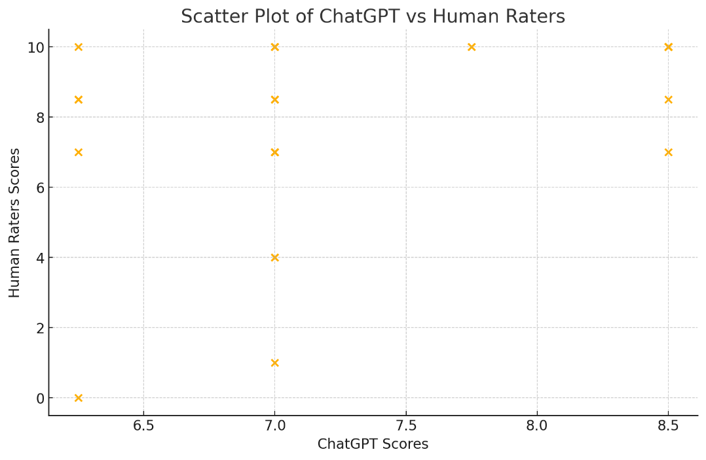
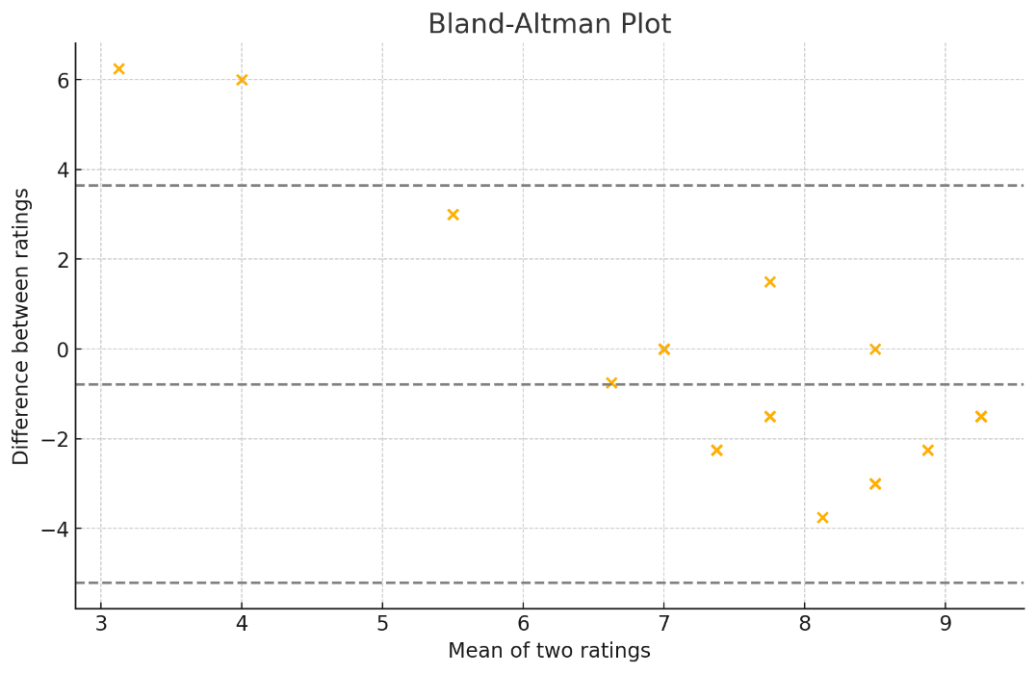
FINDING AND DISCUSSION
Scatter Plot
Bland-Altman Plot
It shows the relationship between ChatGPT's scores and human raters' scores.
It indicates a moderate positive correlation with some dispersion around the line of equality.
It visualizes the agreement between ChatGPT's scores and human raters' scores.
Most points fall within the limits of agreement, but there are a few outliers.
Notes:
SELF-EFFICACY x ACHIEVEMENT
Axes:
X-Axis: Self-Efficacy (ranging from 0 to 5)
Y-Axis: Academic Achievement (ranging from 0 to 10)
Data Points:
Each blue dot represents an individual student's self-efficacy score and corresponding academic achievement score.
Regression Line:
The regression line equation is given as y=0.1118x+7.9138y = 0.1118x + 7.9138y=0.1118x+7.9138.
Slope (0.1118): This indicates that for each one-unit increase in self-efficacy, academic achievement is expected to increase by 0.1118 units, on average. This is a very small increase, suggesting a weak positive relationship.
Intercept (7.9138): When self-efficacy is zero, the predicted academic achievement would be approximately 7.9138. This is the point where the regression line crosses the y-axis.
R-squared (R²):
The R² value is 0.0056.
Interpretation: This indicates that only 0.56% of the variance in academic achievement can be explained by self-efficacy. This very low R² value suggests that self-efficacy is not a strong predictor of academic achievement in this dataset.
MOTIVATION x ACHIEVEMENT
Axes:
X-Axis: Motivation (ranging from 0 to 5)
Y-Axis: Academic Achievement (ranging from 0 to 10)
Data Points:
Each red dot represents an individual student's motivation score and corresponding academic achievement score.
Regression Line:
The regression line equation is given as y=0.1362x+7.7755y = 0.1362x + 7.7755y=0.1362x+7.7755.
Slope (0.1362): This indicates that for each one-unit increase in motivation, academic achievement is expected to increase by 0.1362 units, on average. This is a small increase, suggesting a weak positive relationship.
Intercept (7.7755): When motivation is zero, the predicted academic achievement would be approximately 7.7755. This is the point where the regression line crosses the y-axis.
R-squared (R²):
The R² value is 0.0064.
Interpretation: This indicates that only 0.64% of the variance in academic achievement can be explained by motivation. This very low R² value suggests that motivation is not a strong predictor of academic achievement in this dataset.

Slide 8
REFERENCES
Barrot, J. S. (2023). ChatGPT as a language learning tool: An emerging technology report. Tech Know Learn. https://doi.org/10.1007/s10758-023-09711-4
Baskara, F. R. (2023). Integrating ChatGPT into EFL writing instruction: Benefits and challenges. International Journal of Education and Learning, 5(1). https://doi.org/10.31763/ijele.v5i1.858
Brown, T. B., et al. (2020). Language models are few-shot learners. arXiv. https://doi.org/10.48550/arXiv.2005.14165
Hines, K. (2023). History of ChatGPT: A timeline of generative AI chatbots. Retrieved January 30, 2024, from https://www.searchenginejournal.com/history-of-chatgpt-timeline/488370/
Mahapatra, S. (2024). Impact of ChatGPT on ESL students’ academic writing skills: A mixed methods intervention study. Smart Learning Environments, 11(1), 9. https://doi.org/10.1186/s40561-024-00295-9
Shaikh, S., Yayilgan, S. Y., Klimova, B., & Pikhart, M. (2023). Assessing the usability of ChatGPT for formal English language learning. European Journal of Investigation in Health, Psychology and Education, 13(9). https://doi.org/10.3390/ejihpe13090140
Stojanov, A. (2023). Learning with ChatGPT 3.5 as a more knowledgeable other: An autoethnographic study. International Journal of Educational Technology in Higher Education, 20(1), 35. https://doi.org/10.1186/s41239-023-00404-7
Suastra, I. M., & Menggo, S. (2020). Empowering students’ writing skill through performance assessment. International Journal of Language Education (IJOLE). https://doi.org/10.26858/ijole.v4i3.15060

Slide 9
THANK YOU!

