Slide 1
Designing a Flip e-Book for N4 Kanji to Improve Reading and Writing Skills of Beginner-Level Students
No. Abstract: ABS-25080
Herniwati, Noviyanti Aneros, Melia Dewi Judiasri, Dianni Risda, Shakura Hanna Fazila
Universitas Pendidikan Indonesia

Slide 2
INTRODUCTION
The ability to write and read kanji is a crucial aspect of learning Japanese for non-native speakers. For many learners, mastering kanji presents a significant challenge due to the complexity of their writing, reading, origins, and memorisation strategies. This is due to the unique characteristics of Japanese in its written form, which differ from other alphabet-based languages.
The number of kanji and the number of strokes of kanji at each level make it difficult for students to memorise both reading and writing Japanese sentences. The number of kanji that Japanese language learners must memorise from the basic level N5 = 100 kanji, N4 = 300 kanji, N3 = 650, N2 = 1000 kanji and N1 = 2000 kanji. Low kanji reading and writing skills make it difficult to pass the International Japanese Language Proficiency Test (JLPT). In fact, in Japanese, kanji is a very important part of understanding the meaning of the sentence as a whole.

Slide 3
INTRODUCTION
3. Thus, the urgency is in line with the demands of SDGs 'Quality Education' and education 4.0 with development innovation in compiling N4 Flip e-Book kanji teaching materials to improve Japanese reading and writing skills.

Slide 4
LITERATURE REVIEW
This research is based on several key theories, namely the kanji theories of Suzuki and Ishida, Oomori and Suzuki, Takamizawa, and Iwabuchi, as cited in Sudjianto.

Slide 5
METHOD
The research method used was a pilot project-based learning (mini-research) with Japanese Language Education Master's students in the Japanese language curriculum and teaching materials development course. Data for N4 kanji teaching materials were gathered from various kanji reference books and JLPT N4 Practices. The data were then classified and organised according to themes, and an N4 Kanji Flip e-Book was designed.
Kanji Themes: Verbs, Adjectives, Myself and Home, School, Cities, Vacation and Shopping, Seasons and Time.
Number of Kanji N4: 128 Kanji

Slide 6
Designing a Kanji History e-book to strengthen Japanese language skills
Needs analysis
Analyzing and searching for kanji history data for each kanji character from Japanese language reference books
Lecturers and Students
Designing a Kanji History e-book to improve reading and writing skills
Compiling kanji history according to predetermined themes
Trial on second-year Japanese language students
Workshop 1
Workshop 2
Workshop 3
Workshop 4
Workshop 5
Workshop 6
Workshop 7
Outcome: A draft of a kanji history book has been created and registered with an ISBN
Goals:
Learners will easily memorize kanji characters and be able to read and write Japanese sentences

Slide 7
Design of the Kanji History e-Book as an effort to strengthen Japanese language literacy
Organizational Structure of the History of Kanji Book
Making kanji illustrations
e-book design Kanji history
the origin story of kanji
How to write kanji
Kanji practice
Illustrations of the entire history of kanji
Arranging the order of the kanji displayed
creating application designs
inputting data from books to e-books
editing inappropriate data
Stage 1
Stage 2
Stage 3

Slide 8
Designing a Kanji History e-book to strengthen Japanese language skills
Kanji e-book Design Plan
Theme-based kanji history list
Audio Native
The origin of the formation of the history of kanji
Naritachi Kanji Illustration
Widespread implementation among Japanese language learners in Indonesia
Examples of the use of historical kanji in Japanese sentences
QUIZ
kanji writing practice
kanji history self-test
Extensive trial of kanji history e-book literacy

Slide 9
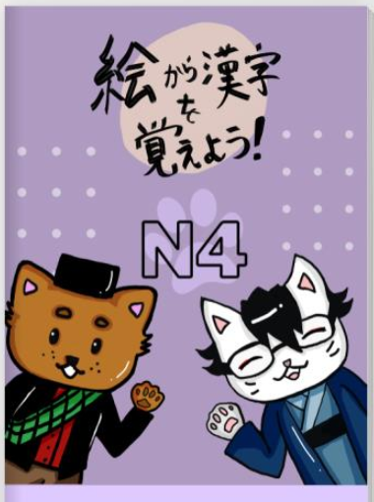
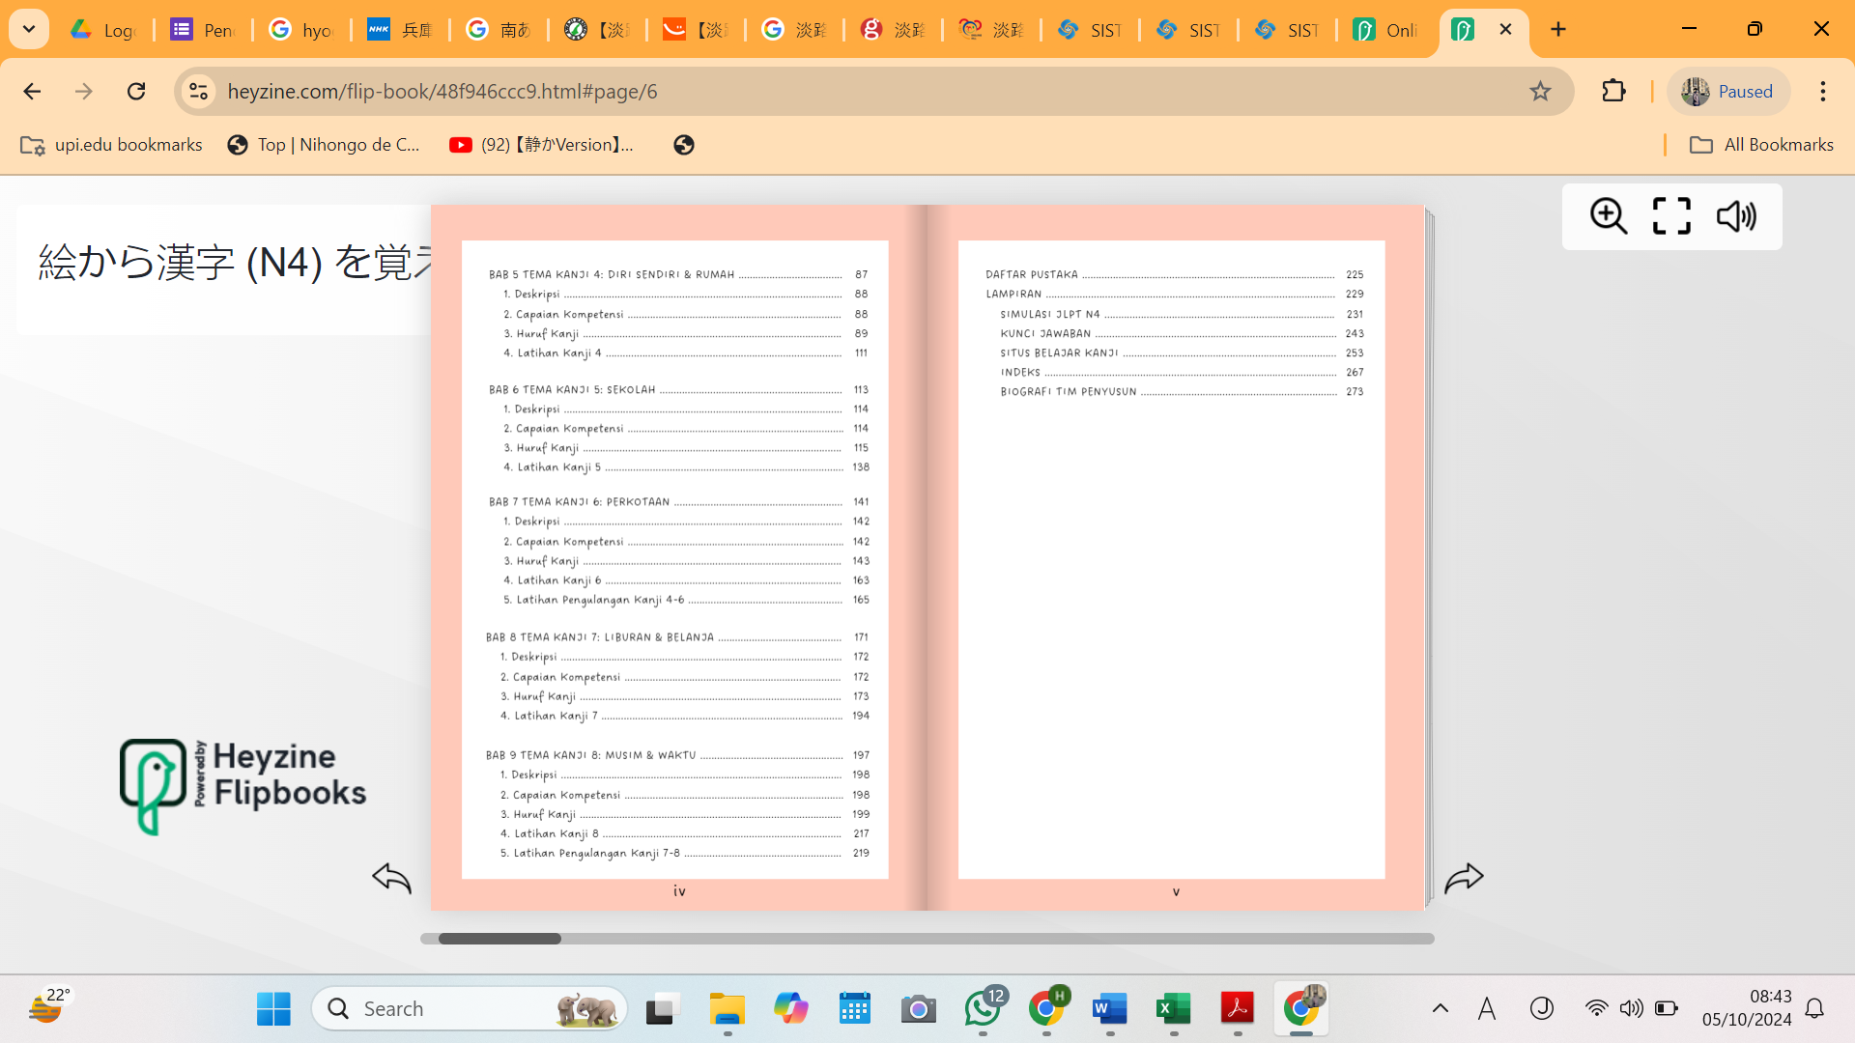
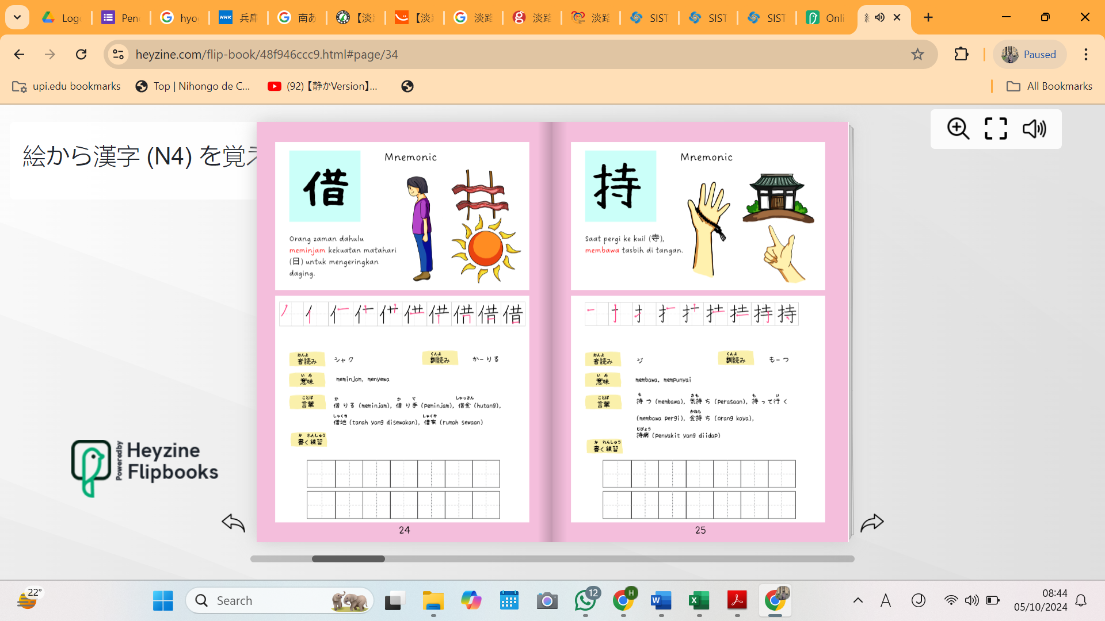
FINDING AND DISCUSSION
Table or chart can be displayed
Draft results of compiling Kanji N4 teaching materials

Slide 10
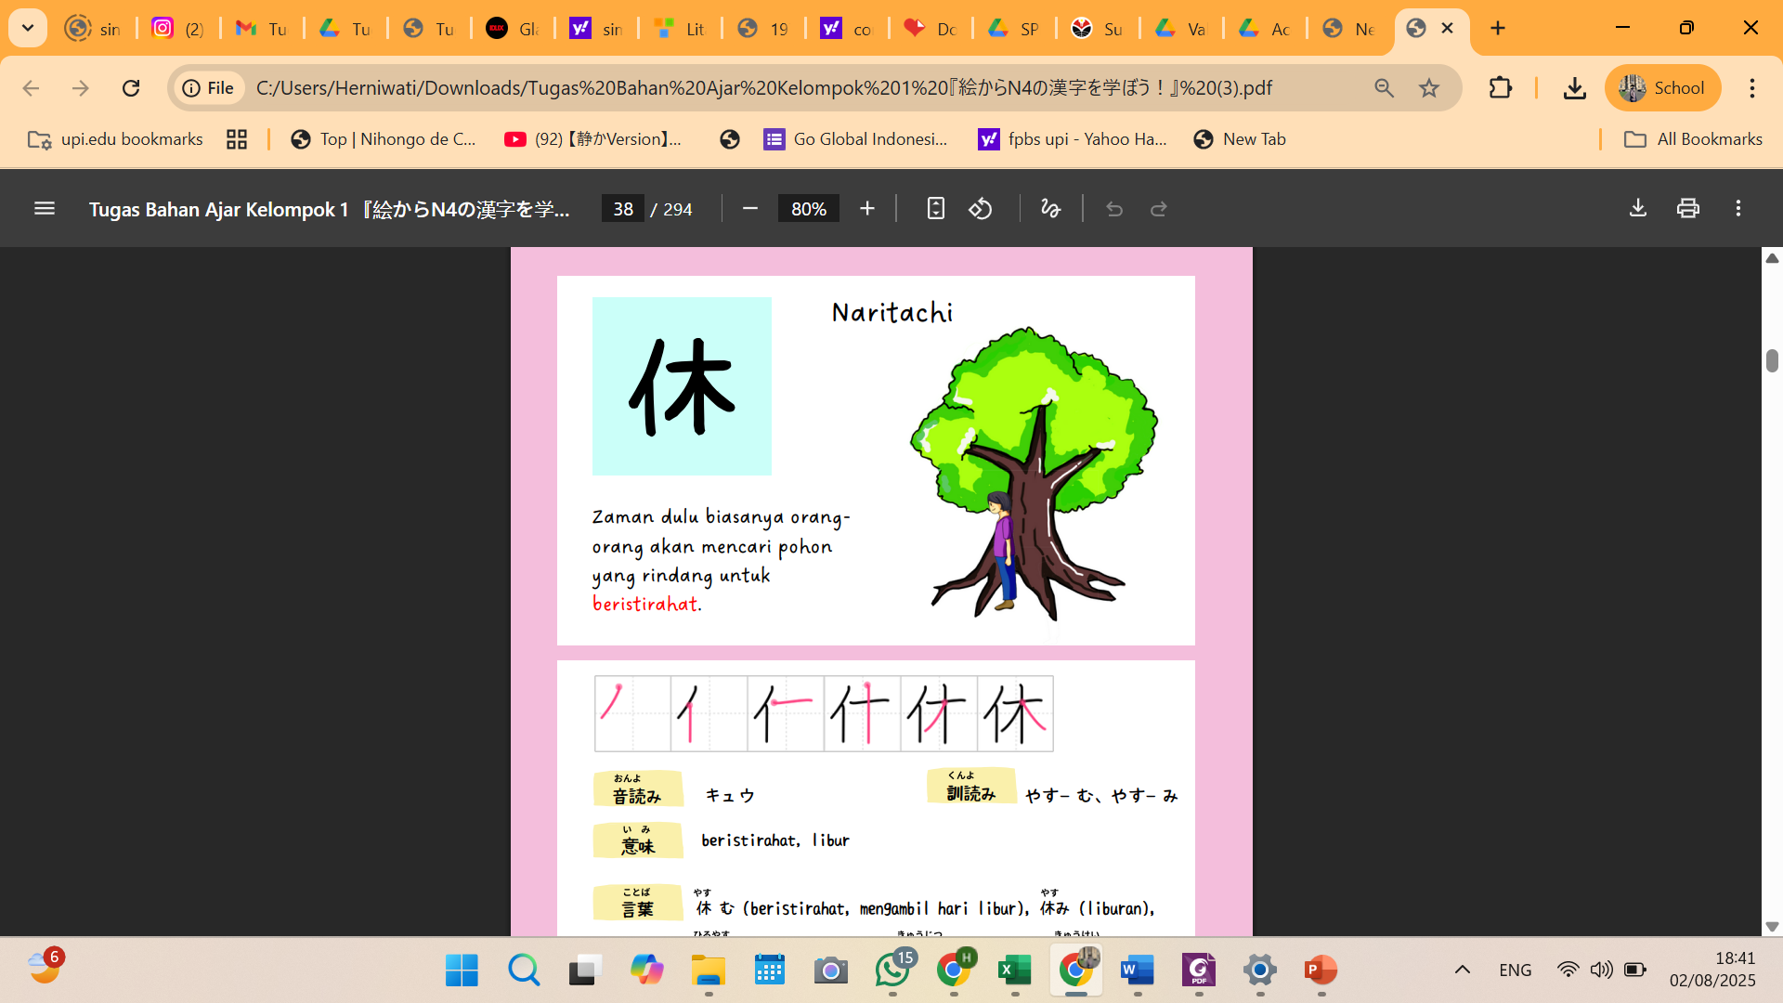
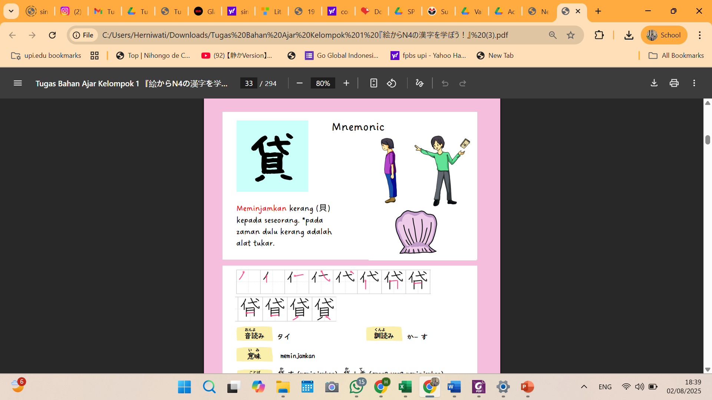
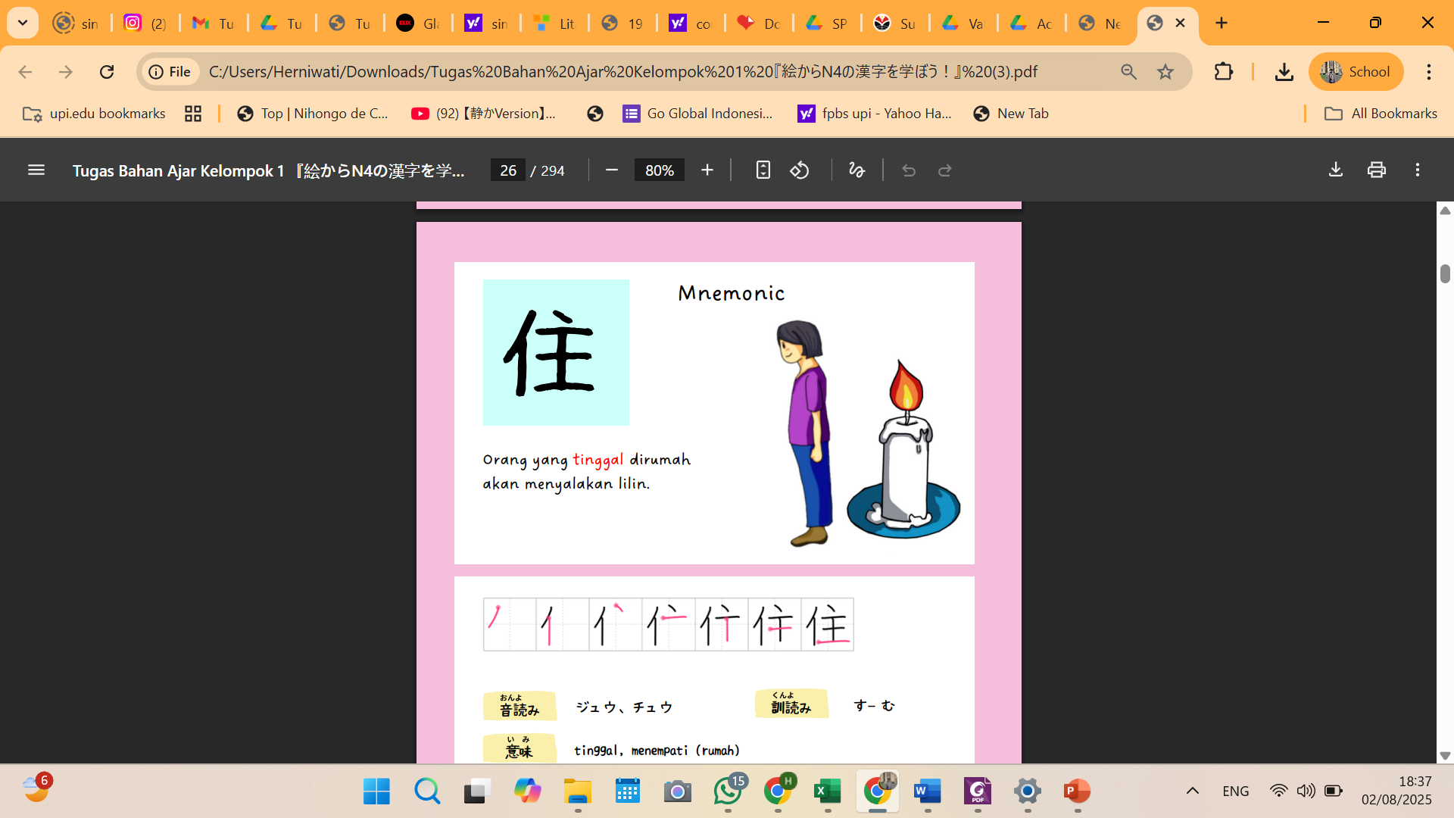
Materi ajar tiap tema
In the past, people usually looked for trees to rest under.
Kanji can be understood by looking at the written form of the kanji in the form of a picture, for example the kanji yasumi (rest) consists of the kanji for person and the kanji for tree.

Slide 11
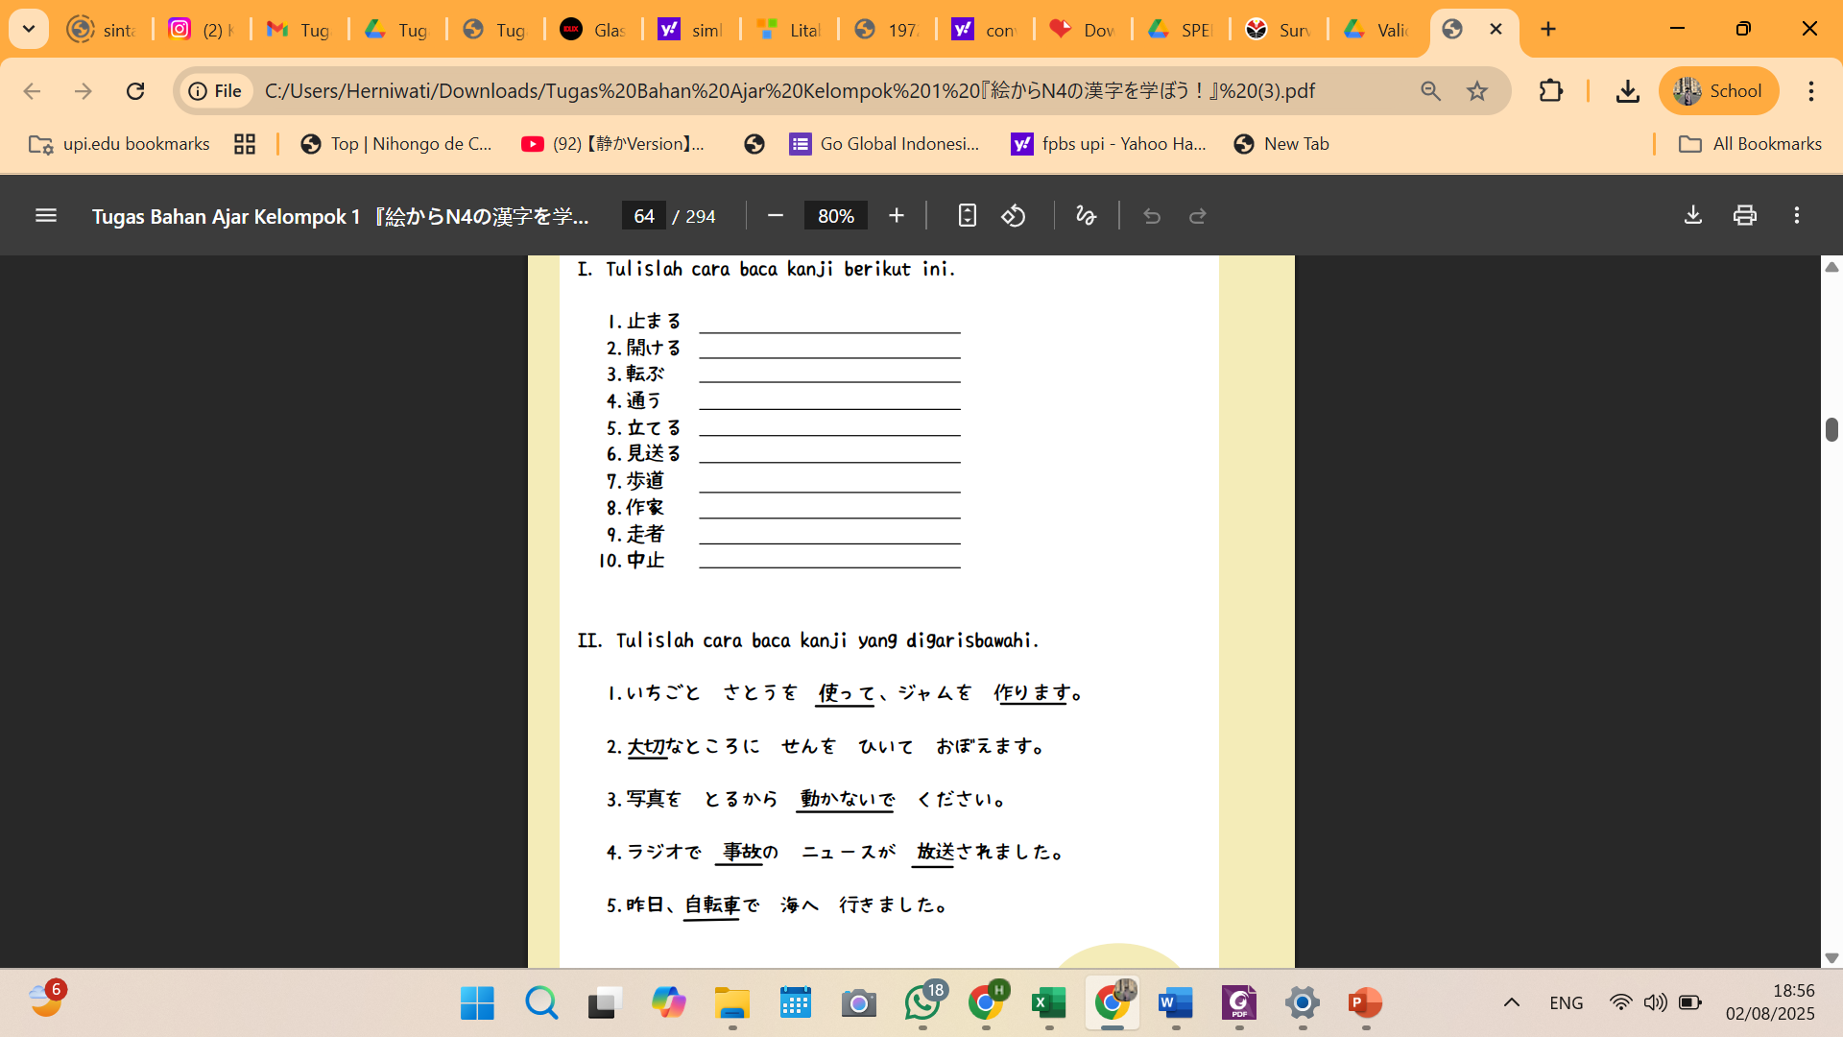
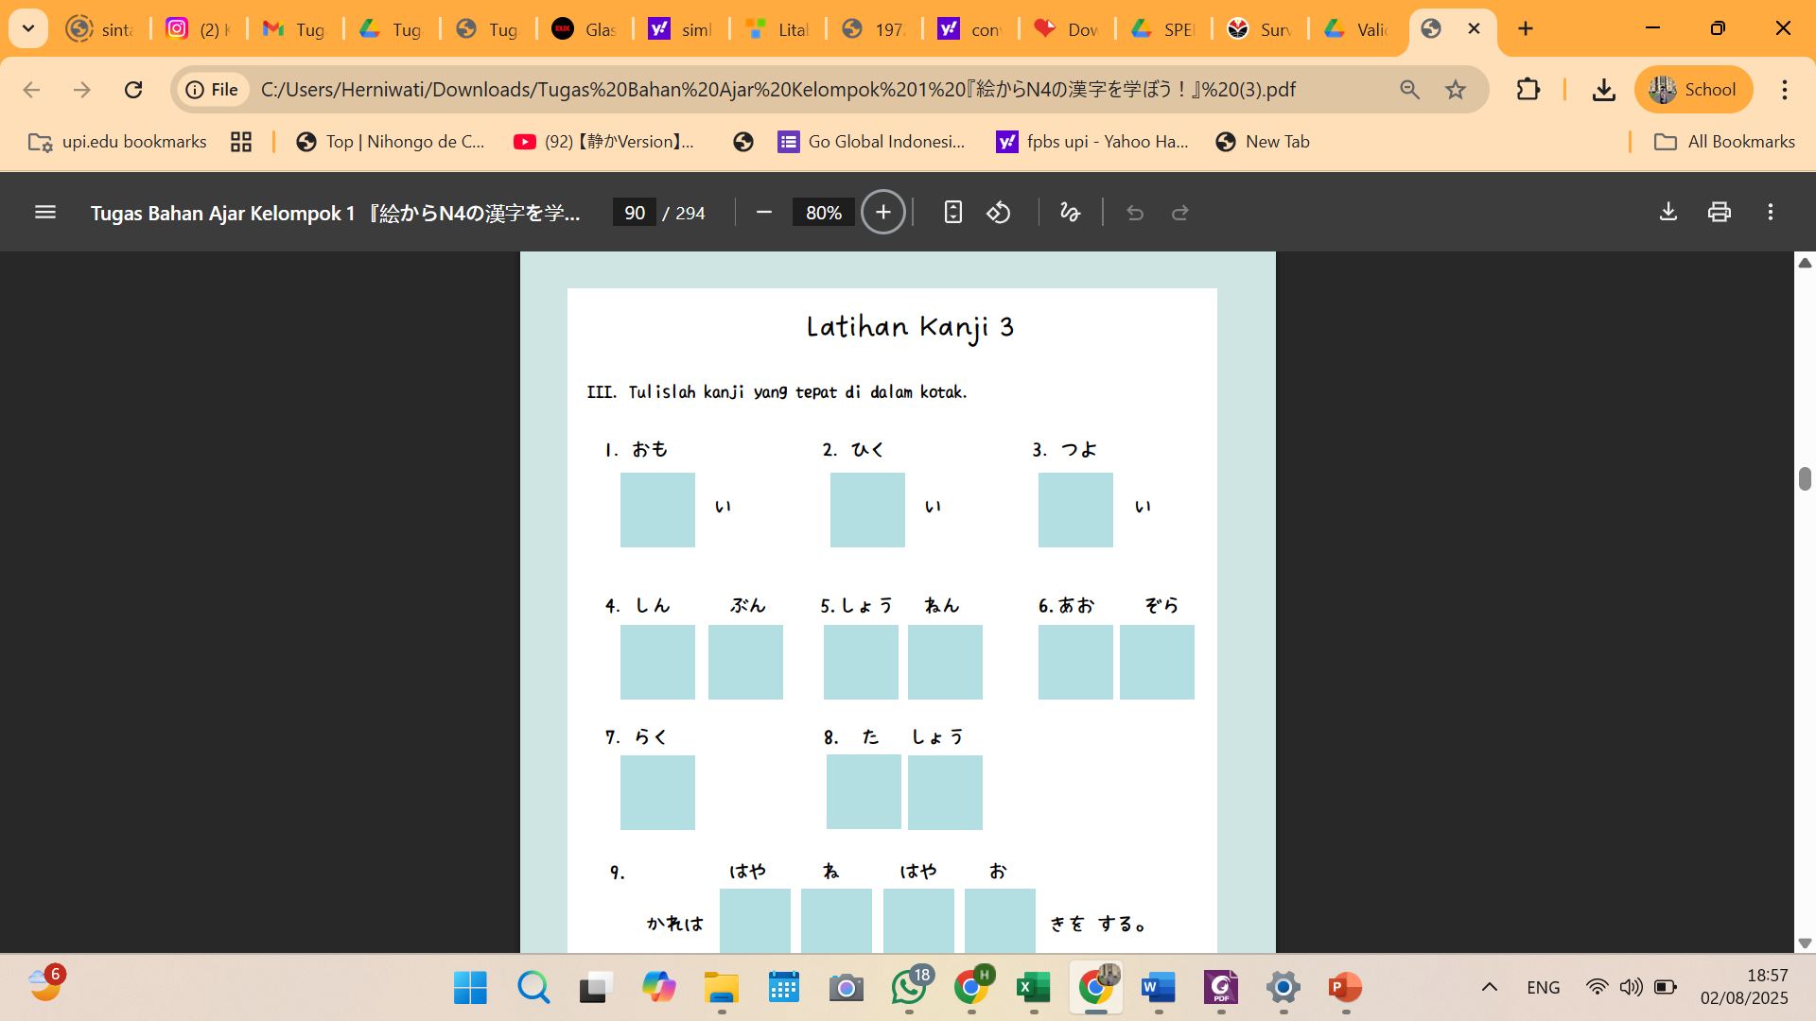
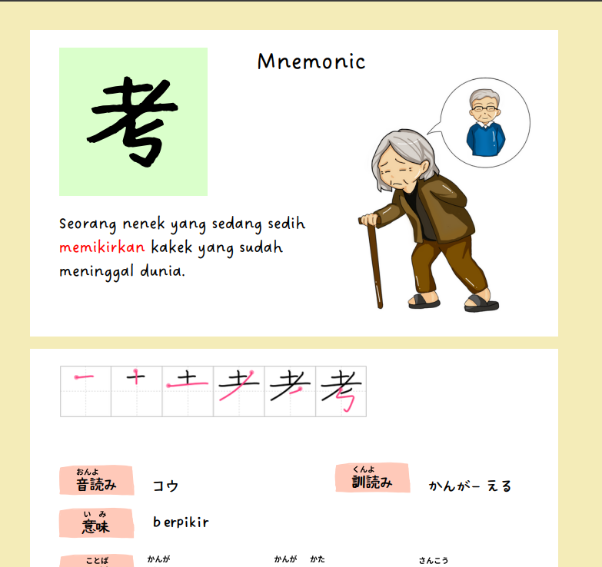
READING AND WRITING PRACTICE

Slide 12
AVERAGE KANJI QUIZ SCORE CHAPTER 1 TO CHAPTER 4
Average score for Quiz 1 = 77.20
Average score for Quiz 2 = 80.60
Rata-rata score Quiz 4 = 72.80
Average score for Quiz 3 = 76.40

Slide 13
CONCLUSION
The pilot project to develop N4 kanji teaching materials using Flip e-books required strong collaboration among students to adapt all the kanji data to be written.
The development of the N4 Kanji Flip e-book can improve N4 kanji reading and writing skills, and this innovation is expected to help learners overcome difficulties in reading and writing kanji through more effective and engaging strategies.
The final evaluation has not yet been completed, as JLPT N4 results will not be announced until September.

Slide 14
REFERENCES
David V. Kanji Handbook: (JLPT All Levels) This Japanese Character Dictionary and Kanji Textbook Uses an Innovative and Effective System. Tuttle Publishing. 2013.
Fujiwara H. Kanji Kakijun Jiten. Tokyo: Dai Ippoki Shuppan. 1990.
Kano C, Shimizu Y, Takenaka H. Basic Kanji Book. Vol. 2: Kihon Kanji 500. Bonjinsha; 1989.
Oomori M, Suzuki E. Nihongo Kyoushi no Nanatsu Dougu Shiriizu 2 Kanji Jugyou no Tsukurikata hen. Tokyo: Aruku Kabushiki Gaisha. 2013.
Suzuki J, Ishida T. Gaikokujin no Tame no Nihongo Reibun Mondai Shiriizu 11 Hyoukihou. Edisi ketiga. Tokyo: Aratake Shuppan Kabushiki Gaisha. 1999.
Sudjianto, Dahidi, A. Pengantar Linguistik Bahasa Jepang. Bekasi: Kesaint Blanc. 2009.
Takamizawa H. Hajimete no Nihongo Kyouiku-Kihon Yoogo Jiten. Tokyo: Bojinsha. 2002.
Williams NK. The key to Kanji: a visual history of 1100 characters. Cheng & Tsui. 2010.\

Slide 15
THANK YOU!
Follow us @...

