Slide 1

Comparison of LOTS and HOTS Brain Images in Speech Production:
A Neurolinguistic Study Based on Standardized Low Resolution Brain Electromagnetic Tomography
No. Abstract: ABS-ICOLLITE-23169
Dadang Sudana, Jatmika Nurhadi, Wawan Gunawan, Hazim Mujahid, Nur C. Mustikasari, Aulia F. Fitri, Syifa N. Aini
Universitas Pendidikan Indonesia

Slide 2
INTRODUCTION
HOTS is among the top five variables that play a role in improving student learning achievement (Pratama & Retnawati, 2018).
These things make HOTS very necessary because with this, students are not only required to practice learning but also to analyze, evaluate and associate all the knowledge gained to solve problems in the future (Pratama & Retnawati, 2018).
In producing speech, a person will always involve cognitive abilities, the involvement of this cognitive function occurs during the planning, execution, responding, and monitoring stages of speech motor output (Alario et al., 2006; Zhang et al., 2018).
This happens because speech production goes hand in hand with the thinking process (Maliana Sari & Suryo Baskoro, 2020).
Speech production depends on neural activity in different areas of the brain (Janssen et al., 2020).
One way to assess what is happening in the brain is with the Electroencephalography method.
In this research, EEG analysis will be utilized which is focused on brain images based on Standardized Low Resolution Electromagnetif Brain Tomography (sLORETA).
It is expected to reveal the differences in brain images when a person produces speech in Low Order Thinking Skills (LOTS) and High Order Thinking Skills (HOTS) conditions.

Slide 3
LITERATURE REVIEW
SPEECH PRODUCTION RESEARCH
"Interactional mechanisms in speech production" by Baese-Berk & Goldrick (2009)
"Gestures and speech production processes: We think, therefore we gesture" by Alibali et al. (2000)
"Sequential Temporal Patterns and Cognitive Processes in Speech" by Goldman-Eisler (1967)
"Speech Production of Second Language Learners" by Temple (2000)
"Speech Production and Cognition Hypothesis" by Kormos (2011)
"Rhythm in speech: What rhythmic organization reveals about cognitive processes in spontaneous speech production versus reading aloud" by Gua'itella (1999)
HOTS RESEARCH AND UTTERANCE PRODUCTION
"The origins of higher-order thinking lie in children's spontaneous talk during the pre-school years" by Frausel et al. (2020)
"Effects of structured story reading, story retelling, and higher-order thinking interventions for English language acquisition and literacy" by Cruz de Quirós et al. (2012)
"Critical Thinking About Fairy Tales: Examining Language Production and Comprehension in Adolescents" by Nippold et al. (2015)
"An examination of Vygotsky's socio-cultural theory in second language acquisition: the role of higher order thinking enhancement techniques and EFL learners' use of private language in reasoning construction" by Mirzaee & Maftoon (2016)

Slide 4
METHOD
Metode yang dipergunakan adalah mixed method.
Partisipan yang terlibat sebanyak 24 orang (12 laki-laki dan 12 perempuan) yang tidak kidal dan merupakan penutur asli bahasa Indonesia).
Partisipan diberikan dua stimulus, yakni dua buah pertanyaan: (1) Pertanyaan tentang deskripsi kamar tidur (LOTS), (2) Pertanyaan tentang pandangan partisipan terhadap pemanasan global dan solusi yang ditawarkan (HOTS).
Data EEG direkam menggunakan Muse Headband yang terhubung dengan Mind Monitor. Hasil data berupa CSV dikalkulasi dengan perangkat lunak LORETA Key.
Data yang telah diolah dan dianalisis menggunakan LORETA Key kemudian disajikan dalam bentuk: (1) Citra Otak Nilai Puncak (Maksimal) LORETA dari kondisi LOTS dan HOTS, (2) Tabel Kontingensi Struktur Otak yang Terlibat pada kondisi LOTS dan HOTS, (3) Hasil Paired Sample T Test Nilai LORETA kondisi LOTS dan HOTS.

Slide 5
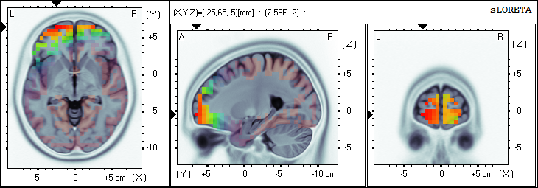
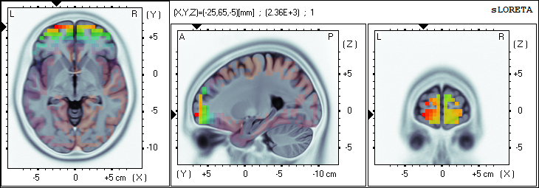
FINDING AND DISCUSSION
LOTS MAX
Value= 7.58E+2 (X= -25 , Y= 65 , Z= -5) (MNI coords)
Brodmann area 10, Superior Frontal Gyrus, Frontal Lobe
HOTS MAX
Value= 2.36E+3 (X= -25 , Y= 65 , Z= -5) (MNI coords)
Brodmann area 10, Superior Frontal Gyrus, Frontal Lobe

Slide 6
FINDING AND DISCUSSION
Distribution of Active Areas with LORETA Values greater than 500 under LOTS conditions
Distribution of Active Areas with LORETA Values greater than 500 in HOTS condition

Slide 7
FINDING AND DISCUSSION
Distribution of Active Lobes with LORETA Values greater than 500 in HOTS condition

Slide 8
FINDING AND DISCUSSION
Paired Sample T Test Result

Slide 9
CONCLUSION
In speaking activities in both LOTS and HOTS conditions, the peak values of LORETA in Brodmann Area 10, Superior Frontal Gyrus, Frontal Lobe. However, if limited to power values above 500, it will be found that in the HOTS condition, participants used 16 different areas, while in LOTS only used 4 different areas. Then in HOTS it is spread over 14 different structures, while in LOTS only 7 different structures.
Meanwhile, when viewed from the lobes involved, the LOTS condition involved three different lobes, namely the Frontal Lobe, Limbic Lobe, and Temporal Lobe, while the LOTS condition only involved one lobe dominantly, namely the Frontal Lobe.
Then when viewed from the difference in voxel results, the average values of LOTS and HOTS have a very significant difference (p<0.001).

Slide 10
REFERENCES
Alario, F. X., Costa, A., Ferreira, V. S., & Pickering, M. J. (2006). Architectures, representations and processes of language production. In Language and Cognitive Processes (Vol. 21, Issues 7–8, pp. 777–789). https://doi.org/10.1080/016909600824112
Alibali, M. W., Kita, S., & Young, A. J. (2000). Gesture and the process of speech production: We think, therefore we gesture. Language and Cognitive Processes, 15(6), 593–613. https://doi.org/10.1080/016909600750040571
Baese-Berk, M., & Goldrick, M. (2009). Mechanisms of interaction in speech production. Language and Cognitive Processes, 24(4), 527–554. https://doi.org/10.1080/01690960802299378
Cruz de Quirós, A. M., Lara-Alecio, R., Tong, F., & Irby, B. J. (2012). The effect of a structured story reading intervention, story retelling and higher order thinking for English language and literacy acquisition. Journal of Research in Reading, 35(1), 87–113. https://doi.org/10.1111/j.1467-9817.2010.01472.x
Frausel, R. R., Silvey, C., Freeman, C., Dowling, N., Richland, L. E., Levine, S. C., Raudenbush, S., & Goldin-Meadow, S. (2020). The origins of higher-order thinking lie in children’s spontaneous talk across the pre-school years. Cognition, 200. https://doi.org/10.1016/j.cognition.2020.104274
Goldman-Eisler, F. (1967). Sequential Temporal Patterns and Cognitive Processes in Speech. Language and Speech, 10(2), 122–132. https://doi.org/10.1177/002383096701000205
Gua’itella, I. (1999). Rhythm in speech: What rhythmic organizations reveal about cognitive processes in spontaneous speech production versus reading aloud. Journal of Pragmatics, 31(4), 509–523. https://doi.org/10.1016/s378-2166(98)00079-4

Slide 11
REFERENCES
Kormos, J. (2011). Speech production and the Cognition Hypothesis. Dalam P. Robinson (Ed.), Second Language Task Complexity (Vol. 2, hlm. 39–60). John Benjamins Publishing Company. https://doi.org/10.1075/TBLT.2.06CH2
Maliana Sari, D., & Suryo Baskoro, B. R. (2020). Prototipe Keperawanan Dalam Perspektif Pengguna Twitter: Kajian Linguistik Kognitif. Deskripsi Bahasa, 3(1), 57–66. https://jurnal.ugm.ac.id/dbhttps://jurnal.ugm.ac.id/db
Mirzaee, S., & Maftoon, P. (2016). An examination of Vygotsky’s socio-cultural theory in second language acquisition: the role of higher order thinking enhancing techniques and the EFL learners’ use of private speech in the construction of reasoning. Asian-Pacific Journal of Second and Foreign Language Education, 1(1). https://doi.org/10.1186/s40862-016-0022-7
Nippold, M. A., Frantz-Kaspar, M. W., Cramond, P. M., Kirk, C., Hayward-Mayhew, C., & Mackinnon, M. (2015). Critical Thinking About Fables: Examining Language Production and Comprehension in Adolescents. Journal of Speech, Language, and Hearing Research, 58(2), 325–335. https://doi.org/10.1044/2015_JSLHR-L-14-0129
Janssen, N., Meij, M. van der, López-Pérez, P. J., & Barber, H. A. (2020). Exploring the temporal dynamics of speech production with EEG and group ICA. Scientific Reports, 10(1). https://doi.org/10.1038/s41598-020-60301-1
Pratama, G. S., & Retnawati, H. (2018). Urgency of Higher Order Thinking Skills (HOTS) Content Analysis in Mathematics Textbook. Journal of Physics: Conference Series, 1097(1). https://doi.org/10.1088/1742-6596/1097/1/012147
Temple, L. (2000). Second Language Learner Speech Production. Studia Linguistica, 54(2), 288–297. https://doi.org/10.1111/1467-9582.00068
Zhang, H., Eppes, A., Beatty-Martínez, A., Navarro-Torres, C., & Diaz, M. T. (2018). Task difficulty modulates brain-behavior correlations in language production and cognitive control: Behavioral and fMRI evidence from a phonological go/no-go picture-naming paradigm. Cognitive, Affective and Behavioral Neuroscience, 18(5), 964–981. https://doi.org/10.3758/s13415-018-0616-2

Slide 12
THANK YOU!
Follow us @jatmikanurhadi

