Slide 1
The Position of Bahasa Indonesia in the Language Policy Document of Schools with an International Curriculum
No. Abstract: ABS-ICOLLITE-23144
Edy Nugraha, Prima Gusti Yanti
Graduate School University of Muhammadiyah Prof. Dr. Hamka Muhammadiyah

Slide 2
INTRODUCTION
1
Public policy planning in positioning Bahasa Indonesia as Indonesia's national language has been considered successful compared to other countries.
2
Bahasa Indonesia serves two key standings: the national language and the country's language. A country’s language policy has a major role in several domains, such as families, government bodies, and schools.
3
Within SPK schools, guidance in language use and teaching is accommodated through a language policy document. The case study that is taken is the language policy document of Sampoerna Academy (SA). The school is thus representative of an SPK school, as it teaches international curriculums, namely Cambridge and International Baccalaureate (IB), alongside the national curriculum.
4
Historically, schools in Indonesia do not only teach the national curriculum but instead also teach other curriculums. Indonesia's national language policy, which states the use of Bahasa Indonesia as the language of instruction in schools, is contrary to schools with international curricula. International schools use English to deliver teaching material

Slide 3
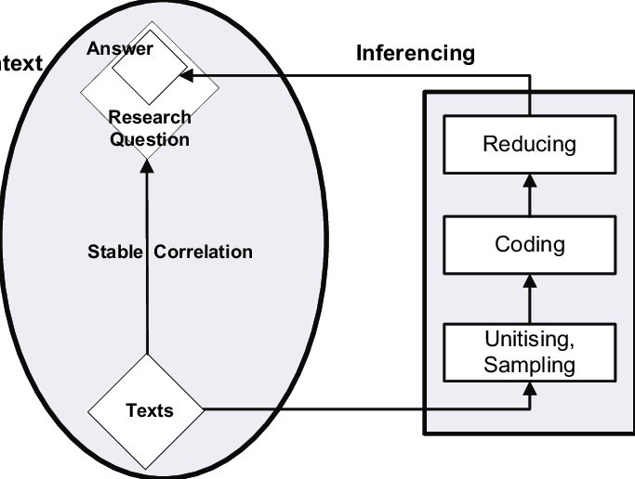
METHOD
The methodology used in this study is qualitative research with content analysis. Krippendorff (in Zuhdi and Afifah, 2004) explains that content analysis is a research technique used to make valid inferences and can be re-examined based on the context.
The data is a language policy documents and the focus of research is the position of Bahasa Indonesia. To investigate the status of Bahasa Indonesia, the researchers use Spolsky’s Theory.

Slide 4
LITERATURE REVIEW
Language Policy
Language Practice (Ecology)
Language Beliefs (Ideology)
Language Management (Planning)
Spolsky (2003) explains that there are three components in language policy, namely practice, belief or ideology, and management or planning. Practice refers to the habitual pattern of language selection whose use is repeated, belief refers to views on language and language use, and management or planning refers to attempts to modify or influence linguistic practice by the intervention of a language (2004: 5).

Slide 5
FINDING AND DISCUSSION
IDEOLOGY (LANGUAGE BELIEF)
Schools respect diverse language and multiculturalism
English is the main language and lingua franca
Bahasa Indonesia and mandarin are additional languages
Based on the rational, vision and mission, and language philosophy in Language Policy Document
21st century skills
Multilingualism and Multiculturalism
Mother Tongue must be developed

Slide 6
FINDING AND DISCUSSION
ECOLOGY (LANGUAGE PRACTICE)
Primary
Secondary
Based on the part Language Pathways: Practices at Sampoerna Academy in Language Policy Document
Bahasa Indonesia are taught from Kindegarten to Grade 6
Allowing students to use mother tongue in class is the concept of language acquisition
Allocates 3 periods per week grade 7-8
2 period per week grade 9-10
2 -6 period per week grade 11-12
Class placement based on the mother tongue

Slide 7
FINDING AND DISCUSSION
PLANNING (LANGUAGE MANAGEMENT)
Page 5-13 part “Guidelines” Language Policy Document
No | Situation | English | Bahasa Indonesia
1 | In-class interaction | All subjects use English | During Bahasa Indonesia classes and in certain situations, such as earthquakes, science labs, and physical education Explaining complex concepts can be done in Bahasa Indonesia
2 | Disaster Simulation | First in English | Followed by Bahasa Indonesia
3 | Recess period | Teacher on duty must communicate in English. Students can use any language. | Students can use the language of their origin as long as it does not exclude other students from the language that their group is using
4 | Correspondence | English and Bahasa Indonesia (two languages) | English and Bahasa Indonesia
5 | Communication with parents | English and Bahasa Indonesia (two languages) | English and Bahasa Indonesia
6 | Communication between colleagues | Within the scope of a large group, English must be used | Within the scope of a small group, Bahasa Indonesia is allowed
6 | Teaching at the kindergarten level | The use of both language and mix-code is allowed | The use of both language and mix-code is allowed
7 | Provision of source books in the library | English is present | Bahasa Indonesia is present

Slide 8
CONCLUSION AND RECCOMENDATION
SA schools still position Bahasa Indonesia as an essential language to be used and taught
This aligns with their ideology which upholds multiculturalism, multilingualism, and respect for the mother tongue
All language ideologies and philosophies presented are also applied in language managements and language practices
It would be better to clearly state that individuals are allowed to use Bahasa Indonesia or other mother tongues because language acquisition and retention will continue to develop if used in everyday life. The role of teaching is to help them understand grammar and recall their acquired vocabulary

Slide 9
REFERENCES
Sampoerna Academy. (9 April 2019). “The Celebration of Sampoerna Academy Surabaya”. diunduh di https://www.sampoernaacademy.sch.id/en/the-celebration-of-sampoerna-academy-surabaya/ pada 22 Januari 2023.
Spolsky, B. (2003). Language practices, ideology and beliefs, and management and planning. In Language Policy (Key Topics in Sociolinguistics, pp. 1-15). Cambridge: Cambridge University Press. doi:10.1017/CBO9780511615245.002
Spolsky (2005). “Language Policy” dalam ISB4: Proceedings of the
4th International Symposium on Bilingualism (ed. ed. James
Cohen, Kara T. McAlister, Kellie Rolstad, and Jeff MacSwan) 2152-2164. Somerville, MA: Cascadilla Press.)
Susanna Karlsson & Tom S. Karlsson (2020) Language policy as ‘frozen’ ideology: exploring the administrative function in Swedish higher education, Current Issues in Language Planning, 21:1, 67-87, DOI: 10.1080/14664208.2019.1593723
Zuchdi, Darmiyati dan Wiwiek Afifa. (2019). Analisis Konten Etnografi & Grounded Theory, dan Hermeneutika dalam Penelitian. Jakarta: PT Bumi Aksara.
Zubadidah, Siti. (2016). Keterampilan Abad ke-21 Keterampilan yang Diajarkan Melalui Pembelajaran. Conference Paper 2016.
Abidin, Yunus. (2019). Konsep Dasar Bahasa Indonesia. Jakarta: PT Bumi Aksara.
BROWN, H. Douglas. (2007). Prinsip Pembelajaran dan Pengajaran Bahasa / H. Douglas Brown (ed. V). Jakarta: Pearson Education Inc.
Fatmawati, Suci Rani. (2015). Pemerolehan Bahasa Pertama Anak menurut Tinjauan Psikolinguistik dalam Jurnal Lentera. (8) 1, 1 Juni 2015.
Mahmud, Saifuddin dan Muhammad Idham. (2019). Teori Belajar Bahasa. Aceh: Syiah Kuala University Press.
Nasution. (2017). “The Implementation of Language Policy in State Islamic University of North Sumatera” dalam Buletin Al-Turas. XXIII (2), Juli 2017.
Sampoerna Academy.(2018). Language Policy.

Slide 10
THANK YOU!
Terima Kasih

