Slide 1
Buddhist Meditation, Ascetic Education, and Emotional Intelligence : An Autoethnography as a Temporary Monk
No. Abstract: ABS-ICOLLITE-23085
Fuji Riang Prastowo
Sociology and Inter-religious Studies, Universitas Gadjah Mada

Slide 2
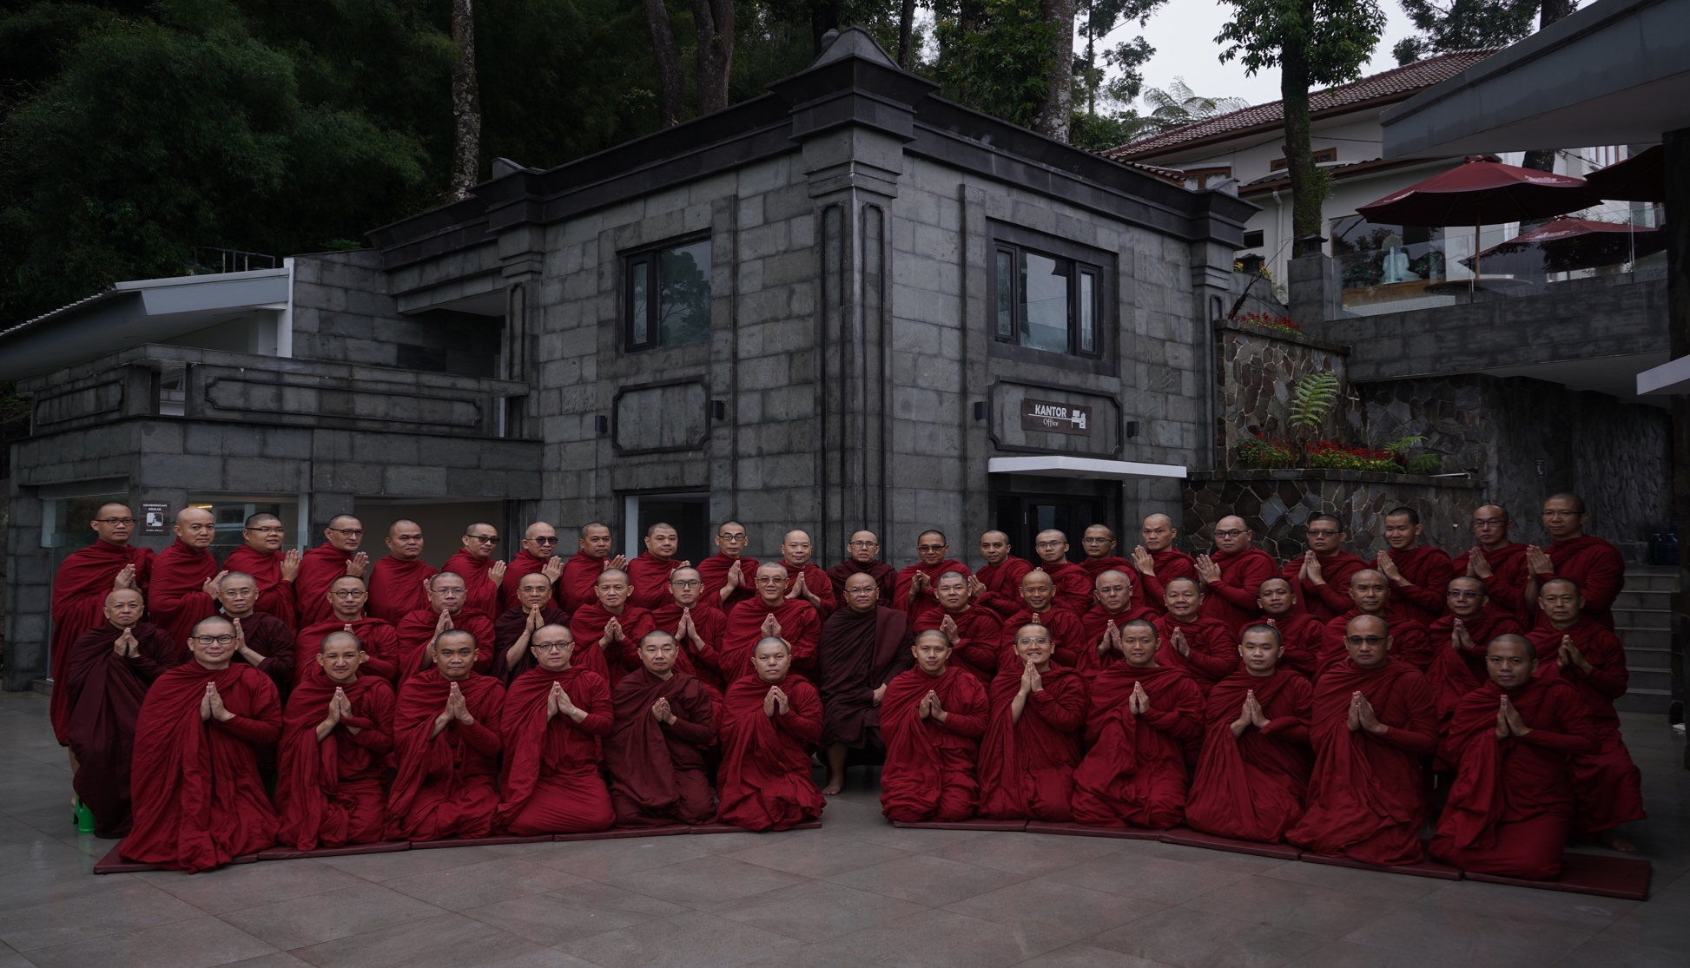
INTRODUCTION
Ascetic education through meditation is one of the most critical aspects of Buddhism to observe consciousness through the process of the cognitive senses doors (Pancadvāravīthi) and inner doors (Manodvāravīthi).
This article reviews ascetic education as a learning autonomy in inquiry-based learning and reflective practice in seeking the essence of life.
Emotional Intelligence : Several authors have demonstrated that meditation practice alters brain activity in areas important for sensory, cognitive and emotional processing (Lazar et al., 2000; Doraiswami and Xiong, 2007; Srinivasan and Baijal, 2007)

Slide 3
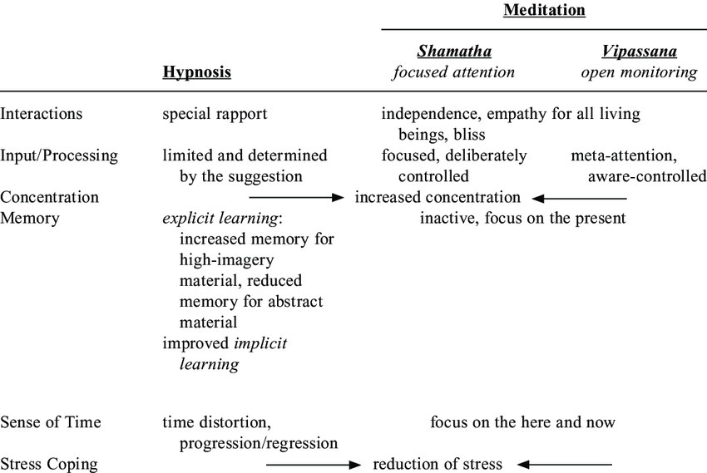
LITERATURE REVIEW
Lutz et al. (2008) suggested a useful framework in which meditation techniques are grouped into two main categories:
focused attention; directing and sustaining attention on a selected object, such as breathing, scriptural passage, mantra, religious pictures, etc. A typical example is Shamatha2 , a single pointed, focusing, pacifying and calming meditation technique. The key concept is the concentration of mind. If the mind is wandering meditators show a disengagement of attention from distraction and a shift of attention back to the selected object.
open monitoring: no explicit focus on objects. This meditation technique is characterized by meta-attention. Vipassana is an example of a form of meditation that includes any meditation technique that cultivates insight including contemplation, introspection, analytic meditation and observations about experience.

Slide 4
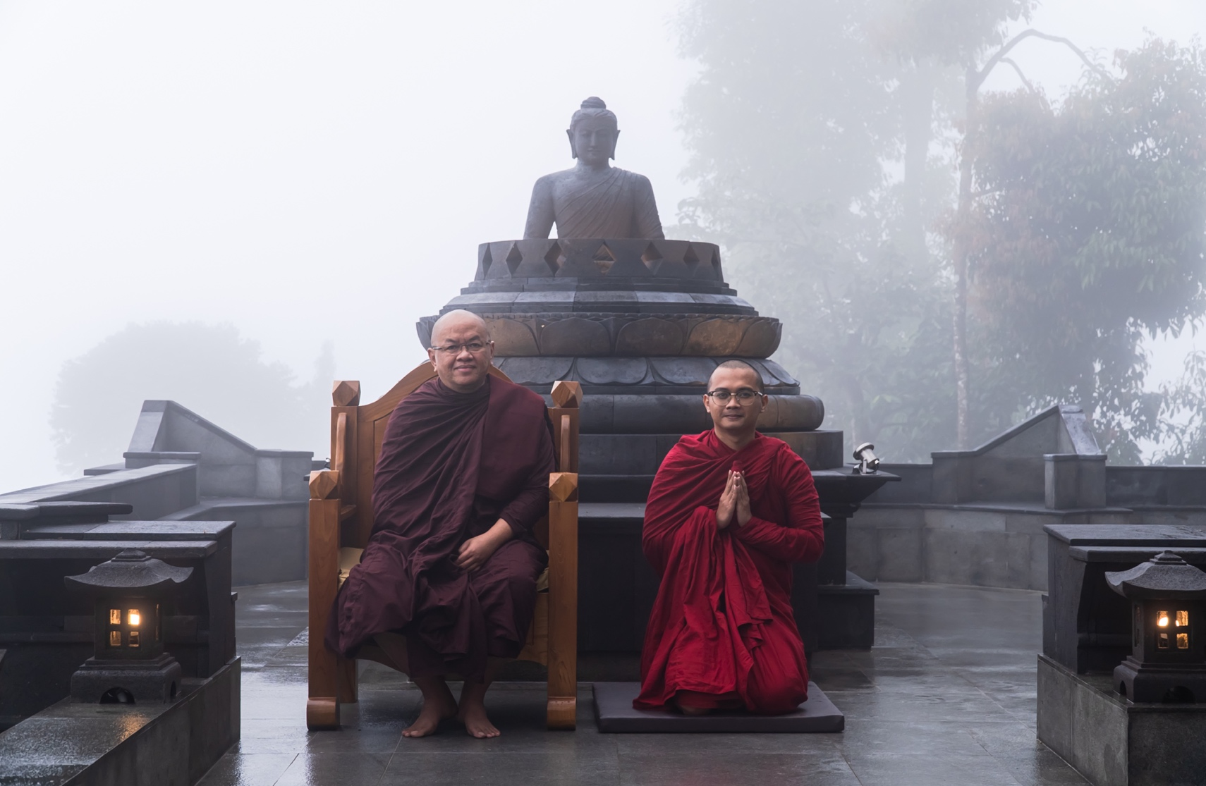
METHOD
The paper uses the autoethnographic notes of the researcher as a temporary monk when attending the Pabbaja Samanera in December 2022 at Megamendung Bogor Hermitage by Dhammavihari Buddhist Studies.
This temporary monk training based on Abhidhamma education uses a 2567-year-old curriculum by Buddha Gautama in India, which emphasizes noble silence without verbal and thought interaction and lives by the monks' rules.

Slide 5
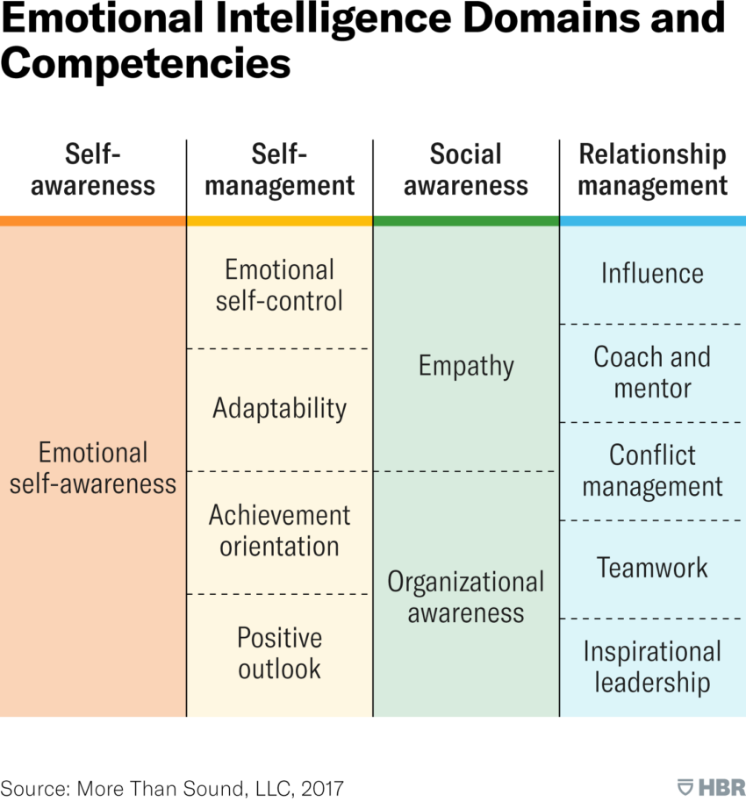
FINDING AND DISCUSSION
The study concludes that there are fundamental differences between Western education, which is based on cognitive intelligence, and Eastern education, especially Dharma from India, which is based on emotional intelligence.
https://hbr.org/2017/02/emotional-intelligence-has-12-elements-which-do-you-need-to-work-on

Slide 6
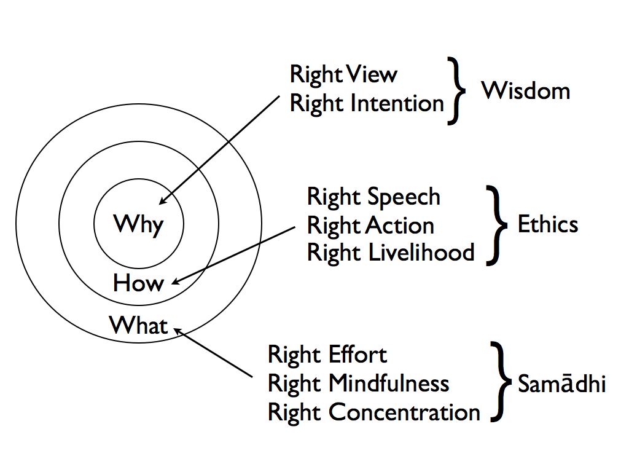
Second, the reflective capacity in Buddhist ascetic education through contemplative meditation aims to let go of worldly attachments.
http://contemplative-studies.org/wp/index.php/2018/02/18/the-noble-eightfold-path-right-actions-2/

Slide 7
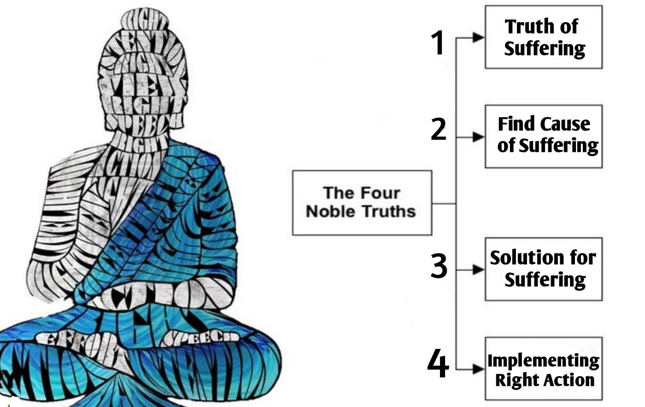
Third, the ultimate goal of Buddhist teaching is to realize Anicca (impermanence), Dukkha (suffering), and Anatta (non-self-teaching).
Pic Resource : https://medium.com/nyc-design/buddhas-four-step-design-thinking-approach-to-deal-with-suffering-10a6fb1525f5

Slide 8
CONCLUSION
Pabajja is an ancient practice in the 2567-year-old theravada tradition of Buddhism that teaches humans to live ascetic lives, i.e. renounce the desires of the world.
The basic practice in Pabajja's education is the temporary life as a monk with many fasting rites and noble silence as the basic supports of meditation practice
Meditation is a universal ascetic education by intervening in the work of the brain through a systematic exercise not to respond to fears due to competition from the neoliberal education system.

Slide 9
REFERENCES
Halsband U, Mueller S, Hinterberger T, Strickner S (2009) Plasticity changes in the brain in hypnosis and meditation. Contemp Hypn 26:194–215
Lazar SW, Bush G, Gollub RL, Fricchione GL, Khalsa G, Benson H (2000) Functional brain mapping of the relaxation response and meditation. Neuroreport 11: 1581–5.
Lutz A, Slagter HA, Dunne JD, Davidson RJ (2008) Attention regulation and monitoring in meditation. Trends in Cognitive Science 12: 163–9.
Srinivasan N, Baijal S, (2007) Concentrative meditation enhances preattentive processing: a mismatch negativity study. Neuroreport 18: 1709–12.

Slide 10
THANK YOU!
Follow us @...

