Slide 1
Representation of Japanese High School Students: Discourse Analysis on AKB48 Song Lyrics
No. Abstract:ABS-ICOLLITE-23216
Ghaida Farisya (1)
Universitas Garut
Via Luviana Dewanty (2)
Universitas Pendidikan Indonesia

Slide 2
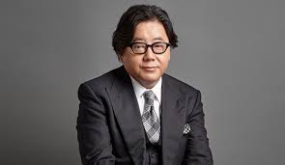
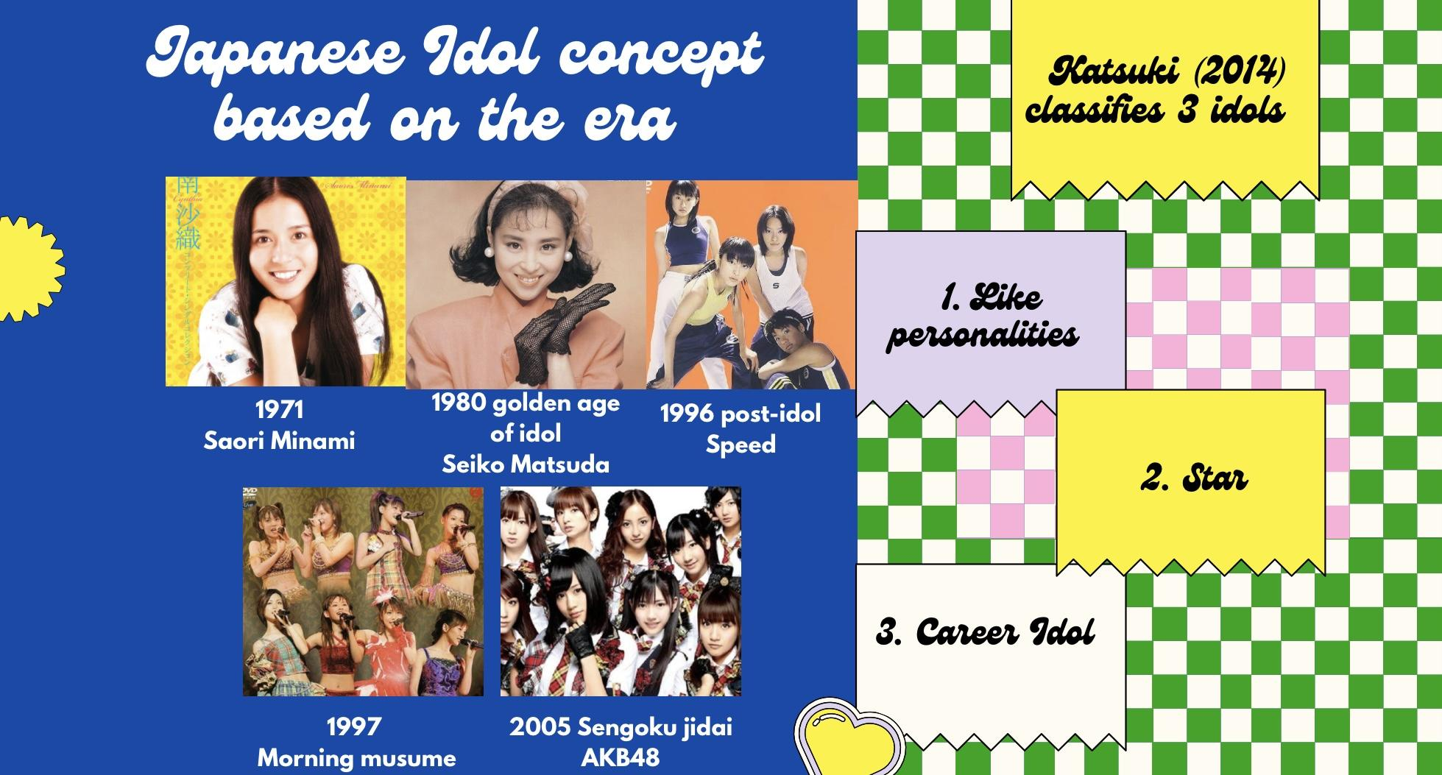
INTRODUCTION
The main concept of Japanese idols is women who look young and have attractive characters. Singing, music and dance performance skills are only secondary for an idol (Cahoon, 1993; Lin and Lin, 2007; Yamamoto, 2019; Van-Haecke, 2020)
How are high school girls represented in 5 AKB48 song lyrics?
How is the image of high school girls built based on the subject-object and writer-listener positions?
All Images from Apple Music. AKB48 Daily and Wikipedia

Slide 3
LITERATURE REVIEW
1
2
3
AKB48: IDOL CONCEPT
Representation of JAPANESE HIGH SCHOOL GIRLS
Critical Discourse Analysis (CDA) by
Sara Mills (1997)
5 AKB48 Songs
JK Nemurihime, Ano Koro no Sneakers, Takeuchi Senpai, Futari Nori no Jitensha, and Boku no Sakura
Position of subject-object
Position of SongWriter-Reader/Listener

Slide 4
METHOD
Find the lyrics of the AKB48 song with the theme of high school students.
Translate and identify representation of high school girl in song lyrics
classify the song verses in 5 AKB48 song lyrics about Japanese high school teenagers
Analyz data use Critical Discourse Analysis from Sara Mills (CDA) in micro/text analysis
conclusions
Qualitative Method
Sara Mills (1997)
Position of subject-object
Position of Song Writer-Reader/Listener

Slide 5
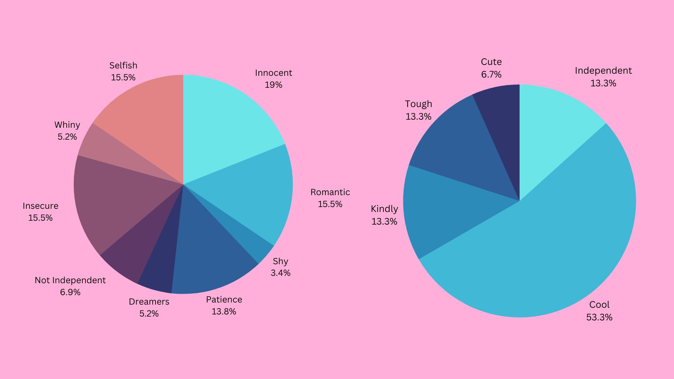
FINDING AND DISCUSSION
Position of Subject-Object
Object
High School Boys
(SongWriter Perspective
Subject
High school girls
Figure 1 Position of Subject-Object

Slide 6
FINDING AND DISCUSSION
2. Position of SongWriter-Listener
Numbers | Lyric
1 | Boku wa mada aokusaku ikiteiru ano koro haiteita sunikaa I’m still childishly living on I’ve been wearing my sneakers (Ano koro no sunikaa-AKB48)
2 | Toki ga dore dake sugite mo niatte itai no seifuku no matter how much time passes, I still want this school uniform to fit (JK nemurihime- AKB48)
3 | Tokyo no daigaku ni icchattara mada saki no koto na noni, watashiwa hitori de fuan ni naru If you’re really going to Tokyo University even though it’s still far ahead, when I’m by myself, i become anxious (Takeuchi senpai - AKB48)
4 | Go to doko demo Heaven kimi to nara, hashiritsudzuketai Cause I’m loving you. go to no matter where, heaven while next to you, I want to continue running cause I’m loving you (Futari nori no jitensha- AKB48)
5 | mezashiteita gooru made tadoritsukezu arukidasu Aim at the goal until your struggling lets you start walking (Boku no Sakura-AKB48)

Slide 7
CONCLUSION
Based on the analysis conducted using Critical Discourse Analysis (CDA) from Sara Mills (1997) it can be concluded that in the position of subject-object position, high school girls are represented as women who are innocent, romantic, selfish, insecure, patient, dreamers, and needing a male companion. This representation is the point of view of the author as a man about the thoughts, feelings, behavior of high school girls.

Slide 8
REFERENCES
Cahoon, K. (1993). Japan: An Illustrated Encyclopedia Tokyo: Kodansha.
Cole, M. W. and Zorach, R. (2009). The Idol in The Age of Art: Objects, Devotions and the Early Modern World. Routledge.
Kinsella, S. (1995). Cuties in Japan. In L. Skov & B. Moeran (Eds.), Women, media, and consumption in Japan (ConsumAsiaN book series). (pp. 220-255). Curzon Press.
Galbraith, P. W. (2012). Idols: the image of desire in Japanese consumer capitalism. In Idols and Celebrity in Japanese Media Culture, edited by Galbraith, P. W. and Karlin, J. G., pp. 185-208. Palgrave Macmillan.
Galbraith, P. W. (2017). AKB business: idols and affective economics in contemporary Japan. In Introducing Japanese Popular Culture, edited by Freedman, A. and Slade, T., pp. 158-167. Routledge.
Haryana, A, et al. (2020). The Representation of Women in Pendhoza’s Bojoku Galak’s Song through Sara Mills’s Critical Discourse Analysis Model [Paper Presentation]. ICHEDS. DOI 10.18502/kss.v4i14.7914
Lin, Y. C. and Lin, C. H. (2007). Impetus for worship: an exploratory study of adolescents’ idol adoration behavior. Adolescence 42(167): 575-588.
Nishiyama, Y. (2016). But Iam Still a Girl After ALL: A Discourse Analysis of Femininities in Popular Japanese Manga Comics. Victoria University of Wellington
McVeigh, B. (1996). Commodifying affection, authority and gender in the everyday objects of Japan. Journal of Material Culture, 1(3), 291-312.
Miller, L. (2004). You are doing burikko!: Censoring/scrutinizing artificers of cute femininity in Japanese. In S. Okamoto & J. S. S. Smith (Eds.), Japanese language, gender, and ideology: Cultural models and real people (pp. 148-165). Oxford University Press.
Mils. S (1997). Discours. Routledge
Schutz, U.G. (2015). What Text Can Tell Us About Male and Female Characters in Shojou and Shounen Manga. EAJPC. DOI:10.1386?eapc.1.133_1
Tajima, Y. (2018). Japanese idol culture for ‘contents tourism’ and regional revitalization: a case study of regional idols. In Global Leisure and the Struggle for a Better World, edited by Beniwal, A., Jain, R. and Spracklen, K., pp. 117-139. Palgrave Macmillan.
Van-Haecke, P. J. (2020). Female idols in Japan: desiring desire, fantasmatic consumption and drive satisfaction. East Asian Journal of Popular Culture 6(1): 77-92.
Yamamoto, S. (2019). Japanese Female Aidoru Identities. The University of Arizona. [A Dissertation Submitted to the Faculty of the DEPARTMENT OF EAST ASIAN STUDIES].
Yu, S. (2017). Japanese Anime and Woman’s Gender-Role Changing. Jyväskylä University. [A Thesis Submitted to the Faculty of Humanities]

Slide 9
THANK YOU!
ありがとうございました。

