Slide 1
IMPLEMENTATION OF COGNITIVE LITERACY DIMENSION STRATEGY IN PROSE APPRECIATION LEARNING AT UNIVERSITY
ABS-ICOLLITE-23031
Halimah¹, Suci Sundusiah¹, Aswan², Sri Ulina Br Sembiring¹ ¹Universitas Pendidikan Indonesia, ²Universitas Negeri Malang

Slide 2
INTRODUCTION
It is undeniable, the progress of the times marked by technological advances brings positive and negative impacts.
Ngafifi (2014, p. 42-43) stated even though technological advances gives many various benefits for humans, however, this technological advance will give a negative impact to social culture: a. moral decline among community members; b. delinquency and deviance among teenagers have increased; c. changes in interaction patterns among humans.
According to that phenomenon, it is important to provide an implementation of moral values in society, especially in education society.
Halimah, et al (2020) stated that literary appreciation is suitable as a moral teaching tool, especially in the short story genre.

Slide 3
LITERATURE REVIEW
Literary Appreciation Process (activity) of beautifying, enjoying, inspiring, and apprehending literary works individually. (Saryono, 2009; Aminuddin, 2011)
The Dimensions of Cognitive Literacy Related to readers’ or writers’ ability in interpreting text and writing. (Kucer & Cecilia, 2006, etc)
Fiction Prose Appreciation Learning

Slide 4
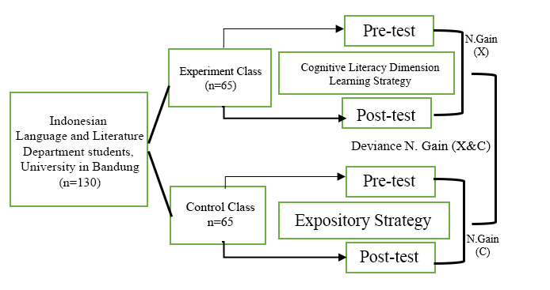
METHOD
True Experimental Design Design of the randomized pre-test and post-test control group (RPPCGD

Slide 5
FINDING AND DISCUSSION
Description Table of Pre-test & Post-test of Students in Appreciating Short Story in the Indonesian Fiction Prose Appreciation Course
Pre Test
 | N | Mean | Std. Deviation | Std. Error | 95% Confidence Interval for Mean |  | Min | Max
 |  |  |  |  | Lower Bound | Upper Bound
Experimental Class | 65 | 64.8231 | 3.826 | .4746 | 63.8749 | 65.7713 | 59.00 | 74.50
Control Class | 65 | 68.7692 | 3.824 | .4743 | 67.8216 | 69.7169 | 60.50 | 76.00
Total | 130 | 66.7962 | 4.294 | .3766 | 66.0509 | 67.5414 | 59.00 | 76.00
Post Test
 | N | Mean | Std. Deviation | Std. Error | 95% Confidence Interval for Mean |  | Min | Max
 |  |  |  |  | Lower Bound | Upper Bound
Experimental Class | 65 | 90.66 | 2.826 | .350 | 89.9690 | 91.3695 | 85.00 | 95.50
Control Class | 65 | 87.76 | 2.980 | .369 | 87.0307 | 88.5078 | 83.00 | 95.50
Total | 130 | 89.21 | 3.238 | .284 | 88.6572 | 89.7812 | 83.00 | 95.50
The average score of the control class is higher than the experimental class.
The average ability of the experimental class is higher han the control class.

Slide 6
CONCLUSION
The improvement of short story appreciation in the Indonesian fiction prose appreciation course that used cognitive literacy dimension learning strategy (experimental class) is higher than the other class (control class) that used expository learning strategy.

Slide 7
REFERENCES
Abrams, M.H. (2009). A Glossary of Literary Terms, Ninth Edition. Boston: USA Wadsworth Cengage Learning. [Online]. Diakses dari file:///D:/E%20Book /Abrams.pdf.
Aminuddin. (2011). Pengantar Apresiasi Karya Sastra. Bandung: Sinar baru Algensindo.
Halimah, Sumiyadi, Mulyati, Y., Damaianti, V. S. (2020). Critical literacy approach in the teaching of literary appreciation using Indonesian short stories. Indonesian Journal of Applied Linguistics, 10(1). 84-94. https://doi.org/10.17509/ijal.v10i1.24992
Knaflic, L. (2014). Psychological Aspects of Literacy. Libellarium, VII, (1), 41-53. [Online]. Diakses dari https://hrcak.srce.hr/file/202150.
Kucer, S.B. dan Cecilia, S. (2006). Teaching the dimensions of literacy. London: Lawrence Erlbaum Associates, Publishers.
Kucer, S.B. (2014). Dimensions of Literacy and Writing in School Settings. New York dan London: Routledge Taylor & Francis Group. [Online]. Diakses dari file:///D:/E%20Book/Kucer-Dimensions %20of%20Literacy_%20(2014).pdf.
Kuswana, W. S. (2012). Taksonomi Kognitif: Perkembangan Ragam Berpikir. Bandung. PT Remaja Rosdakarya.
Moore, M. (2009). Dimensions of Literacy: Sociocultural. University of New England: Courtney Graffius. [Online]. Diakses dari https://luv2teach.weebly.com/uploads /3/9/6/4/3964527/dimensions_of_literacy._sociocultural.pdf.
Ngafifi, M (2014). Kemajuan Teknologi dan Pola Hidup Manusia dalam Perspektif Sosial Budaya. Jurnal Pembangunan Pendidikan: Fondasi dan Aplikasi Volume 2, Nomor 1, 2014. Diunduh dari: https://journal.uny.ac.id/index.php/jppfa/article/download/217
Petersson, et al. (2009). Language and Literacy from a Cognitive Neuroscience Perspective. Dalam Olson dan Torrance (Penyunting ), The Cambridge Handbook of Literacy (hlm. 153-182). New York: Cambridge University Press. [Online]. Diakses dari https://escholarship.org/uc/item/4fp2h2zp.
Saryono, D. (2009). Dasar Apresiasi Sastra. Yogyakarta: Elmatera Publishing.
Siregar, Syofian. (2014). Statistik parametrik untuk penelitian kuantitatif. Jakarta: Bumi Aksara.
Sugiyono. (2011). Metode Penelitian Pendidikan: Pendekatan Kuantitatif, Kualitatif, dan R&D. Bandung: Alfabeta.

Slide 8
THANK YOU!

