Slide 1
MANABU BUNPOU" APPLICATION ON A SMARTPHONE AS AN ADDITIONAL UNDERSTANDING OF JAPANESE GRAMMAR FOR ELEMENTARY-LEVEL STUDENTS
No. Abstract: ABS-ICOLLITE-23140
Herniwati Herniwati, Nuria Haristiani, Melia Dewi Judiasri, Nabila Siti Mahdiyyah
Universitas Pendidikan Indonesia

Slide 2
INTRODUCTION
In learning Japanese, grammar has a significant role so that learners can use the language under the rules of Japanese as a foreign language they are learning. Some students experience difficulties in learning Japanese grammar, partly due to limited study time. It is not enough for students to learn with the guidance of a teacher in class only. Therefore practical learning is needed without any limitation of space, time and place. The learning process is through a digitalization system to increase the efficiency and effectiveness of learning as a solution to strengthening students' understanding of mastering Japanese grammar, namely through a smartphone application. Aside from being a communication tool, smartphones are cellular phones with more capabilities and make it easier to get information and applications for learning. The existence of this smartphone is indeed able to provide various advantages and conveniences for its users, especially students. This research aims to develop the digitization of Japanese language teaching through smartphone applications for Japanese grammar learning tools as e-learning media.

Slide 3
LITERATURE REVIEW
Ali (2010 p. 89) suggests that learning media is defined as anything that can be used to convey messages, stimulate thoughts, feelings, concerns and willingness of students so that they can encourage the learning process. Media forms are used to enhance the learning experience to make it more concrete.
Multimedia-based learning media is here to be a solution in dealing with this problem because multimedia can touch all five senses: sight, smell, taste, hearing and touch. Computer Technology Research (CTR), states that people are only able to remember 20% of what they see and 30% of what they hear. But people can remember 50% of what was seen and heard and 80% of what was seen, heard and done all at once.
In addition, according to Munir (2012 p. 8), multimedia can provide benefits in delivering and receiving information. Among them are more communicative because they use pictures and animations that are better understood, easy to make changes because all information is stored on the computer so that it can be continuously updated and developed as needed, more interactive and more flexible in expressing creativity.

Slide 4
Bunpou JLPT N4
Japanese Language Proficiency Test (JLPT) level N4 is a basic Japanese language ability test or more precisely a pre-intermediate or chuushokyu (中初級) in which students are required to be able to master at least around 300 kanji, 1500 vocabularies, and be able to read simple material and understand everyday conversations that are spoken slowly. Level N4 is also a bridge between levels N5 and N3, namely from the basic level to the intermediate level.
The Japanese grammar structures (bunkei) included in the JLPT N4 grammar material (bunpou) amount to 93:
No. | Bunkei | No. | Bunkei | No. | Bunkei
1 | ~てみる | 29 | 受身形 | 57 | ~な
2 | ~そうだ | 30 | ~でいます | 58 | ~しろ
3 | ~んです | 31 | ~がする | 59 | ~って
4 | ~方 | 32 | ~ところだ | 60 | ~てくれる
5 | ~ので | 33 | ~でしょう？ | 61 | ~ようになる
6 | ~ことができる | 34 | ~らしいです | 62 | ~さ
85 | ~ようになる | 88 | ~お～ください | 91 | ~てはいけない
86 | ~ことになっている | 89 | 敬語 | 92 | ~ようにする
87 | ~お～になって | 90 | ~なら | 93 | ~てほしい

Slide 5
METHOD
The quantitative descriptive method used is to find out the benefits of the Manabu Bunpo application by conducting experiments using the application and then collecting information regarding its use. Respondents who will use this application in this study consist of students from the Department of Japanese Language Education FPBS UPI.
Participants in this study included the researchers themselves who made the application as well as several students at the Indonesian University of Education majoring in Japanese Language Education who were preparing for JLPT N4, namely level II/semester 4th students totalling 25 students.

Slide 6
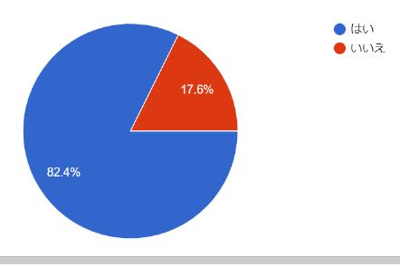
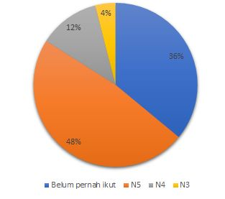
Participant
class participant
have taken the JLPT test
JLPT passing results N5, N4, N3

Slide 7
FINDING AND DISCUSSION
Minimum 2 slides, maximum 4 slides.
Table or chart can be displayed
The expected research results are a smartphone application called "Manabu Bunpo" which aims to help Japanese language learners to be able to study independently in improving Japanese grammar skills. This application has several features consisting of a start menu, levels, quizzes, and about.
These developments include explanations of sentence patterns, how to use them, and example sentences with Indonesian meanings, as well as a quiz containing "Bunpou" questions at level N4 JLPT. From the results of trials on 25 Japanese Language Education Students, this application has an average percentage of 88.8%, which means it is very feasible to be used as a JLPT N4 "Bunpou" learning application.

Slide 8
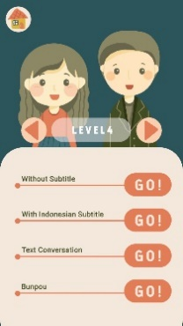
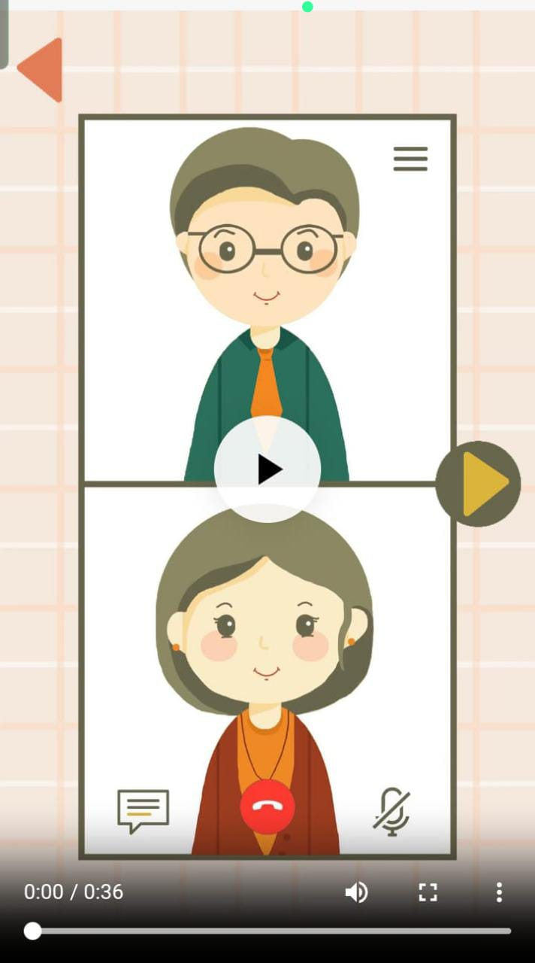
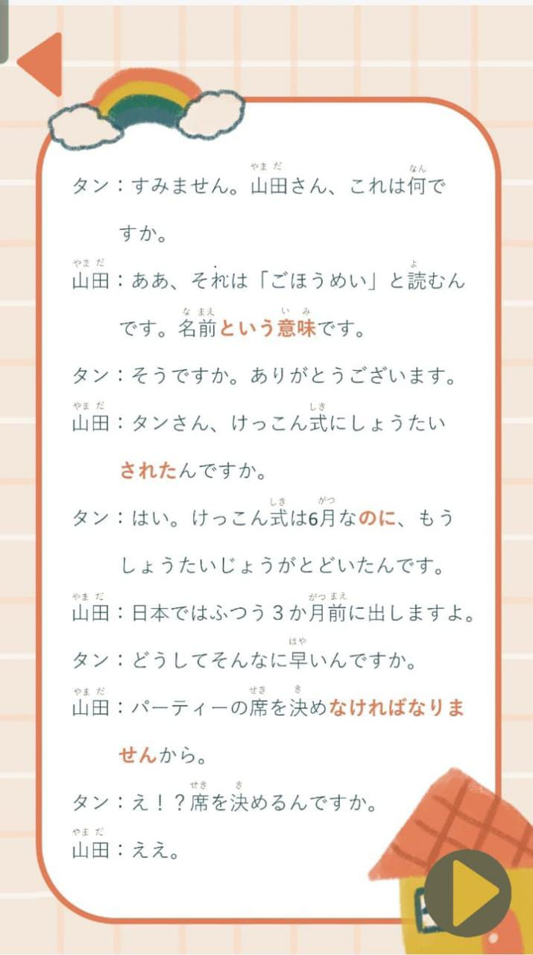
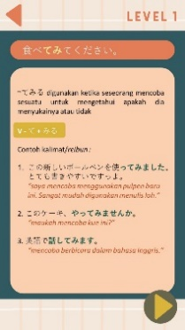
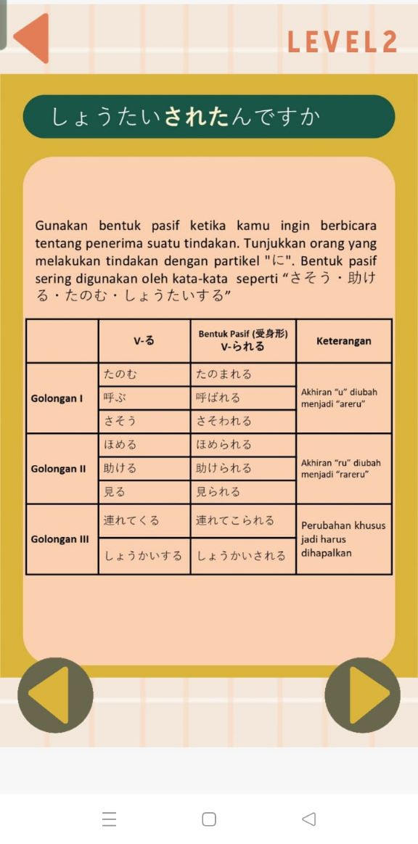
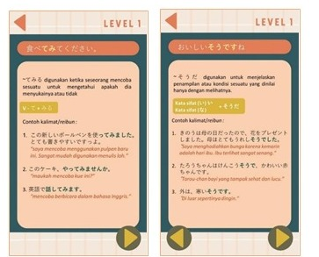
APPLICATION MANABUNPOU
The material developed in this application consists of several kinds. Among other things, the material is in the form of video conversations, conversational texts that explain the contents of the videos, and grammar related to the contents of the videos. In addition, there are also quizzes to help train students to better understand the content of the material.

Slide 9
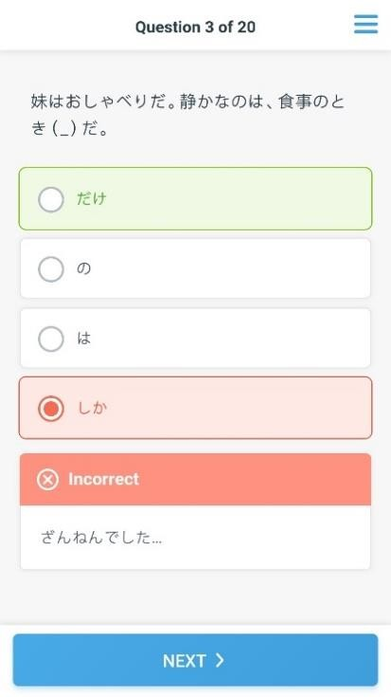
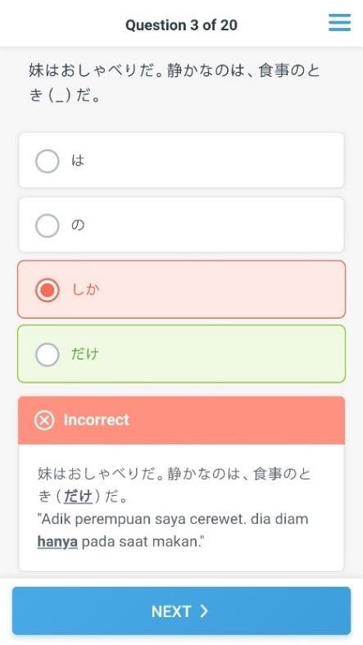
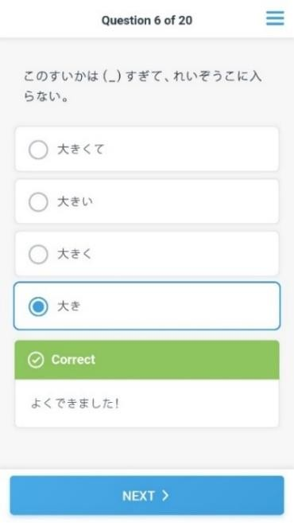
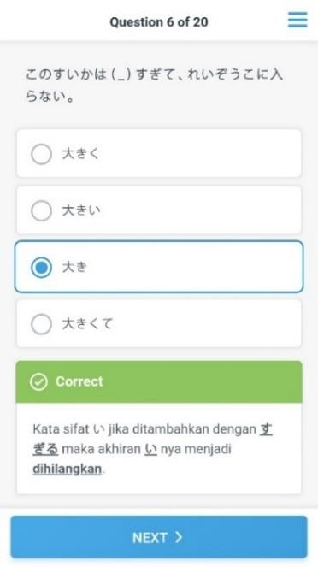
Sample Quiz Questions
Students answer on JLPT questions through quizzes and can immediately find out whether they answered correctly or incorrectly

Slide 10
Quiz Manabunpou JLPT N4 Results
The results of the average quiz score at "Bunpou" questions at level N4 JLPT

Slide 11
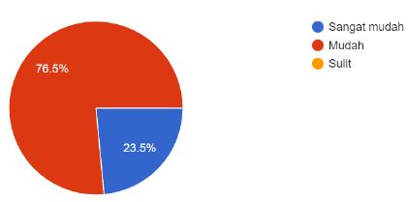
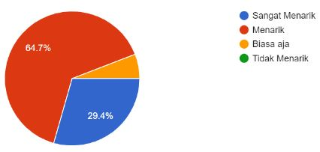
Manabunpou Application Questionnaire Results
Easy to open
Difficult to open
Very Easy
Easy
Difficult
Difficulty level of using the Manabunpou Application
Is the application "Manabu Bunpou" easy to learn?
very interesting. interesting
Just normal
not interesting
Manabunpou Application satisfaction

Slide 12
CONCLUSION
The use of smartphones has now become one of the primary needs that cannot be separated in human life. In the field of education, smartphones can be used as learning media that can help students better understand the material being studied because their use is more practical and easy to use.
The "Manabunpo" application is an Android-based smartphone application developed as a JLPT N4 grammar (bunpou) learning medium in the form of a hybrid application created using Microsoft PowerPoint, iSpring Suite 9, and Website2APK Builder software.
This application has several main features which are the structure of the application builder. Among other things, it consists of a start menu, levels, quizzes, and about.
The material contained in this application includes video conversations which are also equipped with text, then contains 93 Japanese sentence patterns at level N4 which were developed from several sources. These developments include an explanation of sentence patterns, how to use them, and example sentences with Indonesian meanings. as well as a quiz containing bunpou level N4 questions
From the results of trials on 25 Japanese Language Education Students, this application has an average percentage of 88.8%, which means it is very feasible to be used as a JLPT N4 bunpou learning application.

Slide 13
REFERENCES
The references are in the APA style, 7th edition.
Ariyanti, D. (2019). Be a Smart Teacher With Smartphone. Ponorogo: Uwais Inspirasi Indonesia
Arsyad, A. (2013). Media Pembelajaran. Jakarta: Rajawali Pers.
Qomariyah, N.W. (2018) Pengembangan Bahan Ajar Membaca Bipa Untuk Tingkat Pemula Dengan Pendekatan Kontekstual. Skripsi. Universitas Muhammadiyah Malang.
Susilana, Rudi dan Riyana, C. (2009). Media Pembelajaran: Hakikat, pengembangan, pemanfaatan, dan Penilaian. Bandung: Wacana Prima.
Sutrisno, T. (2019). Keterampilan Dasar Mengajar (The Art Of Basic Teaching). Pamekasan: Duta Media Publishing.
Tolle, Herman dan Pinandito, A. dkk. (2017). Pengembangan Aplikasi Perangkat Bergerak. Malang: UB Press.
Yaumi, M. (2018). Media dan Teknologi Pembelajaran. Jakarta: Prenadamedia Group
Yudistira, Y. (2011). Membuat Aplikasi iPhone Android & BlackBerry Itu Gampang. Jakarta: Mediakita.

Slide 14
THANK YOU!
Follow us @...

