Slide 1
Needs analysis for nursing Japanese language learning for caregivers
No. Abstract: ABS-ICOLLITE-23125
Lena Aprilliana¹, Herniwati Herniwati², Nuria Haristiani³Maya Purnama Sari⁴
Indonesia University of Education

Slide 2
INTRODUCTION
Japan is currently dealing with a condition known as "Slowing population growth and aging population," which is preventing population growth and leading to a significant proportion of old people. In 2023, there will be 20,000 elderly care employees in Japan, where there is a yearly need for 50,000 such workers. The Indonesia-Japan Economic Partnership Agreement (IJ-EPA) and Specified Skilled Worker (SSW) programs allow for a quota of 550 Indonesian nurses and senior nurses per year. The Japanese language proficiency test (JLPT), which measures proficiency in the Japanese language as it is used in ordinary life situations, must be passed by prospective caregivers. To fulfill the criteria of the work, potential caregivers must learn Japanese. Learning can generally be done bravely (online) or elegantly (face-to-face). The most recent advancements in education, specifically learning in the era of the fourth industrial revolution, are currently available. Learning 4.0 is a new approach to education that places an emphasis on managers using and applying their knowledge of technology. Web-based learning is one of the cutting-edge ways that technology is being used in the educational process. The term "web-based learning" refers to a variety of applications for electronic learning, also known as "e-learning." Web-based learning allows for independent study based on one another's comprehension.
Based on research by Fauzi and Rosliyah (2020), a media prototypical online course on basic vocabulary was developed. It contains five topics for basic vocabulary instruction and includes instruction in both Japanese and Indonesian. According to the study, 81.65% of students used the course to learn vocabulary a standard-bearing threshold Japan Foundation Ability level A1. This study aims to identify materials teaching Japanese language materials needed for nursing and identify obstacles and analyze solutions that become obstacles in learning nursing Japanese.

Slide 3
LITERATURE REVIEW
According to Sefriani, R, (2020) the online learning process using e-learning can train students to learn independently, so that learning can shift to student-centered learning or student-centered learning, which is highly recommended by the current government.
E-Learning
According to Wicaksono, et al (2015.p.7) e-learning is an approach to learning development and a collection of learning methods using digital technology that is able to empower, distribute and improve learning outcomes.
According to Sefriani, R, (2020) the online learning process using e-learning can train students to learn independently, so that learning can shift to student-centered learning, which is highly recommended by the current government.
Website atau Web
According to Nasution (2019. p. 67) a website or that is commonly shortned to the web is a collection of pages that are interconnected and can be accessed via the front page (homepage) using a browser. The website displays information on text data, still or moving image data, animation data, sound, video and or a combination of all of them, both static and dynamic which forms a series of interrelated buildings where each is connected to a network of pages (hyrperlinks).

Slide 4
METHOD
This research is a descriptive research with a survey method. Descriptive research is research that is carried out to describe a phenomenon that is currently happening with scientific procedures to answer actual problems (Sutedi, 2011). The research instrument was a questionnaire distributed via Google form to 140 students and 20 teachers. After the data entered and recorded by the Google form is analyzed then described through a qualitative approach.

Slide 5
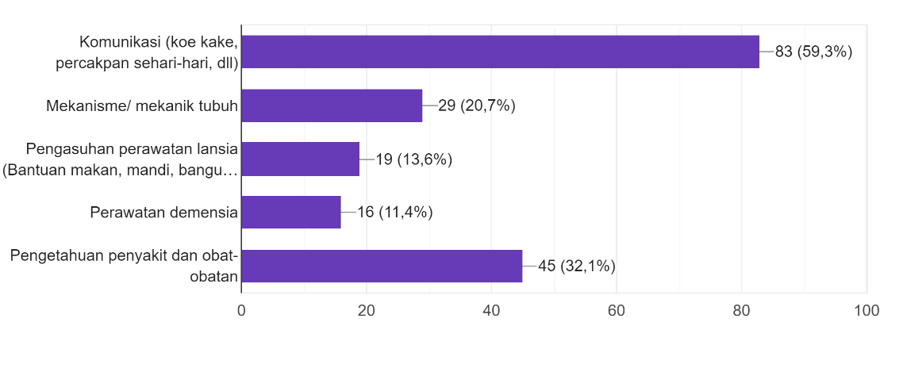
FINDING AND DISCUSSION
Mid-course
Needs analysis for Japanese Nursing learners for caregiver candidates
Communication (everyday communication,expression,etc)
Body mechanics
Eldery care (help with eating, bathing,etc)
Basic Japanese (Grammar, Vocabulary,etc)
Dementia care
Knowledge of disease and medicine
Communication conversation and non-formal)
Nursing (Practice and Procedures for caring the elderly, ssw test material)

Slide 6
FINDING AND DISCUSSION
It is necessary
Post-Course
Needs analysis for Japanese Nursing learners for caregiver candidates
Need
Less necessary
Very unnecessary
No. | Question | It is necessary | Need | Less necessary | Very unnecessary
1. | Are image illustratins needed in nursing Japanese language learning web? | 62,9% | 37,1% | - | -
2. | Are videos needed in nursing Japanese learning web? | 67,9% | 30,7% | 1,2% | -
No. | Question | Yes | No
1. | Is Japanese character recognition material needed on a nursing Japanese language learning website? | 92,9% | 7,1%
2. | Is Japanese grammar material needed on nursing Japanese language learning website? | 97,1% | 2,9%
3. | Are special nursing material needed on a nursing Japanese language learning website? | 98,6% | 1,4%
4. | Is material on procedures for caring for the elderly needed on the nursing Japanese language learning website? | 97,9% | 1,1%
5. | Is the practice of nursing SSW questions needed on the nursing Japanese language learning website? | 97,9% | 1,1%
6. | Are examples of cases in the life of nursing Japanese language learning website? | 100% | -

Slide 7
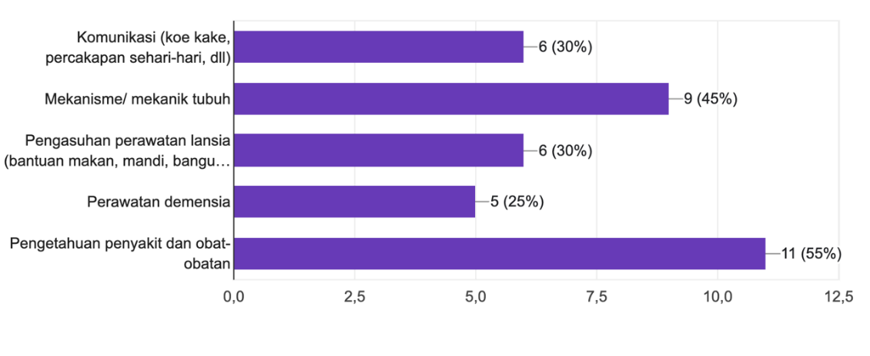
FINDING AND DISCUSSION
Mid-course
Needs analysis for nursing Japanese language teachers for caregiver candidates
Communication (everyday communication,expression,etc)
Body mechanics
Eldery care (help with eating, bathing,etc
Basic Japanese (Grammar, Vocabulary,etc)
Dementia care
Communication conversation and non-formal)
Knowledge of disease and medicine
Nursing (Practice and Procedures for caring the elderly, ssw test material)
)
Grammar, Vocabulary, Communication

Slide 8
FINDING AND DISCUSSION
It is necessary
Post-Course
Needs analysis for nursing Japanese language teachers for caregiver candidates
Need
Less necessary
Very unnecessary
No. | Pertanyaan | Sangat perlu | Perlu | Kurang perlu | Sangat tidak perlu
1. | Are image illustratins needed in nursing Japanese language learning web? | 70% | 30% | - | -
2. | Are videos needed in nursing Japanese learning web? | 80% | 20% | - | -
No. | Pertanyaan | Ya | Tidak
1. | Is Japanese character recognition material needed on a nursing Japanese language learning website? | 80% | 20%
2. | Is Japanese grammar material needed on nursing Japanese language learning website? | 95% | 5%
3. | Are special nursing material needed on a nursing Japanese language learning website? | 95% | 5%
4. | Is material on procedures for caring for the elderly needed on the nursing Japanese language learning website? | 100% | -
5. | Is the practice of nursing SSW questions needed on the nursing Japanese language learning website? | 100% | -
6. | Are examples of cases in the life of nursing Japanese language learning website? | 100% | -

Slide 9
CONCLUSION
The result of the teacher analysis show that in addition to books, 75% need web based learning media and 25% need them. The result of the student analysis showed that 44,3% really needed it and 51,4% needed media e-learning web based as a support in learning nursing Japanese independently for prospective caregivers. The content needed by student is iluustrated picture, videos, learning letters, grammar, special nursing materials, procedures for caring for the elderly, examples of nursing student questions and examples of nursing life cases. As a facilitator, the teacher directs and guides in providing digital teaching materials as revolution 4.0 towards 5.0, besides that it can be used as a reference that can be widely used as research for the development of other digital teaching materials.

Slide 10
REFERENCES
Aminah,S dkk. (2018). Pengiriman Tenaga Perawat dan Careworker Indonesia ke Jepang dalam Kerangka Indonesia- Japan Economic Partnership Agreement (IJ-EPA). Jurnal Bakti Budaya, 1(1).92-101
Deni. (2012). Pendidikan Teknologi Informasi dan Komunikasi. Bandung: PT. Remaja Rosdakarya. Effendy
Hamid, M.A ,dkk. (2020). Media Pembelajaran. Medan: Yayasan Kita Menulis.
Ministry of Health, Labour and Walfare. (2022). Maintain Sufficient Manpower to Support Social Security System. https://www.mhlw.go.jp/english/wp/wp-hw2022/dl/summary.pdf diakses 20 juli 2023
Nasution, A.KP. (2019). Media Pembelajaran Berbasis Internet. Aceh: As-Salam Press
Oishi, I.RV. (2020). Pentingnya Belajar Mandiri Bagi Peserta Didik Di Perguruan Tinggi. Jurnal IKRA-ITH Humaniora, 4(2)
Pritandhari, M & Wibawa, F.A. (2021). Analisis Pembelajaran Mandiri Berbasis Daring pada Masa Pandemi Covid-19. Jurnal Lentera Pendidikan Pusat Penelitian LPPM UM METRO. 6(1).
Rosliyah Y & Fauzi H, 2020. Persepsi Pembelajar terhadap Media Kamus Tematik Berbasis Web bagi Pembelajar Kosakata bahasa Jepang Tingkat Dasar. CHI’E: Jurnal Pendidikan Bahasa Jepang Vol.8 (1) 2020. Diakses 13 juli 2021
Rusman, dkk. 2011. Pembelajaran berbasis teknologi informasi dan komunikasi, mengembangkan Profesionalitas guru. Jakarta: PT. Raja Grafindo. Sefriani, R & Sepriana, R. (2020). Pengembangan Media E-Learning Berbasis Schoology pada Pembelajaran Kurikulum Pendidikan Teknologi dan Kejuruan. Edukatif: Jurnal Ilmu Pendidikan, 2(1).
Sudjana, N & Rivai, A. (2009). Media Pengajaran. Bandung: Sinar Baru Algensindo.
Sutedi, Dedi. (2011). Penelitian Pendidikan Bahasa Jepang. Humaniora: Bandung.
Wahyuningsih, D & Makmur, R. (2017). E-learning Teori dan Aplikasi. Bandung: Informatika.
Wicaksono, dkk. (2015). Teori Pembelajaran Bahasa. Yogyakarta: Garudhawaca.

Slide 11
THANK YOU!
Follow us @...

