Slide 1
THE CULTURAL LEXICON IN STRUCTURAL TERMS OF KAMPUNG ADAT SINAR RESMI LEADERSHIP CISOLOK DISTRICT, SUKABUMI DISTRICT
No. Abstract: ABS-XXX
Rinaldi Supriadi, Nur Fitriyani, Mia Nurmala
Universitas Pendidikan Indonesia

Slide 2
INTRODUCTION
Indonesia as an archipelagic country has a diversity of customs, religions, cultures and languages, which is its own wealth for this country.
One of the areas that reflects this diversity is Sukabumi Regency, especially in Cisolok Subdistrict, Sinar Resmi Village, with the largest population of the Sinar Resmi, traditional village in the area.
The people of the Sinar Resmi traditional village use Sundanese and maintain customary laws written in the regional language, which contain structural terms and greetings that are rarely used in everyday language.
This cultural lexicon research aims to preserve regional languages, especially Sundanese, introduce cultural terms to the community, and understand customary law and related social systems.
The research method uses interviews with elders or traditional heads to gain an in-depth understanding of the cultural lexicon and the cultural meanings contained therein. This research is expected to provide benefits in the preservation of cultural and linguistic wealth in the traditional village of Sinar Resmi

Slide 3
LITERATURE REVIEW
The lexicon is a language component that contains all the information about the meaning and use of words in the language. The wealth of words owned by a speaker, writer or a language, vocabulary, vocabulary. (Kridalaksana, 1982).
A collection of lexemes of a language is called a lexicon, while a collection of words from a language is called a lexicon or vocabulary (Chaer, 2009, p. 8).
Semantics examines symbols or signs that express meaning, the relationship of meaning to one another, and their influence on humans and society. Therefore, semantics includes words, their development and changes (Tarigan, 2009: 7).

Slide 4
METHOD
Types of research | Qualitative Research
Research methods | Descriptive
Data source | Traditional Leader Book of Customary Law Provisions
Data collection technique | Listen Technique Technique Note Surveying Technique Observation Techniques Interview Techniques
Tools | A list of questions Record Tool Stationery Documentation

Slide 5
FINDING AND DISCUSSION
Structural terms and greetings in the traditional village of SinarOfficial, Desa SirnaOfficial, Cisolok District, Sukabumi Regency.
No. | Terms | Lexical Meaning
1. | Tutunggul (Abah) | The Leader
2. | Dukun | Tabib or who treats the sick
3. | Penghulu | The person who regulates religious matters
4. | Bengkong | The person who arranges the circumcision
5. | Paraji | People who help give birth
6. | Tukang Makaya | People in agriculture
7. | Tukang Moro | Animal hunter to jungle
8. | Tukang Kemit | A trusted person who understands the construction and maintenance of traditional houses the most
9. | Tukang BAS | Carpenter or builder
10. | Tukang Ngurus Leuit | The person who takes care of the warehouse where the rice is stored

Slide 6
No. | Terms | Lexical Meaning
11. | Ema Beurang | People who help in the pre and postpartum period
12. | Tukang Bebersih | People who like to clean their hometown
13. | Dukun Sato | People take care of the health of people's pets
14. | Canoli | People who take rice
15. | Tukang Para | The person who arranges consumption when there is a hajat event
16. | Kasenian | People who preserve the arts in the village
17. | Tukang Dapur | The person who takes care of the food in the kitchen
18. | Tukang Panday | A person who makes tools from iron
19. | Kokolot Lembur | Elders in the village
20. | Incu Putu | Village structural successor/village children

Slide 7
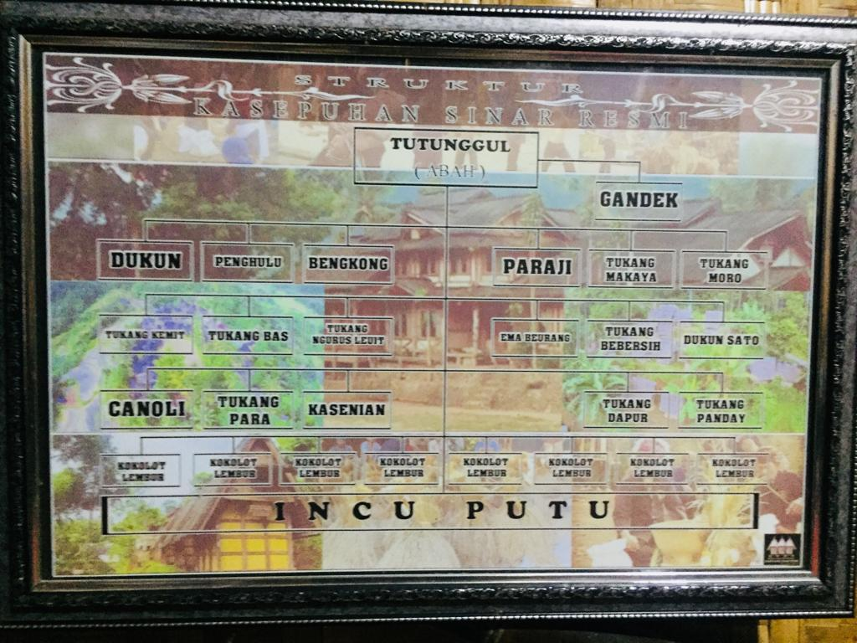
The highest leader in Kasepuhan SRI is Abah then the role (task) of Abah is assisted by several Kasepuhan institutions that have existed for a long time and are still there today.
The meanings of the terms above are basic vocabulary, some of which are taken from other regional languages besides Sundanese. This is in line with what Tarigan (2009) said that basic vocabulary is words that do not change easily or have very little possibility of being collected from other languages.

Slide 8
The pattern of leadership and the structure of power in the Kasepuhan SRI community can experience changes due to social dynamics. The historical approach is used to understand social change and how power structures have developed over time.
Authority in Weber (1957) and the factors underlying the legitimacy of power, including people's economic dependence, are important keys in understanding the dynamics of the power structure in the SRI Kasepuhan community. Social analysis and historical approaches will reveal patterns of change and leadership in these societies.
Social institutions in society are systems of behavior and relationships that meet special needs. Its main function is to provide guidelines for behavior, maintain the integrity of society, and provide a handle for social control.
Social institutions differ from other conceptions such as groups, associations, and organizations in that they meet collective needs and have organizational characteristics, patterns of thought and behavior, certain immunities, and have goals, symbolic symbols, and means to achieve ends.
The process of social institutionalization is a process of structuring and internalizing new norms in society to achieve system stability and universality. The level of norms is assessed based on moral ties and community sanctions for violating these norms.

Slide 9
CONCLUSION
Based on the discussion above, the researcher concludes that there are 20 structural lexicons in the traditional Kasepuhan Sinar Official Sirna Resmi Village, Cisolok District, Sukabumi Regency. The 20 structural lexicons are: Tutunggal, shaman, penghulu, bengkong, paraji, tukang makarya, tukang moro, tukang kemit, tukang BAS, tukang leuit, ema beurang, cleaner, sato shaman, canoli, tukang para, artist, craftsman kitchen, panday workers, kokolot lembur and incu putu. Everything has a semantic meaning according to the needs of the traditional village, and there are several terms taken from other regional languages.

Slide 10
REFERENCES
Alwi, H.(2010). Tata Bahasa Baku Bahasa Indonesia. Jakarta: Balai Pustaka.
Chaer. A. (2007). Kajian Bahasa. Jakarta: Rineka Cipta.
Chaer. A. (2009). Linguistik Umum. Jakarta: Rineka Cipta.
Hadi, S. (2007). Statistik 2. Yogyakarta: Andi Offset.
Koentjaraningrat. (1984). Kebudayaan Jawa. Jakarta : PN. Balai Pustaka
Kolopaking, dkk. (2011). Maternal self-efficacy in the home food environment: a qualitative study among low-income mothers of nutritionally at-risk children in an urban area of Jakarta, Indonesia. Journal of Nutrition Education and Behavior, 43(3), 180–8.
Kridalaksana, H. (1982). Fungsi dan Sikap Bahasa. Jakarta: Penerbit Nusa Indah.
Kridalaksana, H. (1982). Kamus Linguistik. Jakarta: Gramedia.
Mahsun. (2012). Metode Penelitian Bahasa: Tahapan Strategi, Metode, dan Tekniknya. Jakarta: Rajawali Pers.
Moleong, L.(1989). Metode Penelitian Kualitatif. Bandung.Remaja Rosda
Soekanto, S.(1990). Sosiologi Suatu Pengantar.Jakarta.PT Raja Grafindo Persada.
Tarigan, H. G. (2009). Pengajaran Bahasa. Bandung: Angkasa.
Weber, M. (1957). The Theory of Social and Economics, Glencoe:The Free Press.

Slide 11
THANK YOU!
Follow us @...

