Slide 1



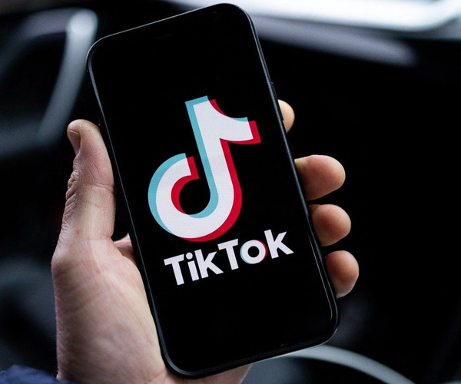






The Development of TikTok-Based on Collaborative Learning Media to Enhance Students' Speaking Skills
Jendriadi
Indonesian Language and Literature Education Departement, Universitas Tidar
Indonesian Language and Literature Education Departement, Universitas Tidar

Slide 2


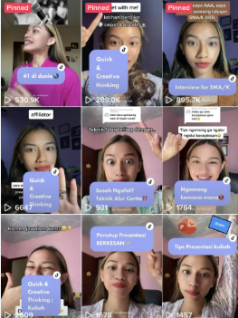
Background
Many students
use digital tools
Traditional teaching methods may feel boring for them
TikTok Justn’t for fun, its also for speaking skills

Slide 3
Purpose of the Study
  To explore how TikTok can help students to improve their speaking skills.
  To show the benefits of collaborative learning using TikTok.
  To guide teachers in using TikTok in language classrooms.

Slide 4

What is Collaborative Learning?

Slide 5
Collaborative Learning
  Students work together in groups or pairs.
  They share ideas, speak, and help each other.
  It improves speaking skills and teamwork.
  Students feel more confident when speaking

Slide 6
Why Use TikTok in Class?
  • TikTok is easy to use and popular with students.
  •Making short videos is fun and helps them practice speaking.
  •They can review and repeat their recordings.
  •Students can give and receive feedback from friends.

Slide 7

Learning Activities with TikTok

Slide 8


Challenges to Consider
⚠ Need clear instructions and learning goals
⚠ Not all students have good internet access
⚠ Privacy and safety concerns
⚠ Teachers must check content carefully

Slide 9

Benefits for Students
✅ Build confidence
✅ Practice pronunciation
✅ Improve fluency
✅ Learn to work in teams
✅ Get feedback from peers

Slide 10

Tips for Teachers
Start with simple tasks
Show examples of good videos
Use private class accounts
Teach students about online safety
Combine TikTok with other learning methods

Slide 11

Conclusion
TikTok can make learning speaking more fun and effective.
It helps students become more active, creative, and confident.
Teachers must plan well and guide students properly.
With the right use, TikTok is a powerful learning tool.

Slide 12
That's all, and thank you

