Slide 1
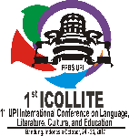
InoLite Kids Strategy as a Differentiated Literacy Learning Innovation for Elementary School Students in Jepara Regency
No. Abstract: ABS-ICOLLITE-24237
Wiwik Wijayanti
Universitas Islam Nahdlatul Ulama Jepara

Slide 2
INTRODUCTION
Problem
The literacy level of students in Jepara district is still at a moderate level.
Schools have not yet fully presented a text-rich environment.
Teachers still need support in presenting media innovations and differentiated models to accommodate all students' needs.
Solution
Based on this, an innovative strategy is needed to improve students' literacy skills, especially in reading, writing, and speaking. The innovation strategy can be done by innovating differentiated literacy learning that can accommodate all the needs of elementary school students through the InoLite Kid strategy.
Urgensi
Students' literacy skills are important to hone from an early age considering that the rapid advancement of science requires students to have the ability to speak, read and write well, this is necessary so that students can fulfill the goal of being competitive, have a broad understanding, and always keep up with the times.

Slide 3
LITERATURE REVIEW
Literacy Skills
Literacy is the fundamental ability of individuals to read, write, and count, which can be demonstrated through basic tests (Arbarini et al., 2023)
Differentiated Learning
Liliteracy encompasses not only reading and writing, but also proficiency in information technology, critical thinking, and environmental awareness (Bastin, 2022)
Differentiated learning is an educational approach that aims to cater to the unique needs of students by providing customized learning experiences based on their ability levels, interests, and learning styles (Nurahayu, 2024)

Slide 4
METHOD
The research method used in this study is a qualitative approach. It is characterized as descriptive research, which means that it describes and analyzes data obtained in the field. The research was carried out in three primary schools: SDN 3 Raguklampitan, SDN 6 Panggang, and SDN 3 Balong. Data collection techniques such as observations, in-depth interviews, and documentation were used. Observations were made to study the literacy strategies implemented in these primary schools, while in-depth interviews were conducted with the principal, teachers, and students to understand their experiences and views on these strategies. Documentation was used to collect visual data for a deeper understanding of literacy innovation strategy activities. Data analysis followed the Milles and Huberman model, involving data reduction, data display, and making conclusions.

Slide 5
FINDING AND DISCUSSION
Kampus mengajar program emerged because of the urgency of education in Indonesia, which is clearly visible in the decline in students' literacy skills at various levels of education, one of which is at the elementary school level (Salsabila et al., 2024).
This research was conducted approximately 4 months during a Kampus Mengajar program assignment.
The results of this study show that differentiated literacy learning innovations that can accommodate all the needs of elementary school students are through the InoLite Kids strategy.
Implementation of the SoLite Kids Strategy in Differentiated Literacy Learning
Literacy learning media innovations using spinners, Ultrasi (snakes and ladder literacy), monopoly literacy
Spinner literacy
In using spinner learning media this literacy, students can spin the literacy spinner until the needle stops ata number. For example, when the needle is on the number 5, the student is given a prize an envelope with the number 5 written on it containing the prepared questionsby the Kampus Mengajar team.
Ultrasi (Snakes and ladder literacy)
Snakes and ladder literacy (Ultrasi) is a snakes and ladders media that contains 56 boxes which will be filled with 26 alphabets starting from A-Z. Each box will be filled with one letter, syllable and accompanied by a picture (Afaf, 2023).
Monopoly Literacy
Monopoly Literacy is a board game adapted from the classic Monopoly game, specifically designed to improve students' literacy skills through fun and educational playing strategies. This game invites students to roll the dice, where for each choice there are various challenges and questions according to the available images that students must complete.
This innovative strategy for using learning media is supported by research conducted by (Kandia et al., 2023) proving that the results of this research show that for students, learning media plays a role in generating interest and motivation to learn. Learning media has a role in assisting teachers in delivering material and increasing students' learning motivation
achieve the basic competencies that have been determined.

Slide 6
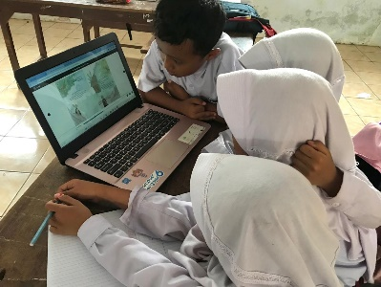
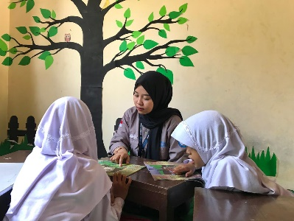
FINDING AND DISCUSSION
Implementation of the SoLite Kids Strategy in Differentiated Literacy Learning
2) Innovation of literacy learning models using games-based learning, storytelling assisted by finger puppets;
Games-based learning
Game Based learning are carried out by asking students a question. Students compete to answer questions by raising their hands first, saying their name and then answering. Students who can answer will receive prizes that have been prepared.
Storytelling assisted by finger puppets
Finger puppets can encourage student expression and creativity in a way that is unique to them. we gave students some finger puppet characters. then they were asked to express and tell stories to their friends according to the characters they got.
3) Literacy festivals include sodaku challenge, CEBITA (Cerita Berbasis Digital)
Sodaku challenge (Sekolah Dasar Kreatif Bercerita)
Get students used to reading books and gradually assist them in understanding the reading they have read.
CEBITA (Cerita Berbasis Digital)
Utilizing technology as a support in implementing literacy programs. showing digital-based picture story books using laptops to students. One of the students read a story in a digital book then another friend listened, after reading the story I asked several questions regarding the content of the story reading. They were very enthusiastic about taking turns reading the stories in the digital book. The innovative strategy of using gdigital book-based literacy is supported by research conducted (Lasmini et al., 2022) It was concluded that scrapbook-based digitalbooks could improve students' reading and writing literacy.

Slide 7
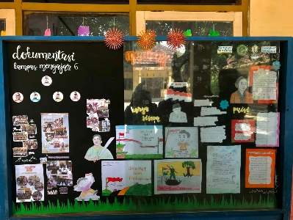
FINDING AND DISCUSSION
Implementation of the SoLite Kids Strategy in Differentiated Literacy Learning
4) Litercy Camp;
Literacy Camp for elementary school children is an educational activity designed to improve children's cultural literacy skills and social interaction skills through a series of fun, interactive and educational activities. The main aim of the literacy camp is to foster interest in reading and writing, improve language skills, and develop critical and creative thinking abilities.
5) Text-rich environmental creations include word displays, literacy infographics and reading corners
Create a text-rich environment by displaying slogans and posters in the school environment. create a text-rich classroom atmosphere. literacy activities by displaying posters with positive nuances, such as reading corners, wall magazines, reading corners and creating an environment rich in text. This is done to increase students' motivation and literacy skills.
This is in line with research conducted by (Permatasari & Nuroh, 2024) which states that creating a text-rich school environment can increase the implementation of the school literacy movement (GLS)

Slide 8
Supporting and Obstacle Factor
Supporting factors for innovation in the School Literacy Movement include:
1) Support the commitment of a good School Principal in implementing innovative School Literacy movements.
2) the role of teachers and students as well as other school components in making the innovation of the School Literacy movement a success.
Obstacle factor :
1) the minimum number of books available in the library.
2) students' low interest in reading, and
3) lack of parental involvement in School Literacy Movement activities.
4) limited funds to provide books in the library.

Slide 9
CONCLUSION
Innovation strategies are needed to improve students' literacy skills, especially in reading, writing and speaking. This innovation strategy can be carried out by means of differentiated literacy learning innovations that can accommodate all the needs of elementary school students through the InoLite Kids strategy, namely 1) Innovation in literacy learning media using spinners, Ultrasi (snakes and ladders literacy), monopoly literacy; 2) Innovation in literacy learning models using game-based learning, storytelling with the help of finger puppets; 3) Literacy festival includes sodaku challenge, sakuta challenge; 4) Literacy Camp; 5) Creation of text-rich environments including word displays, literacy infographics, and reading corners. These findings contribute to schools in implementing innovative literacy learning that can accommodate all the needs of elementary school students.

Slide 10
REFERENCES
Afaf, M. (2023). PENGEMBANGAN MEDIA ULAR TANGGA LITERASI ( ULTRASI ) UNTUK PEMBELAJARAN MEMBACA PERMULAAN PADA SISWA KELAS I SEKOLAH DASAR Mawaddatul Afaf Wahyu Sukartiningsih Abstrak. 1966–1975.
Arbarini, M., Suminar, T., Rahmat, A., Loretha, A. F., Putri, D. P., Hasanah, L. U., & Amanda, Y. S. (2023). Life Skill Literasi Perempuan Desa. Bayfa Cendekia Indonesia. https://books.google.co.id/books?id=N3KyEAAAQBAJ
Bastin, N. (2022). Keterampilan Literasi, Membaca, dan Menulis. Nahason Bastin Publishing. https://books.google.co.id/books?id=maykEAAAQBAJ
Kandia, I. W., Suarningsih, N. M., Wahdah, W., Arifin, A., Jenuri, J., & Suwarma, D. M. (2023). The Strategic Role of Learning Media in Optimizing Student Learning Outcomes. Journal of Education Research, 4(2), 508–514. https://jer.or.id/index.php/jer/article/view/193
Lasmini, K. M., Suarni, N. K., & Widiana, I. W. (2022). Scrapbook as Based Digital Books on Literacy in Third Grade Elementary School Students. Journal for Lesson and Learning Studies, 5(2), 259–266.
Nurahayu, H. (2024). Memenuhi Kebutuhan Peserta Didik Melalui Pembelajaran Berdiferensiasi. TATA AKBAR. https://books.google.co.id/books?id=SfrwEAAAQBAJ
Permatasari, S., & Nuroh, E. Z. (2024). PERSEPSI GURU ABAD 21 DALAM MENERAPKAN PEMBIASAAN. 6356, 339–346.
Salsabilla, D. P., Kirana, R. N., Irmawati, I., Ningsih, W., Arum, N. A. D., Rahayu, P., Kosidah, K., & Kartika, D. (2024). Strategi Inovatif Meningkatkan Literasi Numerasi : Forum Komunikasi dan Koordinasi Kampus Mengajar Angkatan 7 di UPT SD Negeri Menilo. Jurnal Pengabdian Sosial, 1(6), 423–428. https://ejournal.jurnalpengabdiansosial.com/index.php/jps/article/view/91

Slide 11
THANK YOU!
Follow us @...

