Slide 1
TITLE HERDigital Diglossia: The Phenomenon of Language Choice and Language Attitude in Cross-Generational Communication in the Digital Era
No. Abstract: ABS-25048
Afi Fadlilah 1; Sri Wiyanti 2, Tresna Dian Sukma Rahayu 3
Universitas Pendidikan Indonesa

Slide 2
INTRODUCTION
As information technology develops, intergenerational communication now takes place in the digital space. However, the different ways of speaking between younger and older generations has led to the phenomenon of ‘digital diglossia’. This communication involves generations such as Baby Boomers, Gen X, Millennials and Gen Z. Each has different social values, language styles and media preferences. Each has different social values, language styles and media preferences.
In the digital space, younger generations are more familiar with quick, symbolic and emoticon-filled communication. In contrast, older generations prioritise clarity and structure in conveying messages. These stylistic differences often lead to miscommunication in digital interactions. This is supported by recent studies (Khairun Nisa et al., 2024; Umar Baki & Mohd Yusri, 2025; Wu et al., 2024).

Slide 3
LITERATURE REVIEW
We base this study on the diglossia theories of Ferguson (1959) and Fishman (1972), as well as digital sociolinguistic theories (Tagg et al., 2017; Androutsopoulos, 2015) relevant to social media interactions. In addition, language attitudes are analysed through three main dimensions: cognitive, affective, and conative

Slide 4
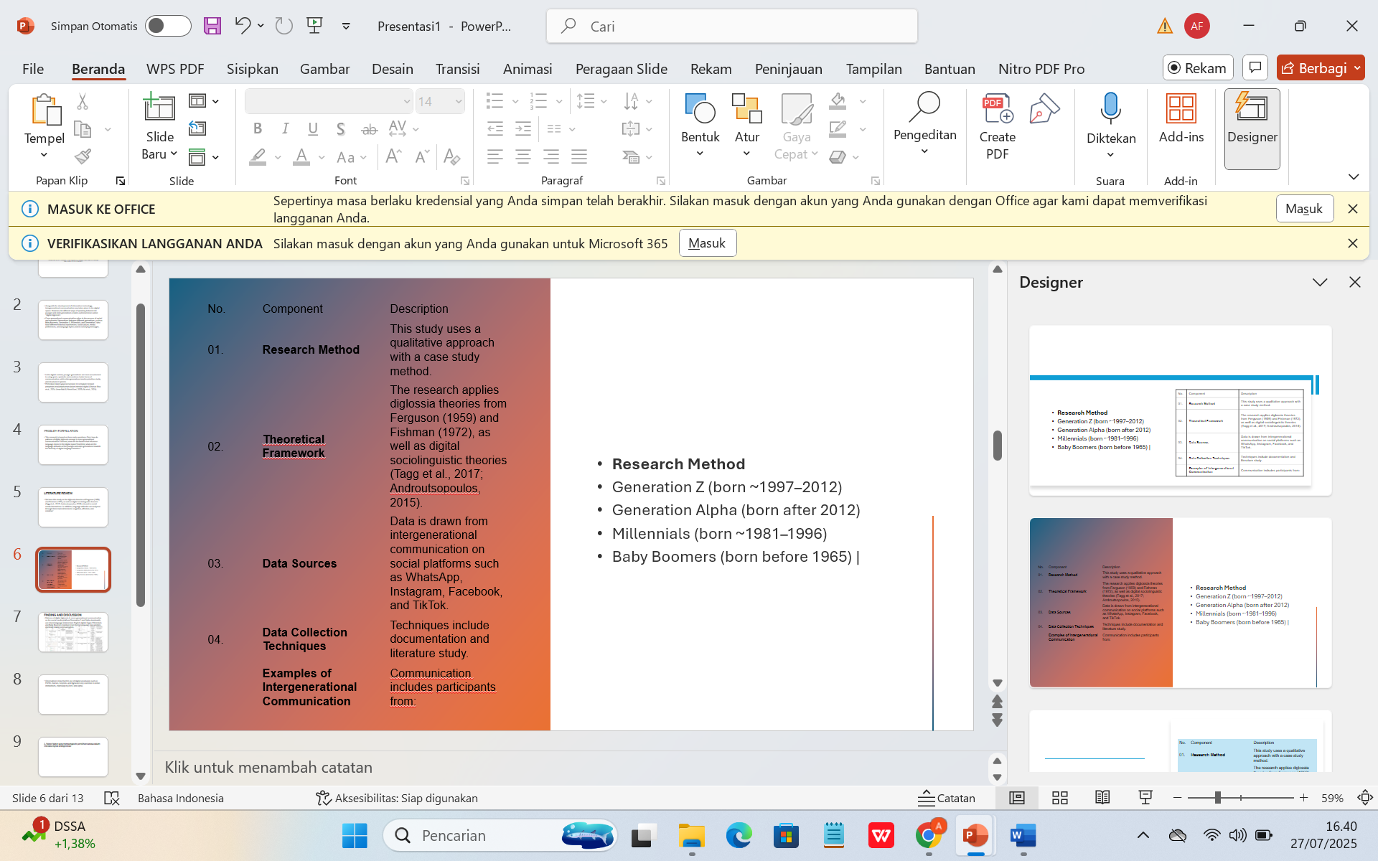
METHOD

Slide 5
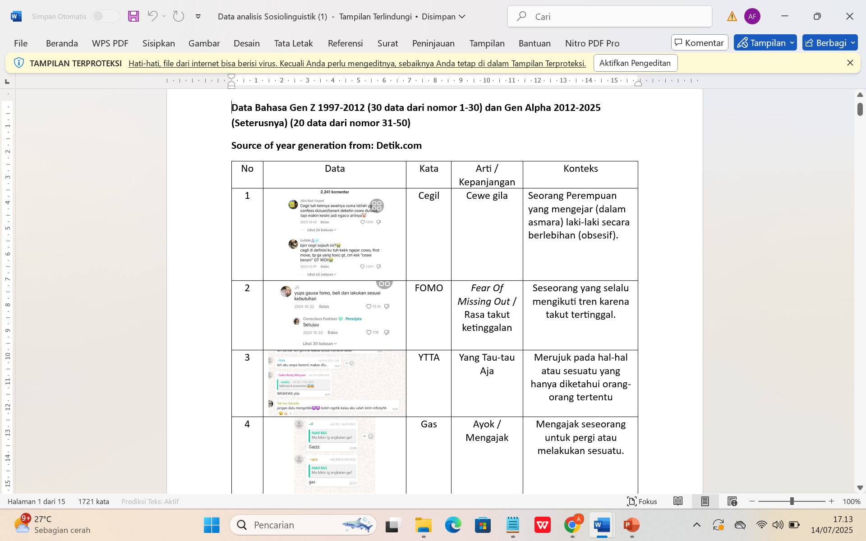
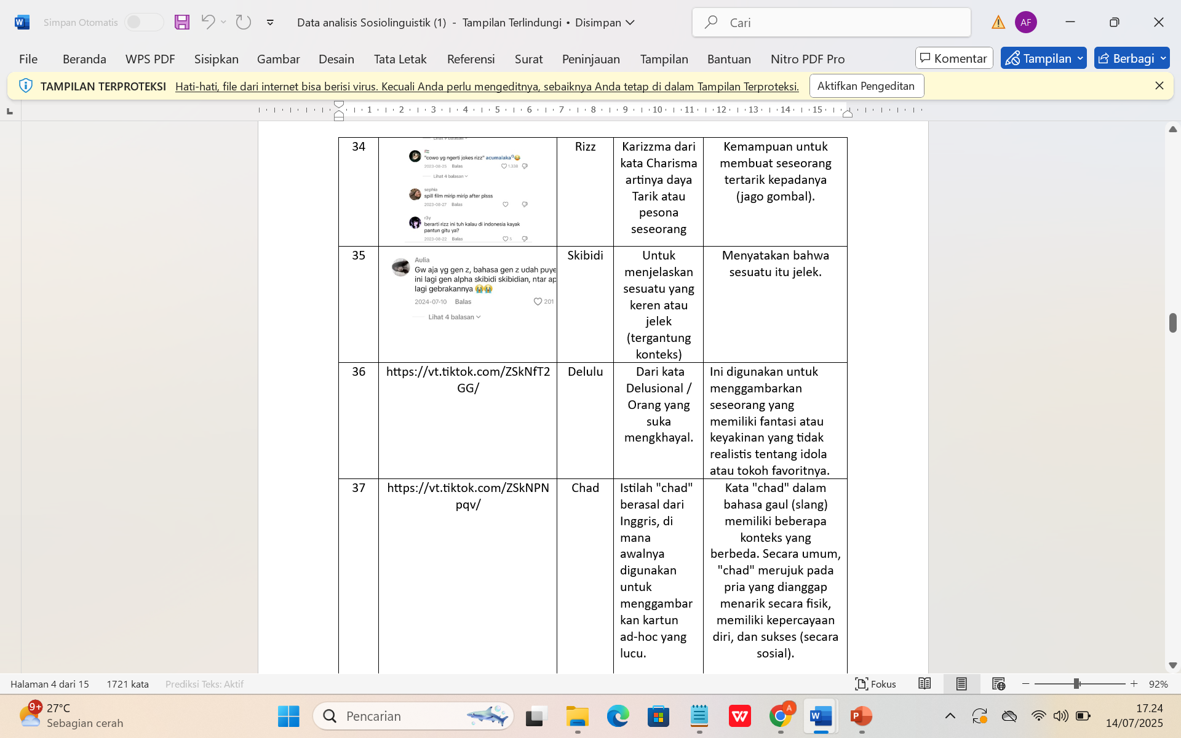
FINDING AND DISCUSSION
1. Patterns of digital diglossia in cross-generational communication on the social media platform
Generation Z and Alpha dominantly use mixed language (Indonesian-English-digital lingo); Millennials and Baby Boomers maintain more formal language; low varieties dominate digital communication.

Slide 6
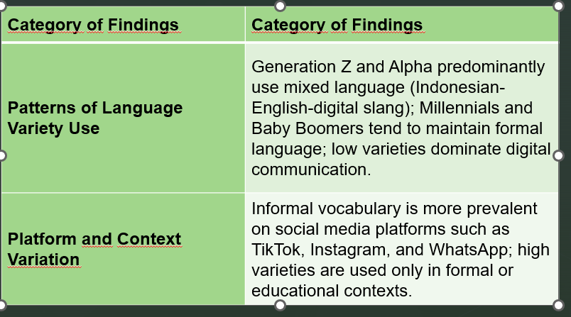
CONCLUSION
The use of digital vocabulary such as FOMO, Gamon, Cepmek, and Sigma are very common in online interactions, especially by Gen Z and Alpha.

Slide 7
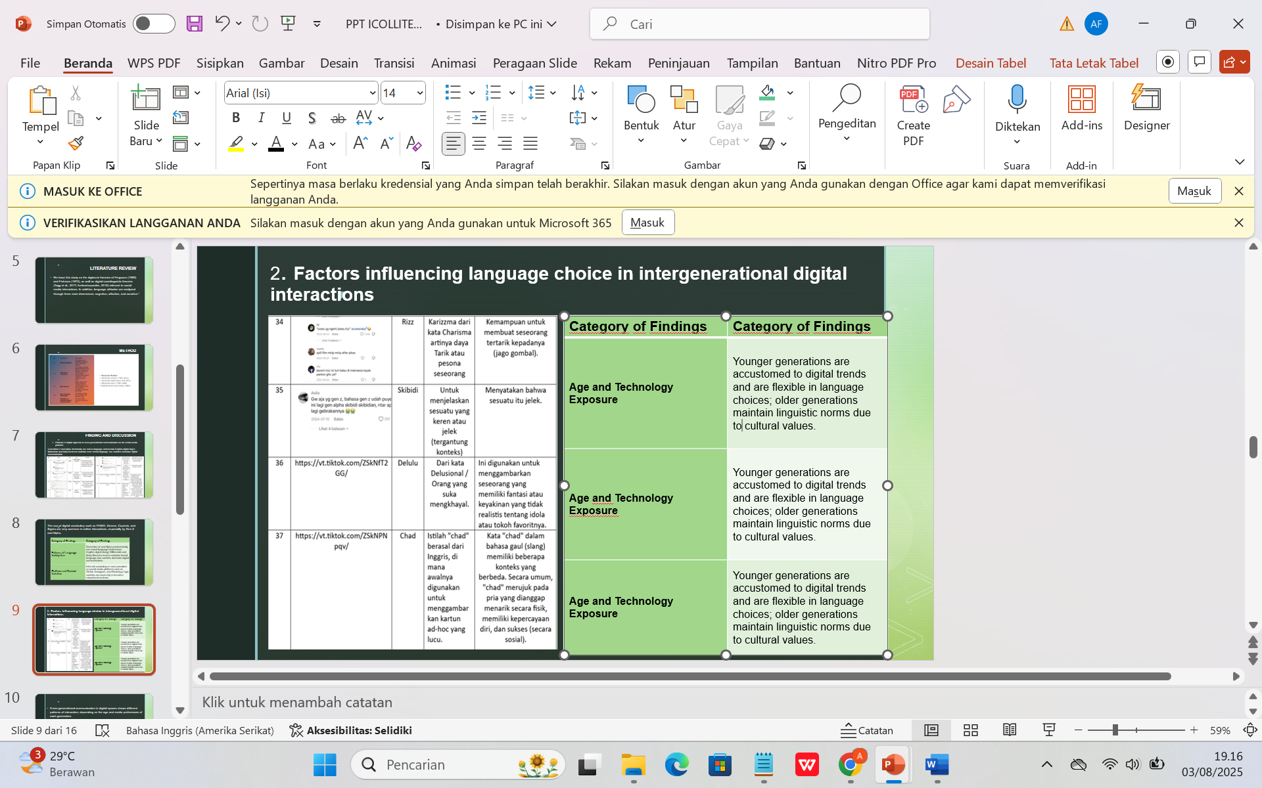
2. Factors influencing language choice in intergenerational digital interactions

Slide 8
Cross-generational communication in digital spaces shows different patterns of interaction, depending on the age and media preferences of each generation.
Gen Z and Alpha mostly use Instagram, TikTok and WhatsApp platforms with a fast, concise and symbolic language style with interactions dominated by the use of visual language and viral terms. In contrast, Generation X and Baby Boomers prefer media such as Facebook and email, and use complete sentences with standardised or semi-formal language.

Slide 9
3. Language attitudes of different generations towards evolving digital language varieties
There are significant differences in language attitudes between younger and older generations towards digital language variations. Gen Z and Alpha show that they have a permissive and open attitude towards the use of mixed language, abbreviations and viral terms. They view digital language as part of their identity and lifestyle, not as a deviation from linguistic norms.
Meanwhile, Generation X and Baby Boomers tend to show a conservative attitude. Some informants expressed concern about the declining ability to write in good and correct Indonesian.

Slide 10
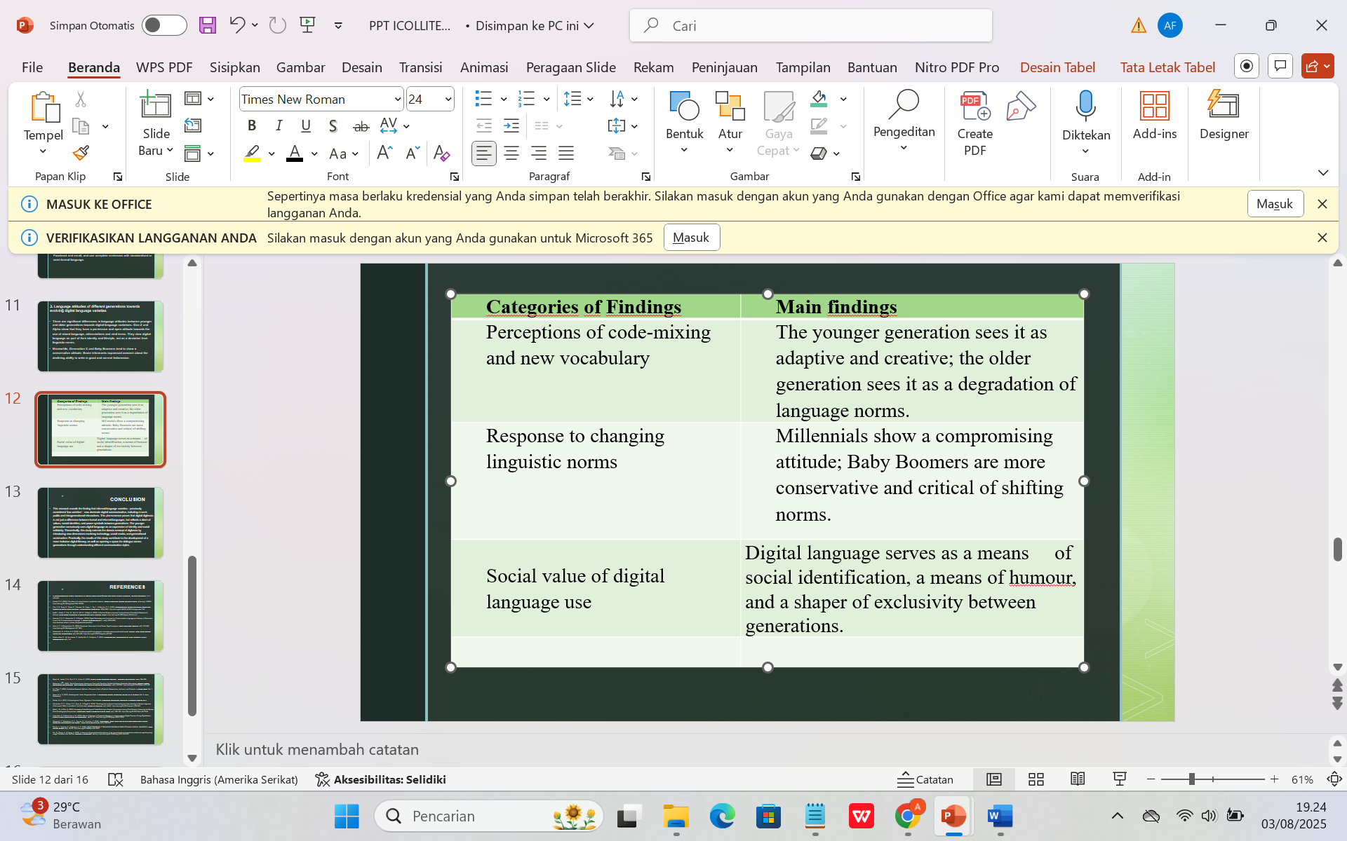

Slide 11
CONCLUSION
This research shows that informal language varieties now dominate digital communication, including in semi-public and intergenerational interactions. This reflects that digital diglossia is not only about the formal-informal distinction, but also includes conflicts of values and social identity between generations. Younger generations utilise digital language as a form of self-expression and solidarity. Theoretically, the findings extend the concept of diglossia to include technological and generational aspects, while practically supporting inclusive digital literacy and intergenerational dialogue.

Slide 12
REFERENCES
A SOCIOLINGUISTIC STUDY: DIGLOSSIA IN SOCIAL MEDIA Abdimo’minova Muxlisaxon Scientific Supervisor : Gulrukh Elmuradova. (n.d.). 479–482.
Ahmed, S. K. (2024). The pillars of trustworthiness in qualitative research. Journal of Medicine, Surgery, and Public Health, 2(January), 100051. https://doi.org/10.1016/j.glmedi.2024.100051
Cho, Y. M., Pang, D., Thapa, S., Sherman, G., Ungar, L., Tay, L., & Guntuku, S. C. (2025). Language-based Valence and Arousal Expressions between the United States and China: a Cross-Cultural Examination. 5586–5600. https://doi.org/10.18653/v1/2025.findings-naacl.310
Hafifi, I., Abidin, Z., Onn, M., Abd, R., Aliff, M., & Majid, A. (2024). A Practical Guide to Improve Trustworthiness of Qualitative Research for Novices. Asian Journal of Research in Education and Social Sciences, August. https://doi.org/10.55057/ajress.2024.6.s1.2
Hamzah, Z. A. Z., Kamarudin, K., & Pabiyah. (2020). Digital Technology and the Impact on Communication Language and Mastery of Generation X and Y for Correspondence Language. … Journal of Archaeology of …, 17(9), 3025–3039. https://archives.palarch.nl/index.php/jae/article/view/4314
Hilmi, A. Z., & Giswandhani, M. (2024). Penerapan Komunikasi Virtual Dosen Digital Immigrant. Jurnal Pendidikan Indonesia, 5(7), 373–382. https://doi.org/10.59141/japendi.v5i7.3093
Kasmantoni, K., & Putra, P. P. (2023). Analisis perspektif kritis generasi z terhadap wacana pada media sosial. Diglosia: Jurnal Kajian Bahasa, Sastra, Dan Pengajarannya, 6(3), 681–696. https://doi.org/10.30872/diglosia.v6i3.698
Khairun Nisa, E., Yuli Kurniawan, P., Kartika Sari, F., & Adyana, S. (2024). Intergenerational Transformation of Slang Language in Digital Communication. 4(1), 1–8.

Slide 13
THANK YOU!
Follow us @...

