Slide 1
AN ANALYSIS OF FEMINISM IN MALEFICENT: MISTRESS OF EVIL (2019)
No. Abstract: ABS-ICOLLITE-23178
Agiela Fadea Putri, Nia Nafisah, S.S, M.Pd.
Universitas Pendidikan Indonesia, Bandung

Slide 2
INTRODUCTION
Maleficent in Maleficent: Mistress of Evil (2019) really cares about the people and creatures around her, which resonates with care-focused feminism.
Women just like men have ethics as caregivers to people around her (Gilligan, 1982)
Many studies (e.g. Azizah & Fitri (2019); Becker, et al., (2016); Sinuraya et al., (2021) have focused on Liberal Feminism on children’s films.
The present study aims to fill the gap by exploring the portrayal of the feminist character in Maleficent through care-focused feminism.

Slide 3
LITERATURE REVIEW
According to Gilligan (1982), care-focused feminism assigns a special value to care ethics, and this theory emphasizes concern for equality for both women and men.
The ethics of care in particular for women develops in three stages (Gilligan, 1982).
- Pre-conventional stage, in which women focus on the self by discovering what she needs of herself and what she wants to achieve.
- Conventional stage, in which women focus on their responsibilities towards others manifested through care and being selfless.
- Post-conventional stage in which women take control of their decision.

Slide 4
METHOD
Data Collection
Data Analysis Procedure
Research Design
A qualitative research utilizing Carol Gilligan's theory of care-focused feminism. Also employing textual and descriptive analysis to gain in-depth analysis of Maleficent from evidence in the film text.
This study used the film Maleficent: Mistress of Evil (2019). In this study, the data were collected through several film aspects: the dialogue, the mise-en-scène, and the camera shot and angle.
Watching the film repeatedly and carefully to find scenes or dialogues of Maleficent that represent care-focused feminism.
Identifying the words or sentences and taking notes of the conversations which contain care-focused feminism.
Classifying and analyzing according to Carol Gilligan's theory of care-focused feminism.
Making a conclusion.

Slide 5
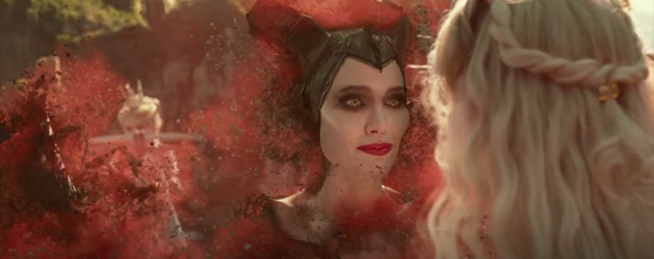
FINDINGS AND DISCUSSION
Maleficent is portrayed as care-focused feminist based on these two findings:
She undergoes the three stages of care-focused feminism
She is portrayed to have care-focused characterization
Pre – Conventional Stage
As someone knows what she wants, Maleficent wants to be a good mother. As a foster mother, she did not have a motherly instinct, but she tries to become a good mother for Aurora.
She nurtures and gives loving attention to Aurora. In this film, she shows motherly love for her goddaughter, Aurora in three scenes. One of which is:

Slide 6
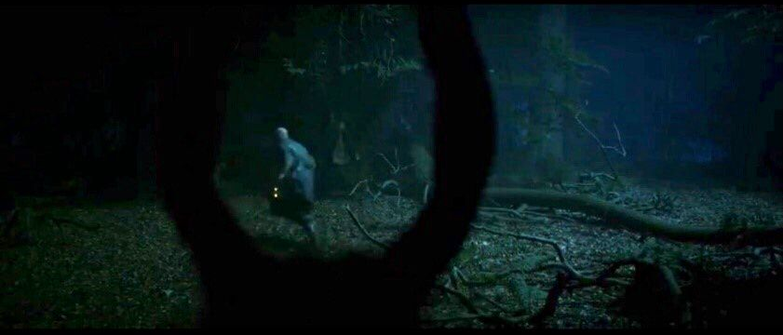
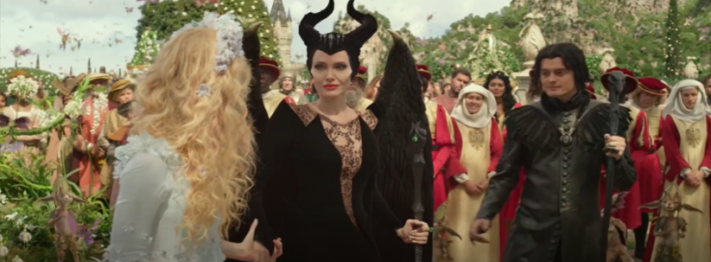
FINDING ONE
Conventional Stage
In this case, Maleficent has a responsibility toward the Moors because she is the Queen. This stage is also revealed through three scenes. One of which is :
Post – Conventional Stage
In the post-conventional stage, Maleficent is responsible for her decisions and has consequences for her responsibilities. As a Queen, Maleficent is responsible towards the Moors and the Dark Feys; she has to be responsible for what she does. This is one of the example of the scene showing this final stage:

Slide 7
FINDING TWO AND DISCUSSIONS
Characteristics of care-focused feminist
A Motherly Character
A responsible Queen
Firm and Fair Character
Discussions
There are three stages of findings that reveal how Maleficent is portrayed as a care-focused feminist.
Similarity of the findings with other studies
Implication of the current findings

Slide 8
CONCLUSION
As a result, Maleficent's actions show her characterization as a care-focused feminist, which is someone who not only knows what she wants but also cares for others. In other words, the main female character in this study has moved toward care-focused feminism.
Previously, some female characters in Disney films are portrayed as liberal feminists because they fight for their women's rights. In contrast, care-focused feminism is not the privilege of being a woman but privileging human beings regardless of their race. Gilligan (1982) said that a care-focused feminist is fighting for their rights and caring for others. The study points out the idea that the main female character has a richer range than previous ones.

Slide 9
REFERENCES
Azizah, N., & Fitri, N. (2019). The representation of liberal feminism through the main character in “The Post” movie. Journal Of English Language teaching, Vol. 3 No.2.
Becker, S., Thomas, D., & Cope, M. R. (2016). Post-feminism for children: feminism ‘repackaged’ in the Bratz films. SAGE Publications, Vol. 38(8).
Belsey, C. (2005). Culture and the real : theorizing cultural criticism. Routledge.
Gilligan, C. (1982). In a different voice. Harvard University Press.
Hourihan, M. (2005). Deconstructing the hero: literary theory and children's literature. London: Routledge.
Moleong, L. (2005). Metodologi penelitian kualitatif. Bandung: Remaja Rosdakarya.
Lockyer, S. (2008). Textual analysis. SAGE.
Rønning, J. (Director). (2019). Maleficent: Mistress of evil [Motion picture].
Siagian, F. H. (2018). Feminism in patriarchal society reflected in the main character of Perempuan berkalung sorban movie.
Sinuraya, J. S., Azhar, A. A., & Sazali, H. (2022). Analysis of semiotics representation of feminism in the Mulan film 2020. International Journal of Cultural and Social Science, 94-105.
Tong, R. (2009). Feminist thought : a more comprehensive introduction. Avalon Publishing.
Wiijayati, A. T. (2020). The character of Moana in the Disney movie script Moana seen from liberal feminism.

Slide 10
THANK YOU!

