Slide 1
TECHNO PEDAGOGY APPROACH REGIONAL LANGUAGE EDUCATION REVITALIZATION IN SOCIETY 5.0 ERA
No. Abstract: ABS-ICOLLITE-23037
Nunuy Nurjanah, Rostika Srihilmawati
Universitas Pendidikan Indonesia

Slide 2
INTRODUCTION
The 21st century presents challenges to the rapid globalization system. The world of education must always align with the changing times. Technopedagogy exists as an ICT-based approach that is expected to be able to provide a stimulus that raises critical thinking responses in the learning process. This relates to the output of learning in the concept of higher order thinking. This technopedagogical concept becomes relevant when it is associated with the era of society 5.0 which places humans at the center of innovation which requires certain skills as an adjustment to the times. The technopedagogical approach can be used in the revitalization of local language education in the era of society 5.0.

Slide 3
LITERATURE REVIEW
With regard to technopedagogy, there are many explanations that this term refers to practices (teaching) that consider pedagogical aspects (teaching and learning methods, motivation, developing student skills), and technological aspects (using computers, the internet, interactive whiteboards, etc.). There are several writings related to technopedagogy, among which the opinion appears that:
To prepare students for the challenges of the 21st century and to help them succeed in their future endeavors, teachers must incorporate technology into their classrooms. One need to implement innovative techno-pedagogical skills by improving infrastructure, improving English language proficiency and online content knowledge, resolving teacher shortages, increasing teacher incentives, increasing awareness of existing techno pedagogical services, using licensed software, enhancing departmental coordination, and reducing frequent power outages and fluctuations in electricity. (Bansal, 2022, p. 3785)
Bansal, S. (2022). Role of Techno-Pedagogical Skills for Enchancing Teaching and Learning. Journal of Positive School Psychology, 6(2), 3785-3793.
TECHNO-PEDAGOGY: WHAT IS THE ROLE OF PROSPECTIVE TEACHERS IN PREPARING FOR LEARNING IN THE DIGITAL ERA. Technopedagofy is prospective teachers are ready to face the challenges of learning in the digital age and can make a breakthrough in learning in the digital age (Setiasih, 2021, p. 237).
Setisih, O. (2021). Techno-Pedagogy: What is the Role of Prospective Teachers in Preparing for Learning in the Digital Era? EDUTECH: Jurnal Teknologi Pendidikan, 20(1), 237-255.

Slide 4
METHOD
Both a descriptive method and a qualitative approach are used in this paper. In this paper’s data collection methods, a literature review is used. This method involves monitoring, evaluating and enchanching the techno pedagogy approach on regional language education revitalization in society 5.0 era.

Slide 5
FINDING AND DISCUSSION
Sundanese, which needs to be developed based on technology as a form of innovation-
transformation of cultural values. In relation to this, the understanding is examined in a technopedagogic discussion concept.
Technopedagogic terminology is a teacher's
knowledge or ability to integrate technology
into learning, which aims to be able to
develop student potential and competence.
Technopedagogic is considered to be an art of combining technology in designing learning
with the aim of increasing student
competence—giving flexibility in learning by
applying all technological media that are
relevant to needs, both in concept and context

Slide 7
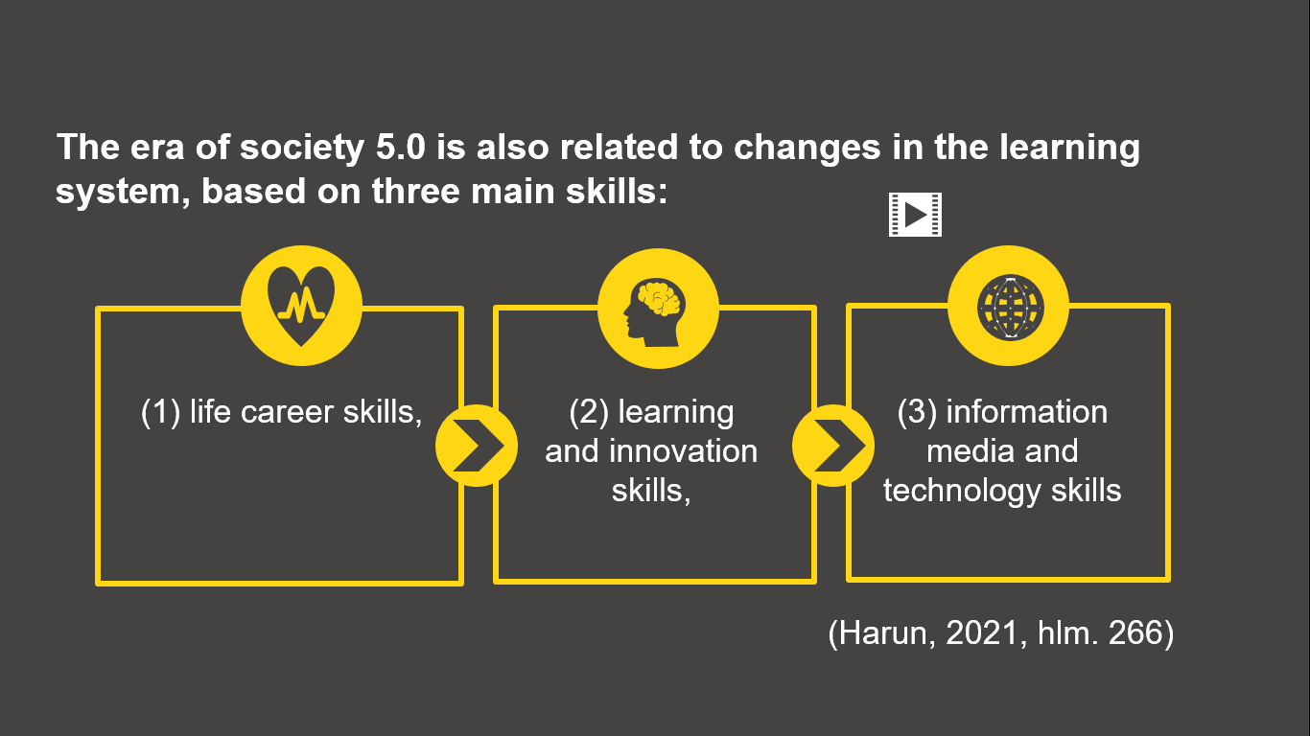

Slide 8
CONCLUSION
Regional language education must be the main means of forming human beings who are able to adapt to the flow of globalization, educational people who are able to live and exist amidst changes of life in a global format. Therefore, regional language education needs to reorient in today's life, by not only taking responsibility in the conservation function which will actually make you trapped in the paradigm of life in the romanticism of past glories, but to be more orientated to the function of innovation which is transformative for life in multidimensional through the integration of technology in learning. Thus, it will be able to give birth to future-minded generations but still have self-identity. Reorienting regional language education needs to place the character-building agenda as the main goal above other goals. Development in regional language education must be oriented towards the birth of educational individuals who have an adaptive attitude to the times and understand their role in life with self-identities while upholding the ideals of local culture. In addition, development in regional language education must aim to produce educational individuals with the spirit of leaders who are transformative by relying on cultural and religious values and upholding human values.

Slide 9
REFERENCES
Al Muchtar, S. (2001). Pendidikan dan Masalah Sosial Budaya. Bandung: Gelar Pustaka Mandiri.
Alfan, M. (2013). Filsafat Kebudayaan. Bandung: Pustaka Setia.
Ellahi, R. M., dkk. (2019) Redisigning Curriculum in line with Industry 4.0. Sciendirect: Procedia Computer Science, 151, 699-708.
Ghavifekr, S. dan Rosdy, W. A. W. (2015). Teaching and Learning with Technology: Effectiveness of ICT Integration in Schools. International Journal of Research in Education and Science. Vol 1, (2), 176-190
Ghavifekr, S., Afshari, M., dan Amla. (2012).Management strategies for E-Learning system as the core component of systemic change: A qualitative analysis. Life Science Journal, 9(3), 2190-2196.
Harun, S. (2021). Pembelajaran di Era 5.0. Prosiding Seminar Nasional Pendidikan Dasar: Pascasarjana Universitas Negeri Gorontalo “Merdeka Belajar dalam Menyambut Era Masyarakat 5.0”, Gorontalo: 25 November 2021, 265-276.
Herlambang, Y T. (2015). “Pendidikan Kearifan etnik dalam mengembangkan karakter”. Jurnal Pendidikan Dasar. Vol. 7, (1), 40-50.
Herlambang, Y T. (2018). Pedagogik: Sebuah Telaah Kritis Ilmu Pendidikan Dalam Multiperspektif. Tasikmalaya: Ksatria Siliwangi.
Hidayatno, A., dkk. (2019). Industry 4.0 Technology Implementation Impact to Industrial Sustainble Energy in Indonesia: A Model Conceptualization. ELSEVIER: Energy Procedia, 156, 227-233.
Kipper, dkk. (2021). Scientific Mapping to Identify Competencies Required by Industry 4.0. Elsevier: Technology in Society, 64, 1-9.
Nastiti, F. E. dan ‘Abdu, A. R. N. (2020). Kesiapan Pendidikan Indonesia Menghadapi Era Society 5.0. Edcomtech, 5(1), 61-66.
Padmawati, N. N. dan Pihung, E. S. (2022). Mengembangkan Pembelajaran Digitalisasi di Era Society 5.0. WIDYADARI, 23(2), 378-388.
Priyantoko dan Hasanudin, C. (2022). Digitalisasi Bahan Ajar Bahasa Indonesia untuk Meningkatkan Keterampilan 5C Siswa di Era Society 5.0. Prosiding Senada (Seminar Nasional Daring), Bojonegoro: 4 Juli 2022, hlm. 356-365.
Rahayu, K. N. S. (2021). Sinergi Pendidikan Menyongsong Masa Depan Indonesia di Era Society 5.0. EDUKASI: Jurnal Pendidikan Dasar, 2(1), 87-100.
Sabri, I. (2019). Peran Pendidikan Seni di Era Society 5.0 untuk Revolusi Industri 4.0. Prosiding Seminar Nasional Pascasarjana UNNES, Surabaya: (t.t), 343-347.
Sullivan, R. (2019). Troubling Structures: A Material-Embodied Pedagogy of Technical Difficulty. ELSEVIER: Computers and Cmposition, 53(2019), 47-59.
Tilaar H.A.R (2002). Pendidikan, Kebudayaan, dans Masyarakat Madani Indonesia. Bandung: Rosdakarya.
Tilaar H.A.R (2013). Perubahan Sosial dan Pendidikan: Pengantar Pedagogik Transformatif Untuk Indonesia. Jakarta: Rineka cipta.
Tilaar, H.A.R. (2007). Mengindonesiakan etnisitas dan identitas bangsa Indonesia. Jakarta: Rineka Cipta.
Tilaar, H.A.R. (2015). Pedagogik teoretis untuk Indonesia. Jakarta: Kompas.

Slide 10
THANK YOU!

