Slide 1

ESTABLISHING A MANDARIN PROGRAM AT FPBS:
AN EARLY FEASIBILITY STUDY AND STRATEGIES
ABS-ICOLLITE-25158
Yulianeta, Tri Indri Hardini, Yanty Wirza, Wawan Gunawan

Slide 2
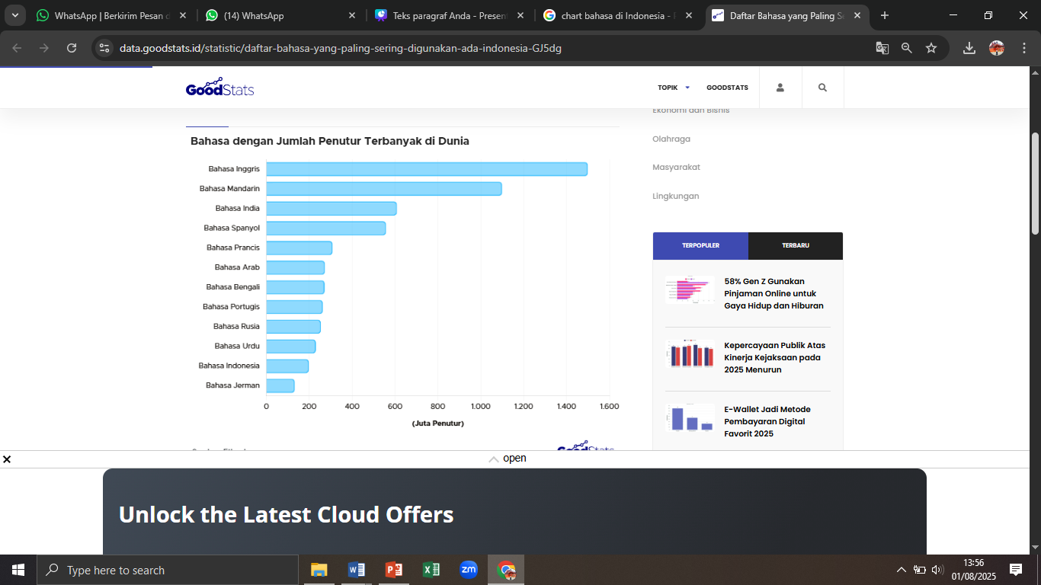
INTRODUCTION
  Indonesia's increasing demand for foreign language education in the era of globalization and digital transformation.
  Mandarin as one of the most strategic foreign languages globally (UNESCO, 2022; Sutami, 2016).
  Growing bilateral relations between Indonesia and China in trade, investment, and culture.
  Lack of sufficient Mandarin teacher education programs in Indonesia’s public universities (Maria, 2019).
  Objective: To assess the feasibility and urgency of launching a Mandarin Language Education Program at FPBS UPI, based on prospective student perceptions.
https://data.goodstats.id/

Slide 3

METHODOLOGY
Design & Instrument
Respondents
  Design used descriptive quantitative approach.
  Instrument: Online questionnaire (Google Forms) consisting of 16 items (Likert-scale, multiple choice, open-ended).
  Respondents: 58 senior high school students across various Indonesian regions.
  Ethical Considerations: Voluntary, anonymous participation with data completeness control.
Procedure
  Procedure:
  Instrument design and validation.
  Distribution and data collection.
  Descriptive statistical analysis.

Slide 4
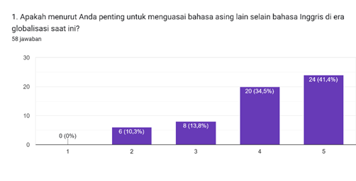
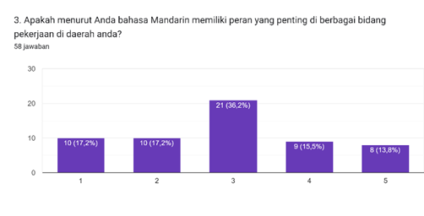
FINDINGS
Global Relevance of
Foreign Languages
Strategic Role of
Mandarin in Global Affairs
Local Relevance of Mandarin
in Employment
  ·75.9% of respondents rated 4 or 5 on the importance of mastering foreign languages beyond English.
  ·Indicates strong awareness of multilingual competence as a 21st-century skill.
  No respondents rated 1 or 2 (low importance).
  67.2% rated Mandarin as important in global trade and international relations.
  Confirms recognition of Mandarin as a UN official language and economic bridge.
  36.2% rated it highly relevant (score 5) in their regional job market.
  Slight variation suggests a need for regional language policy integration.

Slide 5
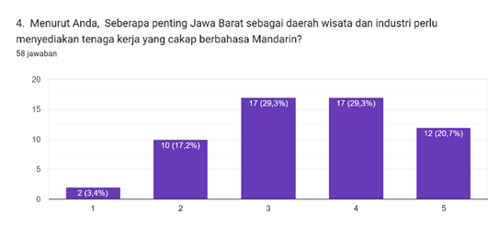
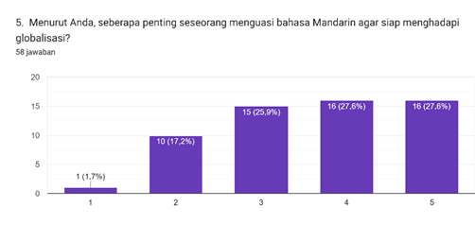
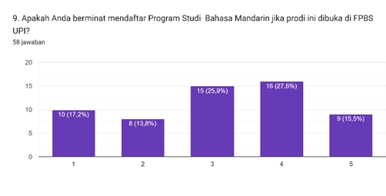
FINDINGS
Demand for Mandarin-Proficient Human Resources
Support for Mandarin
in Higher Education
Interest in Enrolling and
Recommending the Program
  58.6% rated 4 or 5 on the importance of local workforce mastering Mandarin, especially in industrial/wisata regions like West Java.
  55.2% believe Mandarin should be taught at university level.
  72.4% support the opening of a specific Mandarin Education Program at FPBS UPI.
  53.5% expressed intent to apply if the program opens.
  51.7% would recommend it to others.

Slide 6

FINDINGS
Qualitative Findings: Perceptions of 58 Respondents
Strong Support & Enthusiasm
  Mandarin seen as essential for globalization, careers, and diplomacy.
  Positive expectations for program quality and engaging learning.
  “Great idea... hopefully the learning is enjoyable and the lecturers are qualified.”
Clear Expectations
  Competent, certified instructors
  International collaboration
  Enjoyable, high-quality education
Constructive Suggestions
  Partner with Chinese institutions (e.g., Confucius Institute)
  Curriculum aligned with labor market
  Use digital tools in teaching
  Scholarships and affordable tuition
Minority Skepticism
  Mandarin seen as difficult or not personally relevant
  “It’s one of the most difficult languages… I’m not yet interested.”
Implication
  Success needs more than a program launch: strategic outreach, accessible learning, and responsive curriculum are key.

Slide 7

DISCUSSION
Implications of Opening a Mandarin Language Program
  Educational Impact
    Fulfills the gap in Mandarin teacher training.
    Supports multilingual education aligned with CEFR standards.
  Economic and Social Relevance
    Prepares youth to become translators/interpreters in Chinese-affiliated industries.
    Responds to the influx of Chinese businesses and products in Indonesia (Sutami, 2016; Anggraeni et al., 2022).
  Internationalization Strategy
    Promotes academic cooperation with Chinese institutions (e.g., Confucius Institute).
    Enhances student mobility and cross-cultural competencies (UNESCO, 2020).

Slide 8

CONCLUSION AND RECOMMENDATIONS
  Strong interest and positive perception confirm the feasibility of launching the program.
  FPBS UPI is positioned well to pioneer Mandarin education in West Java.
  Policy recommendations
    Proceed with official program proposal to DIKTI.
    Develop industry-aligned curriculum and training modules.
    Initiate international academic partnerships.
  Next Steps
    Curriculum design, public consultation, expert involvement, and targeted promotion.
    Ensure inclusive access via scholarships and affordable tuition.

Slide 9
REFERENCES
  Anggraeni, A., Supriatnaningsih, R., Pamuji, D. Y., & Pramono, S. A. (2022). Graduate learning outcomes of the Mandarin Language Education Program at UNNES based on labor market needs in the industrial sector. Jurnal Cakrawala Mandarin, 6(2), 173–184.
  Ansori, F. (2018). Mandarin Language Center of Al Azhar Indonesia University: Reflection and projection of China-Indonesia socio-cultural relations. Jurnal Al-Azhar Indonesia Seri Humaniora, 4(1), 11–16. https://doi.org/10.36722/sh.v4i1.246
  Anugerahwati, M., & Saukah, A. (2010). Professional competence of English teachers in Indonesia: A profile of exemplary teachers. Indonesian Journal of English Language Teaching (IJELT), 6(2), 47–59. https://doi.org/10.25170/ijelt.v6i2.1545
  Council of Europe. (2001). Common European Framework of Reference for Languages: Learning, teaching, assessment. Cambridge University Press.
  Fitriani, L. (2021). Student interest in the opening of a Korean Language Program at a State University in Jakarta. Jurnal Pendidikan Bahasa dan Sastra Asing, 9(2), 112–125. https://doi.org/10.1234/jpbsa.v9i2.112
  Gong, K., et al. (2019). The citation advantage of foreign language references for Chinese social science papers. arXiv preprint [arXiv:1908.07576].
  Isnaini, N. (2019). The influence of bilingualism on cognitive flexibility with parenting style as a moderating variable (Master's thesis, Faculty of Psychology, UIN Syarif Hidayatullah Jakarta).
  Ivana, I. (2022). Increasing learning interest through Chinese cultural materials in Mandarin language learning. Jurnal Pendidikan Tambusai, 6(2), 11469–11472.
  Lie, A. (2007). Education policy and EFL curriculum in Indonesia: Between the commitment to competence and the quest for higher test scores. TEFLIN Journal, 18(1), 1–14.
  Maria, M. (2019). Issues in Mandarin language education programs in Indonesian public universities. Jurnal Cakrawala Mandarin, 2(2), 1–16. https://doi.org/10.36279/apsmi.v2i2.62.g34
  Marian, V., & Shook, A. (2012). The cognitive benefits of being bilingual. Child Development Perspectives, 6(3), 202–208.
  Masats, D., & Nussbaum, L. (2014). Plurilingual classroom practices and participation: An ethnographic approach. Routledge.
  Prasetyo, R. E., Setiawan, E. I., & Santoso, J. (2025). Development and evaluation of a virtual reality-based Mandarin language learning system enriched with Chinese cultural and geographical contexts. Teknika, 14(2), 223–231.
  Saptadi, N. T. S., Andriani, R., Hayati, R., Raju, M. J., Maulani, G., Wardoyo, T. H., & Hadikusumo, R. A. (2024). Multilingual Education: Theory and Practice. Sada Kurnia Pustaka.
  Setiyadi, A. B. (2006). Teaching English as a Foreign Language in Indonesia. Graha Ilmu.
  Sutami, H. (2016). Functions and status of Mandarin in Indonesia. Paradigma: Jurnal Kajian Budaya, 2(2), 212–239.
  UNESCO. (2020). Education in a multilingual world (Policy Paper). United Nations Educational, Scientific and Cultural Organization.
  UNESCO. (2022). The role of language education in fostering global citizenship and cultural dialogue. Paris: United Nations Educational, Scientific and Cultural Organization. Retrieved from https://unesdoc.unesco.org
  Wulandari, A., & Siregar, H. (2020). Industry needs mapping for new academic programs: A case study of the Digital Library Science Program. Jurnal Manajemen Pendidikan Tinggi, 7(1), 45–60. https://doi.org/10.5678/jmpt.v7i1.45
  Ziraluo, Y. P. B., Zebua, N., & Zebua, E. N. K. (2024). Culture-based education: A literature study in multicultural society. Jurnal Insan Pendidikan dan Sosial Humaniora, 3(1), 180–195. https://doi.org/10.59581/jipsoshum-widyakarya.v3i1.4704

Slide 10


