Slide 1
Examining Technological Pedagogical and Content Knowledge (TPACK) of Korean Language Teachers and Prospective Teachers in the Artificial Intelligence (AI) Technology Era
No. Abstract: ABS-25115
Arif Husein Lubis, Didin Samsudin, Ashanti Widyana, Yuki Risanauli
Universitas Pendidikan Indonesia

Slide 2
INTRODUCTION
The inception of Fourth Industrial Revolution (IR 4.0) demands new skills, including digital skills and creativity
Those new skills should be facilitated by implementing Education 4.0 due to changing learner characteristics
Education 4.0 pinpoints the integration of technology into the teaching process toward more interactive learning experiences and improved outcomes, according to new needs and potentials (Hussin, 2018)
The IR 4.0 also contributes to the development of various artificial intelligence (AI) technologies, prompting transformation across multiple sectors of human life, including education (World Economic Forum & Asian Development Bank, 2017)
Several previous studies (Chai et al., 2021; Chun, 2020; Dogan et al., 2025; Karatas & Atac, 2025; Pokrivcakova, 2019; Tlili et al., 2021) indicate that language teachers particularly view AI technology as providing new opportunities to enhance the quality of their teaching
However, the digital transformation of education through the use of AI technology presents challenges among teachers (Geng et al., 2019; Pokrivcakova, 2019; Tsai & Chai, 2012): understanding the integration of new technologies into the classroom teaching, provision of adequate facilities, technical support, and flexible curricula
Hence, the present study aims to examine TPACK among Korean language teachers in the era of AI, particularly in Indonesia

Slide 3
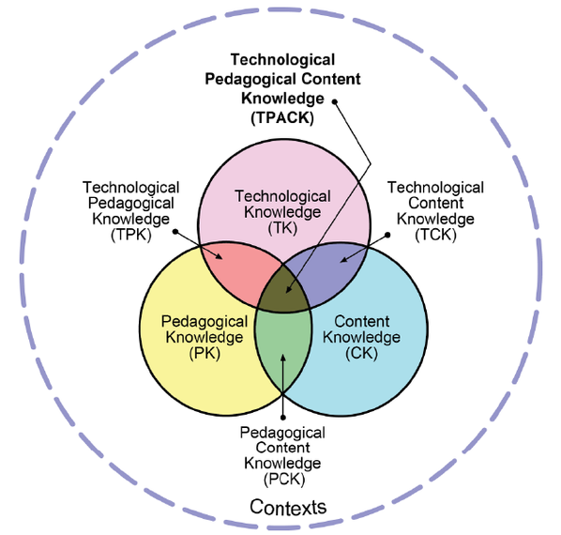
LITERATURE REVIEW
TPACK is based on Shulman’s pedagogical content knowledge (PCK) concept, concerning the most suitable teaching practices as well as the components: Pedagogy and Content. There are seven constructs of TPACK.
TK: Knowledge of how to use different technologies
PK: Knowledge of different teaching and learning approaches
CK: Knowledge of subject matter
PCK: Knowledge of how to make content understandable
TCK: Knowledge of how to use technology to represent or verify subject matter
TPK: Knowledge of how to integrate technology into classroom instructions, management, and evaluation
TPACK: Knowledge of how to use appropriate pedagogical approaches for certain content with appropriate technology
TPACK is being more concerned in the current era of Generative AI; rendering the need to add Contextual Knowledge (XK) to measure its application (Mishra, Warr & Islam, 2023)
TPACK Framework (Benton-Borghi, 2013; Koehler & Mishra, 2006; Koehler et al., 2013)

Slide 4
METHOD
This research addresses one research question: How do Korean language teachers project their knowledge of adapting to AI-supported pedagogical models?
A quantitative and qualitative approach (Creswell & Creswell, 2018)
The quantitative approach = using a questionnaire to describe and measure teachers’ TPACK
The qualitative approach = using interviews to describe their experiences regarding the application of TPACK in the era of AI technology that reflect their understanding
Only 94 of 140 Korean language teachers filled out the questionnaire (37 Likert-10-scale items ). Several of them were invited for an interview (seven questions)
Respondents’ characteristics: having experience in teaching Korean and using technology, including AI, in the learning process
The indicators of the TPACK questionnaire adopted from previous research (Adipat, 2021; Cheng, 2017; Mishra & Koehler, 2006; Redmond & Peled, 2018; Sariçoban, Tosuncuoğlu, & Kirmizi, 2019; Taopan, Drajati, & Sumardi, 2020)
Data analysis: while questionnaire results by calculating the mean score for each construct, interview transcripts by coding relevant responses to further classify them into categories of findings

Slide 5
FINDINGS AND DISCUSSION
Self-evaluated knowledge (Questionnaire)
TK: Most respondents feel confident using AI technologies in Korean language teaching (similar to Karatas & Atac, 2025)
PK: Generally, teachers demonstrate strong pedagogical skills
CK: Most teachers perceive themselves as having sufficient knowledge of Korean language content
PCK: Teachers understand how to select appropriate teaching and assessment methods
TCK: Many teachers know how to check vocabulary, grammar, and source content using AI
TPK: Perceptions vary, with not many teachers confident integrating AI to support student learning and assessment, while others remain hesitant—especially in using it for reflective learning
TPACK: Most respondents know how to select AI technologies aligned with content and pedagogy to enhance learning
From the post-hoc Tukey HSD: TPK scores are significantly lower than PK and TK

Slide 6
FINDINGS AND DISCUSSION
Perceived challenges (Questionnaire)
Some teachers still struggle to effectively facilitate and plan group learning activities
A few of the teachers still lack the ability to handle technical issues that arise
Some teachers sometimes feel unsure when adjusting the teaching methods to specific types of Korean language content they want to deliver
Some teachers are still unfamiliar with using technology for detecting plagiarism
Some teachers lack sufficient knowledge to guide others in AI-integrated teaching within broader cultural and ethical contexts
The perceived challenges in incorporating AI technology into instructional process resonates with previous studies (Hava & Babayiğit, 2025)

Slide 7
FINDINGS AND DISCUSSION
Teachers’ AI-supported TPACK shaped through classroom experiences (Interview)
Teachers acquire the understanding of AI through informal learning and self-exploration (in line with Velander et al., 2023)
Teachers view AI (e.g., ChatGPT, Papago, Naver) as very helpful for checking language accuracy, generating learning texts, and designing instructional materials
Raw AI results are not always appropriate for instructional use
Teachers innovate in using AI for material preparation and feedback (TPK). However, they still rely on their own teaching methods for classroom delivery. This is justified by (Hava & Babayiğit, 2025) that teachers still lack of competence in integrating AI-based applications into the educational process
Teachers face difficulties ensuring students use AI responsibly and produce authentic work

Slide 8
CONCLUSION
Most of the teachers demonstrate above-average level of TPACK ( with the lowest average score on the Technological Pedagogical Content Knowledge indicator. The results indicate that the integration of AI technologies in teaching Korean brings both opportunities and challenges for the teachers. Most teachers of the Korean language consider AI technologies supportive tools in checking students’ accuracy and preparing instructional materials. Meanwhile, some teachers encounter challenges including technical difficulties and unfamiliarity with some AI tools, which can be integrated into the instructional approaches and methods. Further research can conduct a more rigorous quantitative measurement of foreign language teachers’ TPACK, influenced by multi-faceted factors.

Slide 9
REFERENCES
Chai, C. S., Lin, P. Y., Jong, M. S. Y., Dai, Y., Chiu, T. K., & Qin, J. (2021). Perceptions of and behavioral intentions towards learning artificial intelligence in primary school students. Educational Technology & Society, 24(3), 89-101.
Chun, H. (2020). Searching for the coexistence paradigm of human translator and machine translation: Focusing on PBL-based translation practicum class with AI machine translation tools. The Journal of Interpretation and Translation Education, 18(4), 59-96.
Creswell, J.W., & Creswell, J.D. (2018). Research design: Qualitative, quantitative, and mixed methods approaches (5th Edition). SAGE.
Dogan, S., Nalbantoglu, U. Y., Celik, I., & Agacli Dogan, N. (2025). Artificial intelligence professional development: a systematic review of TPACK, designs, and effects for teacher learning. Professional Development in Education, 51(3), 519-546.
Hava, K., & Babayiğit, Ö. (2025). Exploring the relationship between teachers’ competencies in AI-TPACK and digital proficiency. Education and information technologies, 30(3), 3491-3508.
Hussin, A. A. (2018). Education 4.0 made simple: Ideas for teaching. International Journal of Education and Literacy Studies, 6(3), 92-98.
Karataş, F., & Ataç, B. A. (2024). When TPACK meets artificial intelligence: Analyzing TPACK and AI-TPACK components through structural equation modelling. Education and Information Technologies, 1-26.
Mishra P, Koehler MJ. Technological pedagogical content knowledge: A framework for teacher knowledge. Teachers College Record. Juni 2006; 108(6): 1017-1054.
Mishra, P., Warr, M., & Islam, R. (2023). TPACK in the age of ChatGPT and Generative AI. Journal of Digital Learning in Teacher Education, 39(4), 235-251.
Pokrivčáková, S. (2019). Preparing teachers for the application of AI-powered technologies in foreign language education. Journal of Language and Cultural Education. 7(3): 135-153
Tlili, A., Hattab, S., Essalmi, F., Chen, N. S., Huang, R., Chang, M., & Solans, D. B. (2021). A smart collaborative educational game with learning analytics to support English vocabulary teaching. IJIMAI, 6(6), 215-224.
Velander, J., Taiye, M. A., Otero, N., & Milrad, M. (2023). Artificial Intelligence in K-12 Education: eliciting and reflecting on Swedish teachers’ understanding of AI and its implications for teaching & learning. Education and Information Technologies, 1–21.
World Economic Forum, Asian Development Bank. ASEAN 4.0: What does the Fourth Industrial Revolution mean for regional economic integration? Cologny. World Economic Forum; 2017.

Slide 10
THANK YOU!
Follow us @arifhuseinlubis, @didinsamsudin, @anaaemon

