Slide 1
Performing Global, Echoing Local:
Celebrity Glocalization in Instagram @nonawav
No. Abstract: ABS- ICOLLITE- 25168
Poetry Salsabila Nurrania
Universitas Padjadjaran

Slide 2
INTRODUCTION
NoNa is a girl group consisting of four Indonesian women under the international production house 88rising
Despite debuting through a Hollywood label, NoNa's digital interactions on Instagram are still dominated by Indonesian netizens
There is a phenomenon occurring on Instagram regarding the imbalance between global strategies and the response of the local Indonesian audience
Glocalization is seen as the transformation of local economies and cultures adapted by global American productions

Slide 3
LITERATURE REVIEW
The West and Western media view the East or non-Western cultures as exotic, unique, and valuable to be conquered (Said, 1995).
Social media has become a global platform for displaying self-existence and self-representation (Theresa, 2008).
The construction of identity, especially that of celebrities on Instagram, is used as a strategy to attract the attention of audiences and markets (Abidin, 2018).
Glocalization is used to construct non-Western cultures through American production in the global market (Ritzer & Malone, 2000).

Slide 4
METHOD
Analysis focused on narrative and visual aspects through screenshotting pictures, videos, and captions
The selected posts are those published between 29 April 2025 – 4 July 2025
Data was collected using purposive sampling in the form of photos taken from Instagram feeds, videos taken from the Reels feature, and captions that accompanied NoNa's Instagram posts.

Slide 5
Glocalization of Indonesian Celebrity
Celebrities are seen as products of social mobility, whose value is already apparent and reproduced.
Celebrities work to reveal and exploit what already exists to be more visible.
The myth of “global” here does not mean Worldwide, but instead recognized by America or the West.
Contemporary Eastern constructs cannot be separated from the Western perspective, which considers the East to be exotic.

Slide 6
Echoing Through Mimicry
Indonesian celebrities must modify themselves according to Western standards through mimicry to be heard.
Glocalization of Indonesian celebrities is successful in the Indonesian market. Although Indonesia has mass-market appeal, it does not have power

Slide 7


Representation of Indonesian Identity
Representation of Indonesian identity in construction based on:
Exotic aesthetics attached to women's bodies and nature
Cultural symbols viewed from a collective perspective

Slide 8
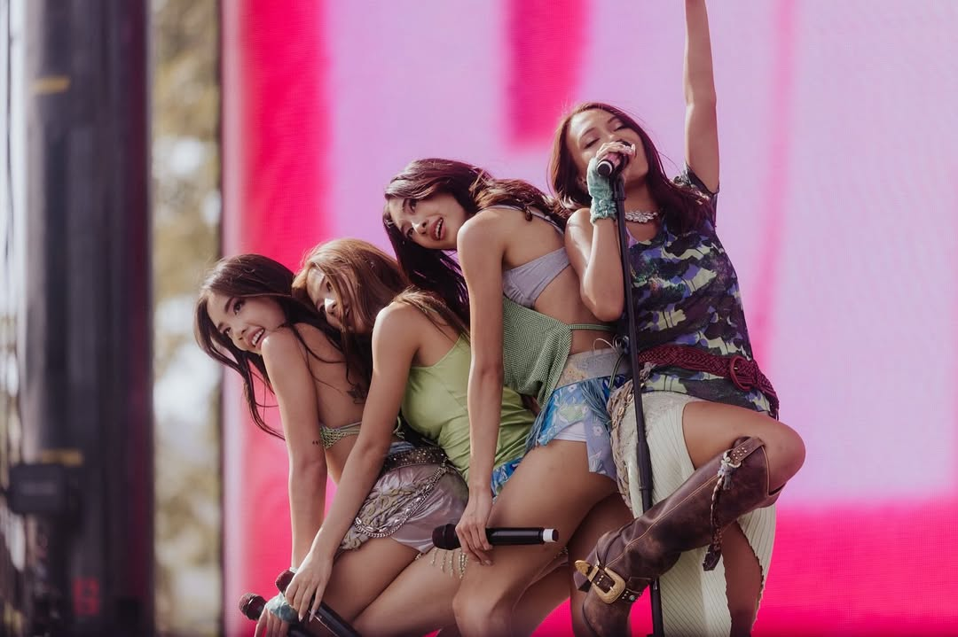
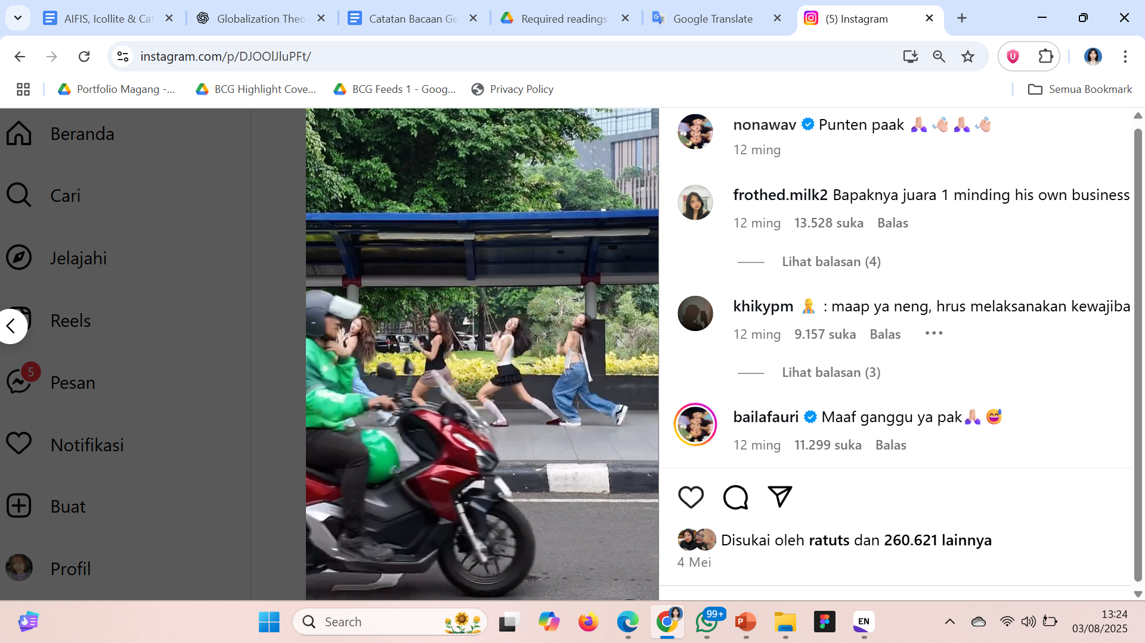
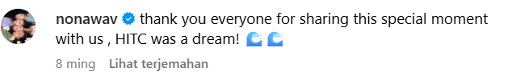
Pictures, Videos, and Captions

Slide 9
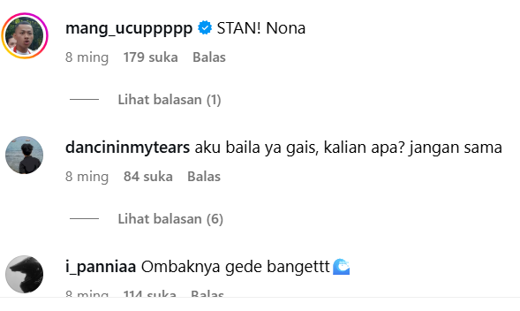
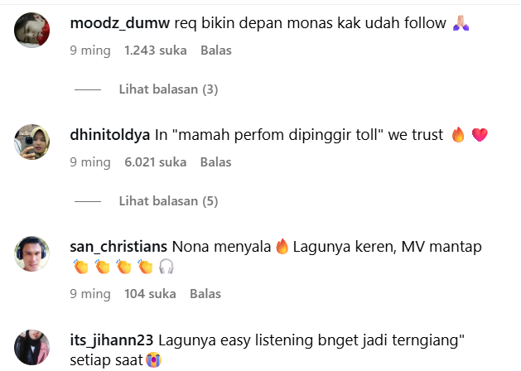
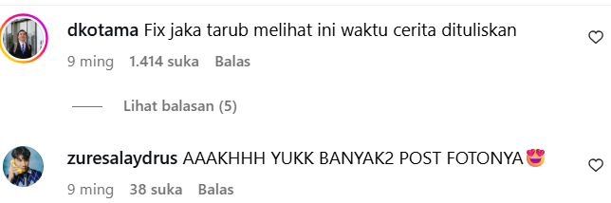
Comment Sections

Slide 10
CONCLUSION
Social media, especially Instagram, is seen as the arena of celebrity glocalization to enhance Western domination in digitized popular culture
Celebrity glocalization has been successful in the local Indonesian market, but has not yet been seen significantly in the global market, indicating the West's arrogance towards non-white/Asian celebrities
Hollywood/American (Western) production houses help the East to be heard but construct their bodies into “the other” to Americans, which is why they are pursuing Indonesian audiences

Slide 11
REFERENCES
Abidin, C. (2018). Internet Celebrity: Understanding Fame Online. Emerald Publishing Limited. https://books.google.co.id/books?id=lORiDwAAQBAJ
Jouhki, J. (2016). The Imagined West: Exploring Occidentalism. Suomen Antropologi, 41, 1-10.
Nnaemeka, F. (2019). Glocalisation of Social Media Contents for Development.
Ritzer, G., & Malone, E. (2000). Globalization Theory: Lessons from the Exportation of McDonaldization and the New Means of Consumption. American Studies, 41.
Senft, T. (2008). Camgirls: Celebrity and Community in the Age of Social Networks (2008).
Sternheimer, K. (2014). Celebrity Culture and the American Dream: Stardom and Social Mobility. Taylor & Francis. https://books.google.co.id/books?id=g0aLBQAAQBAJ
Said, E. W. (1995). Orientalism. Penguin Group. https://books.google.co.id/books?id=66sIHa2VTmoC
Yusuf, K., & Sudarmanti, R. (2021). Understanding Communication and Identity Strategy of Indonesian Diaspora Women as YouTuber. Jurnal The Messenger, 13, 211. https://doi.org/10.26623/themessenger.v13i3.2247

Slide 12
THANK YOU!
Follow me on instagram @poetrysalsabila

