Slide 1
The Effect of interactive multimedia in EFL classrooms on Junior High School Students' Reading Skills: A systematic Literature Review
No. Abstract: ABS-ICOLLITE-25075
Nina Puspitaloka¹, Ermanto², Yetti Zainil³
Faculty of Languages and Arts, Universitas Negeri Padang

Slide 2
INTRODUCTION
Reading not only helps students acquire information but also enhances their overall language proficiency by enriching vocabulary, improving understanding of sentence structure, and fostering critical and analytical thinking.
in practice, reading instruction in EFL classrooms has traditionally been dominated by conventional approaches. Teachers often rely on lectures, assign lengthy textbook passages, and require students to answer comprehension questions in written form These methods are typically teacher-centered and offer limited opportunities for active student participation. Furthermore, the materials used are often decontextualized and disconnected from students’ interests and real-life experiences, resulting in low engagement and making reading activities monotonous and demotivating. As noted by most students lack reading habits and reading proficiency.
These limitations highlight the need for innovation in reading instruction, particularly through the integration of digital technologies.

Slide 3
LITERATURE REVIEW
Digital tools such as educational applications, online platforms, e-books, and game-based reading activities (gamification) have shown promising potential to enrich students' reading experiences. Several studies have demonstrated the effectiveness of interactive multimedia in providing immediate feedback and supporting skill development. For instance, (Nurmahanani, 2021) found that the interactive multimedia-assisted social cognitive model significantly improved early reading skills. Similarly, (Ying & Nazarudin, 2023) emphasized that the use of multimedia resources promotes better comprehension and retention compared to traditional methods.
Moreover, (Fitrawati et al., 2023) highlighted the importance of integrating technology in the development of critical reading materials, demonstrating the adaptability of current educational practices. Interactive multimedia, therefore, serves as a transformative tool in reading instruction, encouraging not only skill improvement but also greater student motivation and engagement (Novitasari et al., 2020). This is further supported by Ref 3, which emphasizes the role of interactive multimedia in enhancing reading skills and facilitating the development of instructional tools.
Despite the growing adoption of digital tools in EFL classrooms, there remains a need to synthesize recent research findings to identify the most commonly used tools and evaluate their effects on students’ reading development. A clearer understanding of these tools and their effectiveness can support educators in making informed decisions regarding instructional design and the integration of technology offering a valuable contribution to the field.

Slide 4
METHOD
Systematic Literature Review (SLR)
This study employed a Systematic Literature Review (SLR) to identify, analyze, and synthesize peer-reviewed research articles related to the integration of digital tools into interactive multimedia for enhancing reading skills among junior high school students in English as a Foreign Language (EFL) classrooms. The SLR approach was selected to enable a comprehensive and structured examination of current trends, effectiveness, and research gaps in this field.
The review followed the PRISMA (Preferred Reporting Items for Systematic Reviews and Meta-Analyses) guidelines to ensure transparency, methodological rigor, and replicability. PRISMA provides a standardized framework for systematically selecting and reporting studies through a four-stage process: identification, screening, eligibility assessment, and final inclusion.

Slide 5
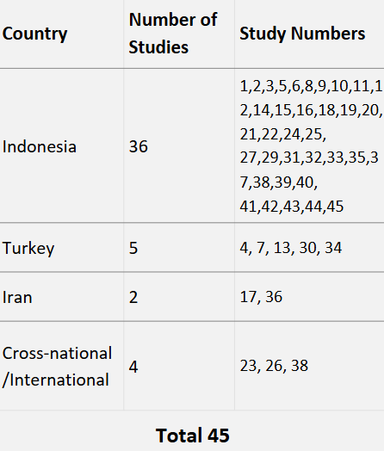
FINDING AND DISCUSSION
Classification of Reviewed Studies by Country of Origin
This systematic review comprises a total of forty-eight empirical studies published between 2020 and 2025, collectively investigating the integration of digital technologies in English language learning at the junior high school level. The main focus of these studies is to identify the most frequently used digital tools in interactive multimedia for reading skills at the junior high school. They also explore the effect of improving students' reading comprehension and vocabulary acquisition through the use of multimedia, augmented reality (AR), interactive digital media, and mobile-based reading platforms. These studies were conducted in various educational settings, with most of them located in Indonesia.
That’s Table shows the results of several varied studies from different countries. These studies vary widely, including experimental, quasi-experimental, classroom action research, research and development, and qualitative descriptive approaches. Most of the participants involved were junior high school students, usually from grades seven to nine, and some studies also involved English teachers, media experts, and instructional designers as part of the process of developing and validating the learning interventions.

Slide 6
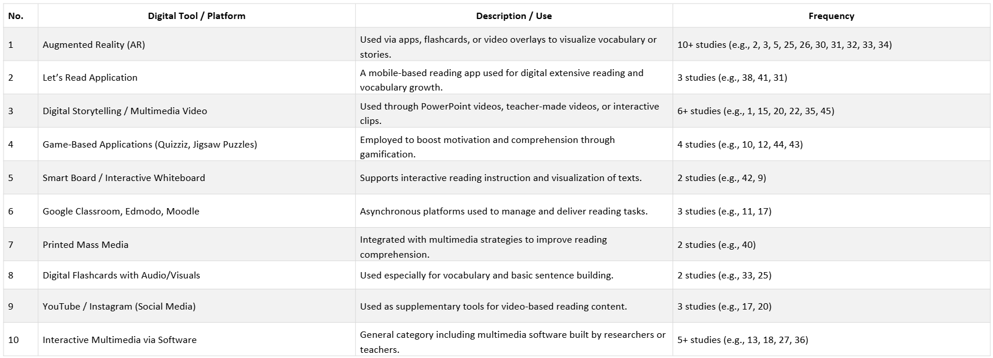
Most Frequently Used Digital Tools in Interactive Multimedia for Reading Skills
An analysis of 45 journal articles revealed a variety of digital tools used to improve reading skills at the junior high school level. Among these tools, Augmented Reality (AR) emerged as the most frequently used tool, especially in vocabulary and narrative comprehension. Moreover, studies show that AR-based media such as flashcards, interactive textbooks, and contextual geometry lessons allow students to visualize language content in a three-dimensional format.

Slide 7
The Effect of Digital Tools in Interactive Multimedia for Reading Skills
The findings indicate that Augmented Reality (AR) and multimedia-based tools exert the most substantial influence on enhancing reading skills among junior high school students. These technologies dominate the digital learning landscape due to their ability to provide immersive, multimodal experiences that bridge abstract concepts with concrete representations. Tools such as AR vocabulary cards, interactive videos, and context-rich digital texts have been consistently reported to increase student engagement, motivation, and comprehension.
Following AR and multimedia platforms, reading applications such as Let’s Read have gained prominence due to their accessibility, levelled reading materials, and supportive features like translation and audio narration. These tools are particularly effective for students with lower proficiency levels, offering scaffolded language exposure and vocabulary acquisition.
Digital games, including jigsaw puzzles and language-based challenges, further support reading development by incorporating elements of gamification that sustain learner interest and foster collaborative learning (Arifin et al., 2024). Such platforms aid in improving reading micro-skills, including inferencing, identifying main ideas, and recalling details.
Lastly, teacher-designed platforms and interactive multimedia modules tailored to local curriculum needs contribute to contextual learning, particularly in low-resource settings. These tools often integrate text,

Slide 8
visuals, and audio in culturally relevant formats, reinforcing reading comprehension through repetitive and scaffolded exposure (Aratusa, 2024).
In conclusion, the integration of AR and multimedia stands out as the most effectful in facilitating reading literacy, while reading applications, educational games, and teacher-created digital content serve as valuable complementary tools. Their combined use demonstrates the potential of digital innovation to transform reading instruction in junior high school settings.

Slide 9
CONCLUSION
The integration of Augmented Reality (AR) and multimedia tools emerges as the most influential approach in enhancing reading skills among junior high school students, offering immersive and interactive learning experiences that improve engagement, comprehension, and vocabulary retention. Complementary digital tools such as reading applications, educational games, and teacher-designed multimedia modules further support literacy development by providing accessible, scaffolded, and contextually relevant content. Together, these innovations highlight the transformative potential of digital technology in advancing reading instruction in junior high school contexts. In light of these findings, educators are encouraged to adopt a blended approach that incorporates AR, multimedia, and gamified platforms into reading instruction while also developing or adapting digital content that aligns with local cultural and curricular needs. Future researchers should explore the long-term effect of these technologies on various reading sub-skills and literacy outcomes across different proficiency levels and learning environments. Further studies in low-resource settings and comparative research between traditional and digital reading interventions are also recommended to support more equitable and evidence-based instructional practices.

Slide 10
REFERENCES
Agustina, I., Sudirman, S., Lubis, R., Siregar, E., & Putra, S. (2024). The Development of Augmented Reality As English Learning Media in Junior High School. KnE Engineering, 2024, 393–403. https://doi.org/10.18502/keg.v6i1.15407
Akrima, N. (2025). J-LATEST Innovative Learning Media : Pop-Up Books for Enhancing. 1, 10–18.
Al-Jarf, R. (2021). Collaborative Mobile eBook Reading for Struggling EFL College Readers. Journal of Research & Method in Education , 11(6), 32–42. https://doi.org/10.9790/7388-1106023242
Alvina Damayanti, Dzul Rachman, & Yeni Rahmawati. (2025). The Implementation of Interactive Learning Through ICT in English Language Education for Junior High School Students. Journal of English Language Learning, 9(1), 830–838. https://doi.org/10.31949/jell.v9i1.13921
Bakri, F., Wahyuni, Permana, A. H., & Sumardani, D. (2021). Textbook Enriched with Video Augmented Reality: Contextual in Motion Concept Learning in Junior High School. AIP Conference Proceedings, 2320(March). https://doi.org/10.1063/5.0037614
BP Setiyadi. (n.d.). IJAR_Dwi Bambang Putut Setiyadi & Hersulastuti.pdf.
Cao, Y., & Xiao, B. (2020). Research on Digital Reading App Design to Stimulate Reading Motivation of Teenagers BT - Advances in Human Factors in Training, Education, and Learning Sciences (S. Nazir, T. Ahram, & W. Karwowski (Eds.); pp. 63–69). Springer International Publishing.
Cetintav, G., & Yilmaz, R. (2023). The effect of augmented reality technology on middle school students’ mathematic academic achievement, self-regulated learning skills, and motivation. Journal of Educational Computing Research, 61(7), 1483–1504.
Fitrawati, Syarif, H., Zaim, M., & Perrodin, D. D. (2023). The perceptions of tertiary students and lecturers regarding CLIL-based critical reading material employing interactive multimedia. Indonesian Journal of Applied Linguistics, 12(3), 598–611. https://doi.org/10.17509/ijal.v12i3.36838
Novitasari, K., Zubaidah, E., Harjana, R., & Daniswari, H. P. (2020). Multimedia Technology to Stimulate Children’s Literacy Ability: Study in Kindergarten in Sleman. Universal Journal of Educational Research, 8(12B), 8011–8016. https://doi.org/10.13189/ujer.2020.082601
Nurmahanani, I. (2021). Social Cognitive Approach through Interactive Multimedia for Early Reading Learning. Dinamika Jurnal Ilmiah Pendidikan Dasar, 13(1), 32. https://doi.org/10.30595/dinamika.v13i1.9301
Ying, H. S., & Nazarudin, M. N. (2023). Emotional Intelligence, Anxiety, and Performance Satisfaction in Malaysian State Netball Players. International Journal of Academic Research in Business and Social Sciences, 13(12), 3408–3423. https://doi.org/10.6007/ijarbss/v13-i12/20299
Zhang, W., Chen, X., Zhang, J., & Xu, S. (2024). A Study on Factors Influencing Digital Reading Behavior of Junior High School Students. Libri, 74(3), 255–271. https://doi.org/10.1515/libri-2024-0004

Slide 11
THANK YOU!
Follow us @...

