Slide 1
Reinterpreting the Term “Neuleum” in the 15th-Century Sundanese Manuscript Bujangga Manik
No. Abstract: ABS-ICOLLITE-25050
Retty Isnendes; Gelar Taufiq Kusumawardhana; Fazri Nur Yusuf;
(Universitas Pendidikan Indonesia; Universitas Islam Negeri Sunan Gunung Djati)

Slide 2
INTRODUCTION
Neuleum appears in the manuscript Bujangga Manik (15th century).
Refers to traditional Sundanese dyeing practices.
Translations vary: blue (nila), black (mud), or metaphorical.
Important for understanding ancient textile industries and natural dyes in West Java.
Raises philological, cultural, and ethnolinguistic questions.

Slide 3
LITERATURE REVIEW
Literary Anthropology Approach
– Interdisciplinary lens on culture through text
Ethnolinguistics
– Language and worldview of Sundanese speakers
Comparative Historical Linguistics
– Word evolution across related languages
Textual Hermeneutics
– Interpretive reading of ancient texts

Slide 4
METHOD
Studi Pustaka
Your title here
Mengkomparasi
Analisis

Slide 5
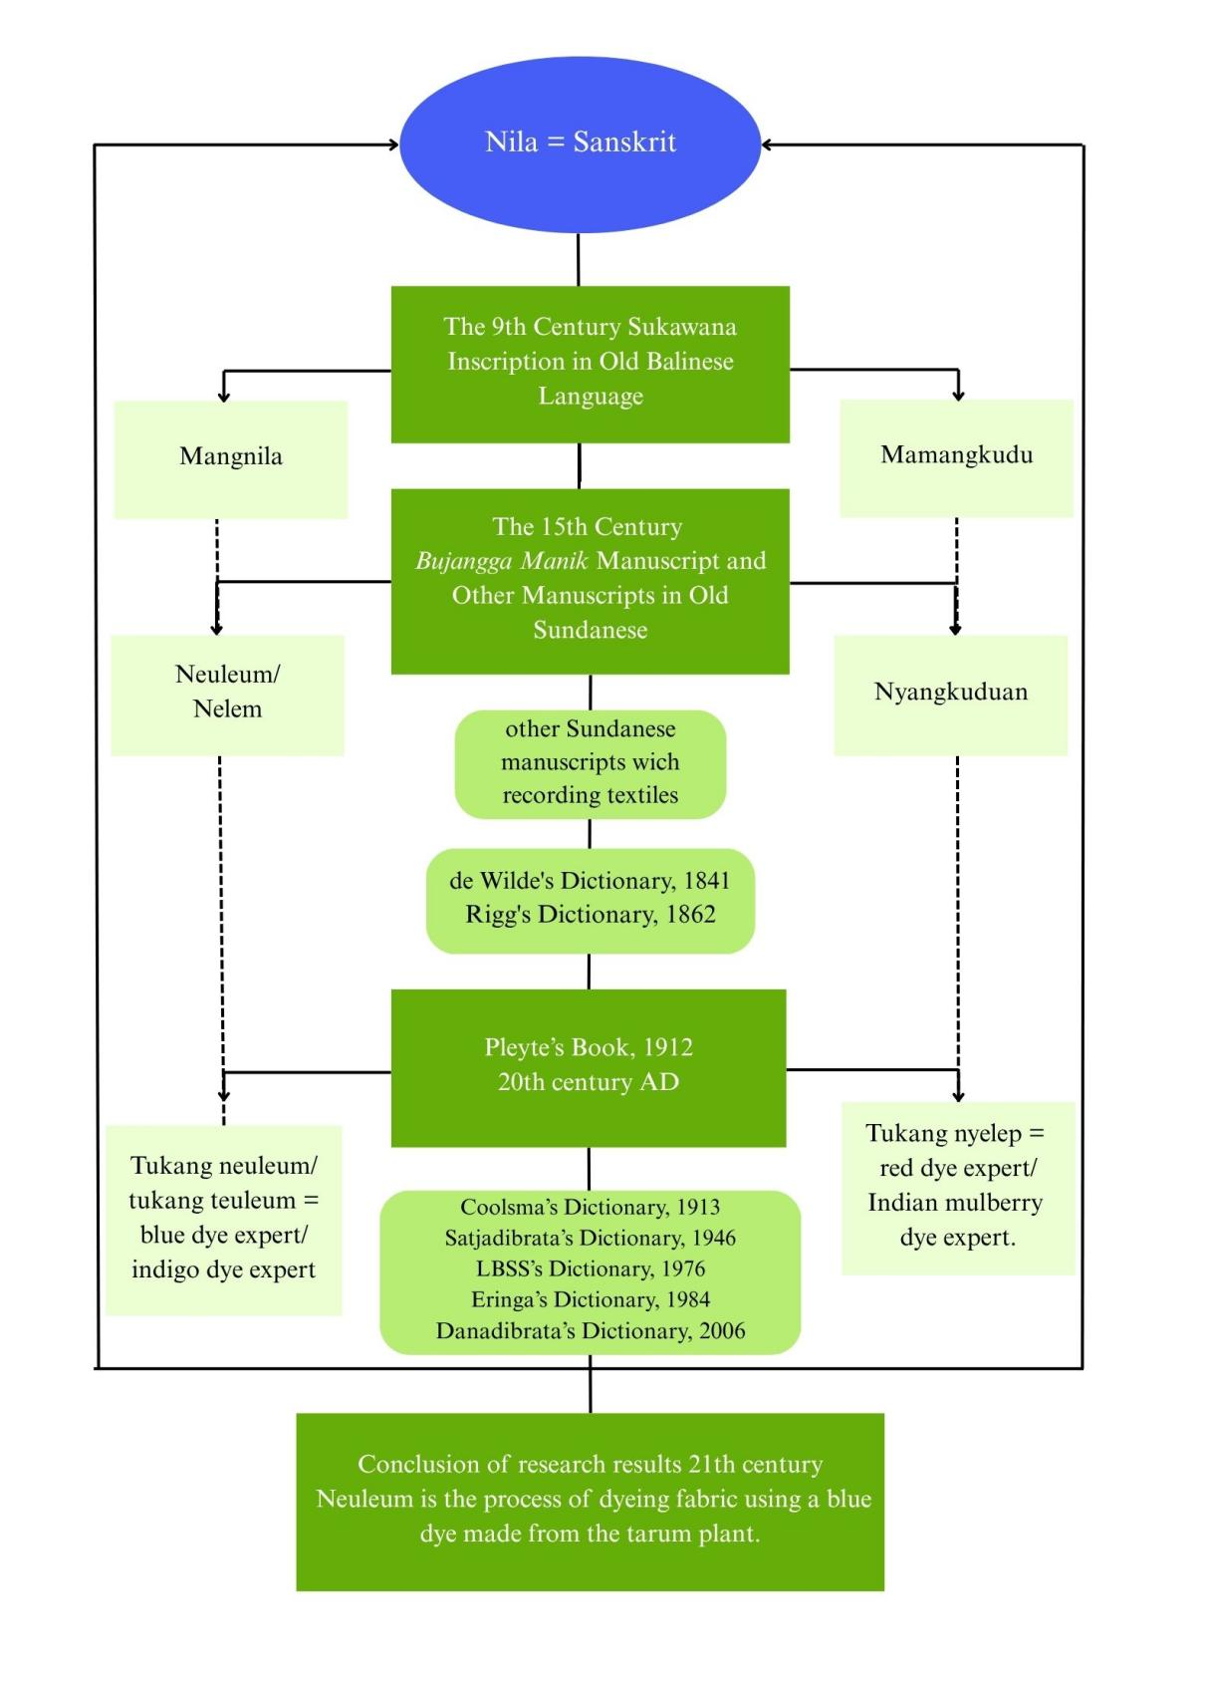

Slide 6
FINDING AND DISCUSSION
√ Neuleum traditionally means dyeing cotton using natural blue dye (nila) made from the tarum plant (Indigofera tinctoria).
√ Confusion stems from visual appearance of dark dye—can be mistaken as black (mud).
√ All early lexicons (Rigg, Eringa, Coolsma) align it with indigo.
√ The term has parallels in Javanese (silem, nilem), Malay (nilam, selam), and Old Balinese (mangnila).
√ Neuleum reflects a culturally significant process in ancient Sundanese society.
√ Reveals the integration of local botany (tarum), craft (weaving/dyeing), and vocabulary.
√ Enhances understanding of Bujangga Manik beyond literary value—into cultural heritage.
√ Highlights continuity of natural dye use from 15th to 20th century.

Slide 7
CONCLUSION
√ The word neuleum should be understood as dyeing with natural indigo derived from the tarum plant.
√ Conflicting definitions (mud/black vs indigo/blue) resolved through historical and linguistic evidence.
√ Reinforces the relevance of philological study in preserving local knowledge and sustainable practices.

Slide 8
REFERENCES
Coolsma, S. (1913). Soendaneesch-Hollandsch woordenboek. A.W. Sijthoff.
Danadibrata, R. A. (2006). Kamus basa Sunda. Kiblat Buku Utama.
Eringa, F. S. (1984). Soendaas-Nederlands woordenboek. Foris Publications.
Gunawan, A. (2019). Textiles in Old Sundanese texts. Archipel, 98, 71–107. https://doi.org/10.4000/archipel.1332
Ismoilovich, D. D., & Ubaydullaevna, N. Y. (2022). Ethnolinguistics: Emergence, development and theoretical research. International Journal of Trend in Scientific Research and Development, 6(6), 1531–1535. https://www.ijtsrd.com/papers/ijtsrd52117.pdf
Isnendes, C. R. (2023). Material artifacts of Sundanese looms with hypogram on the figure of Nyai Pohaci in carita pantun Lutung Kasarung. Indonesian Journal of Applied Linguistics, 12(3), 752–764. https://doi.org/10.17509/ijal.v12i3.47942
Isnendes, C. R. (2024). Kajian antropologi sastra Bujangga Manik abad ke-15 M berdasarkan perspektif antropologi Abu Raihan Muhammad bin Ahmad Al-Biruni dalam Tahqiiq maa li al-Hindi min Maquulatu Maqbuulatu fi ail-Aql au Mardzulat Abad Ke-11 M (naskah pengukuhan guru besar). Universitas Pendidikan Indonesia.
Isnendes, C. R., Haerudin, D., Hendrayana, D., Kusumawardhana, G. T., & Harya, K. P. (2024a). Kajian antropologi sastra pada naskah Sunda kuno Bujangga Manik sebagai upaya dalam pencapaian sustainable development goal’s (SDG’s).
Isnendes, C. R., Haerudin, D., Hendrayana, D., Kusumawardhana, G. T., & Harya, K. P. (2024b). Relevance of Ancient Sundanese manuscript “Bujangga Manik” to aspects of sustainable development goals (SDG’s) through literary anthropology study. Journal of Ecohumanism, 3(8), 3439–3447. https://doi.org/10.62754/joe.v3i8.5011
Keraf, G. (1984). Linguistik bandingan historis.
LBSS. (1976). Kamus umum basa Sunda (Lembaga Basa jeung Sastra Sunda). TARATE.
Łebkowska, A. (2012). Between the anthropology of literature and literary anthropology. Teksty Drugie, 2, 30–43.

Slide 9
Liyana, C. I. (2025). Linguistik: Pengantar studi bahasa. PT. Green Pustaka Indonesia.
Noorduyn, J., & Teeuw, A. (2006). Three old Sundanese poems. BRILL.
Nurova, U. Y. (2021). The emergence and development of ethnolinguistics. Middle European Scientific Bulletin, 8.
Pleyte, C. M. (1912). De inlandsche nijverheid in West-Java als sociaalethnologisch verschijnsel (2nd ed.). Javasche boekhandel & drukkerij.
Raden Satjadibrata. (1946). Kamus basa Sunda. Perpustakaan Perguruan Kem. P.P. dan K.
Rajan, S. S., & Esmail, S. M. (2021). Manuscripts: Preservation in the digital age national mission for manuscripts.
Rigg, J. (1862). A dictionary of the Sunda language of Java. Lange.
Ruhimat, M. (2017). Katalogisasi naskah Sunda Kuno koleksi Kabuyutan Ciburuy. Metahumaniora, 7(3), 392. https://doi.org/10.24198/mh.v7i3.18860
Ruhimat, M., & Sopian, R. (2022). Wayang dan kreativitas dalang dalam naskah kuno. KABUYUTAN, 1(3), 124–131.
Saraswati, U. (2018). The significance and purpose of ancient manuscript for the nation’s culture and character development through the history teaching. Historia: Jurnal Pendidik Dan Peneliti Sejarah, 12(1), 92. https://doi.org/10.17509/historia.v12i1.12120
Setiawan, H., Wartini, T., & Undang A Darsa. (2022). Tiga pesona Sunda kuno. Pustaka Jaya.
West, A. J. (2021). Bujangga Manik or Java in the fifteenth century: An edition and study of Oxford. Curator, 4(2r), 1v.
White, K. (2024). Investigation of cultural and spiritual importance of illuminated manuscripts through manuscript reproduction.
Wilde, A. de. (1841). Nederduitsch-Maleisch en Soendasch woordenboek. Johannes Muller.
Zysk, K. G. (2012). The use of manuscript catalogues as sources of regional intellectual history in India’s early modern period. Aspects of Manuscript Culture in South India, 40, 253.

Slide 10
THANK YOU!
Follow us @...

