Slide 1
The Effectiveness of Using the Canva Application as a Medium in Teaching German Writing Skills to Grade XI Students of SMA Negeri 3 Wonogiri
No. Abstract: ABS-ICOLLITE-25175
Abel Tarisa Ardhana, S.Pd. , Dra. Retna Endah Sri Mulyati, M.Pd.
Universitas Negeri Yogyakarta.

Slide 2
INTRODUCTION
One of the foreign languages studied at school is German. At the secondary school level that implements the independent curriculum, German is a specialization subject for grade XI and grade XII.
In learning a foreign language, especially German, there are four kinds of language skills that must be mastered by students at school. These skills are writing skills (Schreiben), reading skills (Lesen), listening skills (Hören), and speaking skills (Sprechen). These skills are closely related to each other so that the teacher as a facilitator in the classroom must be able to present learning that includes all four skills.
Through observations made by researchers at SMA Negeri 3 Wonogiri, it was found that students still had difficulty in learning German writing skills. Learners tend to be silent and still have difficulties and mistakes in writing German vocabulary. Learners tend to find it difficult to get ideas in pouring their writing in German.
To overcome these problems, a solution is needed, namely the use of suitable learning media so that students are easier to learn vocabulary, how to write correctly and are motivated in learning German, especially in writing skills.
One of the media that has never been applied in learning activities for German writing skills of 11th grade students of SMA Negeri 3 Wonogiri is the Canva application media. Canva application media is an application that offers interesting features in its use. One of the interesting features contained in the Canva application that is suitable for writing skills is the Canva Document and Presentation feature. This is because, in this feature, students can write their ideas and creativity flexibly by adding images, colors and others. In addition, teachers can easily provide corrections to students' work in the comments section so that students are easier to know where they are.

Slide 3
LITERATURE REVIEW
"Using Canva As Media For English Language Teaching (ELT): Developing Creativity For Informatics Students“ by Tira Nur Fitria published in 2022 .
"Teaching Writing Through Canva Application To Enhance Students' Writing Performance“by Hadi, Izzah & Paulia in 2021.
"Using Canva In Teaching Writing To EFL Classroom Students“ by Muhammad Fadil Jumami in 2021.
"Indonesian Language Learning Media Using Canva Application at SMA N 1 Krian Sidoarjo“ by Suwito and Abd. Syakur in 2023.

Slide 4
METHOD
This research is a quasi-experimental research. This research design uses Pre Test-Post Test Control Group Design with two classes of subjects, namely experimental class and control class. The population in this study were all students of class XI SMA Negeri 3 Wonogiri who had received German language subjects. Data collection in this study was carried out with tests. The test used was a written test to determine the German writing skills of students of class XI SMA Negeri 3 Wonogiri. The test was conducted twice in this study, namely pre-test and post-test in the experimental class and control class. Before the treatment, students were given a pre-test to measure their initial German writing skills. Then after implementing learning with Canva application media, a post- test was conducted to determine the final results of learning German writing skills of XI grade students of SMA Negeri 3 Wonogiri.

Slide 5
FINDING AND DISCUSSION
The results of this study were obtained from a German writing skills test. The test was
given to the experimental class and control class in the form of a guided essay writing test in the form of replying to E-Mail. The test was conducted twice for each sample, namely pre-test and post-test.
The Following are the results of the pre-test and post-test of the two clases (experiment and control):
Control
Class
12
Experimental Class
10 9
6
Kelas Kontrol
Kelas Eksperimen
15
10
5
15
10
7
8
4
10
10
4
3
5
3
1
1
5
4
5
2
4
2
2
1
2
0
5
3
1
1
1
0
57-60 61-64 65-68 69-72 73-76 77-
80
0
0
57-60 61-64 65-68 69-72 73-76 77-80
58-6162-6566-6970-7374-7778-81
74-76 77-79 80-82 83-85 86-88 89-91
Pre-test
Post-test

Slide 6
FINDING AND DISCUSSION
The results of the analysis requirements test were carried out by testing the normality of the distribution and the homogeneity of variance test. The following data distribution normality test is shown in the following table.
Results of Normality of Distribution Test
Variable | Significance | Description
Experiment Pre-test | 0,200 | Normal
Experiment Post-test | 0,579 | Normal
Control Pre-test | 0,339 | Normal
Control Post-test | 0,455 | Normal
Variance Homogeneity Test Results
Group | Db | Fh | Ft | P (Sig.) | Description
Pre-Test | 1:46 | 2,154 | 4,05 | 0,149 | Fh< _{Ft}= Homogeneous
Post-Test | 1:46 | 0,262 | 4,05 | 0,611 | Fh< _{Ft}= Homogeneous

Slide 7
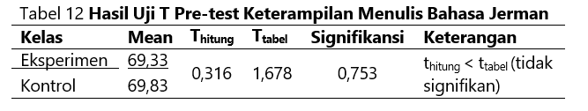
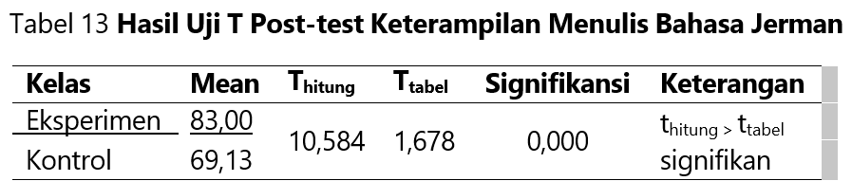
FINDING AND DISCUSSION
Hypothesis Testing use T-test.

Slide 8
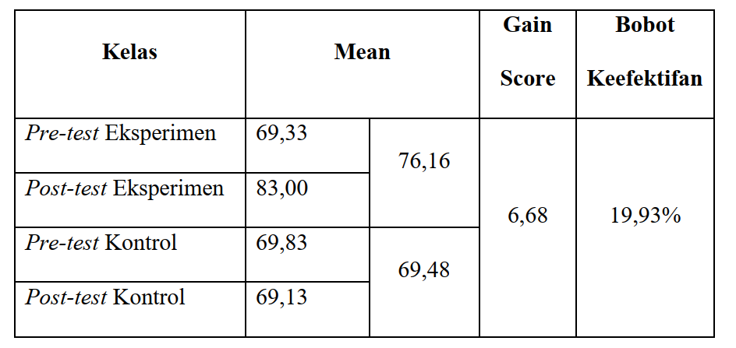
FINDING AND DISCUSSION
The result of the calculating of the effectiveness weight can be seen in the following table:

Slide 9
CONCLUSION
Based on data analysis, testing, hypotheses, and discussions that have been made, t h e following conclusions can be drawn.
There is a difference in learning achievement of German writing skills of students of grade XI SMA Negeri 3 Wonogiri between classes taught using Canva application media and classes taught using conventional media. This difference can be proven by data analysis at the significance level 𝛼= 0.05 using the t-test resulting in a count of 10.584 greater than the table 1.678 with a significance value of less than 0.05 (0.000 < 0.05).
The use of Canva application media is more effective in learning German writing skills of grade XI students of SMA Negeri 3 Wonogiri compared to using conventional media. The effectiveness is proven by the effectiveness weight of 19.93%.

Slide 10
REFERENCES
EßER, Ruth (2000): Schreiben im Vergleich. Kulturelle Geprägtheit wissenschaftlicher Textproduktion und ihre Konsequenzen für den universitären DaF-Unterricht. In: Krumm, H.-J.
Jalinus, N., & Ambiyar. 2016. Media dan Sumber Belajar. Jakarta: Kencana
Nurgiyantoro, Burhan. 2001. Penilaian dalam Pengajaran Bahasa dan Sastra. Yogyakarta: BPFE. PORTMANN, Paul R. (1991): Schreiben und Lernen: Grundlagen der fremdsprachlichen Schreibdidaktik. (Reihe Germanistische Linguistik : 1229) Tübingen: Niemeyer Richards, Jack C. & Schmidt, Richard. 2010. Longman Dictionary of Language Teachhing comprehension exercises. Cambridge: Cambridge University Press.
Tanjung, R. E., & Faiza, D. 2019. Canva Sebagai Media Pembelajaran Pada Mata Pelajaran Dasar Listrik dan Elektronika. Jurnal Vokasional Teknik Elektronik dan Informatika, 7(2), 79-85

Slide 11
VIELEN DANK!

