Slide 1

Reading Literacy Skills Assessment Challenge in the Digital Age:
An Overview of Teacher Perspectives and Competencies
No. Abstract: ABS-ICOLLITE-23162
Rizki Akbar Mustopa, Vismaia S. Damaianti, Yeti Mulyati, Dadang S. Anshori
Indonesia University of Education

Slide 2
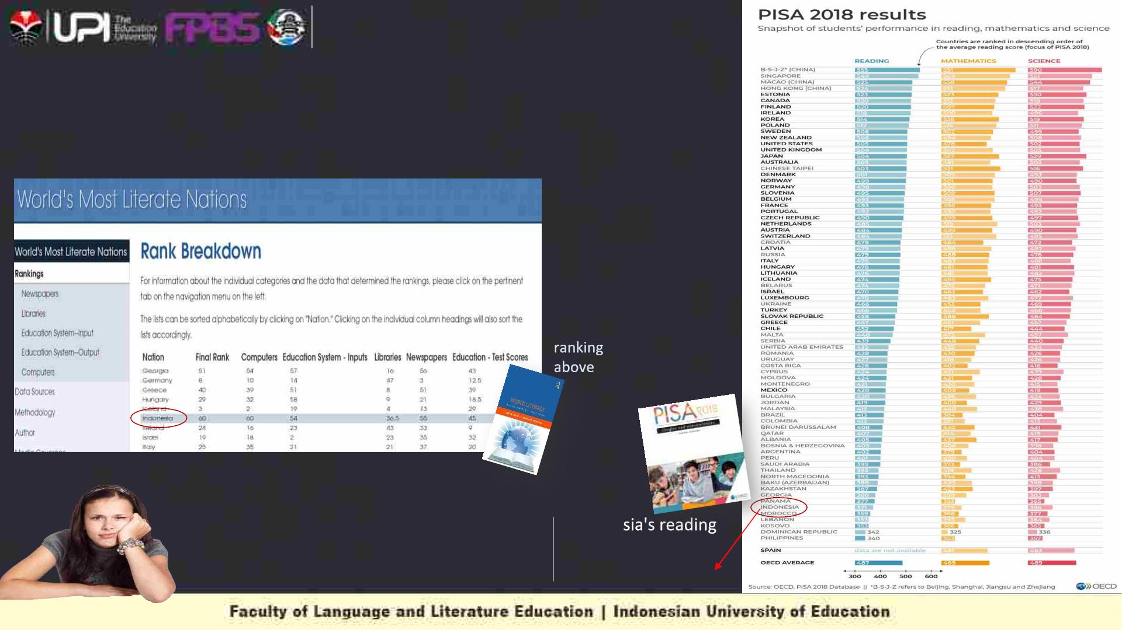
INTRODUCTION
Level of reading comprehension ability: literal, inferential, critical, and creative abilities;
focuses on measuring the ability to determine: main ideas, idioms/phrases according to the
discourse context, inferences, grammatical features, detailed information, unwritten facts,
supporting ideas, vocabulary according to the discourse context
(Westwood, 2001; Tindale, 2003; Hibbard. & Wagner, 2003; Anderson, 2008; Caldwell, 2008; Brown & Abeywicakrama, 2010; Scanlon,
Anderson, & Sweeney, 2010).
Based on the results of the
WMLN survey, sponsored
by Unesco, the United
Nations Educational,
Cultural and Scientific
Agency in 2016, Indonesia
was ranked 60th out of 61
countries. Indonesia's
is only one level
Botswana, Africa.
What should we do?
PISA result:
7 of 10 students aged 15 years have a reading
Indone
score is ranked
literacy level below the minimum competency 72 of 77 countries

Slide 3
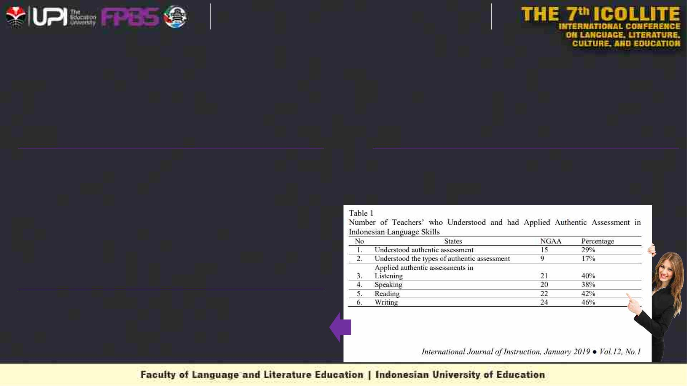
LITERATURE REVIEW
Let's take a glance at the evaluation aspect!
Evaluation of reading comprehension skills need aspects of thinking:
analysis, evaluation, and creation (the "top end" of Bloom's taxonomy);
logistical reasoning; judgment and critical thinking,
problem-solving by real-life tasks by placing reading as a necessity;
creativity and creative thinking
A reading comprehension evaluation program is directed to
help readers with reading comprehension difficulties to provide
consistent and coordinated information by collecting primary
data about students' cognitive, affective, and experiential
status (Afflerbach, 2008).
(Hauser, et al., 2005; Brookhart, 2010).
Reading comprehension tests can be carried out by:
(1) reading passages or paragraphs and providing missing
keywords;
However, this has not been supported by the teacher's ability
to conduct the evaluation process (Adnan, et al., 2019).
(2) answering multiple choice questions in response to the
examiner's directions;
(3) retelling the results of reading, summarizing, or answering
questions related to the text after reading quietly
(Rathvon, 2004; Klingner, Vaugh, & Boardman, 2007; Raphael &
Au, 2010; Harris, & Graham, 2014).
"They don't use a rubric in the assessment. The final finding,
teachers do not have adequate competence in carrying out
authentic and integrative assessments."
Adnan, Suwandi, S., Nurkamto, J., & Setiawan, B. (2019). Teacher Competence in Authentic and Integrative
Assessment in Indonesian Language Learning. International Journal of Instruction, 12(1), 701-716

Slide 4
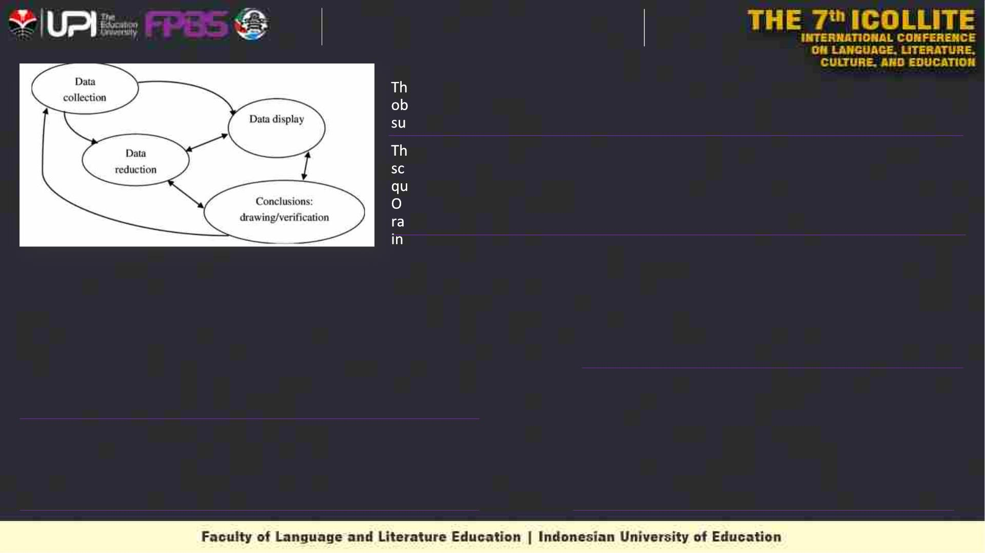
METHOD
is study uses qualitative methods with descriptive analysis. The research data were
tained from observations without manipulating the environment of the research
bjects (Denzin & Lincoln, 2009; Cresswell, 2012; O'Reilly & Kiyimba, 2015)
is study utilized the main data in the form of answers or responses from 38 high
hool teachers in Subang Regency (West Java, Indonesia) from different schools on
estions regarding obstacles and challenges in evaluating reading comprehension.
bservations were also made of five teachers from different schools who were
ndomly selected to find out the implementation of reading literacy skills assessment
class.
Interactive Data Analysis Miles & Huberman (1994)
1. Data Collection
3. Data Display
Data is presented in visual form or graphs and tables as
needed.
Distribution of questionnaires to obtain data on teacher responses
regarding the obstacles experienced in assessing students' reading
literacy skills.
Direct observation to find out the implementation of the teacher's
reading comprehension evaluation.
3. Conclussion: Drawing/Verification
Conclusions were drawn by checking the suitability of
the data obtained from three data acquisition
techniques, namely distributing questionnaires,
observing, and tracking/documenting questions about
the teacher's reading ability.
2. Data Reduction
Data in the form of the teacher's answers to the competency
assessment questionnaire for reading literacy are grouped and sorted
so that they can be described.

Slide 5
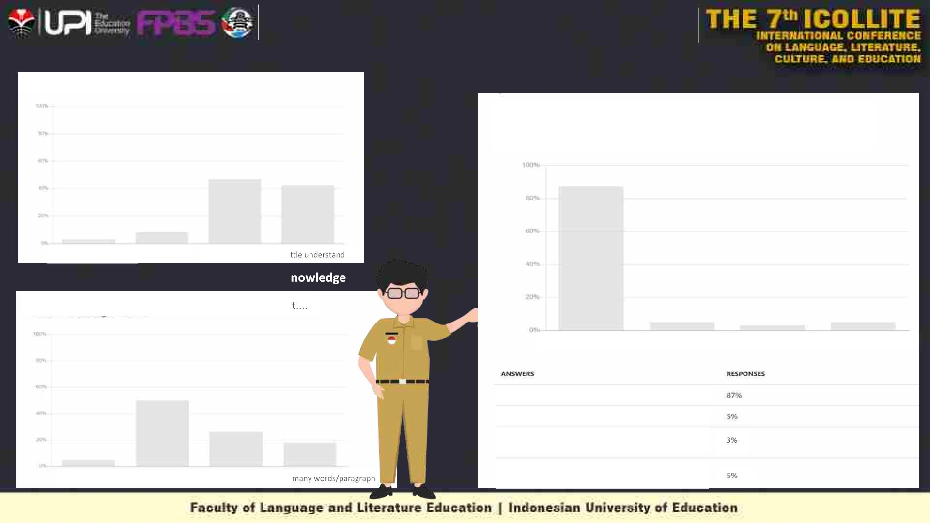
FINDING AND DISCUSSION
Graph-1: Barriers to Teacher Competence and Knowledge
Regarding reading evaluation, I ....
Graph-3 Teachers' Habits in Designing Reading Test Questions
In making a reading evaluation instrument (Indonesian matter), I...
really understand
understand
quite understand a li
Graph-2 Barriers to Teacher Competence and K
I understand reading literacy evaluation as a form of tes
A
B
C
D
A. Create questions by including paragraphs/text
B. include complex problems in test questions
C. make questions that allow students to work on them
for a long time
true/false
multiple choice
short essay contains
D. trying to make the questions can only be answered
with higher-order thinking skills

Slide 6
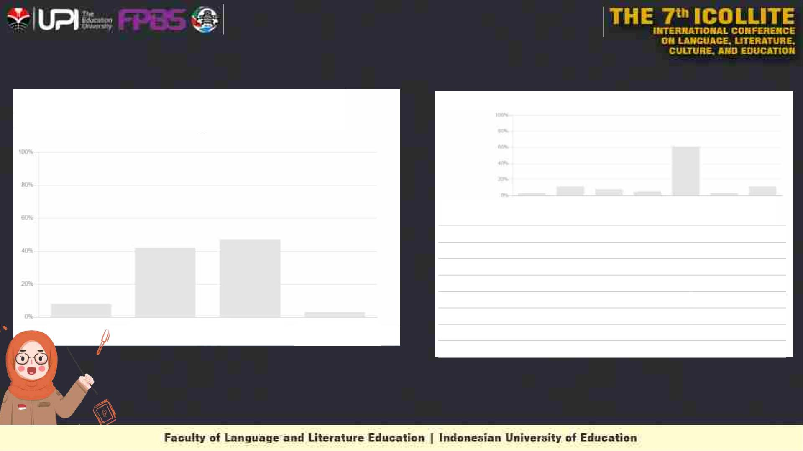
FINDING AND DISCUSSION
Graph-4 Teacher Knowledge Related to Knowledge Dimensions
in Reading Evaluation
Graph-5 Teachers' Habits of Carrying out a Reading Evaluation
Regarding the dimensions of factual, conceptual, procedural, and
metacognitive knowledge in reading evaluation, I...
In the reading evaluation, I present questions that are...
A
B
C
D
E
F
G
ANSWERS
RESPONSES
3 %
A. interpreting graphic symbols
B. remembering the concept of reading
11%
8 %
C. understanding the structure of the text
D. concluding the text
5%
E. . searching for and retrieving information in text
F. Interpreting graphic symbol
G. rating the text
61%
3%
understand
quite understand
a little
understand
absolutely
do not understand
3%

Slide 7

FINDING AND DISCUSSION
Sample of teacher's reading evaluation questions (Research Subjects)
Kompetensi Dasar
Mengidentifikasi teks laporan hasil observasi yang dipresentasikan dengan lisan dan tulis.
Kompetensi Dasar
Mengidentifikasi ciri kebahasaan teks ceramah yang dibaca
Soal
Bacalah teks laporan berikut !
Soal uraian
Ikan air tawar terbagi ke dalam tiga golongan, yakni ikan peliharaan, ikan buas, dan ikan liar. Ikan
peliharaan terdiri atas ikan-ikan yang mudah diperbanyak. Contohnya: ikan bandeng, ikan mas,
Sebutkan 4 ciri kebahasaan yang menandai pidato!
Jawaban:
ikan gurame, dan lain-lain. Ikan buas memiliki sifat jahat terhadap ikan-ikan lain. Contohnya: ikan
gabus dan ikan lele. Ikan liar, meskipun jarang dipelihara, tetapi memiliki keuntungan secara
ekonomis. Contohnya: ikan pari, ikan bunter, dan ikan jeler. Teks laporan di atas adalah bagian
dari ...
menggunakan kata penghubung argumentatif; menggunakan pernyatan
langsung; menggunakan kata-kata rujukan; menggunakan pernyataan
langsung
a. Deskripsi
b. Definisi
c. Klasifikasi
d. Sebab-akibat
e. contoh
Jawaban: C

Slide 8
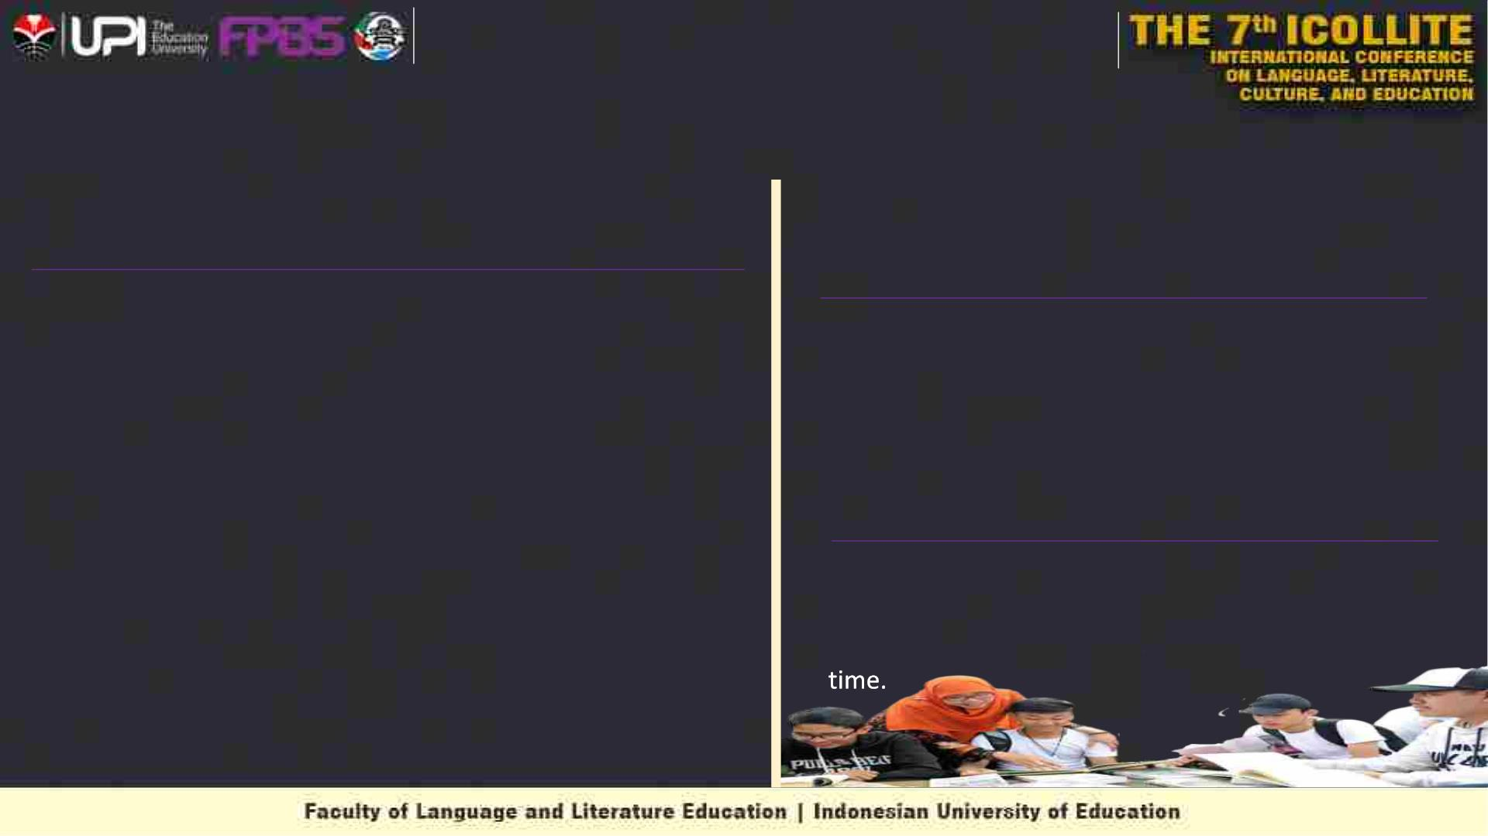
FINDING AND DISCUSSION
Results of Observation of Implementation of Evaluation of Reading Proficiency in The Class Room
Supporting factor:
flexibility of time to carry out the evaluation process in class
with support from superiors (principals).
The teacher as the designer and implementer of the
assessment plays a dominant role in determining the
success of the reading literacy assessment.
Obstacle factor:
§ the reading material presented is less diverse, the
measurement of proficiency is only reading content at
the basic level of reading ability;
§ Documentation of evaluation results and follow-up of
reading evaluation results has not been carried out on an
ongoing basis (only teachers and students are directly
involved);
The presence of educators is essential to provide a
quality literacy experience with chronologically age-
appropriate literature for students with broad support
needs; as well as consideration of how and how much
the teacher should be directly involved in reading
activities (Hudson & Test, 2011; Troyer, 2017).
§ literacy habituation is carried out without teacher
guidance regarding steps and follow-up of reading
results;
§ literacy-cultivating activities are not equipped with an
evaluation of the reading process;
Collaboration between teachers, school management
teams, and parents is needed to control the
improvement of students' reading skills from time to
§ the ratio of Indonesian teachers and students is
unbalanced, 1 teacher: 30-35 students

Slide 9

CONCLUSION
There is alignment of the information on the answers to the teacher's competency questionnaire with the
results of observation and analysis of the teacher's work questions.
Obstacles in the assessment of reading literacy skills are known to be the impact of teachers' lack of
understanding regarding the ideal formulation of reading literacy skills, school facilities related to the
availability of relevant reading topics and books, as well as factors of students' initial abilities since they
first entered high school.
As an implication, it is necessary to consider the existence of factors supporting the ability to read
comprehension (such as easy access to reading materials, structured exercises, and teacher guidance) in
the learning process and evaluation of reading in schools. Collaboration between teachers, school
management, and parents also needs to be done to assess, measure, and monitor the development of
students' reading abilities.

Slide 10
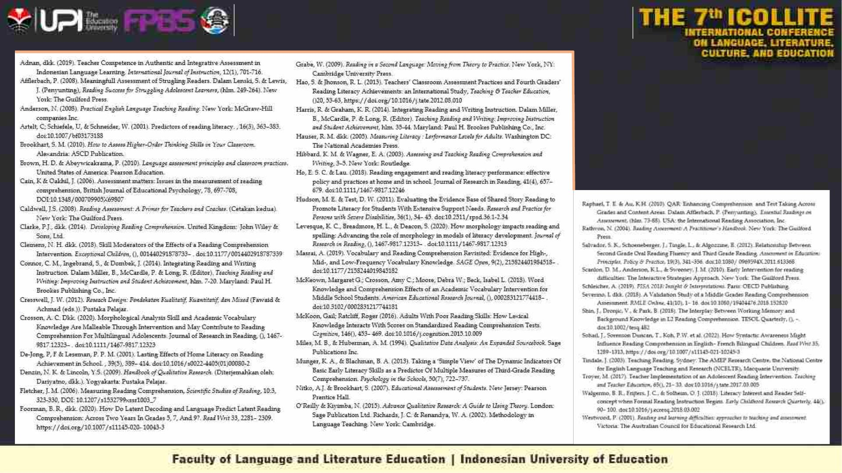
REFERENCES

