Slide 1
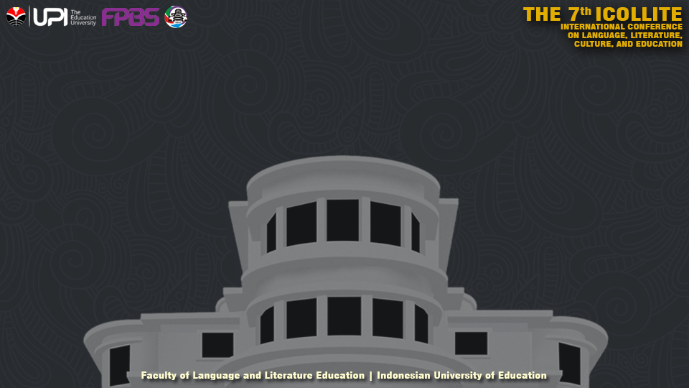
THE TRANSLATION STRATEGIES OF KOREAN IDIOMATIC EXPRESSIONS IN THE ‘GOING SEVENTEEN’ VARIETY SHOW
No. Abstract: ABS-ICOLLITE-23175
Author (s), Rastya Ismatriyana¹, Didin Samsudin²
Affiliation (s). Indonesian University of Education

Slide 2
INTRODUCTION
Translation is a language transfer process that helps bring culture from the source language (SL) to the target language (TL). To make the message from the source language acceptable, a translator must be able to properly adjust the grammatical and lexicon conditions of the translated word. This phenomenon can be a challenge for translators, mainly when translating culture-specific items, such as idioms that contain cultural elements to make up the language. These challenges can be overcome by using suitable translation strategies.
According to Baker (2018), there are 4 strategies for translating idiomatic expressions: (1) using an idiom of similar meaning and form, (2) using an idiom of similar meaning but dissimilar form, (3) translation by paraphrase, and (4) translation by the omission.
The writer finds an interesting translation phenomenon in the variety show 'GOING SEVENTEEN', where the idiom is translated literally first before adding the context of the idiom’s meaning. Therefore, this research was conducted to determine the types of translation strategies applied to the variety show 'GOING SEVENTEEN'.

Slide 3
LITERATURE REVIEW
The first previous study, entitled 'Orientation of Translation of Korean Idioms in the Webtoon “Touch Touch You”' was written by Dewi Rusyana and Suray Agung Nugroho in 2022. This research explains more about the technique of translating Korean idioms using the theory of Molina and Albir (2002). The result obtained is that the translation method used in the webtoon is mainly oriented toward the source language. There are seven different translation techniques, with the most common equivalent techniques. However, applying this technique does not guarantee that the message can be conveyed correctly because of the translator's obstacles in understanding the culture and source language.
Another previous study entitled 'Translation of Idioms: How They are Reflected in Movie Subtitling' by Yana Shanti Manipuspika and Damai Reska Julia Winzami was released in 2021. This research discusses the technique of translating idioms in the film 'Murder On the Orient Express' using Baker's theory ( 2018). The result is described that translators more often translate English idioms using paraphrasing techniques because they cannot find suitable idioms in Indonesian.

Slide 4
METHOD
This study employed descriptive qualitative research, described as an investigation into which verbal or written data is descriptively assessed. This study is intended to be qualitative because qualitative research collects data in words or images rather than numbers (Fraenkel & Wallen, 2010: 423). This indicates that the research's data were presented with a thorough explanation of the analysis findings. Selinger (1989) also said, “Descriptive research involves a set of techniques designed to specify, describe, or explain what occurs or is interpreted in nature without adding or explaining anything significant."
The data studied came from the Korean source language (SL) text and the Indonesian target language (TL) in the subtitles, obtained from the content analysis results using the note-taking method. Researchers took 32 episodes from ‘GOING SEVENTEEN’ season 2022. The 120 idioms obtained are then analysed using Baker's translation strategy theory (2018).

Slide 5
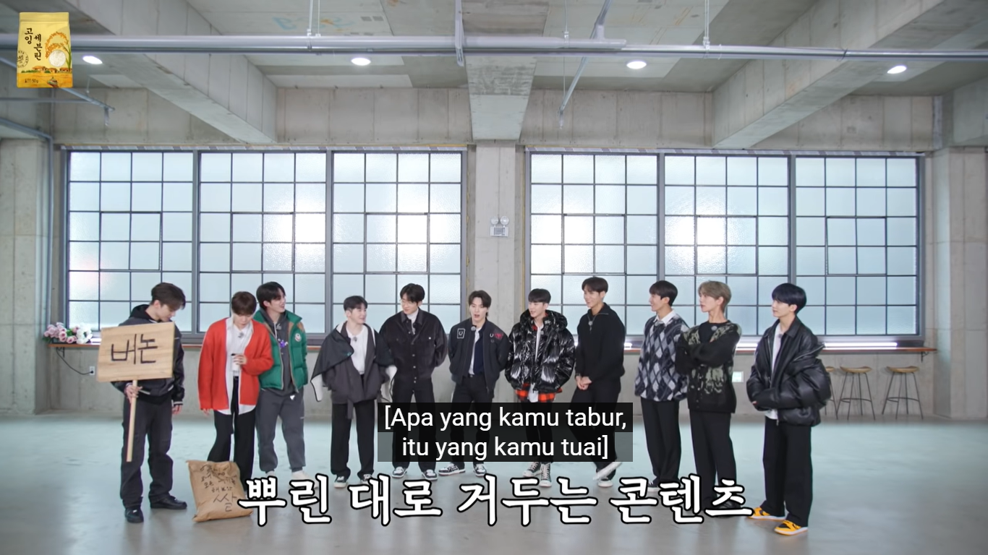
FINDING AND DISCUSSION
1. Using an Idiom of Similar Meaning and Forms
SL: 뿌린 대로 거두는 콘텐츠
TL: Apa yang kamu tabur, itu yang kamu tuai.
‘뿌린 대로 거둔다’ is a Korean proverb which means ‘you reap what you sow’ or ‘everything that happens is a result of things which you have done in the past’. This proverb in Indonesian is ‘Apa yang kamu tabur, itu yang kamu tuai’, so the translator used an idiom of similar meaning and forms to transfer the exact context for the viewers.

Slide 6
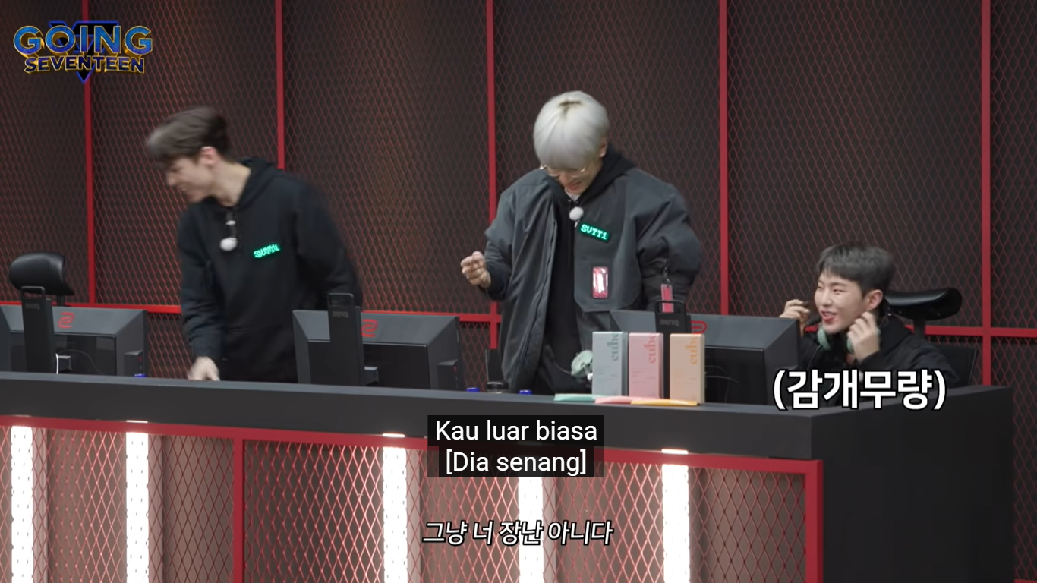
FINDING AND DISCUSSION
2. Using an Idiom of Similar Meaning but Dissimilar Form
SL: 그냥 너 장난 아니다 [감개무량]
TL: Kau luar biasa [Dia bahagia]
‘장난 아니다‘ can literally translate to ‘you are no joke’, but the translator translates it to ‘kau luar biasa’, which has the same meaning but in different lexical forms. While ‘감개무량’ is a 사자성어 or four-character Hanja idiomatic expression which means ‘overwhelming feelings.’ It translated to ‘Dia bahagia’ instead and had a different form with the original idiom.

Slide 7
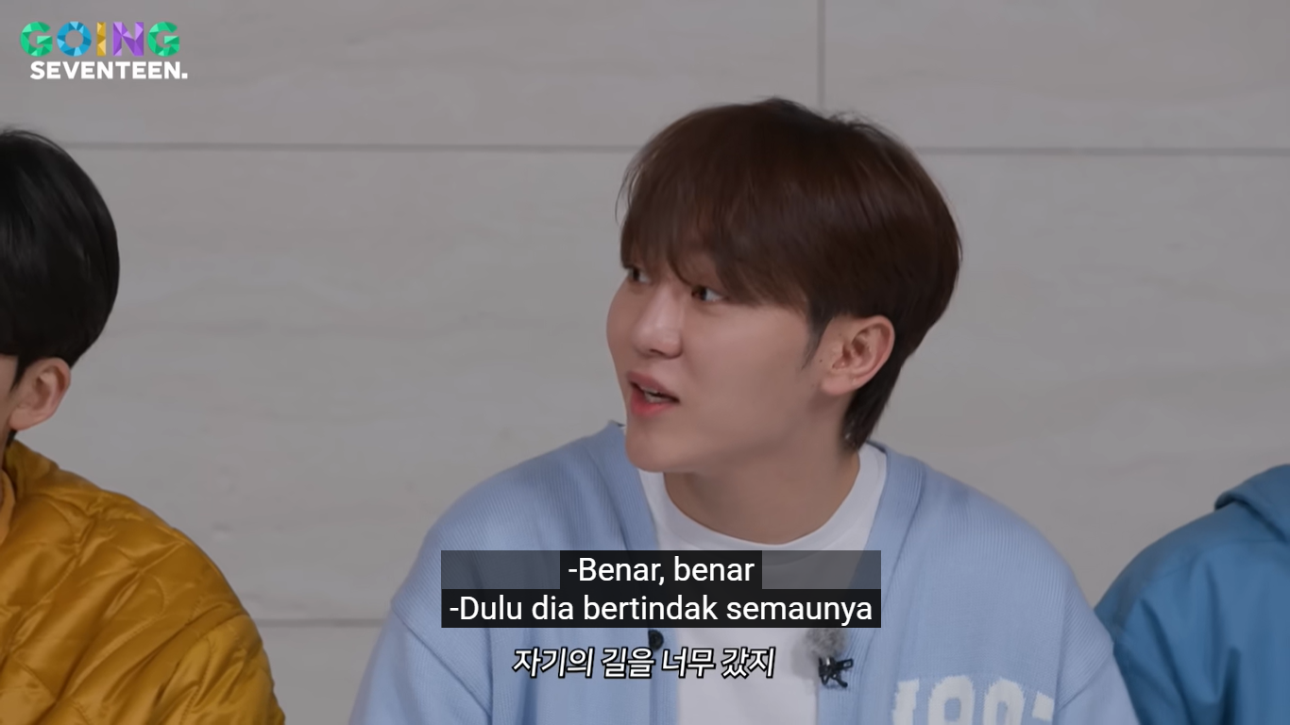
FINDING AND DISCUSSION
3. Translation by paraphrase
SL: 자기의 길을 너무 갔지
TL: Dulu dia bertindak semaunya.
The literal translation of the SL can be translated as ‘he was gone too far in his way’, but the translator translated it into ‘dulu dia bertindak semaunya’. They paraphrased it using different words and grammatical structures to fit the context of the conversation more.

Slide 8
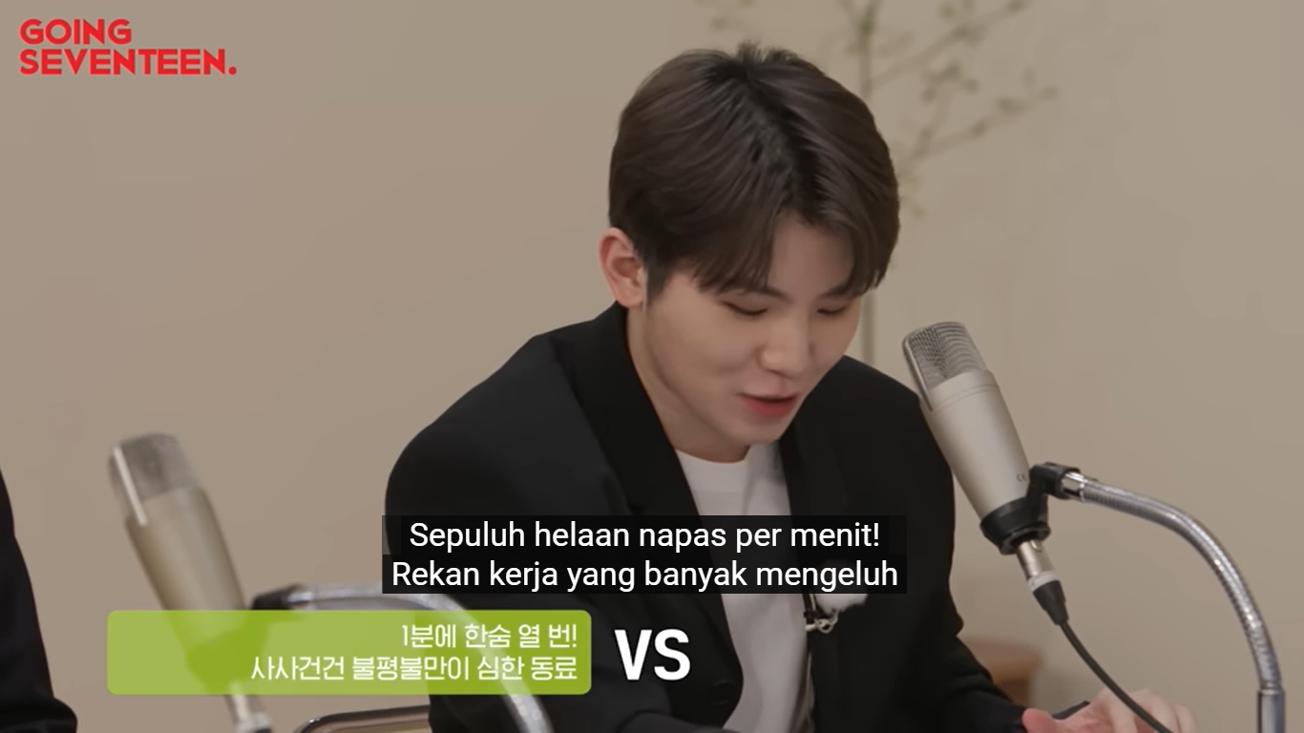
FINDING AND DISCUSSION
4. Translation of Omission
SL: 사사건건 불평불만이 심한 동료
TL: Rekan kerja yang banyak mengeluh
‘사사건건’ is also a four-character Hanja idiomatic expression which means ‘all applicable events’. The translator omitted the idiom since it would be a waste of words, and the subtitle would be too long to read even if it has equivalent terms in the TL.

Slide 9
CONCLUSION
It can be concluded that the most frequently used strategy was using the same idiom of the same meaning but with a different form with 50 idioms, followed by the same form and meaning with 35 idioms. These two strategies can convey the sense of Korean idioms into Indonesian in the variety show. Meanwhile, 29 idioms use the paraphrasing strategy, and 6 idioms use the omission strategy. These two strategies are lesser because the translator tries to maintain the original meaning of the idiom so that the audience can also understand the language and culture contained in the idiom.

Slide 10
REFERENCES
Baker, M. (2018). In Other Words: A Course book on Translation (Third Edition). London and New York: Routledge.
Fraenkel, Jack & Norman Wallen. 2010. How to Design and Evaluate Research in Education 7th edition. New York: McGraw-Hill.
Korean-English Dictionary (Online). 사사건건. Retrieved July 7th 2023 from https://korean.dict.naver.com/koendict/#/entry/koen/7aa5823dac23435d991b4fe1969887a6
Namu Wiki. (2022). 감개무량. Retrieved July 7th 2023 from https://namu.wiki/w/%EA%B0%90%EA%B0%9C%EB%AC%B4%EB%9F%89
Rusyana, D., & Nugroho, S. A. (2022). ORIENTASI PENERJEMAHAN IDIOM BAHASA KOREA DALAM WEBTOON “TOUCH TOUCH YOU”. BAHTERA: Jurnal Pendidikan Bahasa dan Sastra, 21(2), 132-145.
Selinger, H. W., & Shohamy, E. (1989). Second language research methods. Oxford: Oxford University Press.
Shanti Manipuspika, Y., & Reska Julia Winzami, D. (2021). Translation of idioms: How they are reflected in movie subtitling. AWEJ for Translation & Literary Studies, 5(1).
Sulistijani, E., & Parwis, F. Y. (2019). Strategi Penerjemahan Subtitling dalam Film" Ender’s Game". Deiksis, 11(03), 210-220. DOI: http://dx.doi.org/10.30998/deiksis.v11i03.4111

Slide 11
THANK YOU!
Follow us
rastyaisma@upi.edu
didinsamsudin@upi.edu

