Slide 1
RECONSTRUCTION OF SUNDANESE PÉSO PANGOT FOR LEARNING MEDIA WRITING TRADITIONAL ACTIVITIES
No. Abstract: ABS-ICOLLITE-23132
Tedi Permadi
Indonesian University of Education

Slide 2
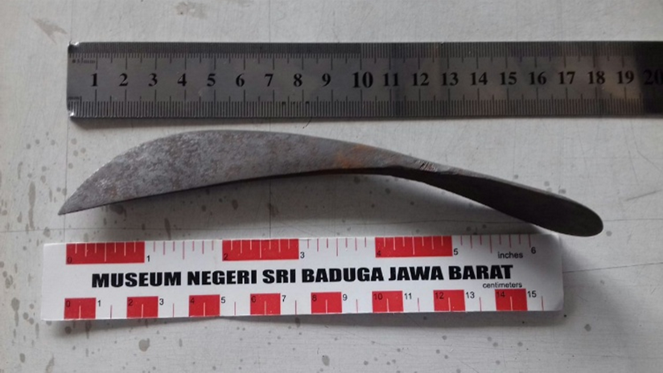
INTRODUCTION
The use of péso pangot and lontar in the writing tradition of the Sundanese people is closely related to the writing of the Sundanese script and the Cacarakan script, taking place in the range of the 16th to 18th centuries. Péso pangot is a writing instrument made of metal that is used for engraving, based on the péso pangot artifact stored in Kabuyutan Ciburuy (KB) Garut Regency, the shape is very ergonomic, making it easier to hold and use to write.
In mid-2002, the KB collection's péso pangot was successfully duplicated with slight modifications, the results of which were exhibited in a series of activities at the VIII Archipelago Manuscripts International Symposium in Jatinangor, Sumedang, 12–14 August 2002. In early 2018, 4 replicas were made again, 2 using Damascus steel and 2 using Japanese AISI standard D2 carbon steel.
Based on this, it is necessary to reconstruct the making of péso pangot which is more practical so that it can be produced in large quantities and can be used as a learning medium in the practice of writing traditional scripts on palm leaves, both in formal and non-formal environments.

Slide 3
LITERATURE REVIEW
The theory referred to, is regarding the types and techniques of making manuscript materials, including in the form of leaves which include palm leaves, coconut, palm, and nipah; leather which includes bark and animal skins; and traditional paper. Besides that, there are also other media in the form of buffalo horn, bamboo, bones, metal plates, etc. (Atja, 1968, p. 5; Kozok, 1999, pp. 28–29; Mulyadi, 1994, p. 44-46); the use of types of writing instruments such as pens and cutting knives, in Sunda known as péso pangot, in Indramayu and Cirebon known as wreti and lading panurat, in Bali known as pengrupak (Ekajati, 1988, p. 9; Kozok, 1999, p. 35; Ming, 1993, p. 16); and the use of the Cacarakan script, as a recording medium in the past (Kalsum & Wartini, 1993, p. 4).
In addition, it also refers to the theory of learning media which functions as a tool for teaching and learning processes, especially 3-dimensional concrete objects and equipment that can be used directly so that there is concrete experience. (Nurdyansyah, 2019, p. 51; Sapriyah 2019, p. 471).

Slide 4
METHOD
The research method in this study covers two aspects, namely procedures, and techniques within the framework of philological research. The philological research framework directs the study of manuscripts as the object of research, both texts and codices, aiming at studying past cultures, presenting them to present life, and utilizing them for future lives on the principle of continuity (Soeratno, 2004, pp. 2–3, 8)
The application of research procedures with an emphasis on reconstruction efforts for making péso pangot is carried out with the steps of (1) conducting a literature study, in this case in the form of searching for written sources that discuss péso pangot as a traditional writing tool; (2) description of the péso pangot collection of Kabuyutan Ciburuy (KB); (3) reconstructing the production of péso pangot, carried out by providing tools and materials that are principally in accordance with their designation, namely as writing instruments; and (4) the use of reconstructed péso pangot as a medium for learning to write traditional characters.

Slide 5
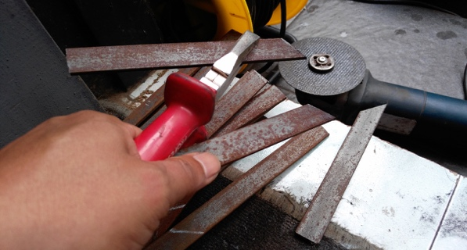
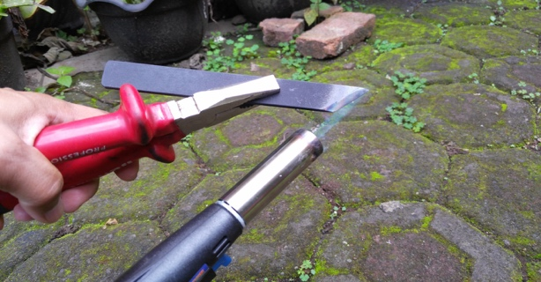
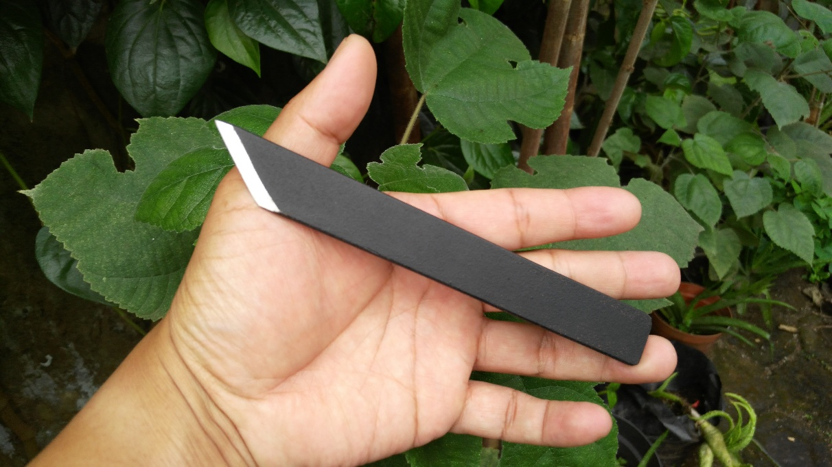
FINDING AND DISCUSSION
Making péso pangot, which has the same shape as the KB collection, requires equipment that is not simple because it requires a furnace and metal forging equipment. Based on this evaluation, there are practical considerations so that making péso pangot is easier and can be done by students and the general public without having to procure expensive equipment; although still using raw materials in the form of metal it is easier to do.
The material used is plate iron with a width of 2 cm and a thickness of 3 millimeters, and is widely sold in iron shops; The consideration is that the metal is easy to shape, easy to make sharp edges, and easy to sharpen again if needed. The equipment needed is a vise or vise for plate iron clamps and a grinder for cutting and sharpening plate iron; in addition, paint is used to coat the part of the pangot péso which is used as a handle so that it does not cause rust; materials and manufacture are easily duplicated.

Slide 6
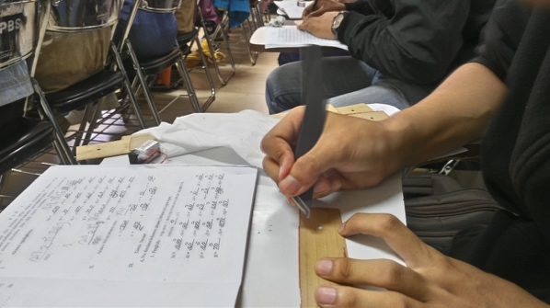
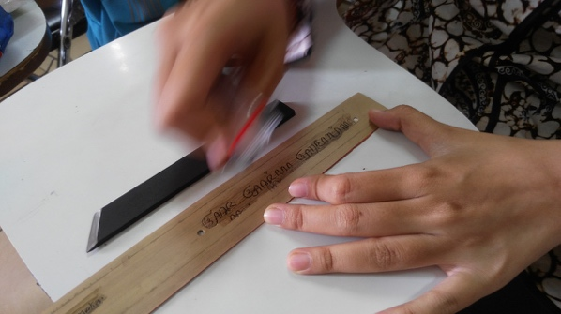
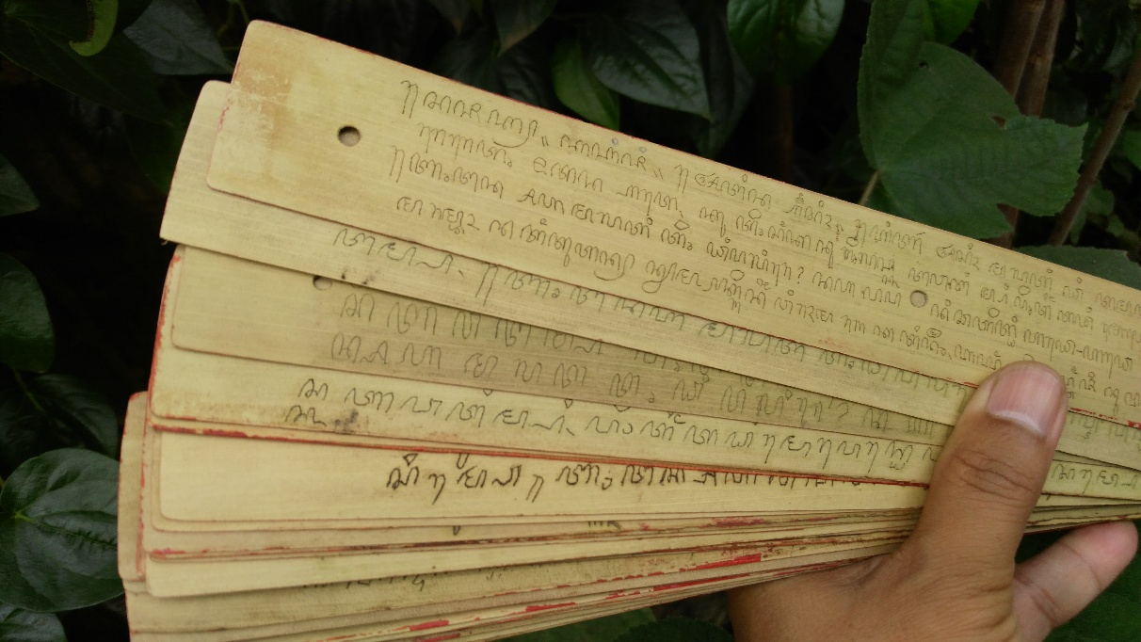
To introduce the Cacarakan script, the Sundanese script book compiled by R.H. Rochadi GK and R.L. Sadeli Erawan BK which was published by Kitara Publishers in Bandung in 1980. In practice, students learn script forms, punctuation, and how to write them with classical and individual assistance.
Palmyra leaves to be used as material or writing media require a long production chain to produce good quality palm leaves, including the physical appearance of palm leaf sheets (lempir) which are smooth, and flexible, the fibers do not break easily and can last a long time. In the practice of writing lontar, each student was given two palm leaves and a lent pangot peso. The following is documentation of the practice of writing lontar using the aforementioned péso pangot.

Slide 7
CONCLUSION
Based on this analysis and discussion, the conclusions obtained are (1) it is necessary to have sharp and pointed sides in making péso pangot so that it functions to etch character characters, (2) making péso pangot can use iron plates which are sold in iron shops, the work is easy only requires a vise and grinding tool, (3) learning to write traditional script, in this case the Cacarakan script, with medium péso pangot and palm leaves, not only provides knowledge and skills to learning participants, but at the same time gives a sense of pride in heritage the culture of the Indonesian nation, and (4) the results of this research can be duplicated into activities in various circles, both for education. formal or non-formal.

Slide 8
REFERENCES
Atja, D. (1968). Tjarita Parahijangan. Bandung: Jajasan Nusalarang.
Gunawan, A. (2011). Membaca Teks Sunda Kuna Sanghyang Sasana Maha Guru. Konferensi Intemasional Budaya Sunda II.
Kalsum, & Wartini, T. (1993). Aksara Cacarakan.
Kozok, U. (1999). Warisan leluhur: sastra lama dan aksara Batak (Vol. 17). Kepustakaan Populer Gramedia.
Ming, D. C. (1993). Malay manuscripts: materials and problems of conservation. Journal of the Malaysian Branch of the Royal Asiatic Society, 66(2 (265), 81–102.
Mulyadi, S. W. R. (1994). Kodikologi Melayu di Indonesia. Fakultas Sastra Universitas Indonesia.
Nurdyansyah, N. (2019). Media Pembelajaran Inovatif. In Media Pembelajaran Inovatif. https://doi.org/10.21070/2019/978-602-5914-71-3
Nurwansah I. (2019, December 9). Rekonstruksi Penulisan Lontar Sunda1.
Putra, D. M. (2017). Replika Naskah Nusantara sebagai Pengembangan Seni, Budaya, dan Sastra. Manuskripta, 7(1), 81–96.
Sapriyah. (2019). Media Pembelajaran dalam Proses Belajar Mengajar. 2(1), 470–477.

Slide 9
THANK YOU!
Follow us @...

