Slide 1
The Role of Social Media in Language Education
No. Abstract: ABS-23029
Roni Nugraha Syafroni
Universitas Singaperbangsa Karawang

Slide 2
INTRODUCTION
This research
Social Media: Instagram -> Celebgram Product Endorsement -> Jessica Mila
Language Education -> advertising text material grade 8
Analyzing Jessica Mila's photo captions -> women's clothing, air freshener, shampoo, jewelry, cosmetics, bags, face whitening, and coffee drinks product

Slide 3
LITERATURE REVIEW
Theories
1. Chaer: Linguistics
2.Astuti: Social Media
3. Arnaiz: Advertising Text Material

Slide 4
METHOD
Descriptive Analysis
1. Literature Review: theory from Chaer's book and other semantic journals
2. Documentation Review: Photos from Jessica Mila’s Instagram account

Slide 5
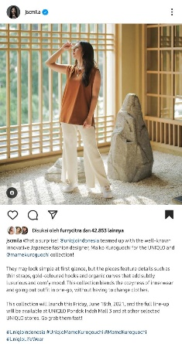
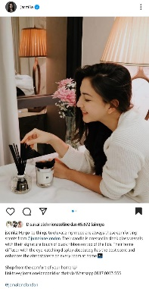
FINDING AND DISCUSSION
Women's Clothing Endorsement Product
The meaning field are fashion designer; simple; thin straps, gold-coloured hooks and organic curves; luxurious and comfy; cozyness of innerwear; outfit in one-go.
Air Freshener Endorsement Product
The meaning field are elevate my mood; comforting scents; candle; sleek glass vessels; has the best scent; enhances the atmosphere

Slide 6
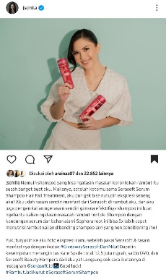
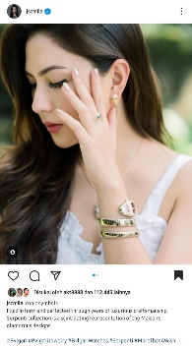
Shampoo Endorsement Product
The meaning field are kerontokan rambut; serum;
Sophora root; menutrisi rambut
Jewelry Endorsement Product
The meaning field are luxurious craftsmanship; Serpenti collection;
scintillating; glamorous designs

Slide 7
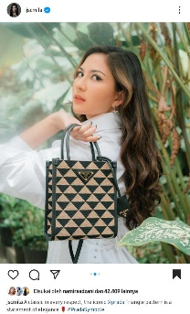
5. Cosmetics Endorsement Product
The meaning field are Comfy; hydrating; shine.
6. Bags Endorsement Product
The meaning field are classic; elegance.

Slide 8
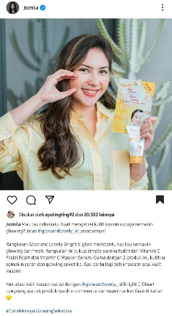
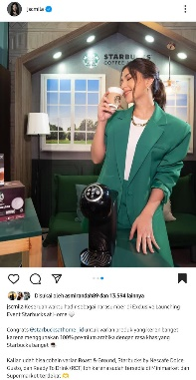
7. Face Whitening Endorsement Product
The meaning field are kulit kusam; glowing; Bright C glow; fresh;
Vitamin C Facial Foam; Vitamin C Masker Serum; cerah.
8. Coffee Drinks Endorsement Product
The meaning field are varian produk; premium arabika; varian Roaast & Ground;
Starbucks by Nescafe Dolce Gusto; Ready To Drink (RDT).

Slide 9
9. Relevance to Class 8 Advertising Text Material
Several vocabularies that are characteristic of advertising language
Students can learn to make advertisements by writing advertising language according to the example of the meaning field
The theme and title of the advertisement made by the students later, of course, is given by the teacher

Slide 10
CONCLUSION
Social Media: Instagram
Analysis of Jessica Mila's endorsement product captions
Linguistic Theory
Advertising Text Material

Slide 11
REFERENCES
1. Arnaiz, T. (2022). Iklan: Pengertian, tujuan, jenis, dan ciri-cirinya, materi kelas 6 SD/MI. Retrieved November 30, 2022, from https://bobo.grid.id/amp/083484955/iklan-pengertian-tujuan-jenis-dan-ciri-cirinya-materi-kelas-6-sdmi.
2. Astuti, N. F. (2021). Mengenal fungsi media sosial, berikut pengertian dan jenisnya. Retrieved November 28, 2022, from https://m.merdeka.com/jabar/mengenal-fungsi-media-sosial-berikut-pengertian-dan-jenisnya-kln.html?page=2.
3. Chaer, A. (2015). Pengantar Semantik Indonesia. Jakarta: Rineka Cipta.
4. Duniapcoid. (2022). Pengertian produk. Retrieved November 28, 2022, from https://duniapendidikan.co.id/pengertian-produk/.
5. Fisara, H. A., Ja’far, S., & Siti, N. A. (2021). Idioms and their meaning in the enola holmes movie as a reference to english language teaching. ELT In Focus, 4(2), 104-115.
6. Hidayat, M. A. B., & Ria, K. A. (2021). Pragmatic meanings on deixis in the song lyrics of anne-marie’s speak your mind album. ELT In Focus, 4(2), 116-127.
7. Iwana, M. F., & Emy, S. (2021). A melting pot of malang: linguistics landscape of malang culinary signs. Lire, 5(2), 254-275.
8. Jessica Mila. (2022). https://www.instagram.com/jscmila/?hl=id.
8. Nafilaturif’ah, N., & Mohamad I. P. (2021). Semantic prosody and reference of “healthy” and “unhealthy” collocations in covid-19 corpus. Language Literacy, 5(2), 356-365.
9. Octavhia, A. N., & Bernadus W. J. S. (2019). Code and representation of women in trans art truck model roland barthes semiotics studies. Seloka, 8(2), 14-23.
10. Prasetya, R. E. (2020). Switching code and mixing code in violation of cooperation principles: a socio-pragmatic study. ELT In Focus, 3(2), 24-35.
11. Saefullah, H., & Sidik, I. N. (2020). English needs analysis for economics students: an exploratory research. ELT In Focus, 3(1), 26-36.
12. Sjaerodji, Y. S., & Desi, I. (2022). Semiotic analysis of typography in apple virtual advertisement. Lire, 6(1), 1-18.
13. Tazami, J. A., & Agus, S. (2022). The verb “hit” in palembang language: natural semantic metalanguage study. Language Literacy, 6(1), 106-120.Triyuni, D., Fadhilla, F., & Liska, W. P. (2018). Teenagers’ perception towards language use in advertisement. Language Literacy, 2(2), 145-150.

Slide 12
THANK YOU!
My email: roni.nugraha@fkip.unsika.ac.id

