Slide 1
Translanguaging in BIPA Learning for Japanese Expatriates
No. Abstract: ABS-ICOLLITE-23157
Rosmalela Sidik, Nuny Sulistiany Idris
BIPA Education Study Program, University of Education

Slide 2
INTRODUCTION
Translanguaging allows students to change language for receptive and productive purposes
(Baker in Gracia&Wei, 2011 :6)
U
R
G
E
N
C
y
&
I
M
P
O
R
T
A
N
C
E
Indonesian as a Foreign Language expansion
465 institutions in 42 countries
(Ministry of education and culture, 2021)
Purposes
The use of the translanguaging strategy as a new in BIPA learning for Japanese expatriates
BIPA expatriates learners in Indonesia
Japanese expatriate at 2nd rank or 10% from all foreign worker in Indonesia after chinese
(Ministry of Labour, 2022)
New paradigm & Strategy in teaching BIPA for Japanese
Provide theoretical and practical references about teaching BIPA with translanguaging strategies to Japanese expatriate BIPA learners
Japanese learners tend to use the first language when studying the second language
(MEXT, 2018; Aoyama, 2020)
Japanese learner characteristic
Japanese have 1st language interference in 2nd language study procces
(Prarandari, 2013)
Partial use of L1 in translanguaging plays a role for efficient communication and complements the lack of linguistic resources in L2
(Aoyama, 2020)
Japanese Expatriate require the teachers must master the first language to understand first language interference in Japanese learners
(Sidik, 2021)
Leverage

Slide 3
LITERATURE REVIEW
The Benefits
Challenges
Translanguaging helps develop skills in a weaker language, in this case a second language, because students have to do more challenging assignments in both languages (Baker, 2003; 82).
Translaguanging in use need to examine how students’ L1 use through sidetracking conduces to their L2 development, as Spada (2007) suggests. (Aoyama, 2020)
Translanguaging aims to add to the content of language competence in schools by using sources from the entire linguistic repertoire of the learner, Cenos and Gorter (2021).
Translaguanging practices benefited the students cognitively, socially, and psychologically. (E. Emilia, FA. Hamied, 2022)

Slide 4
METHOD
Research Methods
Data collection
Case study research is an exploration of a case or system that is bound by time with in-depth data collection and also involves a variety of rich sources of information in a context, (Creswell, 1998)
Individual interview
Observation
Analysis document record
Methodology
Participant
Data Analysis
Qualitative Deskriptive
Japanese expatriate BIPA learners at Japan multinational company in Indonesia

Slide 5
FINDING AND DISCUSSION
Observation
Pengajar : tidakとbukanは何が違いますか.
（Apa bedanya Tidak dan bukan?）
Pemelajar : Tidakは動詞形容詞のたBukanは名詞のため （Tidak untuk kata kerja dan kata sifat Bukan untuk Kata benda）
Pengajar : はい、いいね（Bagus)
Pengajar : Ini bukan anjing, ini kuda, Silahkan terjemahkan
dalam Bahasa Indonesia!
Pemelajar : Ini Bukan Anjing, tetapi 馬がインドネシア語でどういう意味？Apa arti uma dalam Bahasa Indonesia）
Pengajar：馬はKudaです。
Pemelajar：あ！、そうか Ini bukan anjing, tetapi kuda.
Observations were made during 15 class meetings with the use of translanguaging which combines the natural use of L1 and L2 initiated by the teacher.
Meeting 1-5 Translaguaging use to build vocabulary knowledge, grammar
Meeting 10-15 Translaguaging use to build and deliver idea transfer on discussion by translation
Meetings 6-10 the use of L1 is only use for instructions, asking questions and free discussion
Translanguaging requires cues to trigger language changes to occur (William, 2000)
Translanguaging used to ask question occurred most frequently compared with other strategies, Confirm previous research
(Gracia and Wei at Emilia, 2022)

Slide 6
FINDING AND DISCUSSION
Observation
Translanguanging can be seen in the absence of traditional movements back and forth between the two language systems but instead becomes a single language unit as a means of communication
(Mazak, 2014).
Pengajar: Misalnya di Toko, mas saya mau nasi goreng
satu ya!
Pemelajar: ああ、Masは店員さんのためですね
（Ooh, mas itu untuk stafnya ya）
たとえば、Mas mau Bir bintang satu!Betul kan?
Pengajar ：baik, silahkan teksnya dibaca!
Pemelajar :これか、俺は読んで?
（Saya baca ini kan）
Pengajar :はい、どうぞ！（Ya, silahkan!）
.

Slide 7
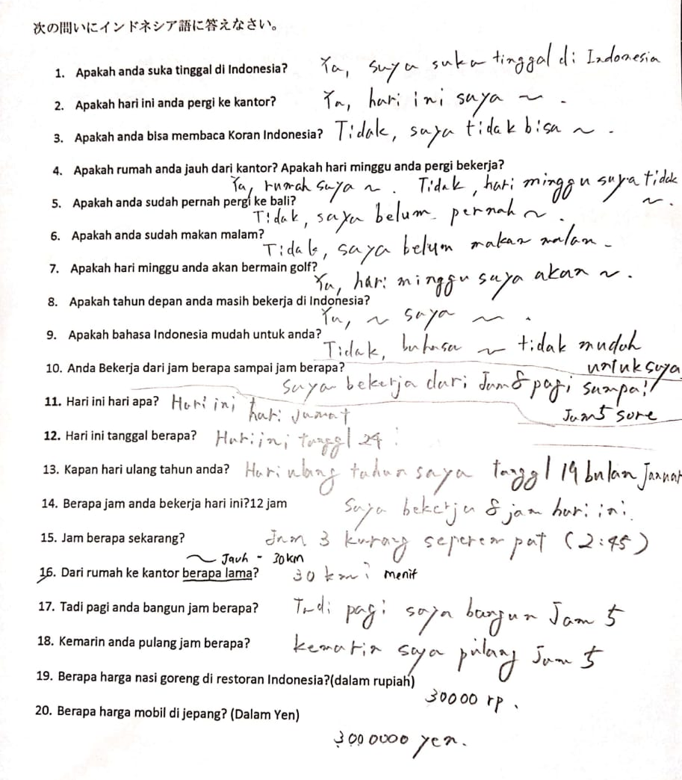
FINDING AND DISCUSSION
Analysis document record
Pemelajar : Saya makan nasi dengan, ？箸インドネシア語でどういう意味?
(Sumpit bahasa Indonesianya apa）
Pengajar : Boleh pakai kamus ya, 辞書を使ってもいいですよ。
(Boleh pakai kamus ）
Pemelajar : ああ、Sumpit、え！狭いもSumpit Kan?
（Aa, sumpit, eh semai juga sumpit kan?）
Pengajar : 狭いはSempit, 箸がSumpit発音が難しいですか？
(Semai itu sempit, hashi itu sumpit, susah untuk diucapkan ya?）
In document analysis on learning outcomes are found errors in sentence production due to limited vocabulary collections and writing, this is stated to be less than optimal if it is connected with the theory of the use of translanguaging which focuses on pedagogical practice, where during language learning, students are enabled to change language for receptive and productive purposes, for example students are allowed to read in English and write in Weils
(Baker in Gracia & Wei, 2011: 6).)

Slide 8
FINDING AND DISCUSSION
Student Opinion
Vocabulary mastery
Translanguaging can imply more resources use of textbooks and audiovisual materials Williams (2002)
Translanguaging help understanding vocabulary in the early learning stages to be faster, and more effective to use of time for study because they can used learning material from their L1
Producing sentences
Translanguaging is also efficient in building understanding because pre-existing knowledge is the basis for further learning and there is also ease of transfer across languages due to the existence of two languages that are interdependent (Wright and Baker, 2017; 280).
Translanguaging in sentence production helps students understand the structure of Indonesian sentences because it uses a combination of vocabulary in 1 sentence, this helps improve language acquisition skills in L1 and L2
Motivating and boosting self-confidence
The characteristics of Japanese students who are waiting to be proficient in communicating make translanguaging increase their motivation to produce sentences in speaking because they can combine sentences in L1 without feeling afraid of being wrong when speaking.

Slide 9
CONCLUSION
BIPA learning with the Translanguaging strategy, is requires the teacher to understand student L1 and this process can be carried out in individual classes or group classes with homogeneous learners
Conclusion
Translanguaging is carried out in a structured and gradual, with reducing in every meeting to help make productive mastery more effective
Need more detailed research with more samples in implementing the translanguaging strategy so that the data is obtained accurately and represents the population of BIPA students

Slide 10
REFERENCES
Aoyama, R. (2020). Exploring Japanese High School Students' L1 Use in Translanguaging in the Communicative EFL Classroom. TESL-EJ, 23(4), n4.
Bradley, J., & Simpson, J. (Eds). (2020). Translanguaging as transformation: The collaborative construction of new linguistic realities.Multilingual Matters
Canagarajah, S. (2011). Codemeshing in academic writing: Identifying teachable strategies of translanguaging. The Modern Language Journal, 95(3), 401-417.
Creese, A., & Blackledge, A. (2010). Translanguaging in the bilingual classroom: A pedagogy for learning and teaching? Modern Language Journal 94 (1), 103-115.
Cenoz, J., & Gorter, D. (2021). Pedagogical translanguaging. Cambridge University Press.
Creswell, J. W., & Poth, C. N. (2016). Qualitative inquiry and research design: Choosing among five approaches. Sage publications.
Emilia, E., & Hamied, F. A. (2021). Translanguaging (TL) practice in a tertiary EFL context in Indonesia. Teflin Journal.
Garcia, O., & Wei, L. (2014). Translanguaging: Language, bilingualism and education. Palgrave Macmillan.
Otheguy, R, Garcia, O., & Reid, W. (2015). Clarifying translanguaging and deconstructing named languages: A perspective from linguistics. Applied Linguistics Review 6 (3), 281-30
Pennycook, A. (2017). Ttranslanguaging and semiotic assemblages. International Journal of Multilingualism, 14(3), 269–282. doi:10.1080/14790718.2017.1315810
Sidik, R., Mulyati, Y., & Sundusiah, S. (2021). Analisis Kebutuhan Bahasa Indonesia bagi Penutur Asing untuk Bertahan Hidup bagi Ekspatriate Jepang. In Seminar Internasional Riksa Bahasa (pp. 64-70).
Nurfitriani, S., & Putra, D. K. (2021). Interferensi Fonologis Bahasa Jepang terhadap Bahasa Indonesia pada Pemelajar BIPA di PT Sakai Mulia Koken Indonesia. Jurnal Bahasa Indonesia bagi Penutur Asing (JBIPA), 3(1), 42-51

Slide 11
THANK YOU!

