Slide 1
Analysis of Cultural Elements in the Integrated Korean Language Book for Intermediate Level 3 for Indonesian Learners through Index, Icon, and Symbol.
No. Abstract: ABS-ICOLLITE-23136
Siti Balqis Nasihin¹, Risa Triarisanti²,
Universitas Pendidikan Indonesia

Slide 2
INTRODUCTION
In this era, language learning books include and emphasize a plethora of cultural elements to represent and highlight the culture of the country whose language is being learned. The aim is for learners not only to grasp the language but also to gain insights into its culture.
Geertz, in Pujiyanti and Zuliani (2014:2), defines culture as a system of symbol meanings, where symbols in the semiotic system function to convey meaning from one mind to another. Symbols imply a relationship between the form of the indicator and the meaning of the signal.
Koentjoroningrat asserts that culture is universal and can be found in various parts of the world. Culture is comprised of seven elements: (a) Language system, (b) Knowledge system, (c) Social system, (d) The system of living equipment and technology, (e) Livelihood system, (f) Religious system, and (g) Art. (Sumarto, 2018).
According to Peirce, as mentioned in Putri (2022: 462), culture can be perceived through three aspects: index, icon and symbol

Slide 3
LITERATURE REVIEW
The first research was conducted by Soffani & Nugroho (2019) entitled "Cultural Elements in Social Media: A Study on Kang Dedi Mulyana's Facebook."
The second previous research was conducted by Hermansya, Suyatno, & Yuniseffendri (2022) titled "Presentation of Indonesian Cultural Elements in BIPA Teaching Materials Published by KEMENDIKBUD."
The third previous research was conducted by Mawaddah (2021) with the title "Cultural Elements in A. Hasjmy's Novels (Postcolonialism Study)."

Slide 4
METHOD
This research method uses qualitative techniques and collects data through literature study techniques, specifically the read-and-record technique. The research instrument used is human, where the researcher acts as a participant and data collector. The library tools used in the reading and recording technique include pens, textbooks, flash drives, laptops, and notebooks.
This research also utilizes a semiotic approach, with Peirce's theory as the theoretical framework. According to Peirce (in Putri, 2022: 462), cultural elements can be categorized based on three aspects: index, icon, and object. Peirce's theoretical formulation includes the concepts of representamen, object, and interpretant. He views a sign as a unity because it presents an object that can be interpreted. Next, the three signs will be grouped based on Koentjoroningrat's theory (1990) as cited in Pujiyanti & Zuliani (2014). Koentjoroningrat's theory identifies seven cultural elements, namely language system, knowledge system, social system, living equipment system and technology, religious system, livelihood system, and art.
This book is a Korean language textbook created by the Korea Foundation with the support of donations from KB Kookmin Bank, and its purpose is to promote the Republic of Korea to foreign countries, including Indonesia.

Slide 5
FINDING AND DISCUSSION
Cultural Elements | Index | Icon | Symbol
Language System | 0 | 0 | 50
Knowlegde System | 0 | 21 | 0
Social System | 4 | 1 | 4
The System of Living Equipment and Technology | 3 | 5 | 0
Religious System | 0 | 1 | 0
Livelihood System | 5 | 6 | 0
Art | 0 | 2 | 0

Slide 6
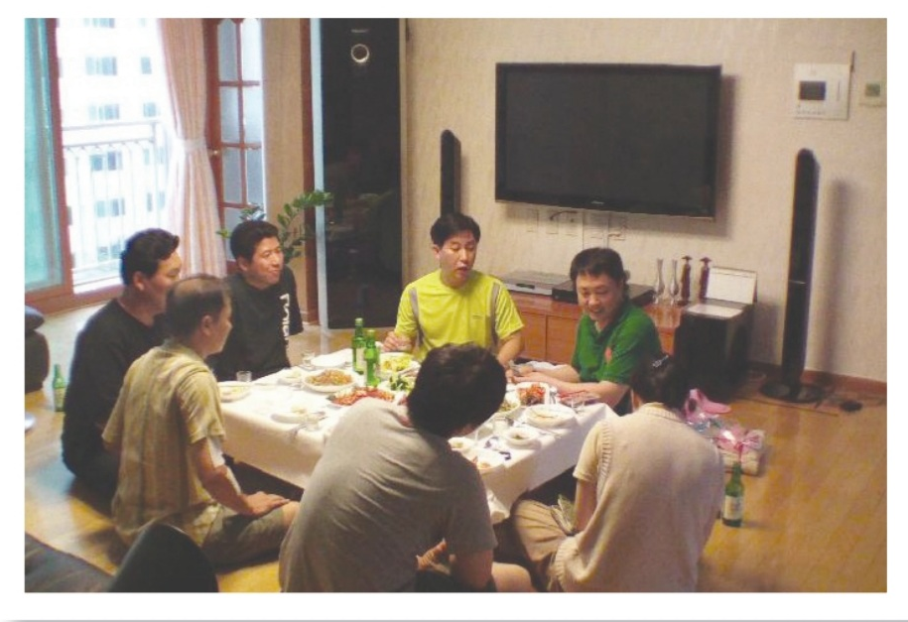
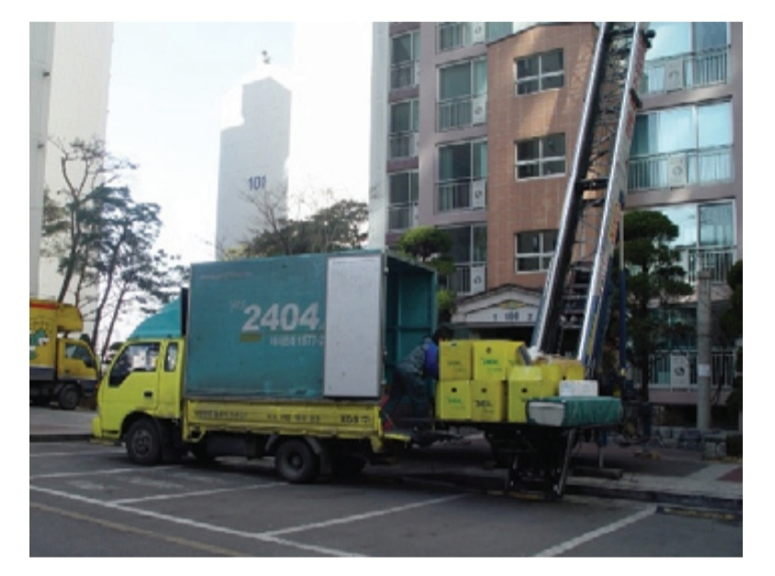
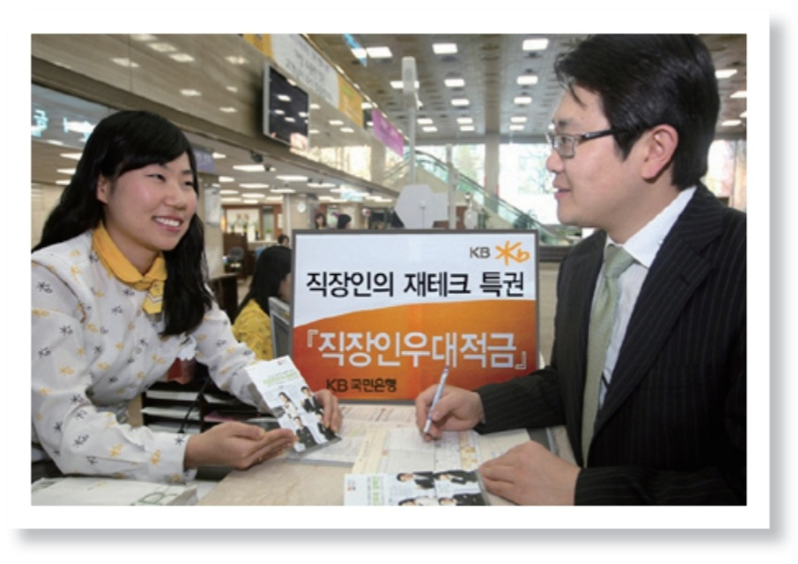
FINDING AND DISCUSSION
In Index:
There are several example of cultural elements in the index
(1) 집들이 (housewarming party) (2) 이삿점센터(moving company) (3) 한국 은행 (Bank of Korea)

Slide 7
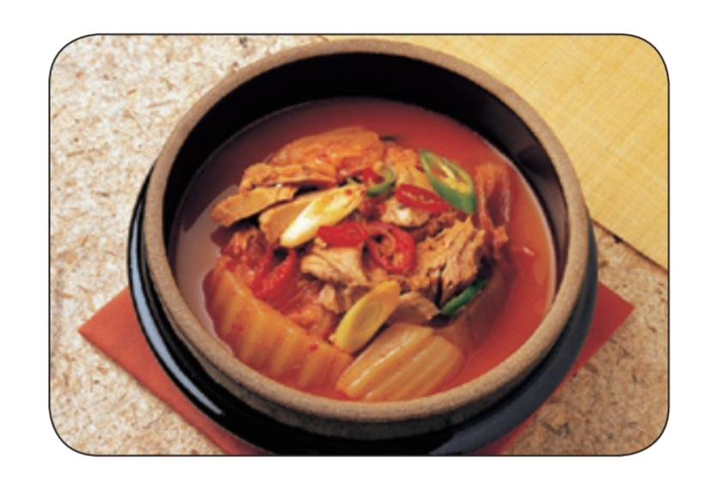
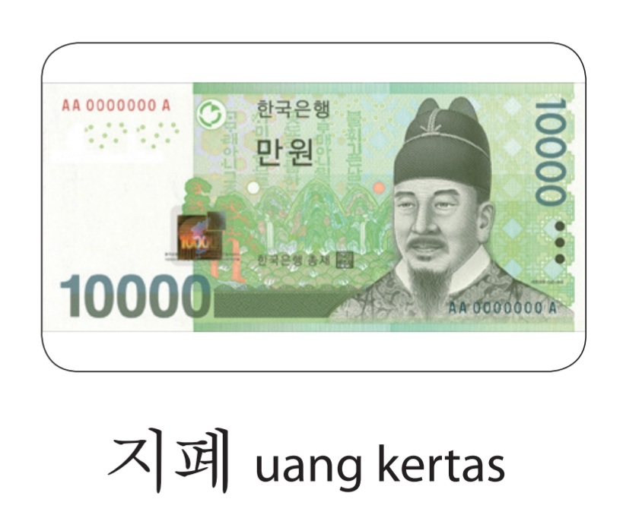
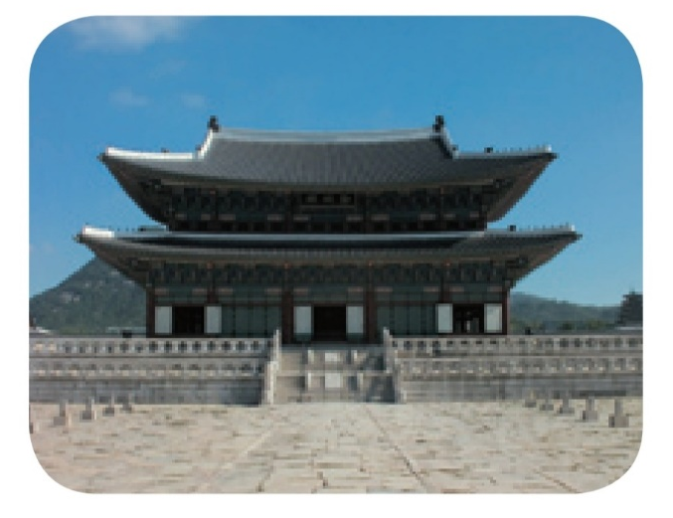
FINDING AND DISCUSSION
In Icon
There are several example of cultural elements in the Icon
(1) Kimchi Jjigae (김치 찌개) (2) won-shaped banknotes (지폐) (3) Ancient Palace (경복궁)

Slide 8
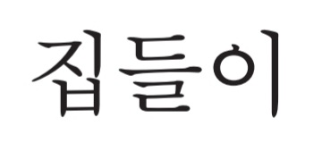
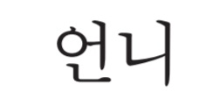
FINDING AND DISCUSSION
In the Symbol
There are several example of cultural elements in the symbol
-는 동안
[-neun dongan]
(2) -아/어 가다
[-a/eo gada] ]
(3) 집들이
(housewarming party)
(4) 언니
[older sister]

Slide 9
CONCLUSION
Based on the results of the research on the elements of Korean culture in the book 'Integrated Korean Language Book for Intermediate Level 3 for Indonesian Learners' published by Kookmin Book and the Korea Foundation, an analysis was conducted using the semiotic approach and Peircean theory of signs, including icons, indexes, and symbols. Furthermore, an additional analysis was performed using Kontjoroningrat's theoretical approach, which identifies seven elements of culture: language system, knowledge system, social system, The system of living equipment and technology, religious system, livelihood system, and art.
Based on the results of the analysis, it was found that the elements of culture in index and symbol sign have not been fully represented. However, in the icon sign, almost all cultural elements are included, except for the language system.

Slide 10
REFERENCES
Ahn, K. H., Lee, J. H., & Subandiati, D. (2013). Bahasa Korea Terpadu untuk Orang Indonesia Tingkat Madya 3. Seoul: The Korea Foundation.
Hermansya, Y. M., Suyatno, & Yuniseffendri. (2022). PENYAJIAN UNSUR BUDAYA INDONESIA DALAM BAHAN AJAR BIPA TERBITAN KEMENDIKBUD. Jurnal DISASTRI (Pendidikan Bahasa dan Sastra Indonesia), 68-79. doi:https://doi.org/10.33752/disastri.v4i3.3714
Mawaddah. (2021). UNSUR BUDAYA DALAM NOVEL KARYA A. HASJMY (KAJIAN POSTKOLONIALISME). Jurnal Master Bahasa Vol. 9 (2).
Pujiyanti, U., & Zuliani, F. R. (2014). CROSS CULTURAL UNDERSTANDING: A HANDBOOK TO UNDERSTAND OTHERS' CULTURES. Yogyakarta: CV. Hidayah.
Putri, S. A., Islami, A. H., Shohihuzzihni, Salsabila, A., & Farida, H. (2022). REPRESENTASI MUATAN BUDAYA YOGYAKARTA DALAM BAHAN AJAR BIPA: KAJIAN SEMIOTIK. Diglosia, Vol.6, No.2, 459-468.
Sumarto. (2019). Budaya, Pemahaman dan Penerapannya“Aspek Sistem Religi, Bahasa, Pengetahuan, Sosial, Keseninan dan Teknologi”. JURNAL LITERASIOLOGI, 1 (2), 144-159. doi:https://doi.org/10.47783/literasiologi.v1i2.49
Soffani, A., & Nugroho, C. (2019). UNSUR BUDAYA DALAM MEDIA SOSIAL: STUDI PADA FACEBOOK KANG DEDI MULYADI. Jurnal Manajemen Komunikasi, Vol. 3 (2), 158-172. doi:https://doi.org/10.24198/jmk.v3i2.12936

Slide 11
THANK YOU!
balqisnasihin@upi.edu, risatriarisanti@upi.edu

