Slide 1
THE USE OF SCRAMBLE TYPE COOPERATIVE LEARNING MODEL IN LEARNING BASIC READING COMPREHENSION OF JAPANESE LANGUAGE
No. Abstract: ABS-XXX
Hanna Ramadhina
INDONESIAN UNIVERSITY OF EDUCATION

Slide 2
INTRODUCTION
Indonesia is the second largest country in the world to learn Japanese culture and language.
In practical life, there are still many learners who find it difficult to understand the material in Japanese texts.
One of the problems faced by learners of Japanese is feeling bored while studying.
The researcher came up with the idea of using a scrambled cooperative learning model for basic reading comprehension of japanese language.

Slide 3
LITERATURE REVIEW
Baso, et al. (2021) in his article entitled Application of Scramble Model in Chinese Reading Learning for Class IV Students of Frater Thamrin Elementary School Makassar. In the article, based on the results of observations made, it is known that the lack of varied learning models used by teachers in the Chinese reading learning process makes it difficult for students to understand the Chinese reading material being taught. The purpose of their research was to find out the planning process, implementation and results of the application of the scramble model in learning to read Chinese for fourth grade students of Frater Thamrin Elementary School Makassar. The research method uses the Classroom Action Research (CAR) model. The results of the study stated that the results of students' Chinese reading tests increased in each cycle or it means that it has been concluded that the scramble learning model can improve the Chinese reading skills of fourth grade students of Frater Thamrin Elementary School Makassar.

Slide 4
Methods
Design
A Sample
Quasi-experiment
One-group pretest-posttest
28 first-year students in class 2A of the Department of Japanese Language Education FPBS UPI in the 2023/2024 academic year
Methods
Data Collection Techniques
Instrument
Experiment, test, questionnaire, observation and documentation
Test and questionnaire

Slide 5
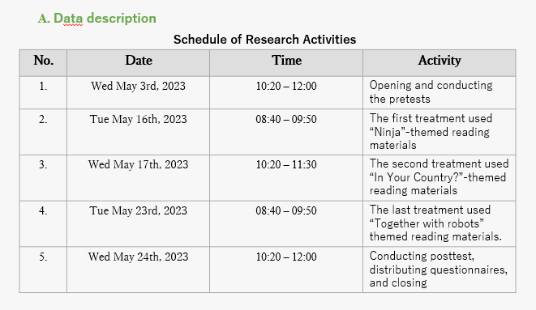
FINDING AND DISCUSSION

Slide 6
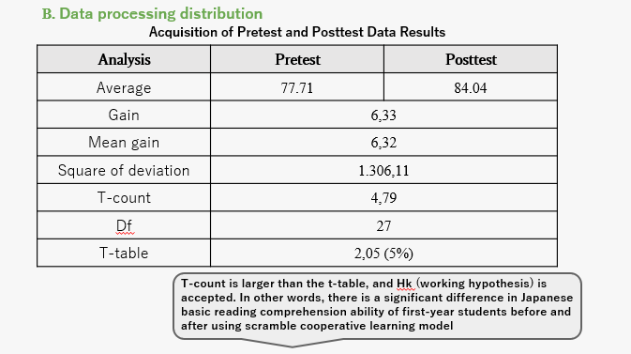
FINDING AND DISCUSSION

Slide 7
FINDING AND DISCUSSION

Slide 8
FINDING AND DISCUSSION

Slide 9
CONCLUSION
1.
2.
3.
It was found that the result of t count > t table based on the analysis of pretest and posttest data using statistical calculations. So, it can be said that there is a significant difference in Japanese basic reading comprehension ability of first-year students before and after using scramble cooperative learning model
The reading comprehension ability of Japanese basic level first year students after using the scramble type cooperative learning model for three times, showed a good change in the students' scores. So it can be said that students' reading comprehension ability has improved compared to before the use of this model
The questionnaire results show that most respondents responded positively to the use of the scramble type cooperative learning model in learning basic reading comprehension of Japanese. Students can more easily draw conclusions and understand the material and content of the reading text, understand more easily the meaning contained in each paragraph, and make learning interesting .

Slide 10
REFERENCES
Baso, S., Saleh, N., & Adys, H. P. Penerapan Model Scramble Dalam Pembelajaran Membaca Bahasa Mandarin Pada Siswa Kelas IV SD Frater Thamrin Makassar. Wen Chuang, 1(1), 11-21.
Sutedi, D. (2011). Penelitian Pendidikan Bahasa Jepang. Bandung: Humaniora
Trianto. (2010). Model Pembelajaran Terpadu. Jakarta: Bumi Aksara.
WorldCat. 日本語教育事典. [Online]. Available at: https://www.worldcat.org/title/nihongo-kyoiku-jiten/oclc/647488172

Slide 11
THANK YOU!

