Slide 1
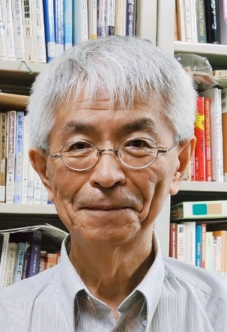
Differences in Direction Indicating Expressions between Japanese and German: A Contrastive Analysis of Newspaper Articles on Traffic Accidents
No. Abstract: ABS-ICOLLITE-23051
Yoshinori NISHIJIMA,
Kanazawa University.

Slide 2
INTRODUCTION
It is said that each language has its own preferred expressions. Japanese tends to be expressed subjectively from the speaker’s, i.e., focal person’s, standpoint, while English seems to be more factual and objective in its verbalization, such as: “財布を取られた (saifu-o torare-ta) [my wallet was stolen]” in Japanese and its corresponding English translation “someone took my wallet.” (Mizutani, 2008, 16f.)
According to Ikegami (2003), Japanese tends to depict an event from within the situation where it occurs in an experiential and subjective way, while English tends to express an event from outside the situation where it occurs in an objective way. This difference in the way languages grasp the situation is referred to as “subjective construal” and “objective construal.”
The aim of this study is to analyze how directions are expressed in similar traffic accident newspaper articles in Japanese and German in terms of subjective and objective construal, and to verify that Japanese tends to express directions subjectively and German objectively.

Slide 3
LITERATURE REVIEW
Ikegami (2000: 290-293) compares the opening sentence of Kawabata Yasunari’s novel Yukiguni with its English translation Snow Country by Seidensticker and argues that Japanese is a language of “subject-object congruence” and English a language of “subject-object opposition.”
(1) Kunizakai-no nagai tonneru-o nukeru-to yukiguni deatta.
country.border-POSS long tunnel-OBJ go.out-when snow.country COPULA-PAST
(2) The train came out of the long tunnel into the snow country.
(1) is a sentence in which the narrator expresses an experiential awareness, perhaps from the protagonist's point of view, that as soon as the train came out of the long, dark tunnel, the landscape changed completely and he realized that he entered a snow country. In other words, in Japanese, there is no separation between the subject (the narrator) and the object (the world depicted), and the expressing subject and the depicted object are not clearly separated, but are integrated into a single world.
In (2), however, the composition is that the narrator explains to the reader the scene where the train has left the long tunnel and entered the snow country. In other words, the framework can be read as a separation between the expressing subject of the story and the world in which the story is told, with the narrator explaining to the reader what is happening in the story world from outside the story world.
The above examples show that each language has its preferred way of expression.

Slide 4
METHOD
As mentioned above, Japanese tends to be expressed subjectively, while Western languages such as English and German tend to be expressed objectively.
In order to find out whether this tendency also exists in the expression of directional instructions, a comparison was made between Japanese and German newspaper articles, which corresponded almost exactly in terms of content.
Specifically, an article on a traffic accident, which occurs on a daily basis and is reported within the same 5W1H (6 W-Fragen) framework, will be analysed as a case study.
Hypothesis:
Japanese directional expressions are made from the subjective point of view of a particular person. In German, on the other hand, directions are given from an objective point of view.

Slide 5
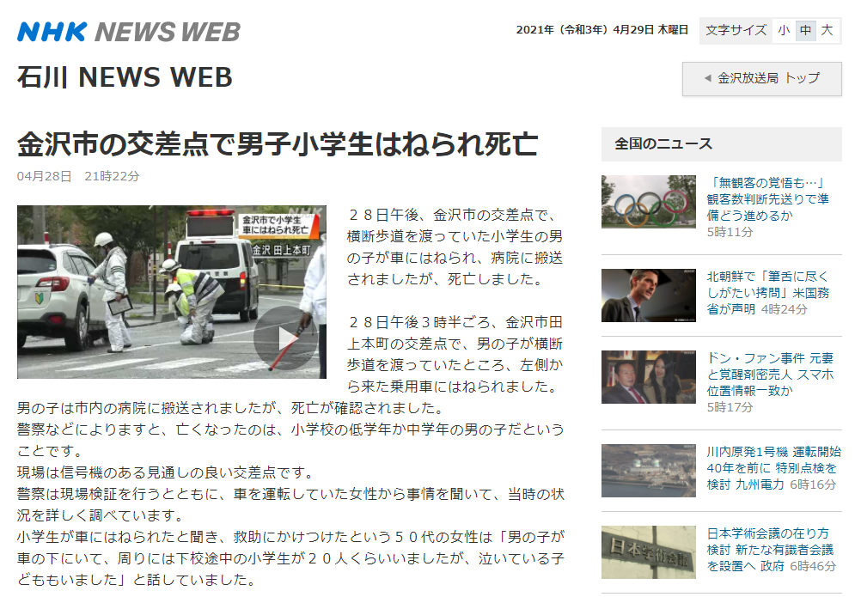
FINDING AND DISCUSSION
Japanese newspaper article
Ishikawa NEWS WEB
Kanazawashi-no koosaten-de danshi shoogakusei hanerare shiboo
[A schoolboy was hit and killed at an intersection in Kanazawa.]
April 28, 21:22
“… 28nichi gogo 3jihan goro kanazawashi tagamihonmachi-no koosaten-de otokonoko-ga oudanhodoo-o watatteita-tokoro hidarigawa-kara kita jooyoosha-ni haneraremashita. …”
[“… At around 3.30pm on April 28, a boy was hit by a passenger car coming from the left side when he was crossing a pedestrian crossing at an intersection in Tagamihonmachi, Kanazawa. …”]

Slide 6
FINDING AND DISCUSSION
Explanation of the Japanese expression
“… hidarigawa-kara kita jooyoosha-ni haneraremashita. …”
left.side-from come-PAST passenger.car-by hit-PASS-PAST
“… was hit by a passenger car coming from the left side…”
“hidarigawa-kara kita”
left.side-from come.PAST
To whom or to what does the expression “left side” in “coming from the left side” refer?
This directional indication of “left side” is expressed from the perspective of the victim (a school boy) in this article, i.e., the subject to be sympathised with. In this sense, it is a subjective expression.
Left side
Right side

Slide 7
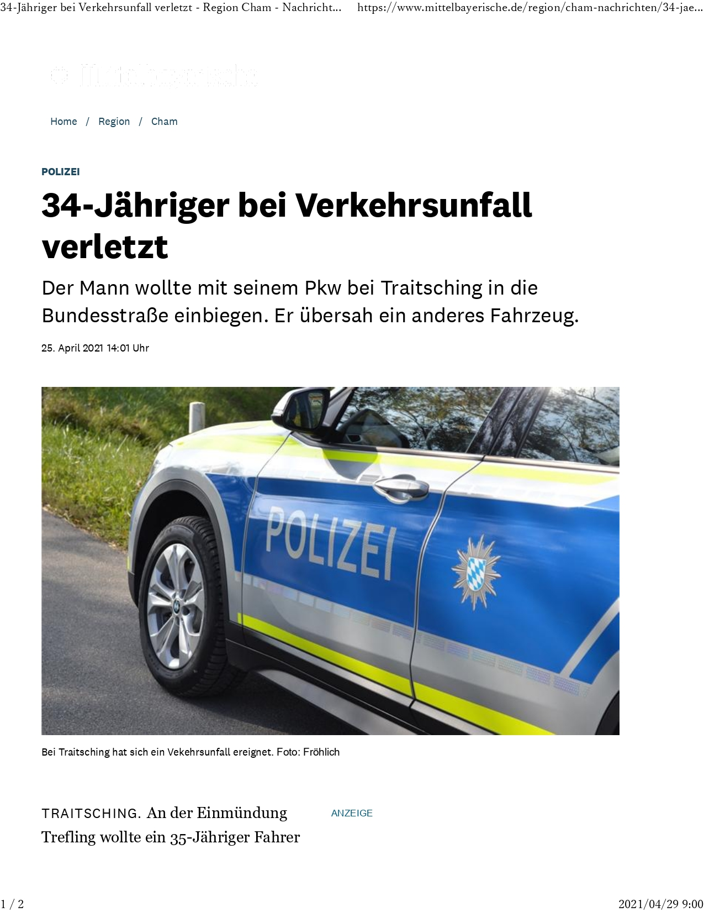
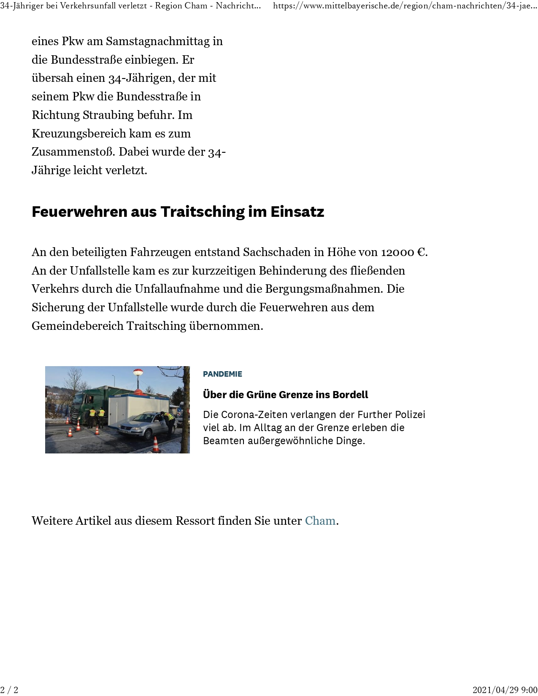
FINDING AND DISCUSSION
German Newspaper article:
Mittelbayerische Zeitung
34-Jaeriger bei Verkehrsunfall verletzt [34-year-old man injured in traffic accident]
Der Mann wollte mit seinem Pkw bei Traitsching in die Bundesstraße einbiegen. Er übersah ein anderes Fahrzeug. [The man wanted to turn onto the national road with his car near Traitsching. He overlooked another vehicle.]
25. April 2021 14:01 Uhr
„TRAITSCHING. An der Einmündung Trefling wollte ein 35-Jähriger Fahrereines Pkw am Samstagnachmittag in die Bundesstraße einbiegen. Er übersah einen 34-Jährigen, der mit seinem Pkw die Bundesstraße in Richtung Straubing befuhr. Im Kreuzungsbereich kam es zum Zusammenstoß. Dabei wurde der 34-Jährige leicht verletzt. ...“
[“TRAITSCHING. At the Trefling junction, a 35-year-old driver of a car wanted to turn onto the main road on Saturday afternoon. He overlooked a 34-year-old man who was driving his car on the main road in the direction of Straubing. A collision occurred at the intersection. The 34-year-old was slightly injured. ...”]

Slide 8
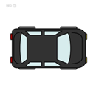
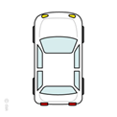
FINDING AND DISCUSSION
Explanation of the German expression
„Er übersah einen 34-Jährigen, der mit seinem Pkw die Bundesstraße in Richtung Straubing befuhr.“
[“He overlooked a 34-year-old man who was driving his car on the main road in the direction of Straubing.”]
“Straubing” is a place name. Since place names can objectively identify places, expressions containing them can be regarded as objective expressions.
direction ➡ Straubing
a 34-year-old driver
At the Trefling junction
a 35-year-old driver

Slide 9
CONCLUSION
The results show that in Japanese, the direction is expressed in terms of the left and right of the person involved such as “a boy was hit by a passenger car coming from the left side,” while in German, the direction to the city is used like “He overlooked a 34-year-old man who was driving his car on the national road in the direction of Straubing.”
In this way, Japanese describes direction subjectively with reference to the body of the person concerned, while German expresses direction objectively using place names. These are exactly the expressions that correspond to subjective and objective construal, respectively.
The present analysis is limited to directional expressions in traffic accident articles. It is therefore unclear whether directional expressions have a similar tendency in other genres of newspaper articles. In the future, it is necessary to further examine whether this difference is also valid for other newspaper articles.

Slide 10
REFERENCES
Ikegami, Y. (2000). “nihongoron” eno shootai [Invitation to the “theory of Japanese”]. Tokyo:
Kodansha.
Ikegami, Y. (2003). Gengo niokeru <shukansei> to <shukansei> no gengoteki shihyoo (1)
[<subjectivity> and linguistic indicators in languages (1) ]. In M. Yamanashi et al. (Eds.),
Ninchigengogaku ronkoo 3 [Studies of Cognitive linguistics 3] (pp. 1-49). Tokyo: Hituzi shobo.
Mizutani, N. (2008). Hanashikotoba no bunpoo – eigotono taishoo o chuushin ni – [Grammar of
spoken language: Focus on comparison with English]. Nihongogaku, 27(5), 16-22.

Slide 11
THANK YOU!
Yoshinori NISHIJIMA
E-mail: yoshinori.nishijima@gmail.com
yotchan@staff.kanazawa-u.ac.jp
https://researchmap.jp/Yoshinori_Nishijima?lang=en
https://www.researchgate.net/profile/Yoshinori-Nishijima

