Slide 1
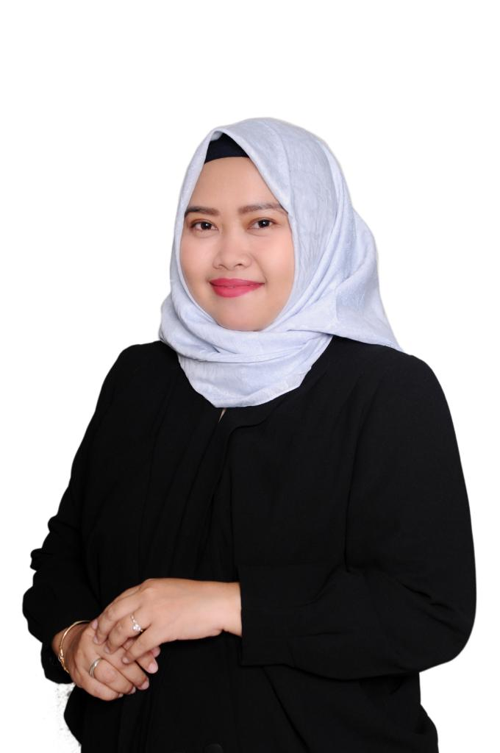
NAMING F&B BUSINESS IN MARGONDA DEPOK: WORD FORMATION STUDY
No. Abstract: ABS-ICOLLITE-23048)
Tri Rahayu Mayasari¹, Nico Harared²
¹ Universitas Nasional, Jakarta ² Universitas Indraprasta PGRI, Jakarta
Follow us on Instagram @3_rahayu_mhum / 082113443503 @nicoharared / 08116602125

Slide 8
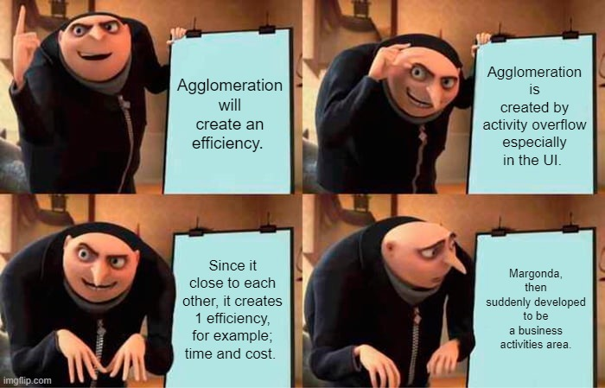
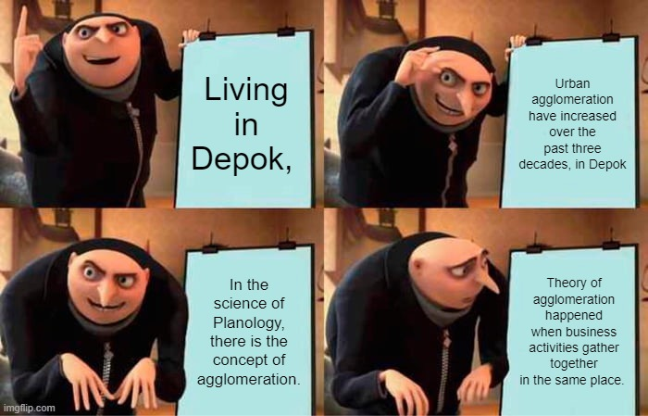
INTRODUCTION
Maximum 1 slide

Slide 9
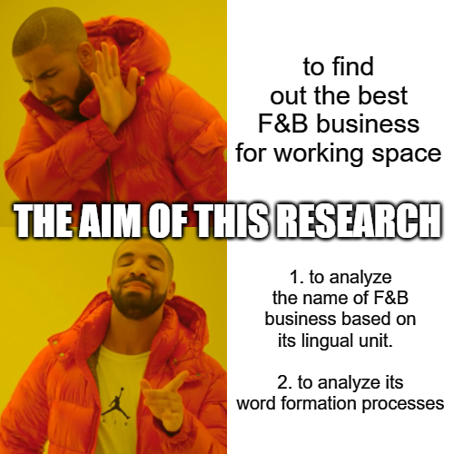
Urgency?

Slide 10
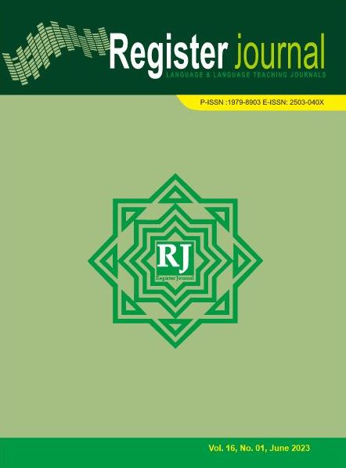
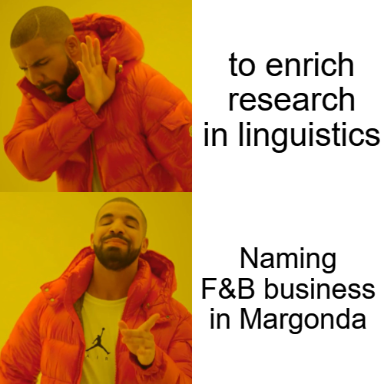
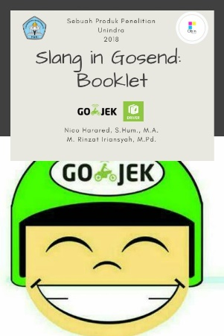
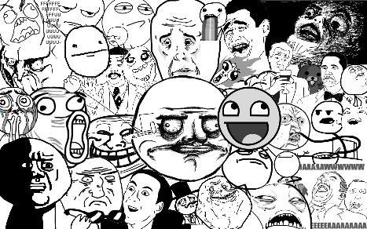
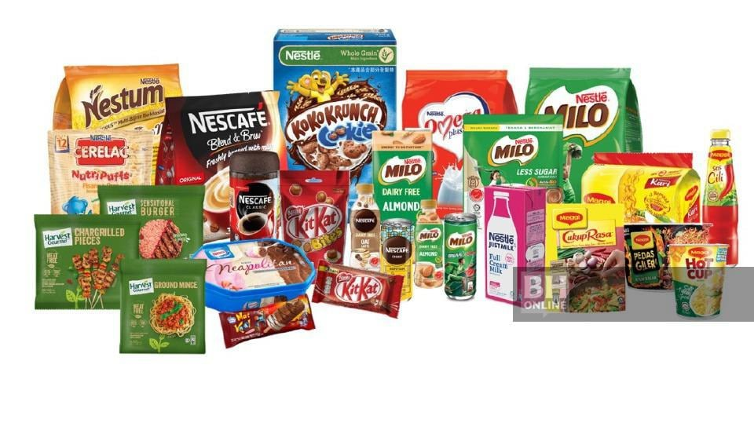
LITERATURE REVIEW
(Giyatmi et al., 2014)
(Harared, 2018)
(Komara, 2018)
(Harared & Iriyansah, 2018)
Research: Positioning
(Mayasari, Harared, 2023)
Types of Slang in Gosend
Brand names with English in Indonesian products are created
word formation used by the franchise business, especially F&B
Types of Slang in 1cak.com

Slide 11
METHOD
Source of the data
The brands of F&B appear in Margonda Depok
Qualitative
Data collection technique
Observational Method & Screenshoot
Data analysis technique:
Descriptive qualitative

Slide 12
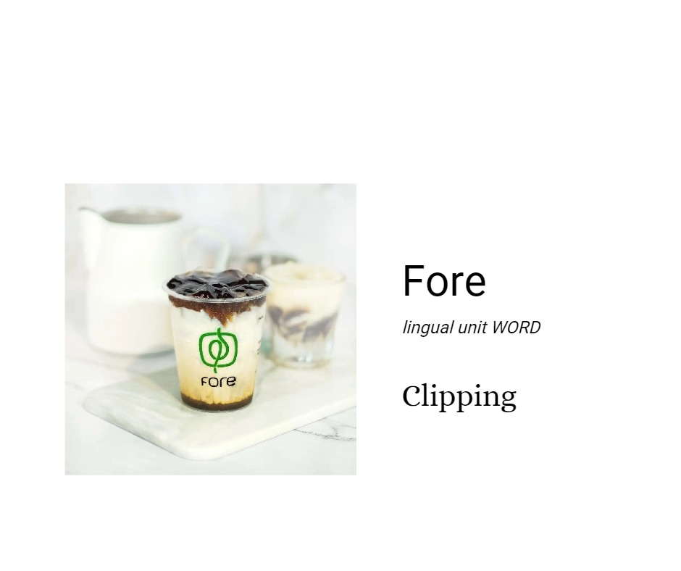
FINDING AND DISCUSSION
Minimum 2 slides, maximum 4 slides.
Table or chart can be displayed

Slide 13
FINDING AND DISCUSSION
Minimum 2 slides, maximum 4 slides.
Table or chart can be displayed

Slide 14
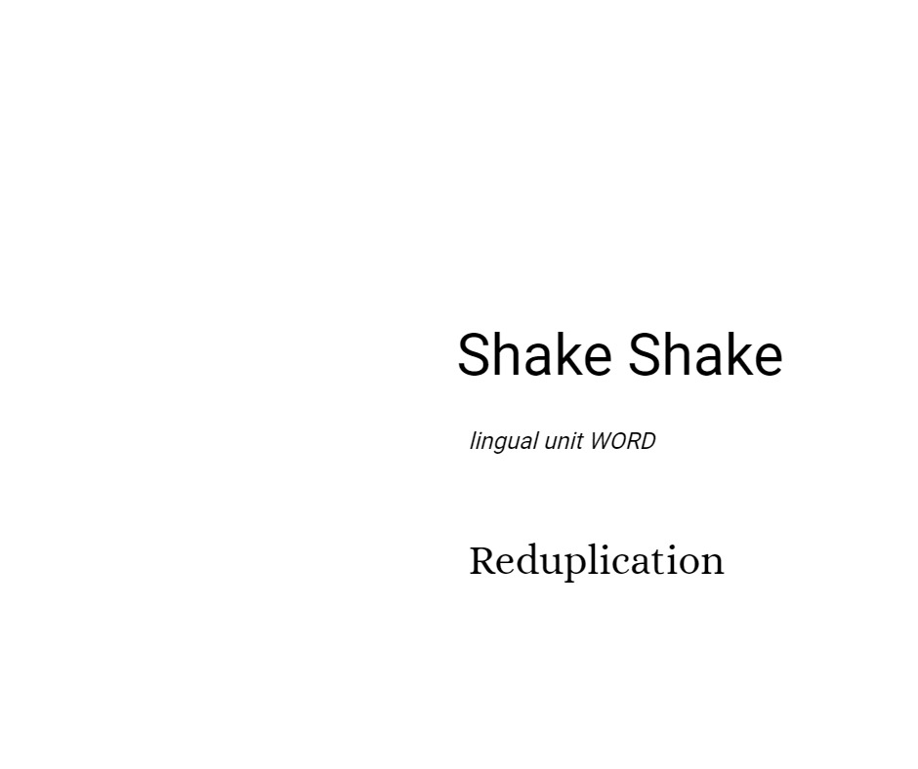
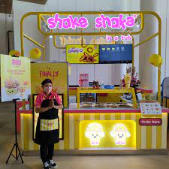
FINDING AND DISCUSSION
Minimum 2 slides, maximum 4 slides.
Table or chart can be displayed

Slide 15
FINDING AND DISCUSSION
Table or chart can be displayed

Slide 16
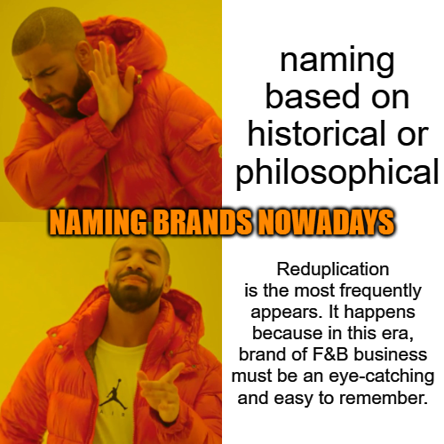
CONCLUSION
Maximum 1 slide

Slide 17
REFERENCES
Coleman, J. (2012). The Life of Slang. In Oxford University Press (Vol. 8).
Ek, A. (2018). Blending Words or: How I Learned to Stop Worrying and Love the Blendguage A computational study of lexical blending in Swedish. https://www.diva-portal.org/smash/get/diva2:1253226/FULLTEXT02
Giyatmi, G., Hastuti, E. D., Wijayava, R., & Arumi, S. (2014). The analysis of English word formations used on brand names found in Indonesian products. Register Journal, 7(2), 179–204.
Gries, S. T. (2004). Isn’t that fantabulous? How similarity motivates intentional morphological blends in English. Language, Culture, and Mind, 415–428.
Harared, N. (2018). SLANG CREATED AND USED IN 1CAK.COM SITE: SOCIOLINGUISTICS STUDY (Yanti Ph.D, Ed.; Issue April, pp. 338–341). UNIKA ATMA JAYA.
Harared, N., & Iriyansah, M. R. (2018). Slang analysis of the conversation among drivers Gosend by Gojek: A Case Study in Whatsapp Group. Seminar Nasional Struktural 2018, 107–113.
Komara, C. (2018). Analisis struktur lexical blend nama produk waralaba Indonesia. Konferensi Linguistik Tahunan Atma Jaya, 13.
Lehrer, A. (2007). Blendalicious//Lexical Creativity, Texts and Contexts. Amsterdam, Philadelphia, 115–133.
Mattiello, E. (2013). Extra-grammatical morphology in English. In Extra-grammatical Morphology in English. De Gruyter Mouton.
Renner, V. (2015). Lexical blending as wordplay. Wordplay and Metalinguistic/Metadiscursive Reflection, 119–133.
Ronneberger-Sibold, E. (2012). Blending between grammar and universal cognitive principles: Evidence from German, Farsi, and Chinese. Cross-Disciplinary Perspectives on Lexical Blending, 115–144.
Tsvetkova, M. (2017). THE NON-LINGUISTIC CONTEXT – A BRIDGE TO LINGUISTIC ITEMS AND PHENOMENA. Studies in Linguistics, Culture, and FLT, 02, 219–226. https://doi.org/10.46687/SILC.2017.v02.018
Yule, G. (2006). The Study of Language (third). Cambridge University Press.

Slide 18
THANK YOU! We Need Feedback & Respond, because we want to wide our circle
Follow us on Instagram
@3_rahayu_mhum / 082113443503 @nicoharared / 08116602125

