Slide 1
The Use of Chat GPT AI as Japanese Conversation Learning Media
No. Abstract: ABS-ICOLLITE-23212
Mumu Muhammad Rifai,
Universitas Pendidikan Indonesia (s).

Slide 2
INTRODUCTION
CHAT GPT
Learning a new language, especially Japanese, can be a challenging yet rewarding endeavor. With the advancements in Artificial Intelligence (AI) and Natural Language Processing (NLP), chatbots powered by GPT (Generative Pre-trained Transformer) AI models have become valuable tools for language learning. This presentation focuses on their application as Japanese Conversation Learning Media, aiming to examine their potential in facilitating learners' ability to engage in meaningful conversations in Japanese.

Slide 3
LITERATURE REVIEW
Various studies have explored the effectiveness of AI-powered chatbots in language acquisition ( Kohnke, Moorhouse & Zou, 2023; AbuShawar & Atwell, 2015), including Japanese. OpenAI ChatGPT is an advanced chatbot that utilizes the OpenAI GPT-3 language model. Its primary purpose is to produce human-like text responses within a conversational setting. Trained on extensive data of human interactions, OpenAI ChatGPT can adeptly generate responses spanning a broad spectrum of subjects and prompts.
Chatbots such as OpenAI ChatGPT offer a dynamic and interactive learning experience, simulating real-life conversations and providing personalized feedback, which enhances learners' language skills.

Slide 4
METHOD
Literature Review

Slide 5
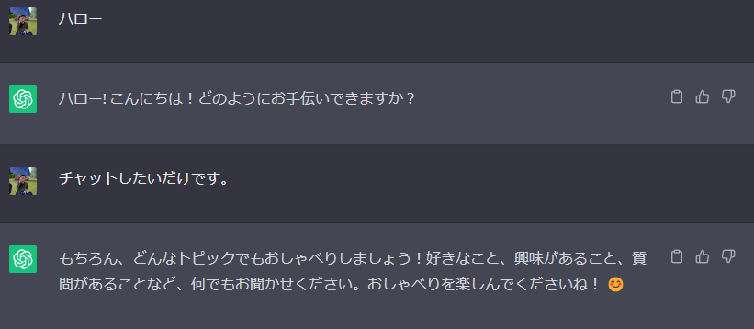
FINDING AND DISCUSSION
Advantages of ChatGPT OpenAI
Responses are very varied and not like a robot
Continuous response to the previous talk
Can correct grammar mistakes

Slide 6
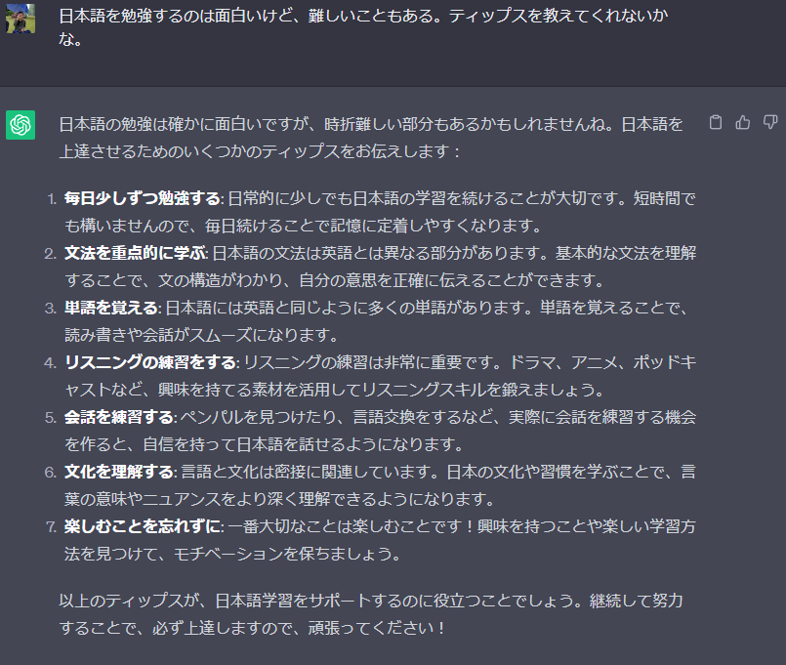
FINDING AND DISCUSSION

Slide 7
FINDING AND DISCUSSION
The literature review on the use of Chat GPT AI as Japanese conversation learning media highlights the growing interest in leveraging artificial intelligence (AI) chatbots for language acquisition, specifically in the context of learning Japanese conversational skills.
The rising popularity of ChatGPT in the domain of language education, especially in the emerging field of computer-assisted language learning, calls for a thorough examination of the possible ramifications of this remarkable tool (Sakai, 2023).

Slide 8
CONCLUSION
In conclusion, this presentation sheds light on the potential and advantages of utilizing ChatGPT AI as Japanese Conversation Learning Media. The advancements in Artificial Intelligence (AI) and Natural Language Processing (NLP) have made chatbots, particularly those powered by GPT AI models like OpenAI ChatGPT, valuable tools for language learning. As revealed through various studies, these AI-powered chatbots offer dynamic and interactive learning experiences, simulating authentic conversations and providing personalized feedback to enhance learners' language skills.

Slide 9
REFERENCES
Maximum 1 slide
Kohnke, L., Moorhouse, B. L., & Zou, D. (2023). ChatGPT for language teaching and learning. RELC Journal, 00336882231162868.
AbuShawar, B., & Atwell, E. (2015). ALICE chatbot: Trials and outputs. Computación y Sistemas, 19(4), 625-632.
Sakai, N. (2023). Investigating the Feasibility of ChatGPT for Personalized English Language Learning: A Case Study on its Applicability to Japanese Students.

Slide 10
THANK YOU!
Follow us @...

