Slide 1
TRADITIONAL BALINESE GAMES LEXICONS
No. Abstract: ABS-ICOLLITE-23026
I Gede Budasi, I Ketut Trika Adi Ana
Universitas Pendidikan Ganesha

Slide 2
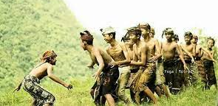
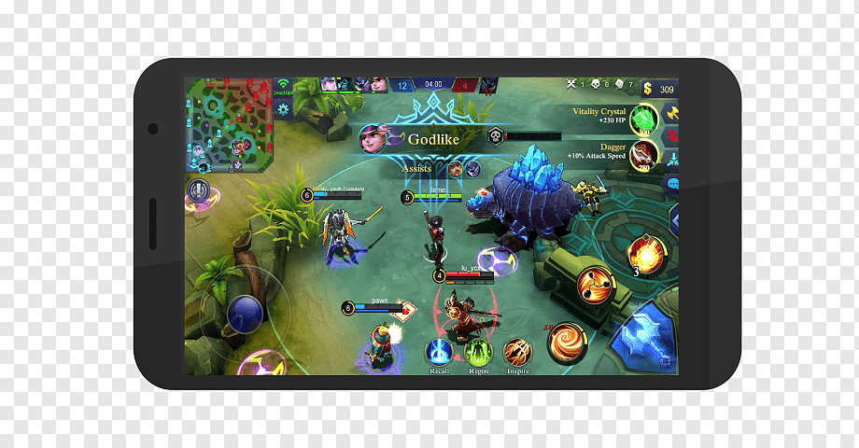
INTRODUCTION
Replace Balinese traditional game
Only a few Balinese children still play traditional Balinese games.
Most Balinese children no longer understand many traditional Balinese game lexicons.
Thus, this study aims to identify and record the lexicons used in traditional Balinese games to preserve them.
SMARTPHONES

Slide 3
LITERATURE REVIEW
THEORETICAL REVIEW:
Lexicon
Lexicon is the list of words found in a language (Aronoff & Anshen, 2003).
Language and Culture
Language and culture are related to each other (Mikhaleva & Régnier, 2014). It means that we can maintain a language through cultural activities (Johnson, 2012).
Endangered language
An endangered language is a language that is in danger of extinction, and the phenomenon is called language endangerment (Tsunoda, 2001).
EMPIRICAL REVIEW:
Arya (2015) identified the reasons why Balinese traditional games were no longer played by Balinese children
Lestari et al. (2017) conducted a study to preserve Balinese traditional games by implementing in one of the kindergarten in Bali
Jayendra (2021), Widiastuti and Kusuma (2021) implemented Balinese traditional game to teach character education
Yoganantha et al (2021) and Pasta et al. analyzed traditional Balinese game from photography perspectives
Novelty: No study has been conducted to preserve Balinese Traditional Game form linguistics point of view

Slide 4
METHOD
This study can be classified as an ethno-linguistics study that aims to preserve Balinese traditional lexicons.
The researchers collected the data through interviews.
The samples of the study were selected through a snowballing technique. One key informant and four supporting informants were involved in this study.
Data trustworthiness was evaluated using source triangulation
The collected data were analyzed qualitatively using interactive data analysis model that consisted of three steps, data reduction, data display, and conclusion drawing/verification

Slide 5
FINDING
NAMES OF THE GAME
Siap-siapan | Maceleng-celengan | Tajen-tajenan | Makelas-kelasan
Matembing | Mameong-meongan | Masuntik | Gebug
Magala-galaan | Masujang-sujang | Maunti | Macepetan
Mageri-gerian | Macurik manggis | Madayung | Magemuk-gemukan
Matajog/Tajog | Malekenting | Malayangan | Macingklak
Makepung | Mancan-macanan
LEXICON CLASSIFICATION
Names of game:
22 lexicons
Game Tools:
30 lexicons
Game rules:
34 lexicons
TOTAL: 86 lexicons
TOOL
Taji-tajian | Sanan | Telebing | Guwangan
Don jarak | Keroncongan | Ende | Ikut
Don waru | Lampit | Gitikan | Kaluk
Tedeng aling-aling | Pis bolong | Suntik | Kebo
Klangsah | Sen bengol | Katik | Cikar
Siap | Klip | Keraras | Gedebeg
Tajog | Ketip | Layangan | Benang
Tiing | Talen
RULES
Pekembar | Embung | Munggah | Curub
Saya | Cak | Ngalih | Mabulet ginting
Ngencel | Bebeh | Mengkeb | Meong
Ngandong | Menang | Negen | Bikul
Ngenyang | Kalah | Genuk | Mesulub
Jaran | Sapih | Celeng | Nyongkok
Sut | Nyerah | Ngajet | Ngemel
Jaga | Manggis | Cub | Melinggeb
 | Bataran |  | Curik

Slide 6
FINDING
NOUN
Siap-siapan | Taji-tajian | Talen | Macurik manggis | Kebo
Matembing | Don jarak | Kaluk | Malekenting | Sanan
Magala-galaan | Don waru | Telebing | Mancan-macanan | Keroncongan
Mageri-gerian | Tedeng aling-aling | Ende | Makelas-kelasan | Lampit
Matajog/Tajog | Klangsah | Gitikan | Gebug | Pis bolong
Makepung | Siap | Suntik | Tajen-tajenan | Sen bengol
Magemuk-gemukan | Tajog | Katik | Masuntik | Klip
Maceleng-celengan | Tiing | Keraras | Maunti | Ketip
Mameong-meongan | Cikar | Layangan | Madayung | Macingklak
Masujang-sujang | Gedebeg | Benang | Malayangan | Macepetan
Ikut | Guwangan | Jaran | Genuk | Celeng
Meong | Bikul | Bataran | Bebeh | Embung
Curik | Manggis |  | Mabulet ginting
WORD CLASS
Noun:
62 lexicons
Verbs:
27 lexicons
Adjective:
5 lexicons
Ngencel | Curub | Ngalih | Ngajet | Munggah
Ngandong | Mesulub | Mengkeb | Cub | Ngemel
Ngenyang | Nyongkok | Negen | Jaga
Cak | Menang | Kalah | Sapih | Nyerah

Slide 7
CONCLUSION & SUGGESTION
This study concluded that:
There were 22 traditional games with total 86 lexicons were identified in this study that can be classified into names of game, tool, and rules.
The lexicons were dominated by nouns and followed by verbs. Only few adjectives were identified in this study. Some of the lexicons are similar to Indonesian lexicon.
Since this study was limited only to identifying the traditional Balinese games lexicons, a further study to identify Balinese children understanding of those lexicons is crucial to be conducted. That study is important to be conducted because it will determine the existence of those lexicons.

Slide 8
References
[1] Heyes C. Culture. Curr Biol 2020;30:R1246–50. https://doi.org/10.1016/j.cub.2020.08.086.
[2] Ege R, Budke A. “[Culture] Makes Each Country Unique, It’s Kind of like a Trademark.” Empirical Results on Students’ Perceptions of Culture and Space as Learning Prerequisite for Geography Lessons. Eur J Investig Heal Psychol Educ 2022;12:98–113. https://doi.org/10.3390/ejihpe12020009.
[3] Gonzalez MB, Aronson BD, Kellar S, Walls ML, Greenfield BL. Language as a Facilitator of Cultural Connection. Ab-Original J Indig Stud First Nations’ First Peoples’ Cult 2017;1:176–94. https://doi.org/10.5325/aboriginal.1.2.0176.
[4] Zhou C, Dewaele J-M, Ochs CM, De Leersnyder J. The Role of Language and Cultural Engagement in Emotional Fit with Culture: an Experiment Comparing Chinese-English Bilinguals to British and Chinese Monolinguals. Affect Sci 2021;2:128–41. https://doi.org/10.1007/s42761-021-00037-x.
[5] Smeets R. Language as a vehicle of the intangible cultural heritage. Museum Int 2004;56:156–65. https://doi.org/10.1111/j.1350-0775.2004.00470.x.
[6] Budasi IG, Satyawati MS, Anggayana IW. The Status of Leksikon in Tabuh Rah Ritual in Menyali Village. Kasetsart J Soc Sci 2021;42:960–967. https://doi.org/10.34044/j.kjss.2021.42.4.33.
[7] Widiastuti NMD, Kusuma PSD. Kajian Permainan Tradisional Bali Untuk Membantu Pembentukan Karakter Dan Keterampilan Sosial Anak. Segara Widya J Penelit Seni 2021;9:98–105. https://doi.org/10.31091/sw.v9i2.1740.
[8] Wipradana IBK. Minat Dan Motivasi Peserta Didik Kelas Vii Smp Negeri 2 Singaraja Sebagai Generasi Milenial Terhadap Olahraga Tradisional Bali. J Ilmu Keolahragaan Undiksha 2021;9:8–17.
[9] Apriati Y, Moktika T, Asmin E, Widaty C. Pergeseran Permainan Tradisional Menjadi Permainan Virtual Sebagai Dampak Pandemi Covid-19 Di Kota Banjarmasin. PADARINGAN (Jurnal Pendidik Sosiol Antropol 2021;3:390. https://doi.org/10.20527/padaringan.v3i2.3425.
[10] Nur H, Asdana MF. Pergeseran Permainan Tradisional di Kota Makassar. Phinisi Integr Rev 2020;3:17–29.
[11] Widada DM. Menemukan Jati Diri Bangsa melalui Bahasa Indonesia. J-PIPS 2016;3.
[12] Oktavianus O. Bahasa yang Membentuk Jati Diri dan Karakter Bangsa. J Arbitrer 2013;1:68. https://doi.org/10.25077/ar.1.1.68-74.2013.
[13] Antari Swandewi LP. Bahasa Indonesia Sebagai Identitas Nasional Bangsa Indonesia. J Jisipol 2019;8:17. https://doi.org/10.5281/zenodo.3903959.
[14] Simanjuntak CF. Dampak perkembangan teknologi terhadap permainan tradisional di daerah medan. Univ HKKBP Nommensen 2022.

Slide 9
References
[15] Arya PAP. Revitalisasi Permainan Tradisional Bali Sebagai Bagian Dari Atraksi Wisata Budaya Di Kota Denpasar. J Master Pariwisata 2015;1:83–99. https://doi.org/10.24843/jumpa.2015.v01.i02.p07.
[16] Lestari PI, Prima E, Erfiani NMD. Pemertahanan Budaya Melalui Permainan Tradisional Bali di Desa Pemecutan Kaja Kecataman Denpasar Utara. J Parad 2017;1:97–103.
[17] Jayendra PS. Permainan Tradisional Bali Juru Pencar Sebagai Media Pembelajaran Dan Pembentukan Karakter. Adi Widya J Pendidik Dasar 2019;3:65. https://doi.org/10.25078/aw.v3i1.906.
[18] Prasta IGA, Rediasa N, Budiarta GM. Permainan Tradisional Bali Dalam Karya Fotografi Konseptual. J Pendidik Seni Rupa Undiksha 2022;12:94–105.
[19] Yoganatha IPK, Candrayana IB, Bratayadnya PA. Permainan Tradisional di Desa Tua Tabanan dalam Fotografi Dokumenter. Retin J Fotogr 2021;1:45–52. https://doi.org/10.31091/rjf.v1i1.329.
[20] Mahayana IMA, Sukiani NK, Suwendri NM, Winaya MD. Leksikon-leksikon flora dalam metafora bahasa Bali: Kajian ekolinguistik. Kulturist J Bhs Dan Budaya 2019;3:41. https://doi.org/10.22225/kulturistik.3.2.1192.
[21] Kusuma IM. The Leksikons of Tabuh Rah used in Menyali village. Singaraja: Ganesha University of Education; 2019.
[22] Budasi IG, Ana IKTA, Suwindia IG, Sedana IM. Male versus Female Understanding of the Endangered Lexicon of Tabuh Rah Ritual. Theory Pract Lang Stud 2023;13.
[23] Creswell JW. Research design: Qualitative, quantitative and mixed methods approaches. vol. 4. London: Sage publications; 2014.
[24] Fraenkel JR, Wallen NE, Hyun HH. How to Design and Evaluate Research in Education. New York: McGraw-Hill; 2012.
[25] Miles MB, Huberman AM. Qualitative data analysis. illustrate. USA: SAGE; 2014.
[26] Ziatdinov R, Cilliers J. Generation Alpha: Understanding the Next Cohort of University Students. Eur J Contemp Educ 2021;10:783–9. https://doi.org/10.13187/ejced.2021.3.783.
[27] Pereira SW, Fishman EK, Rowe SP. The Future Is Now: How Technology and Entertainment Are Transforming Education in the Artificial Intelligence Era. J Am Coll Radiol 2022;19:1077–8. https://doi.org/https://doi.org/10.1016/j.jacr.2022.06.015.
[28] Alfianto AG, Ekaprasetia F. PISANG GEN ALFA : Smartphone Application for Mental Health Families of Alpha Generation in Indonesia. J a Sustain Glob South 2020;3:10–3.
[29] Arisma PED. Analisis Kondisi Sosial Ekonomi Petani Kopi Di Desa Sepang Kelod Kecamatan Busungbiu Kabupaten Buleleng. J Manaj Perhotelan Dan Pariwisata 2021;5:171–81.
[30] Pallant J. SPSS Survival Manual SPSS Survival Manual : A step by step guide to data analysis using SPSS. New South Wales: Allen & Unwin; 2011.

Slide 10
THANK YOU

