Slide 1
Literacy Competence Profile of 15 Year-Old Students In Bandung Raya
No. Abstract: ABS-ICOLLITE 23184
Dr. Yeti Mulyati, M.Pd., Dr. Suci Sundusiah, M.Pd., Dr. Andoyo Sastromiharjo, M.Pd.,
Devi Fadilah Susanti, Putri Syifa Maulida Salsabila,
Universitas Pendidikan Indonesia

Slide 2
Literacy Competence Profile of 15 Year-Old Students In Bandung Raya
No. Abstract: ABS-ICOLLITE 23184
Dr. Yeti Mulyati, M.Pd., Dr. Suci Sundusiah, M.Pd., Dr. Andoyo Sastromiharjo, M.Pd.,
Devi Fadilah Susanti, Putri Syifa Maulida Salsabila,
Universitas Pendidikan Indonesia

Slide 3
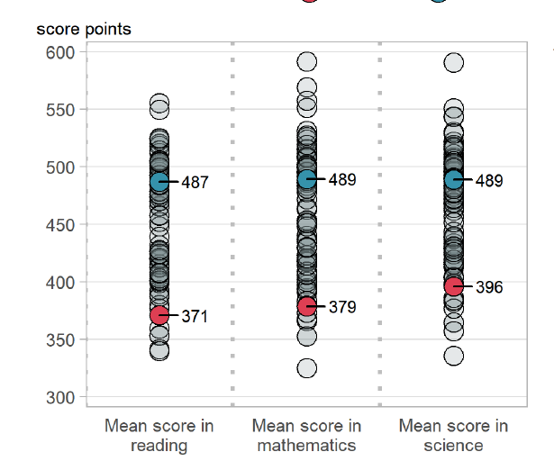
INTRODUCTION
The importance of literacy in this century is a focal point in learning.
Indonesia's reading literacy competency condition on an international scale ranks 72nd out of 77 countries with a score of 371 on the 2018 PISA test.
Other studies explain that students' literacy competence in understanding HOTS questions in Indonesia is still low when measured by the PISA instrument (Yasinta & Hamsa, 2022; Amir, Dalle, Dj, and Rismawati, 2022)
The government responded to this condition by implementing AKM (Asesmen Kompetensi Minimum) and changing the teaching assessment system, as well as providing an alternative to the Merdeka Curriculum.
AKM in the Merdeka Curriculum is used as an instrument for evaluating student learning, including reading literacy.
This research aims to determine the reading literacy competence of 15-year-old students (grade 7 junior high school) in the Bandung Raya area
Indonesia

Slide 4
LITERATURE REVIEW
Reading Literacy
(Vismaia, 2021); (Abidin, Mulyati & Yunansah, 2017)
Reading literacy can be interpreted as a skill to understand and apply the written language needed by society and/or appreciated by individuals.
Asesmen Kompetensi Minimum (AKM)
(Kemdikbud, 2020); (Kurniasih, 2021).
Competency assessment for students to develop self-ability and evaluation of teaching and learning activities.
There are 3 cognitive levels, namely the competency of finding information, understanding text information, and evaluating and reflecting on text
Programme For International Student Assessment (PISA)
(OECD, 2018)
Reading skill is a skill assessed by PADA. Students who take the PISA test are students aged 15 years.

Slide 5
METHOD
Types of research:
Quantitative
Research methods:
Survey
Method type:
Cross-sectional survey.
Research subject:
15th years old students (Grade VIII junior high school students)
Research Instruments:
AKM practice test questions from PUSMENDIK.

Slide 6
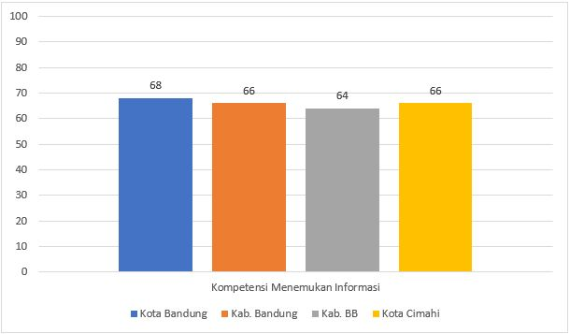
FINDING AND DISCUSSION
Competence to access and retrieve information in the text

Slide 7
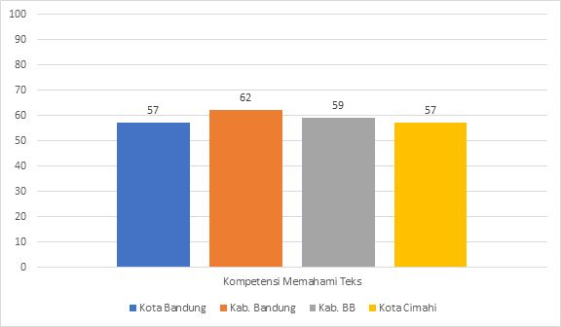
FINDING AND DISCUSSION
2. Competence to interpret and intergrate the information in the text

Slide 8
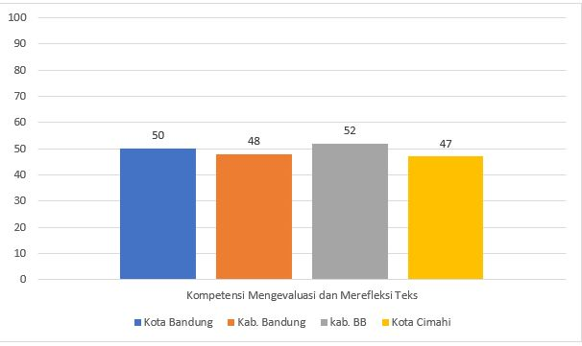
FINDING AND DISCUSSION
3. Competence of evaluate & reflect of information in the text

Slide 9
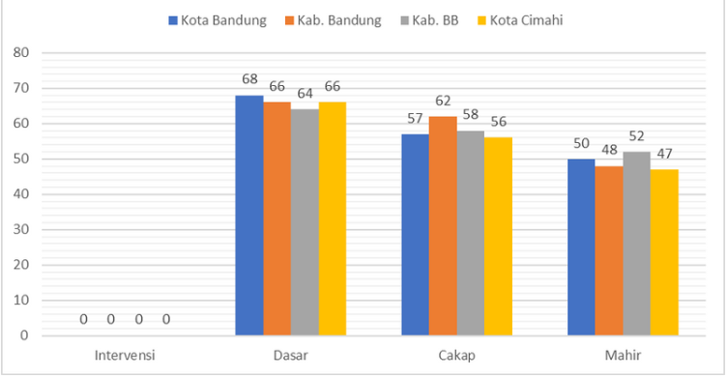
CONCLUSION
Special intervention
basic
competent
proficient

Slide 10
REFERENCES
Damaianti, V. S. (2021). LITERASI MEMBACA: Hasrat Memahami Makna Kehidupan. PT Refika Aditama.
Kemdikbud. (2020). AKM dan Implikasinya pada Pembelajaran. Pusat Asesmen Dan Pembelajaran Badan Penelitian Dan Pengembangan Dan Perbukuan Kementerian Pendidikan Dan KebudayaanPembelajaran Badan Penelitian Dan Pengembangan Dan Perbukuan Kementerian Pendidikan Dan Kebudayaan, 1–37.
Kemdikbud, D. (2021). Asesmen Kompetensi Minimum Sebagai Bagian dari Asesmen Nasional 2021. https://ditsmp.kemdikbud.go.id/asesmen-kompetensi-minimum-sebagai-bagian-dari-asesmen-nasional-2021/
Kurniasih, I. (2021). Kupas Tuntas Asesmen Nasional AKM (JP. Adi (ed.)). Kata Pena.
OECD. (2018). PISA for Development Assessment and Analytical Framework. In OECD Publishing. https://www.oecd-ilibrary.org/education/pisa-for-development-assessment-and-analytical-framework_9789264305274-en
Sani, R. A. (2021). Pembelajaran Berorientasi AKM: Asesmen Kompetensi Minimum (M. Rizal Rumra (ed.)). PT Bumi Aksara. https://books.google.com/books/about/Pembelajaran_Berorientasi_AKM.html?id=vo8lEAAAQBAJ

Slide 11
THANK YOU!

