Slide 1


Narrative structure in personal experience on healthcare service reviews in Santosa Hospital Bandung
Ani Rachmat, Susi Yuliawati, Dian Ekawati
Departemen of Linguistics,
Faculty of cultural Sciences

Slide 2
Outline
Background and relevance
Research objective
Methods
Findings
Discussion
Conclussion
References

Slide 3
Background and relevance
Increasing use of digital platforms for healthcare reviews.
Narrative is one of the language techniques for recapitulating
experience: a technique for constructing narrative units that
correspond to a time sequence in experience (Labov, 1966).
Importance of understanding patient narratives. In the context
of healthcare and illness, narrative is a rich source of knowledge
for practical and research purposes.
For health practitioners: A means of acquiring knowledge as well
as practicing their knowledge. A means to construct their role
and identity as medical professionals (Sarangi & Clarke, 2002).

Slide 4
Background and relevance
For patients: Narratives are useful for sharing experiences about their health and the health services they receive.
Trust and satisfaction are critical in Indonesian
healthcare`s context.

Slide 5
Research objective
The present research examines how patients (their families) employ narratives to evaluate their healthcare service experiences using a corpus-based approach.
We analyze feedback provided by patients (their families) regarding healthcare services at RS Santosa in Bandung, as expressed in online comments posted on Google Reviews.

Slide 6
Methods
Mixed-methods design (qualitative + quantitative).
Data source: 1.021 Google reviews (~29.955 words)
collected until April 2024.
Tools: manual annotation with XML tags, Sketch
engine.
Narrative elements: Abstract, Orientation,
Complication, Evaluation, Resolution, Coda.

Slide 7
Data and Annotation Techniques
Source: Santosa Hospital (Bandung).
Comments annotated using XML (e.g., <ABS>, <COM>).
Manual validation by trained assistants.
Focus: Frequency and sequence of narrative elements.

Slide 8
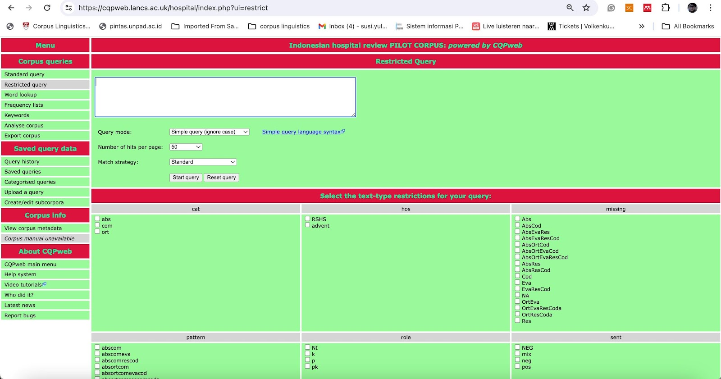
Data and Annotation Techniques

Slide 9
About Narrative
A narrative is a story about events that have happened or are happening to people, animals, etc. (Berger, 1997).
A narrative is the primary way through which humans organize their experiences into temporally meaningful episodes (Richardson, 1990).
Narrative is one method of recapitulating past experience by matching a verbal sequence of clauses to the sequence of events that actually occurred (Labov, 1972).
A narrative should contain at least two narrative clauses and the compulsory structural element of Complication. (Labov & Waletzky 1967; Özyildirim, 2009; & Brookes et al., 2021).

Slide 10
Narrative structure
ABSTRACT: It summarizes the whole story and consists of one or two clauses at the beginning of a narrative.
ORIENTATION: It gives information about the time, place, characters, and their activity or the situation in what will follow.
COMPLICATION: Narrative clauses that inform the audience about what happened. This element is considered obligatory for the formation of a narrative and contains the climax or high point of the story.
EVALUATION: It forms the emotional side of the narrative and explains why the story is worth telling.
RESOLUTION: It informs the audience how the complicating action was resolved. This section indicated the termination of a series of events by releasing the tension.
CODA: It is located at the end of narratives and indicate that the story is over, bridging the gap between the narrative proper and the present, or something providing a short summary of it.

Slide 11
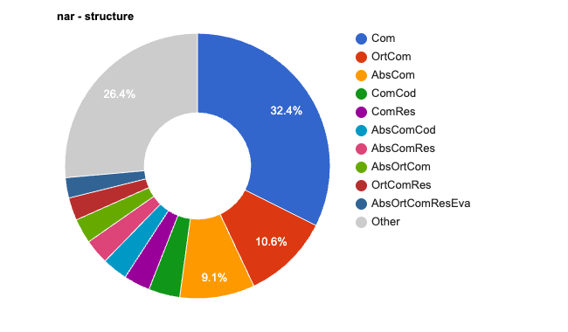
Quantitave findings narrative structure

Slide 12
Awalnya kami ga ada masalah buat pelayanan disini, semua baik, semua profesional.
Ibu saya sudah lama berobat disini hampir 5 tahun tiap bulan kontrol kesini.
Tapiii kinerja BILLING sudah 3 bulan terakhir SANGAT LAMA. Bahkan pasien harus menunggu sampe 2 jam lebih!!
Petugas sering tertukar tumpukan berkas hingga pasien yang sudah dari tadi di salip oleh pasien yang baru dateng.
Masih mending jika masih siang, jika seperti kami yang jadwal dokter nya sore dan sampai billing jam 6 malam dan masih di billing jam stg 9 malam lalu belum mengantri lagi di bagian farmasi.
Astaghfirullah sekali kami rasa.
Mohon diadakan perbaikan di bagian billing bila perlu ganti atau tambah petugasnya hingga antrian pasien tidak terlalu lama dan beban tugas mereka tidak terlalu berat.
Mohon perhatiannya demi kenyamanan bersama.

Slide 13
Qualitative insight
This distribution suggests that while Labov's framework remains relevant, real-world narratives demonstrate:
Structural fluidity: Components blend rather than appearing in rigid sequence
Complication centrality: Conflict remains the narrative core
Evaluation integration: Evaluative elements permeate rather than segment
Cultural evolution: The substantial "Other" category suggests narrative structures continue to evolve beyond traditional frameworks
The chart essentially validates Labov's emphasis on complicating action while revealing the complex, hybrid nature of contemporary narrative structure.

Slide 14
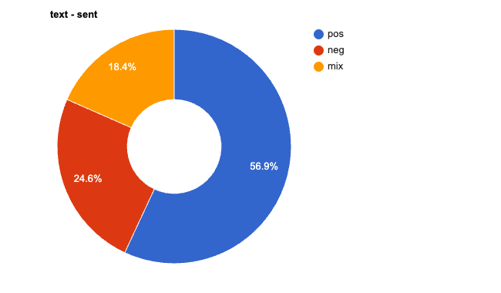
Quantitative findings sentiments

Slide 15
Pelayanan sungguh baik, cepat dan ramah. Saya pakai BPJS dilayani dengan baik dan adil. (Pos.)
Proses antriannya lambat banget, nunggu pendaftaran/dokter/billing rata2 diatas 2 jam.
Parah managementnya gak ada improve.
Kalo gak terpaksa control disini gak bakal lagi mau ke RS ini! (Neg.)

Slide 16
Qualitative insight
Healthcare Context Implications
For a Major Hospital in Bandung:
The 56.9% positive sentiment is encouraging but leaves room for improvement, especially for a leading healthcare institution
The combined negative and mixed sentiments (43.1%) suggest significant opportunities for service enhancement
This distribution is typical for healthcare services, where patient experiences can be highly variable due to the complexity of medical care
Potential Areas of Concern: The mixed sentiment category is particularly telling in healthcare contexts, as it often reflects:
Good medical outcomes but poor service delivery
Excellent clinical care but long waiting times
Competent staff but inadequate facilities
Effective treatment but poor communication

Slide 17
Conclusion
The structure essentially validates Labov's emphasis on complicating action while revealing the complex, hybrid nature of contemporary narrative structure.
The sentiment distribution suggests that while the hospital is performing reasonably well, there's substantial room for improvement to enhance overall patient satisfaction and experience quality.

Slide 18
References
Arribas-Ayllon, M. (2021). Narrative analysis: DNA testing and collaborative knowledge-building in a CFS/ME forum. Analysing Health Communication: Discourse Approaches, 81–110. https://doi.org/10.1007/978-3-030-68184-5_4/COVER
Atkinson, P., & Delamont, S. (2006). In the roiling smoke: qualitative inquiry and contested fields. International Journal of Qualitative Studies in Education, 19(6), 747–755. https://doi.org/10.1080/09518390600975974
Bednarek, M. (2006). Evaluation in Media Discourse: Analysis of a Newspaper Corpus. Continuum.
Brookes, G., & McEnery, T. (2020). Corpus linguistics. The Routledge Handbook of English Language and Digital Humanities, 378–404. https://doi.org/10.4324/9781003031758- 20/CORPUS-LINGUISTICS-GAVIN-BROOKES-TONY-MCENERY
Brookes, G., McEnery, T., McGlashan, M., Smith, G., & Wilkinson, M. (2021). Narrative evaluation in patient feedback: A study of online comments about UK healthcare services. Narrative Inquiry, 32(1), 9–35. https://doi.org/10.1075/NI.20098.BRO

Slide 19
Quant
References
Brookes, G., & Collins, C. (2023). Corpus Linguistics for Health Communication: A Guide for Research, New York, Routledge.
Cheng, W. (2012). Exploring Corpus Linguistics. Routledge.
Clark, J. A., & Mishler, E. G. (1992). Attending to patients’ stories: reframing the clinical task. Sociology of Health & Illness, 14(3), 344–372. https://doi.org/10.1111/1467- 9566.EP11357498
Dörnyei, Z. (2007). Qualitative data analysis. Research Methods in Applied Linguistics, 19, 242–267.https://global.oup.com/academic/product/research-methods-in-applied-linguistics-9780194422581
Frank, A. W. (1995). The Wounded Storyteller. University of Chicago Press. https://doi.org/10.7208/chicago/9780226260037.001.0001
Gabrielatos, C., & Baker, P. (2008). Fleeing, Sneaking, Flooding. Https://Doi.Org/10.1177/0075424207311247, 36(1), 5–38. https://doi.org/10.1177/0075424207311247
Georgakopoulou, A. (2007). Small Stories, Interaction and Identities. 8. https://doi.org/10.1075/SIN.

Slide 20
THANK YOU

